Slide 1



Giáo viên: Đồng Thị Như Quỳnh
Lớp dạy: 2A2
Đơn vị công tác: TRƯỜNG TIỂU HỌC HƯNG ĐẠO

Slide 2







Unit 2:In the backyard
Lesson 2 (3,4,5)

Slide 3


Slide 4










Class Rules

Slide 5



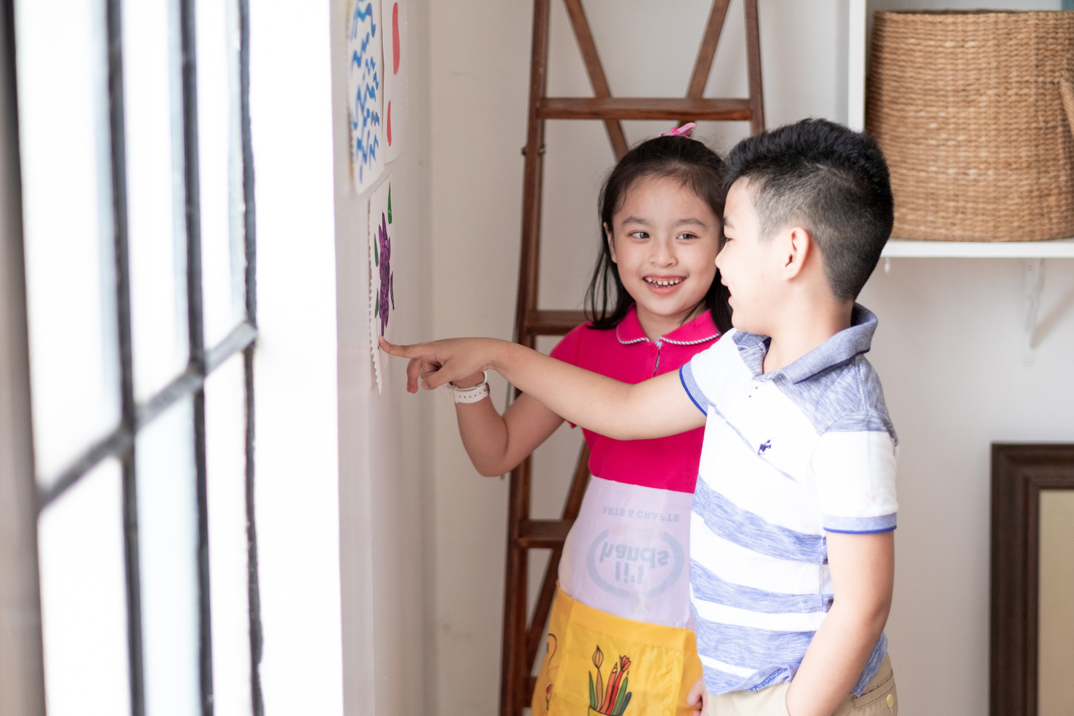



Rule 1
Listen to
your friend
talking in front.

Slide 6








Rule 2
Raise your hand
if you have a question.

Slide 7




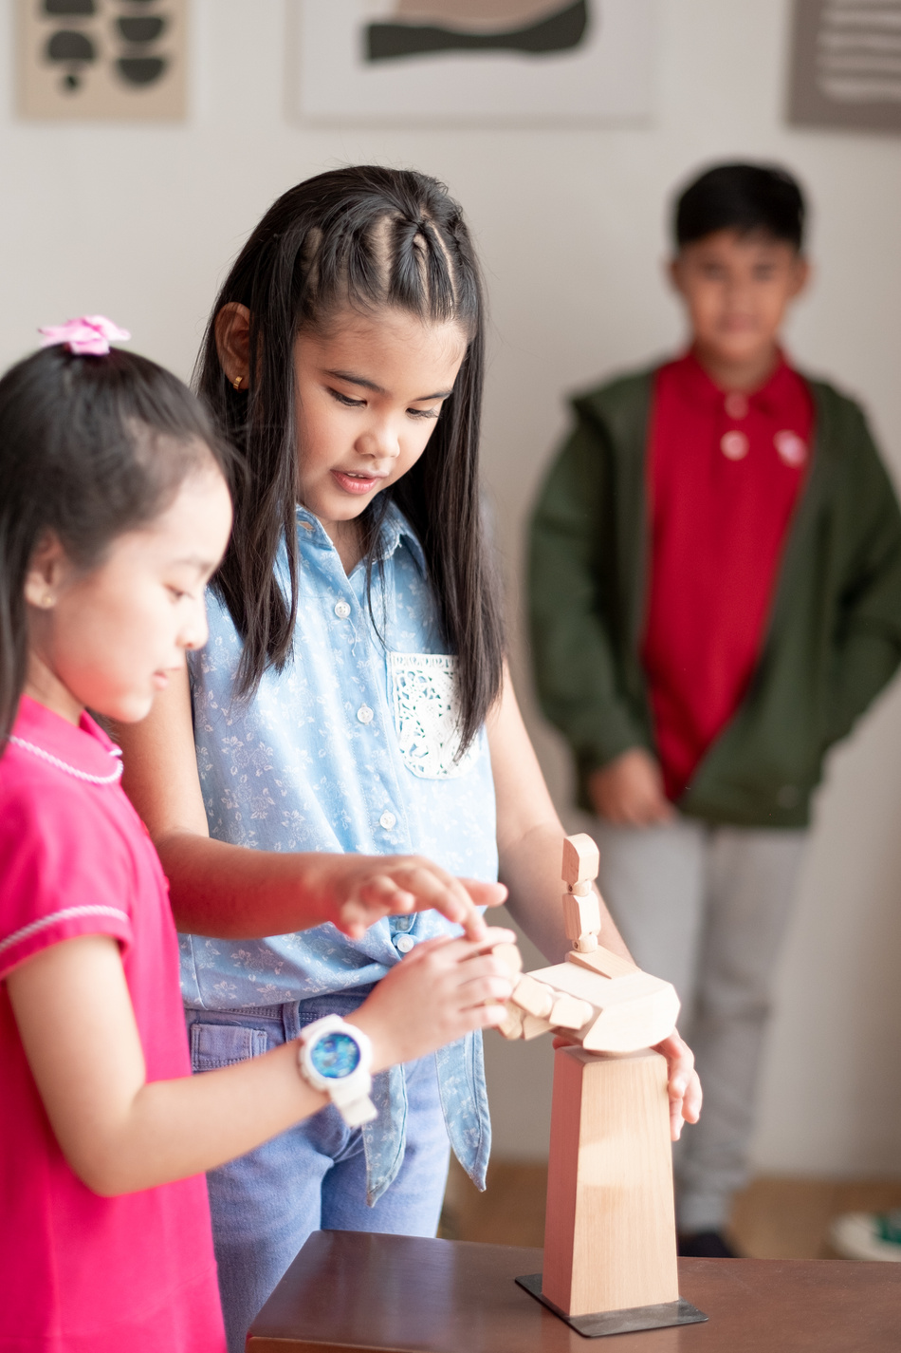


Rule 3
Wait for
your turn.

Slide 8
TABLE OF CONTENT
1. Warm-up & review
2. Activity 3: Listen and chant
3. Activity 4: Listen and circle
4. Activity 5:Look and write
5. Fun corner & wrap-up

Slide 9
01
Warm-up and review
Game: “Odd one out”

Slide 10


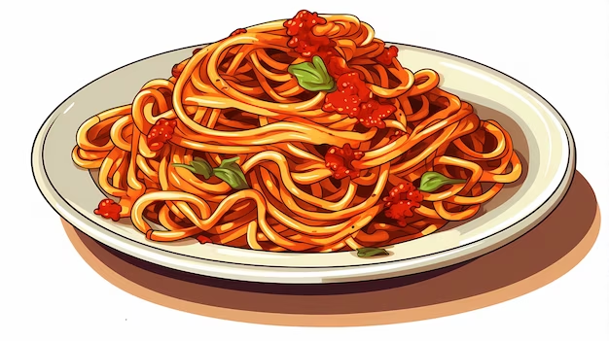
Game: “Odd one out”
Next

Slide 11

Game: “Odd one out”
Next

Slide 12

Game: “Odd one out”
Next

Slide 13

Game: “Odd one out”

Slide 14
02
Activity 3
Listen and chant

Slide 15




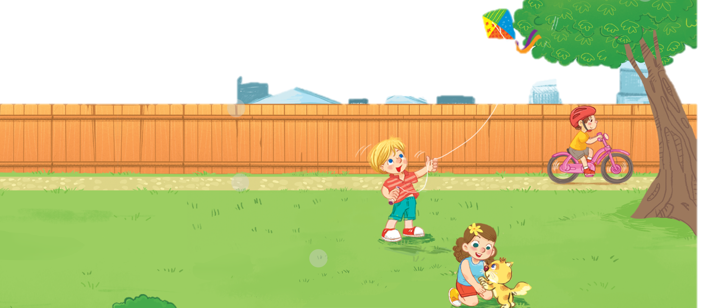
Unit
3. Listen and chant.

Slide 16

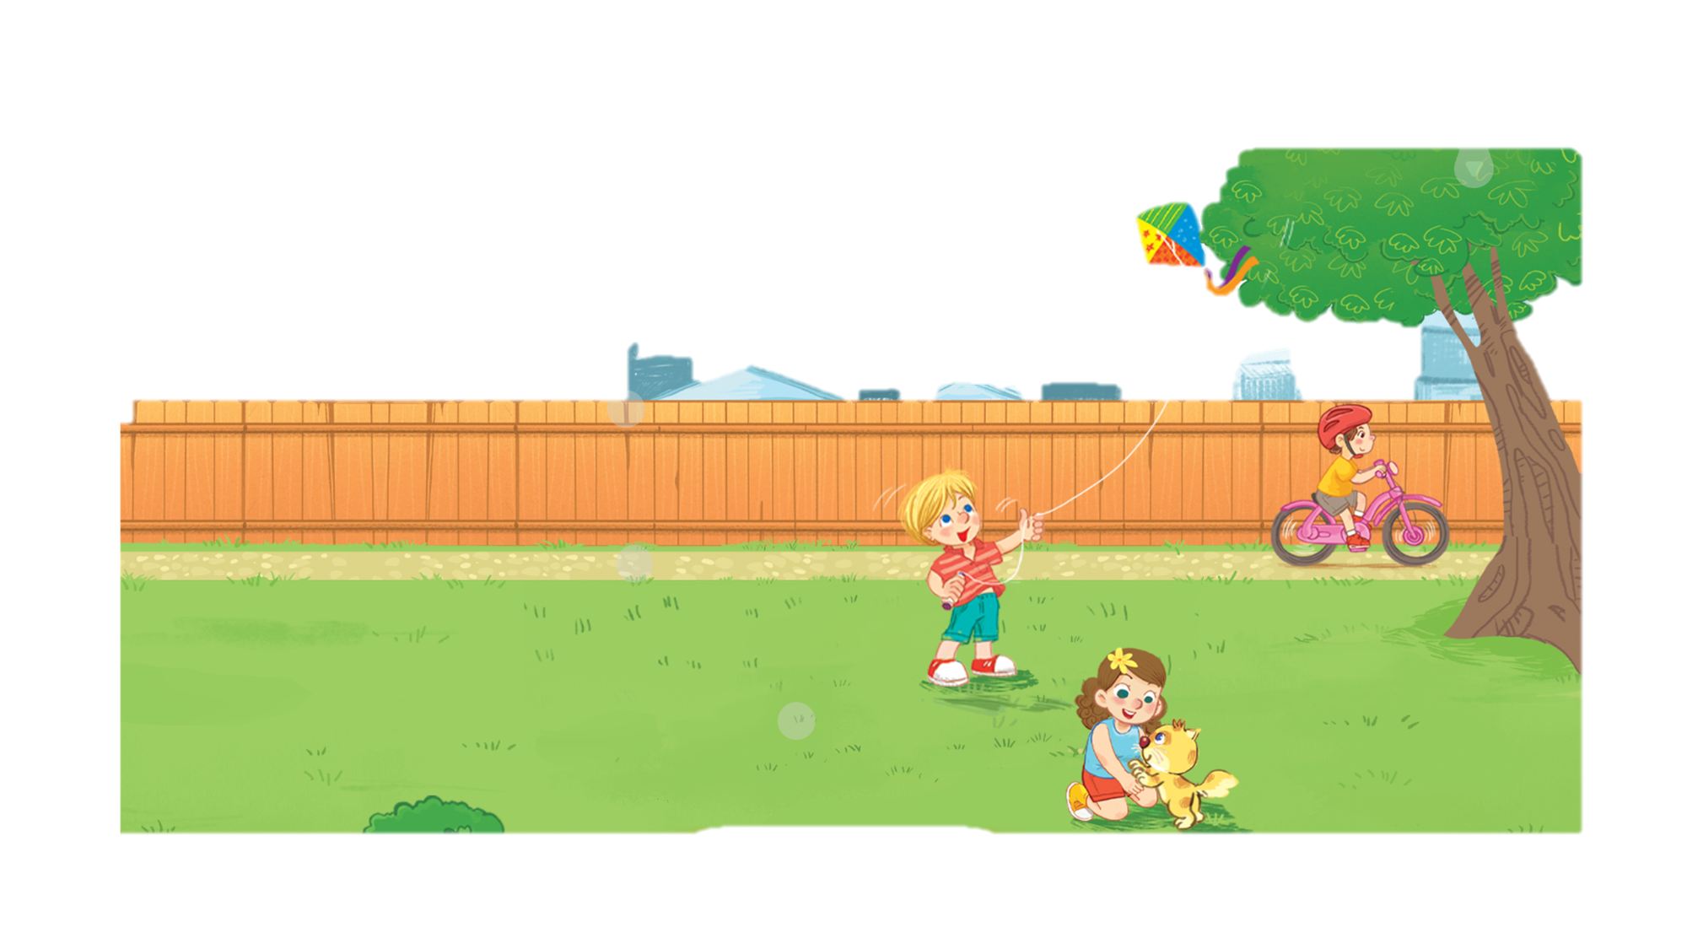


Unit
3. Listen and chant.
K, k, kite.
He’s flying a kite.
K, k, bike.
He’s riding a bike.
K, k, kitten.
She’s playing with a kitten.
This Photo by Unknown Author is licensed under CC BY-NC

Slide 17

WORK IN GROUPS

Slide 18



SPINNING WHEEL

Slide 19
03
Activity 4
Listen and circle

Slide 20
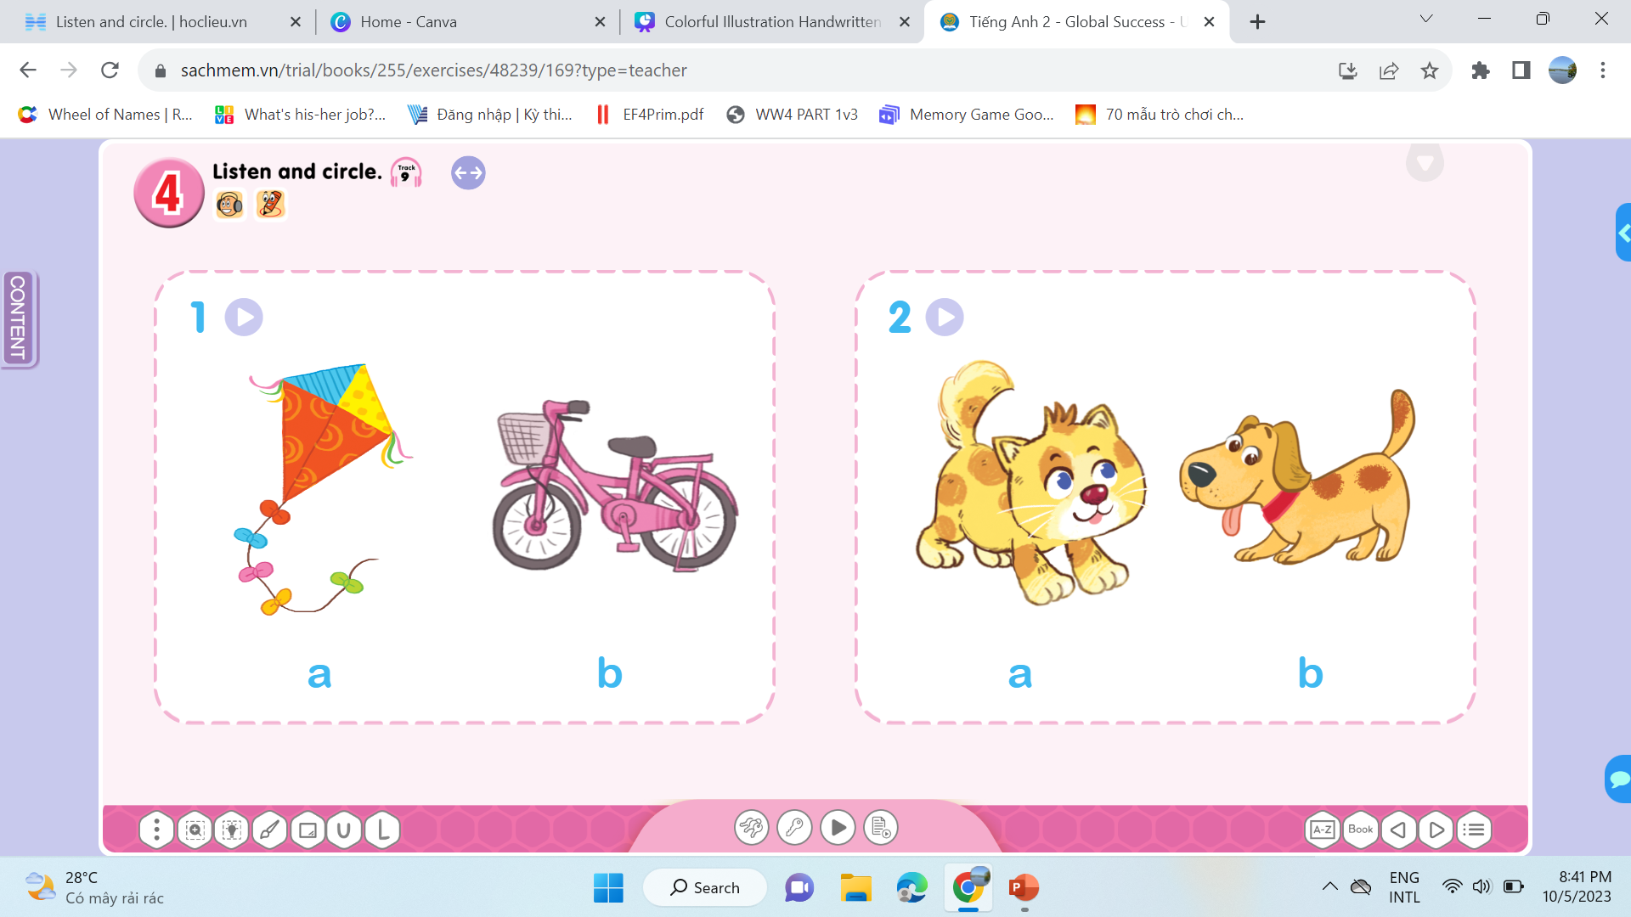
Unit
a
b
a
b

Slide 21
Unit
I have a ….

Slide 22
04
Activity 5
Look and write

Slide 23

Unit
5. Look and write

Slide 24
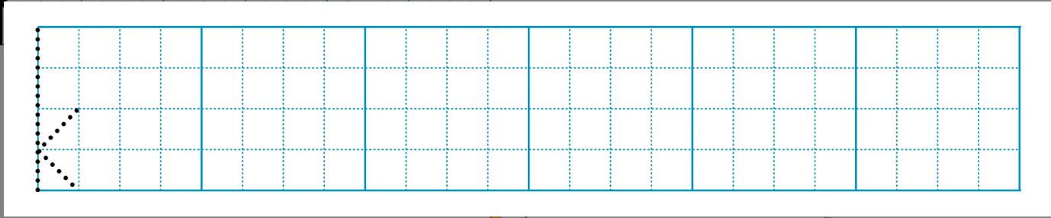
Unit
5. Look and write

Slide 25
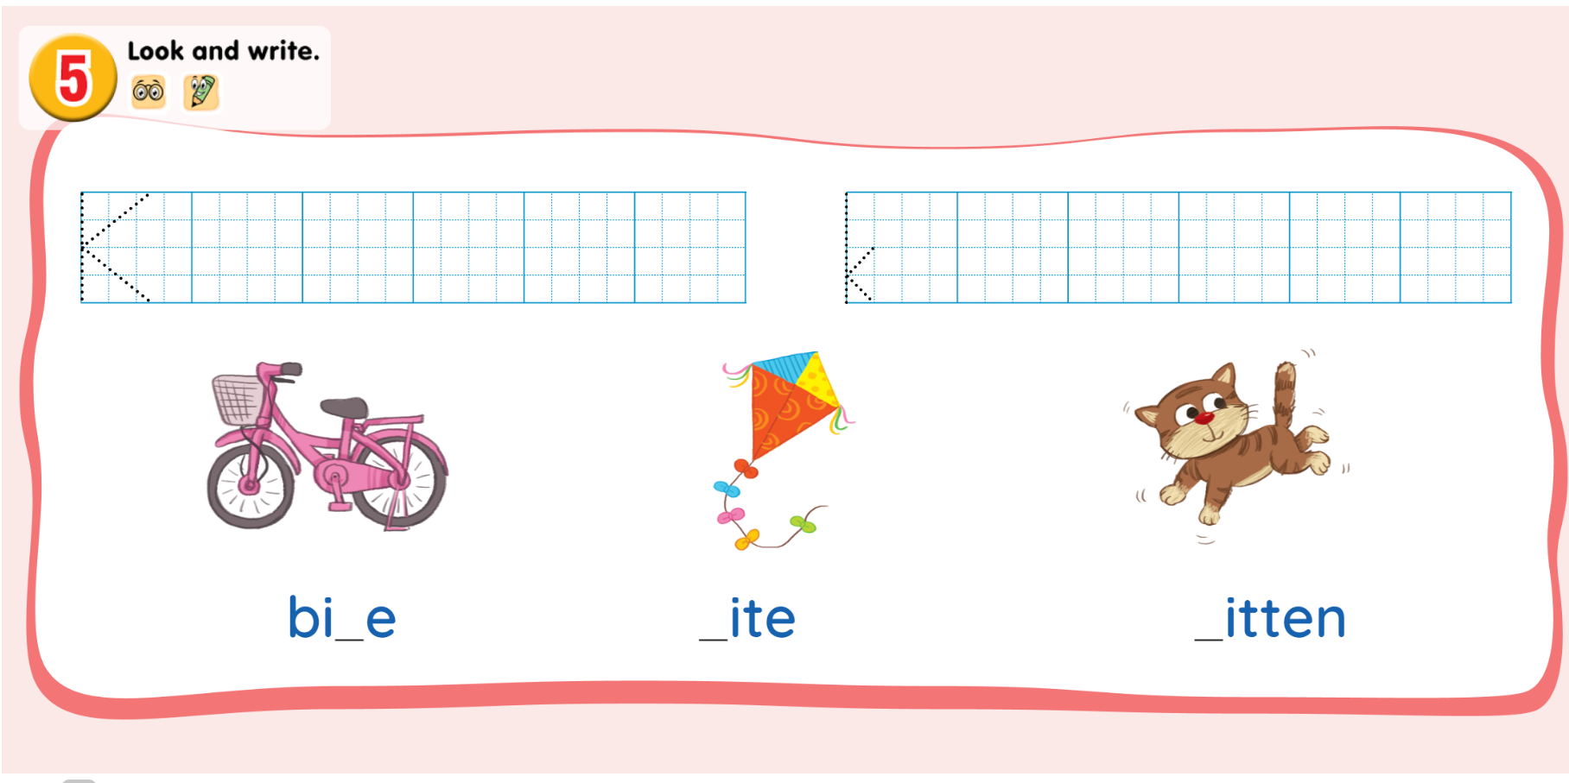
Unit
k
k
bi_e
_ite
_itten
k

Slide 26
05
FUN CORNER &WRAP-UP
Game: “Throw the dice”

Slide 27
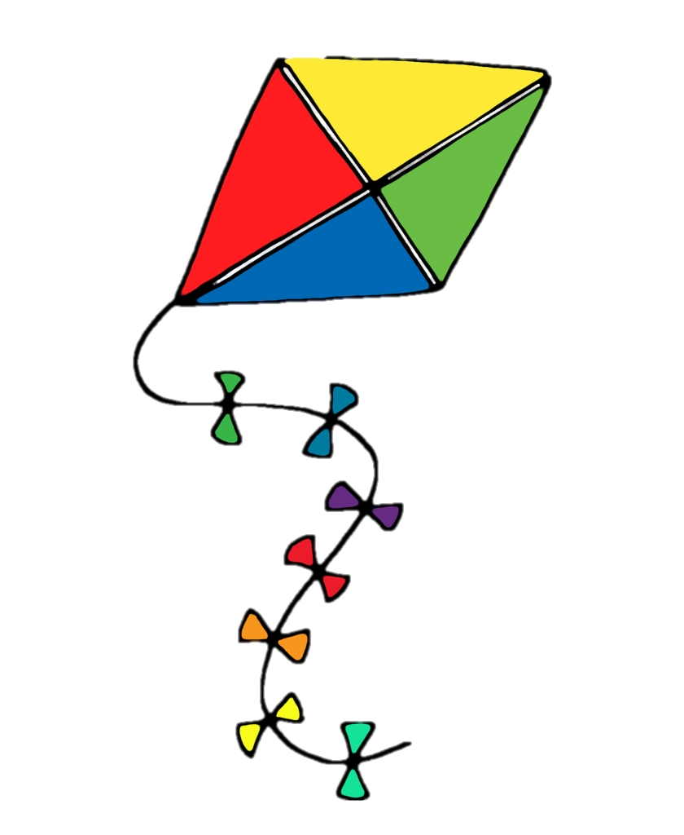

GAME
“Throw the dice”

Slide 28


GAME
“Throw the dice”

Slide 29


GAME
“Throw the dice”

Slide 30


GAME
“Throw the dice”

Slide 31
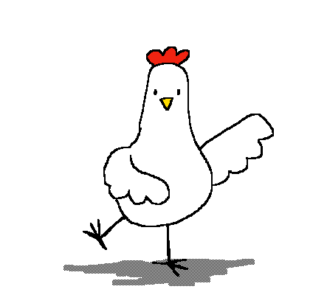
GAME
“Throw the dice”

Slide 32



GAME
“Throw the dice”

Slide 33

GAME
“Throw the dice”

Slide 34

GAME
“Throw the dice”

Slide 35

GAME
“Throw the dice”

Slide 36
GAME
“Throw the dice”

Slide 37



Slide 38
Website: hoclieu.vn
Fanpage: https://www.facebook.com/tienganhglobalsuccess.vn/

