Slide 1















Giáo viên: Tô Thị Hà
Lớp dạy: 2A1
Đơn vị công tác: Trường Tiểu học Hưng Đạo

Slide 3





WELCOME
TO OUR CLASS

Slide 4
FUN TIME 1
Period 1

Slide 5
Table of contents
1. Warm-up & Review
2. Activity 1: Find and circle the words. Then say.
3. Activity 2: Let’s play.
4. Fun corner and Wrap-up

Slide 6
01 WARM-UP & REVIEW Game: Disappearing cards

Slide 7


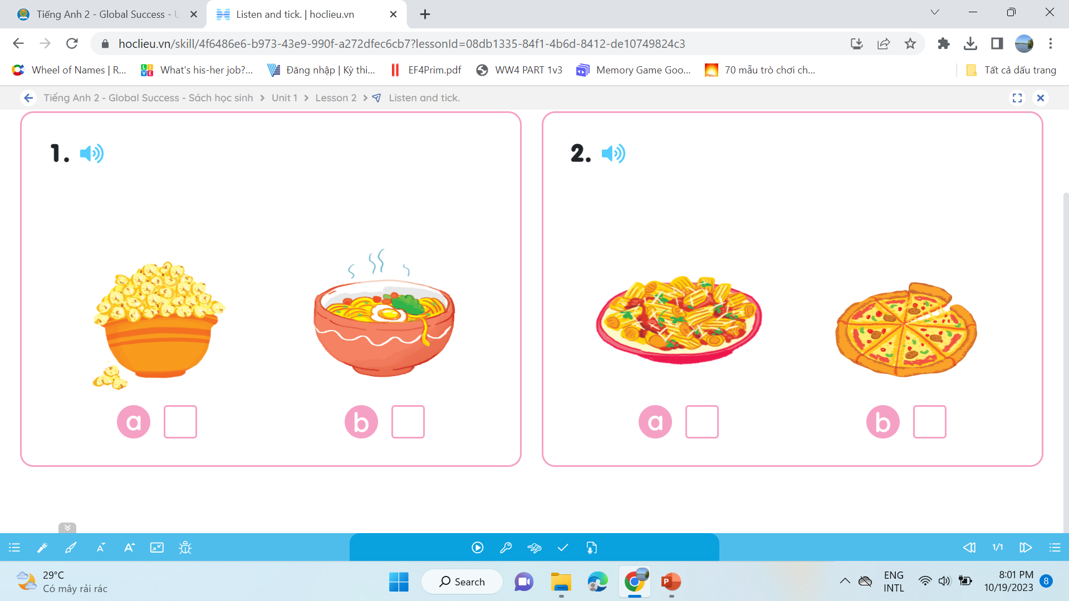



Game: Disappearing cards
Notes:
Click the circle to see the pictures
Click the pictures to cover it

Slide 8
02
Activity 1
Find and circle the words. Then say.

Slide 9



Find and circle the words.Then say.
obspizzanm
vokittenbh
abpopcornd
mkbikebdal
a
b
c
d

Slide 10

Find and circle the words. Then say.
obspizzanm
a

Slide 11
Find and circle the words. Then say.
vokittenbh
b

Slide 12
Find and circle the words. Then say.
abpopcornd
c

Slide 13
Find and circle the words. Then say.
mkbikebdal
d

Slide 14
Find and circle the words. Then say.
pizza
kitten
popcorn
bike
a
b
c
d

Slide 15
03
Activity 2
Let’s play.

Slide 16

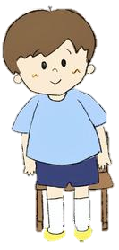

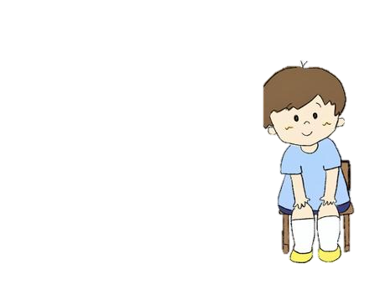
Game: Stand up! Sit down!
pizza
kitten
bike
Notes:
Click the words first to stand up or sit down
Click the picture to see the answer
Click the picture inside to hear the sound

Slide 17

pizza
popcorn
kitten
Notes:
Click the words first to stand up or sit down
Click the picture to see the answer
Click the picture inside to hear the sound

Slide 18


kite
pasta
pizza
Notes:
Click the words first to stand up or sit down
Click the picture to see the answer
Click the picture inside to hear the sound

Slide 19


popcorn
kitten
bike
Notes:
Click the words first to stand up or sit down
Click the picture to see the answer
Click the picture inside to hear the sound

Slide 20


pizza
bike
pasta
Notes:
Click the words first to stand up or sit down
Click the picture to see the answer
Click the picture inside to hear the sound

Slide 21
04
Fun corner & Wrap-up
Option 1
Game: Word game

Slide 22

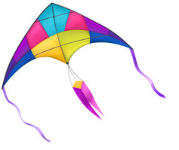





p
* Click to move pictures having the sound ‘’p’’ into the square.

Slide 23




p
* Click to move pictures having the sound ‘’p’’ into the square.

Slide 24

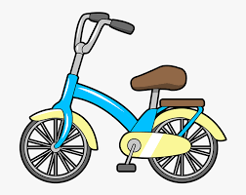
k
* Click to move pictures having the sound ‘’k’’ into the square.

Slide 25






k
* Click to move pictures having the sound ‘’k’’ into the square.

Slide 26
Option 2
Game: Guess the word

Slide 27

pasta
_ _ _ _ _

Slide 28

pizza
_ _ _ _ _

Slide 29
popcorn
p_ _c_ _n

Slide 30

kite

Slide 31

kitten
_ _t_ _ _

Slide 32
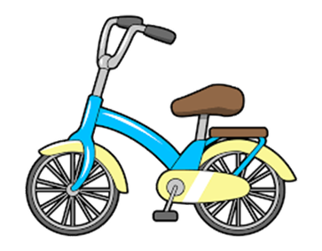
bike
_ _ _ _

Slide 33


Slide 34
Website: hoclieu.vn
Fanpage: https://www.facebook.com/tienganhglobalsuccess.vn/

