Slide 1
Tiếng Anh 3
Giáo viên: Lê Thị Minh Hiếu
Lớp dạy: 3A2, 3A3, 3A4, 3A5, 3A6
Đơn vị công tác: Trường TH Hưng Đạo

Slide 2



Slide 3


Our names
2
9
LESSON 2 – PERIOD 3

Slide 4
TABLE OF CONTENTS
01
02
03
04
05
WARM-UP
MODEL
SENTENCES
PRACTICE
LET’S TALK!
FUN TIME

Slide 5
WARM-UP
01

Slide 6
WHO’S FASTER?

Slide 7


Slide 8


Slide 9


Slide 10


Slide 11


Slide 12


Slide 13


Slide 14


Slide 15



Slide 16


Slide 17









Let’s count together!

Slide 18
MODEL SENTENCES
02

Slide 19
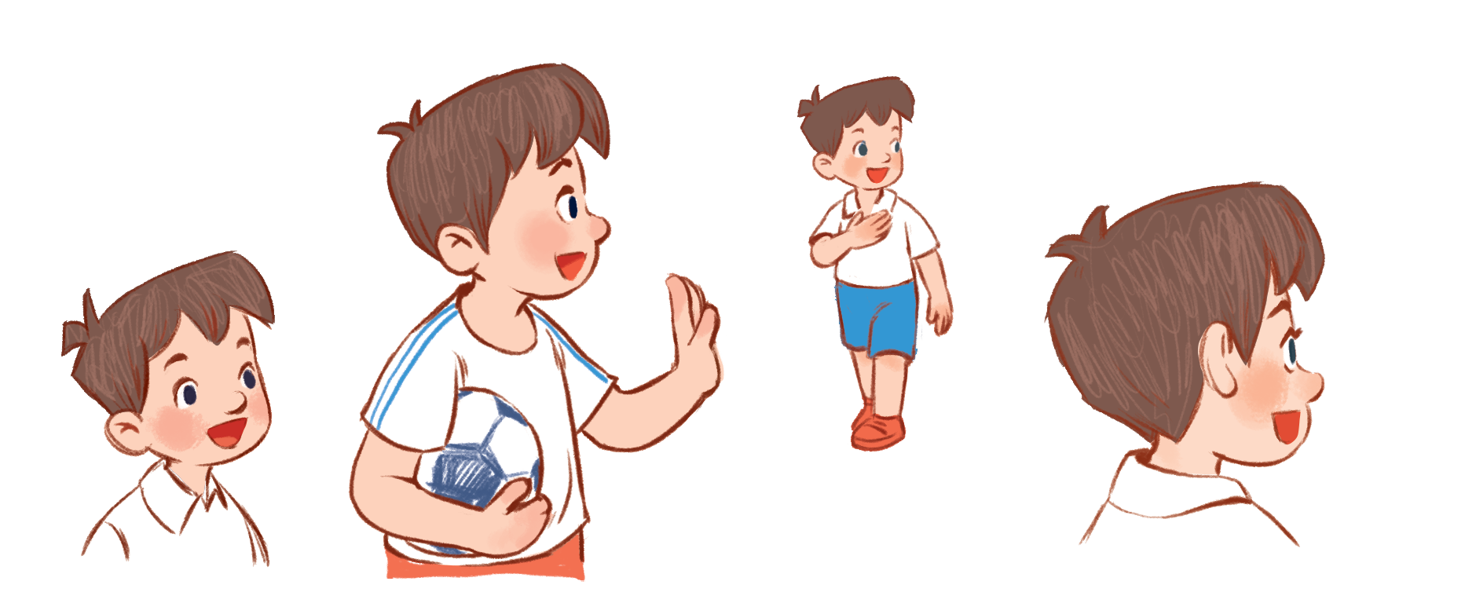

I’m Minh.
What’s your name?
Hello!
My name’s Mary.
Hi!

Slide 20
How old are you?
I’m …… years old.
eight
8

Slide 21

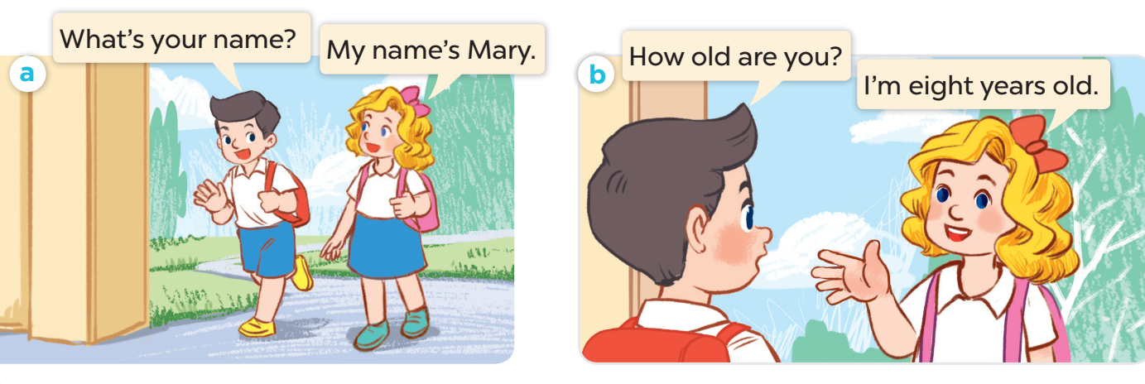

Slide 22
PRACTICE
03

Slide 23
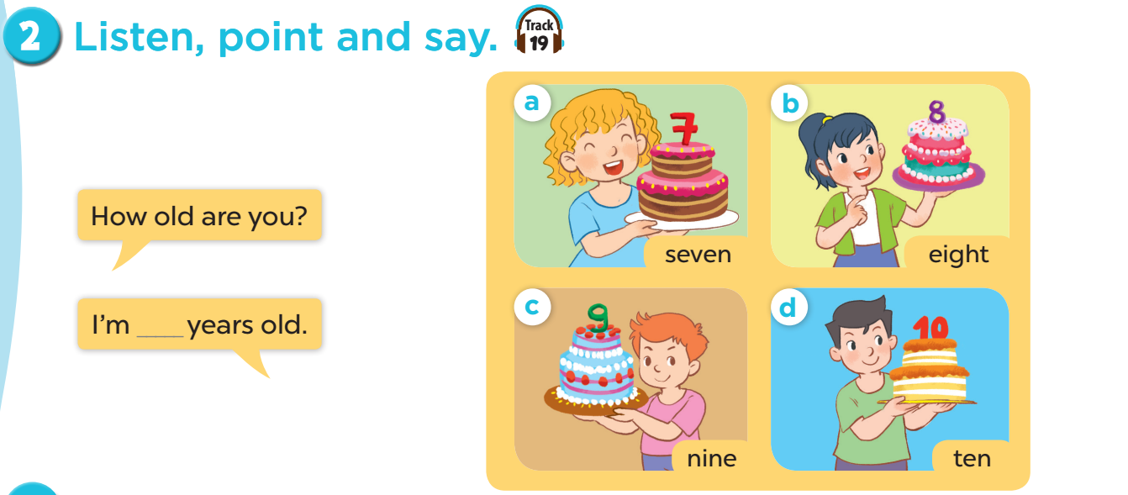

Slide 24


Slide 25


1. Work in teams (girls & boys)
2. Choose and answer.

Slide 26

Notes:
CLICK THE CLOUD – GO TO PART 4

Slide 27



How old are you?
I’m __ years old.
7
Notes:
CLICK PINK AMONG US – GO TO THE POINTS

Slide 28

How old are you?
I’m __ years old.
5
Notes:
CLICK PINK AMONG US – GO TO THE POINTS

Slide 29

How old are you?
I’m __ years old.
9
Notes:
CLICK PINK AMONG US – GO TO THE POINTS

Slide 30

How old are you?
I’m __ years old.
8
Notes:
CLICK PINK AMONG US – GO TO THE POINTS

Slide 31

How old are you?
I’m ___ years old.
10
Notes:
CLICK PINK AMONG US – GO TO THE POINTS

Slide 32

What’s your name?
My name’s ____.
Bill
Notes:
CLICK PINK AMONG US – GO TO THE POINTS

Slide 33
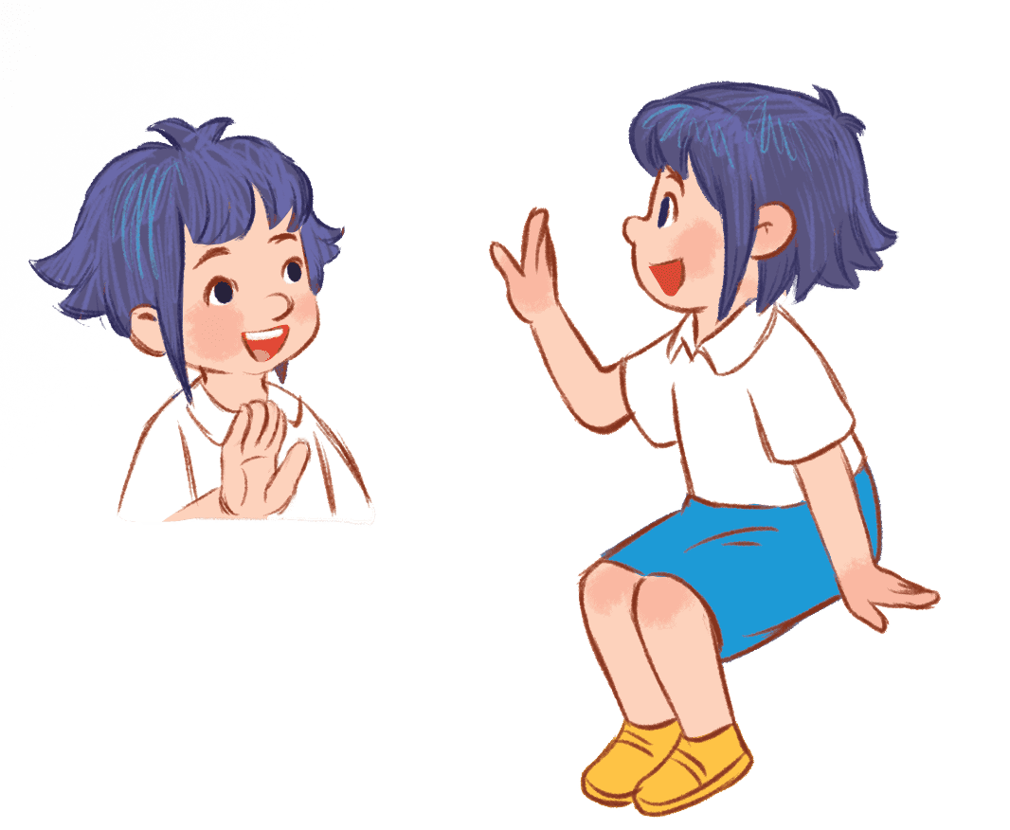
What’s your name?
My name’s ____.
Linh
Notes:
CLICK PINK AMONG US – GO TO THE POINTS

Slide 34

What’s your name?
My name’s ____.
Lucy
Notes:
CLICK PINK AMONG US – GO TO THE POINTS

Slide 35





Slide 36



Slide 37


Slide 38


Slide 39


Slide 40


Slide 41


Slide 42


Slide 43
LET’S TALK!
04

Slide 44
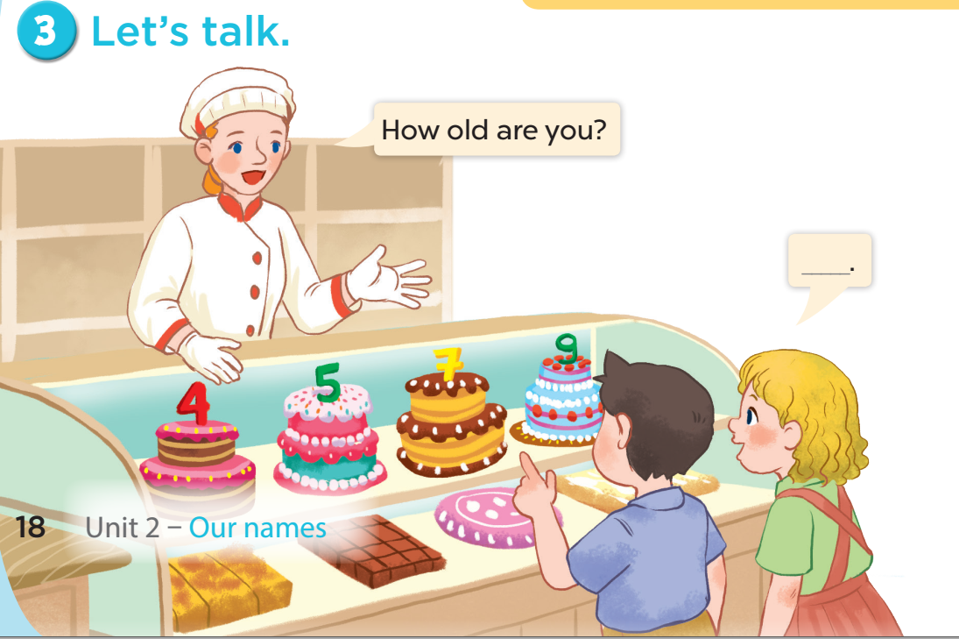

Slide 45
FUN TIME
05

Slide 46


5
10
1
7
8
SPIN
-5
3
9
-3
4
6
2
tekhnologic

Slide 47

Website: sachmem.vn
Fanpage: www.facebook.com/sachmem.vn
Youtube: Sách Mềm

