Slide 1





Slide 2
Review 2
Period 2

Slide 3
Contents
01
02
03
Warm-up
Activity 3
Activity 4
04
05
Activity 5
Chant
Read and match.
Read and complete.
Let’s write.

Slide 4
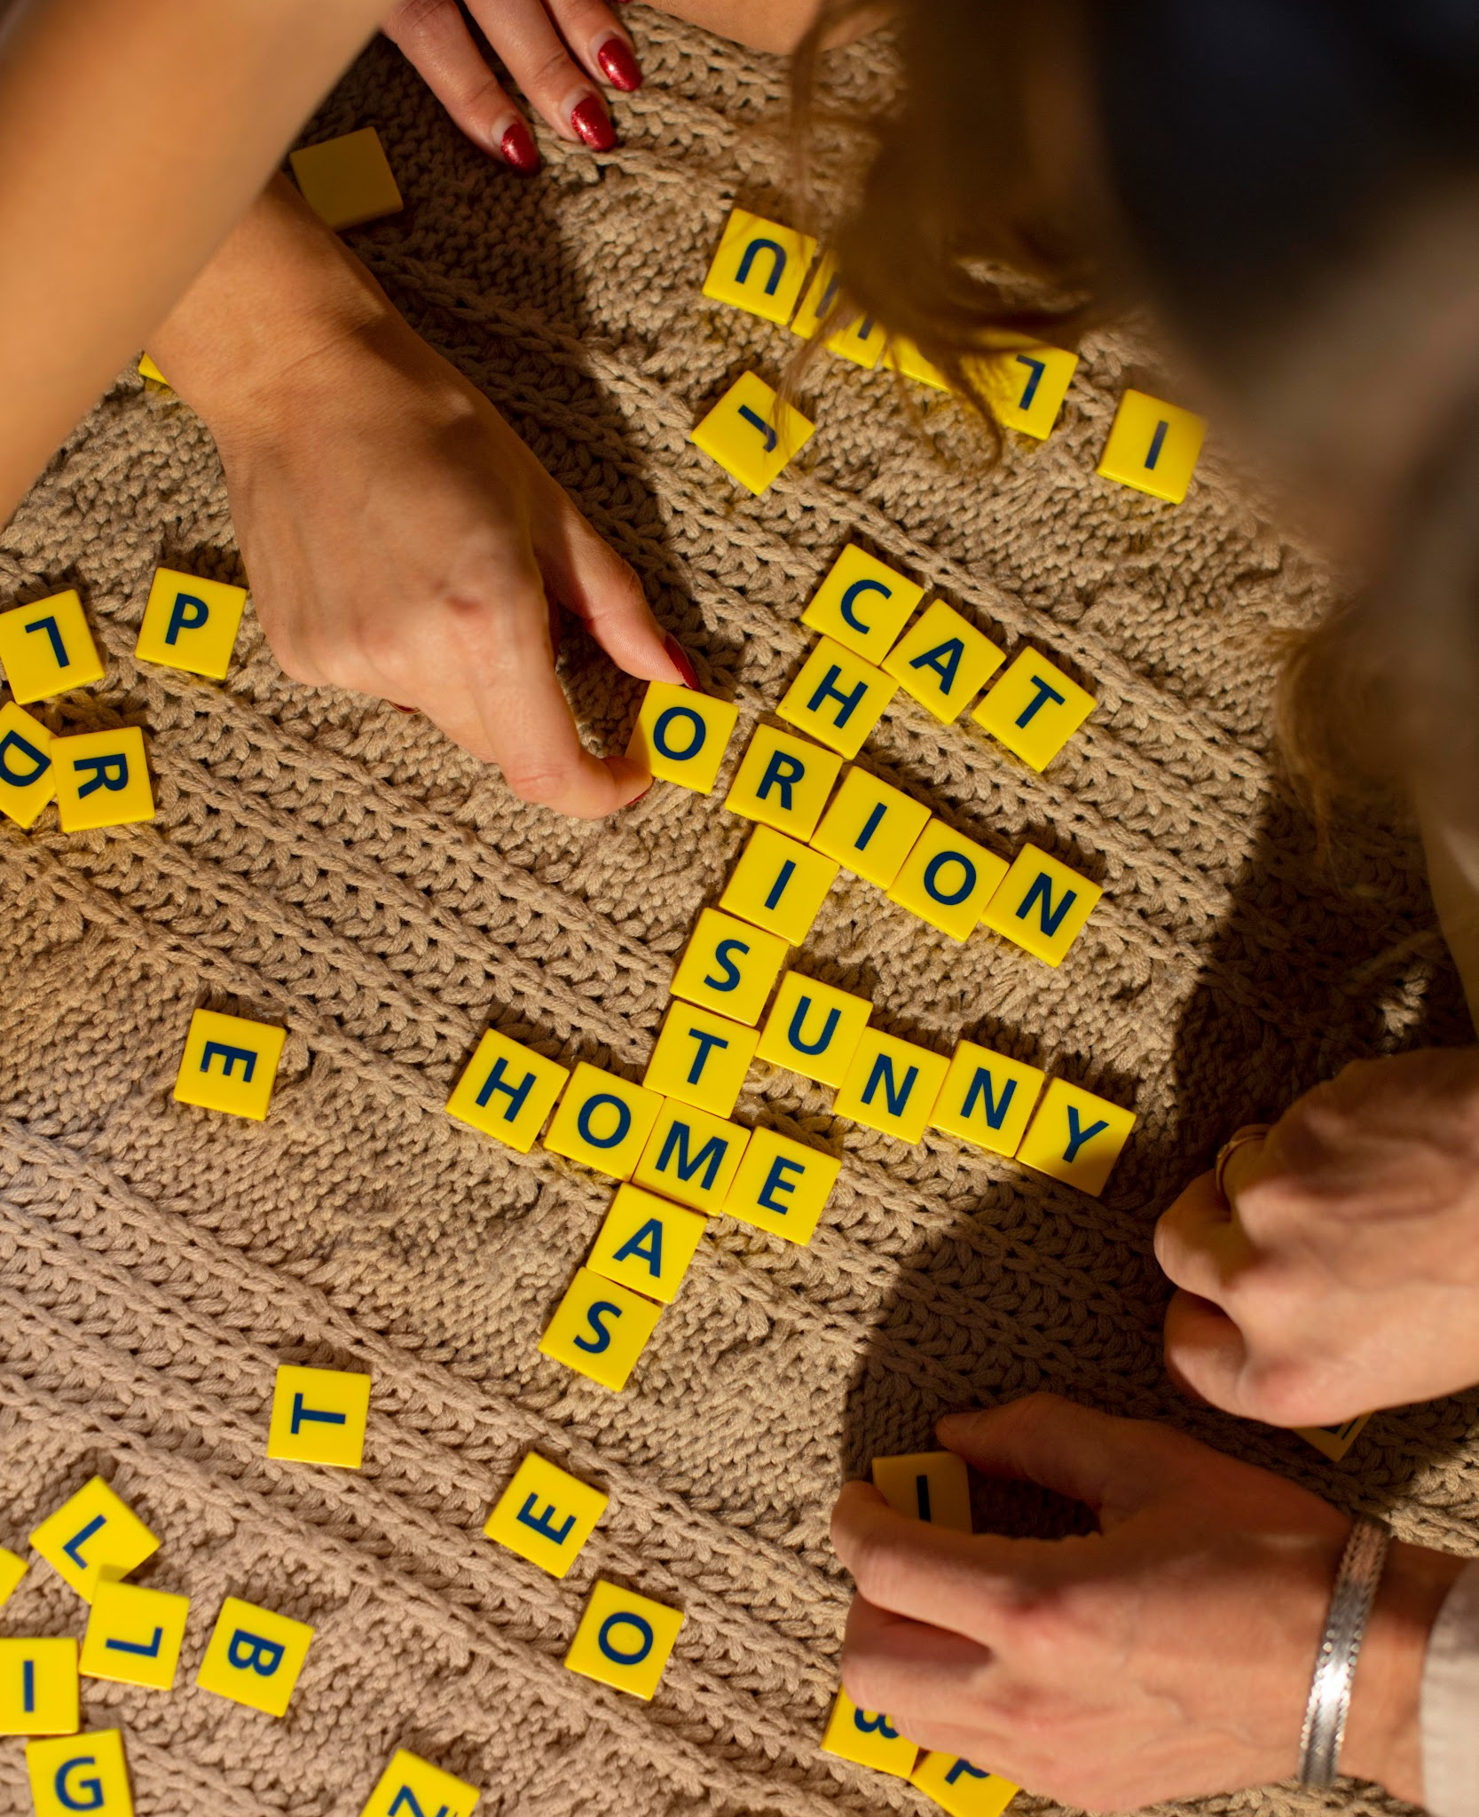
01
Warm-up

Slide 5


Slide 6
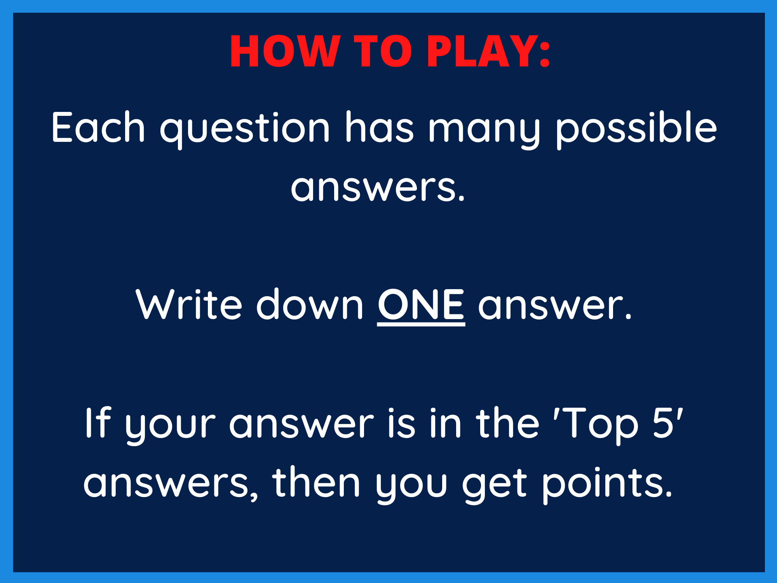

Slide 7


Slide 8
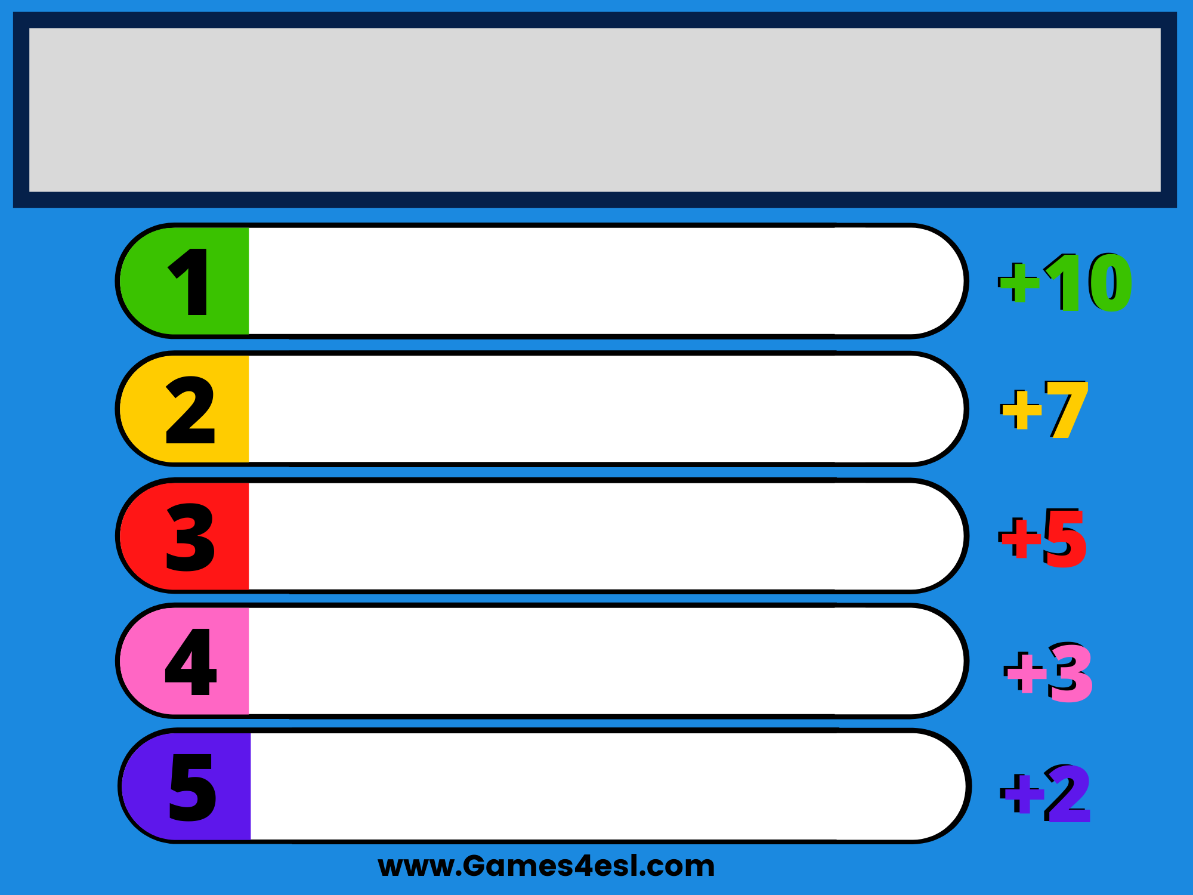
Name a colour.
green
orange
red
pink
purple

Slide 9


Slide 10
Name a month of the year.
April
November
May
October
January

Slide 11


Slide 12
Name a day of the week.
Friday
Monday
Saturday
Sunday
Wednesday

Slide 13


Slide 14
Name what you can do.
sing
dance
swim
ride a bike
fly a kite

Slide 15


Slide 16
Name a subject you learn at school.
English
art
music
maths
PE

Slide 17
02
Activity 3
Read and match.

Slide 18
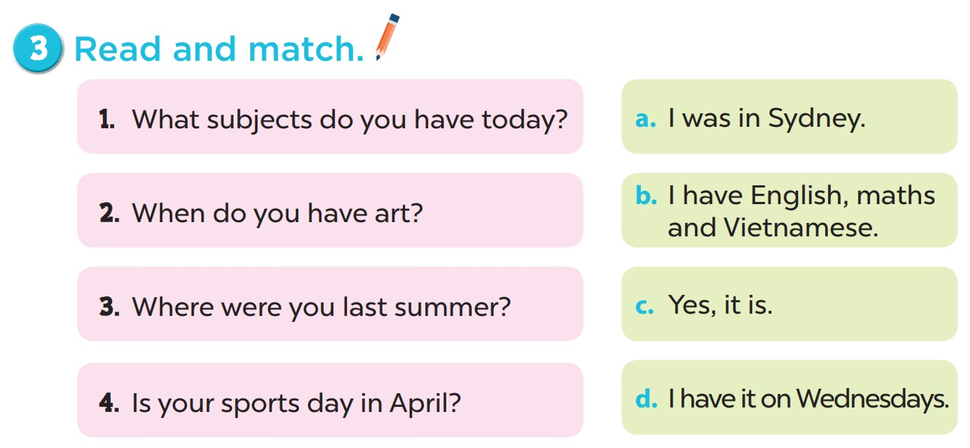

Slide 19
03
Activity 4
Read and complete.

Slide 20
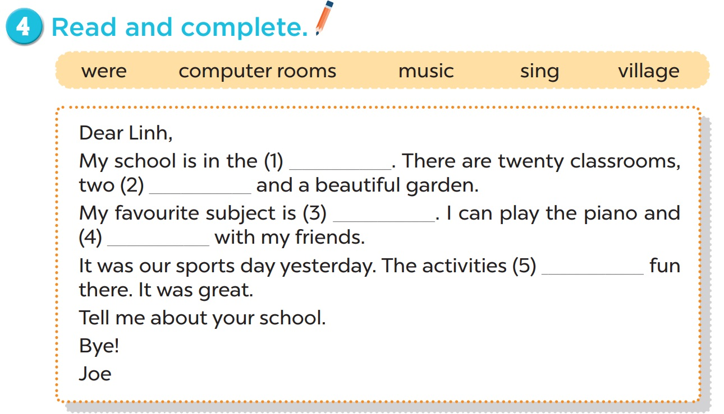
village
computer
rooms
music
sing
were

Slide 21

04
Activity 5
Let’s write.

Slide 22
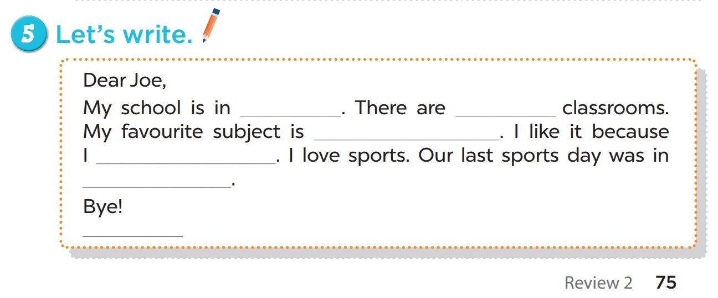
the city
the town
the village
the mountains

Slide 23
two/ three/ four/ ...

Slide 24
maths
art
music
English

Slide 25
want to be a ....

Slide 26
January
March
February
April/ …

Slide 27
your name ^.^

Slide 28
05
Chant

Slide 29
We have a lesson. (2x)
We have lots of fun. (2x)
Our lesson is done.
It’s time to say goodbye
Goodbye, goodbye
Goodbye children!!!

