Slide 1





Slide 2
Unit 11: My home
Lesson 1 - period 1

Slide 3
Table of Contents
01
02
03
04
Look, listen and repeat.
Warm-up
Listen, point and say.
Let’s talk.
05
fun conner & Wrap-up

Slide 4
01
Warm-up

Slide 5
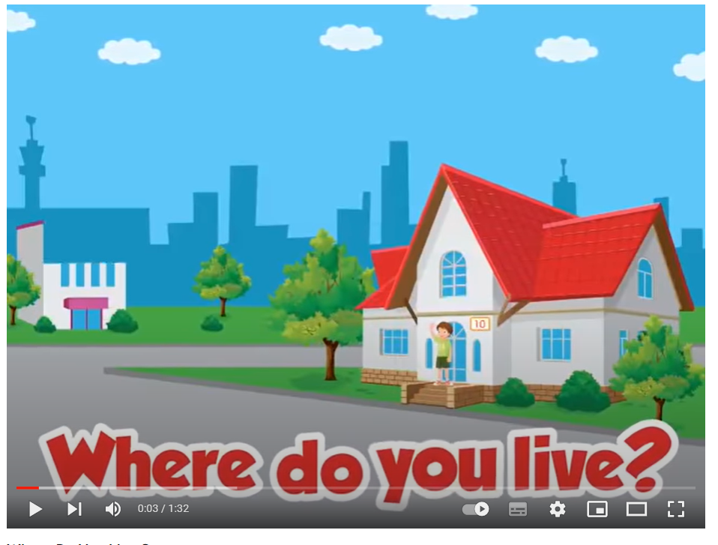
Notes:
https://www.youtube.com/watch?v=3EDzQeh7mWE

Slide 6
02
Look, listen and repeat.

Slide 7
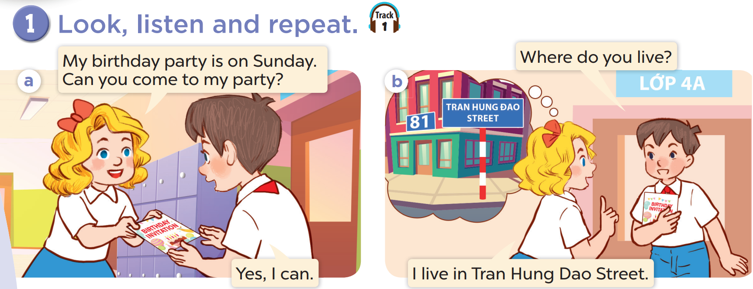


Slide 8
03
Listen, point and say.

Slide 9
vocabulary

Slide 10
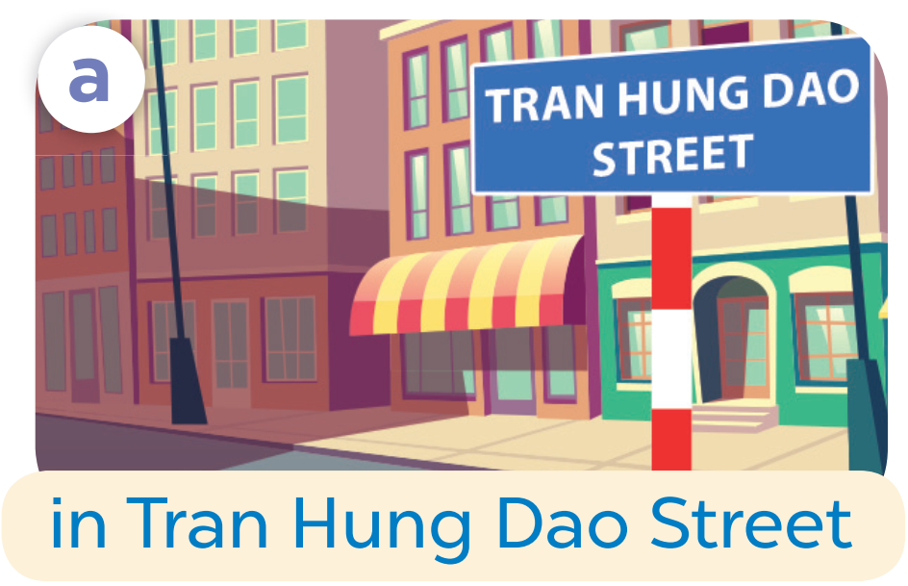

Slide 11
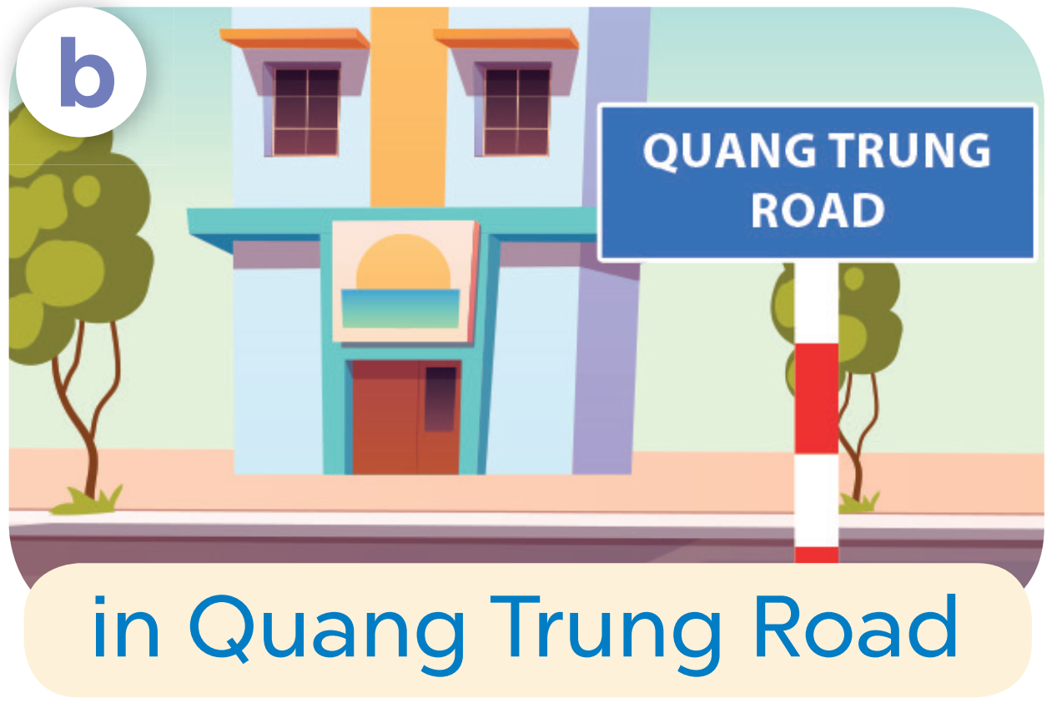

Slide 12
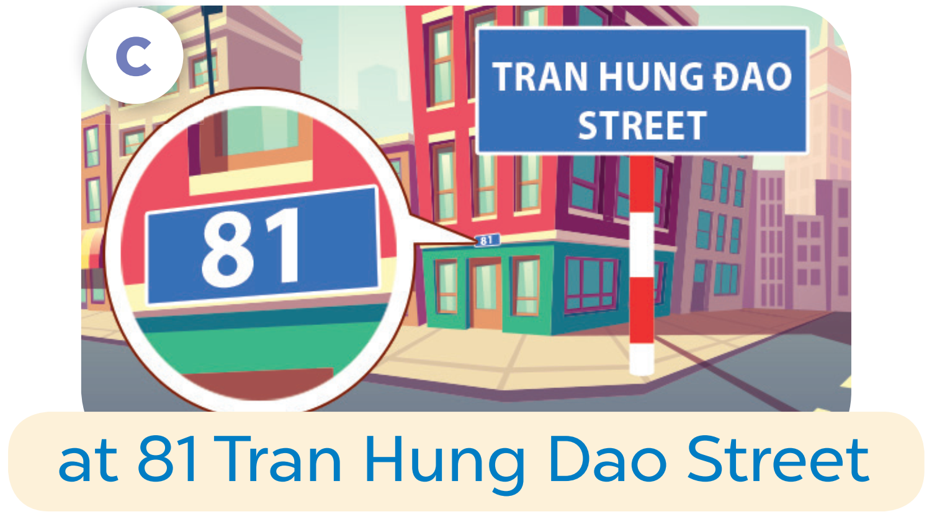

Slide 13
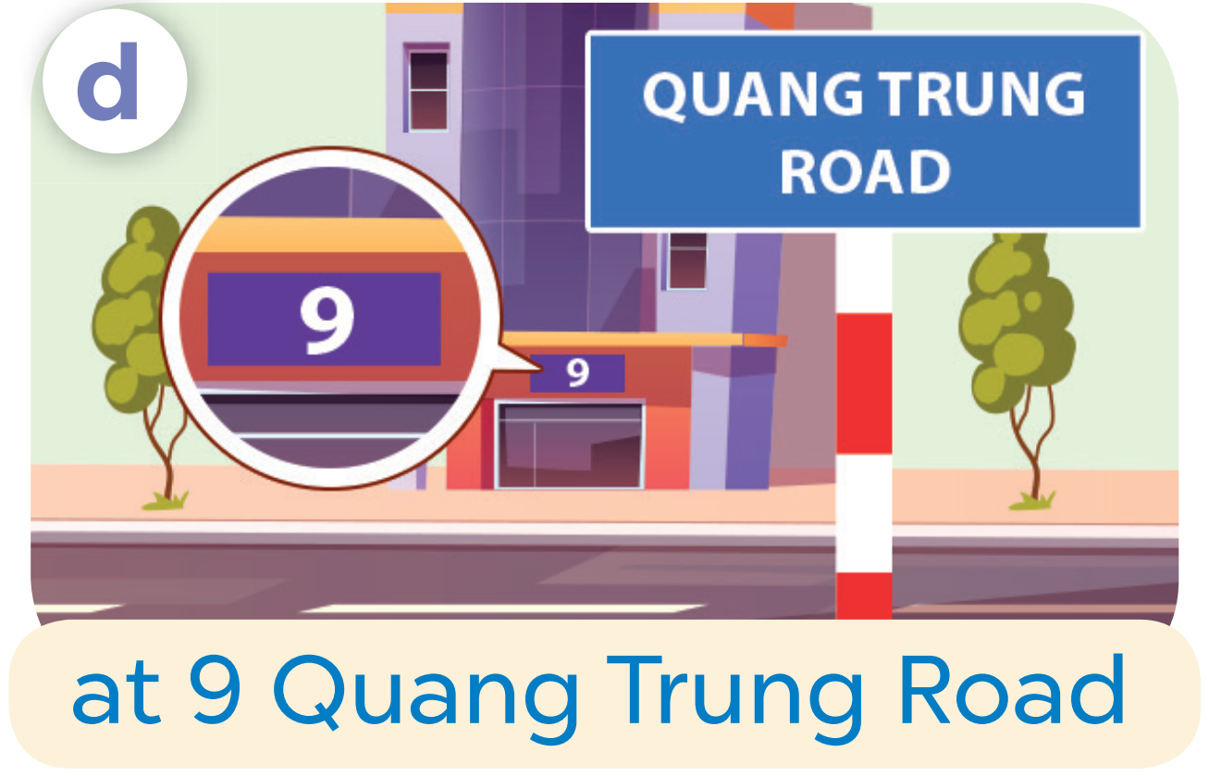

Slide 14
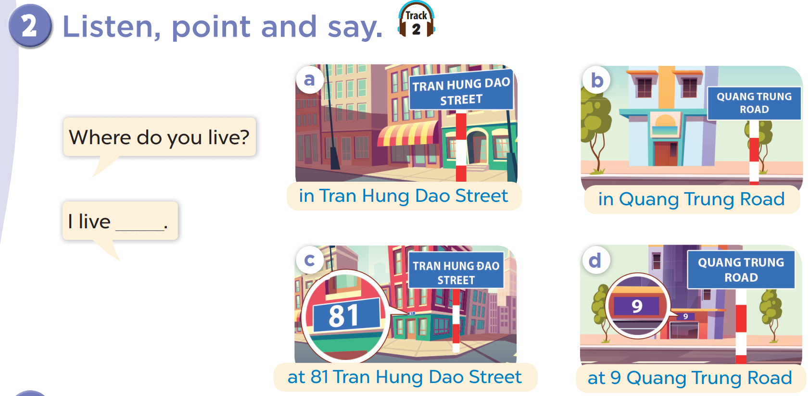

Slide 15
Where do you live?
I live in Tran Hung Dao Street.

Slide 16
04
Let’s talk.

Slide 17
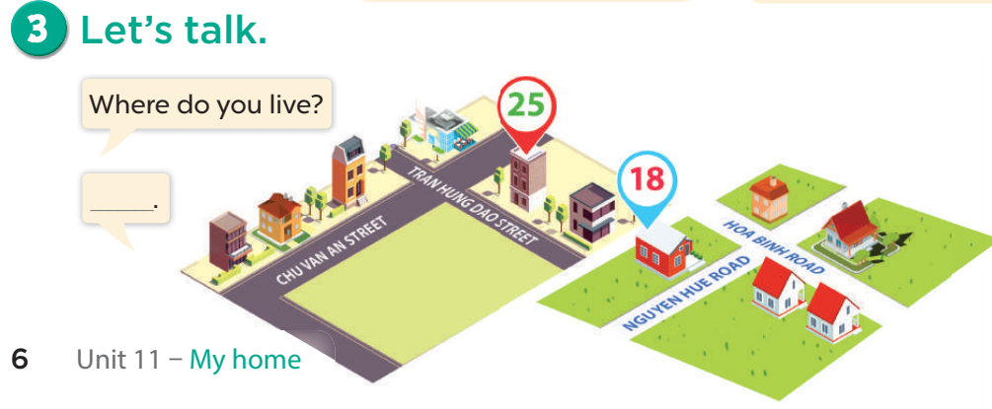

Slide 18
05
fun conner & Wrap-up

Slide 19
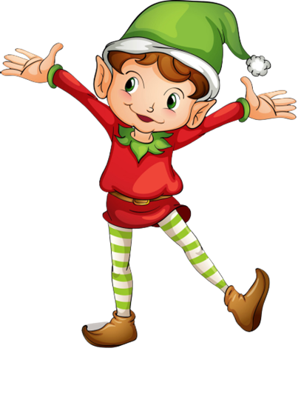
1
point
5
points
Lucky wheel!
Question
Question
Question
Question
Question
Question
SPIN
Question
3
points
2
points
10
points
End
Notes:
5 Segments

Slide 20
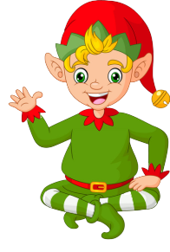
Ask and answer
Where do you live?
____________________.
I live in Tran Hung Dao Street
Back
Check

Slide 21
Ask and answer
Where do you live?
______________.
I live in Quang Trung Road
Back
Check

Slide 22
Ask and answer
Where do you live?
___________________.
I live at 81 Tran Hung Dao Street.
Back
Check

Slide 23
Ask and answer
Where do you live?
___________________.
I live at 9 Quan Trung Road
Back
Check

Slide 24

Ask and answer
Where do you live?
I live in/at…….
Back
Check

Slide 25
Ask and answer
Where do you live?
I live in/at…….
Back
Check

Slide 26
Ask and answer
Where do you live?
I live in/at…….
Back
Check

Slide 27
What have you learnt today?
2. What the core value of the lesson?

