Slide 1


Our summer holidays
10
Lesson 3 – Period 5

Slide 2
01
Warm-up
Board Race

Slide 3
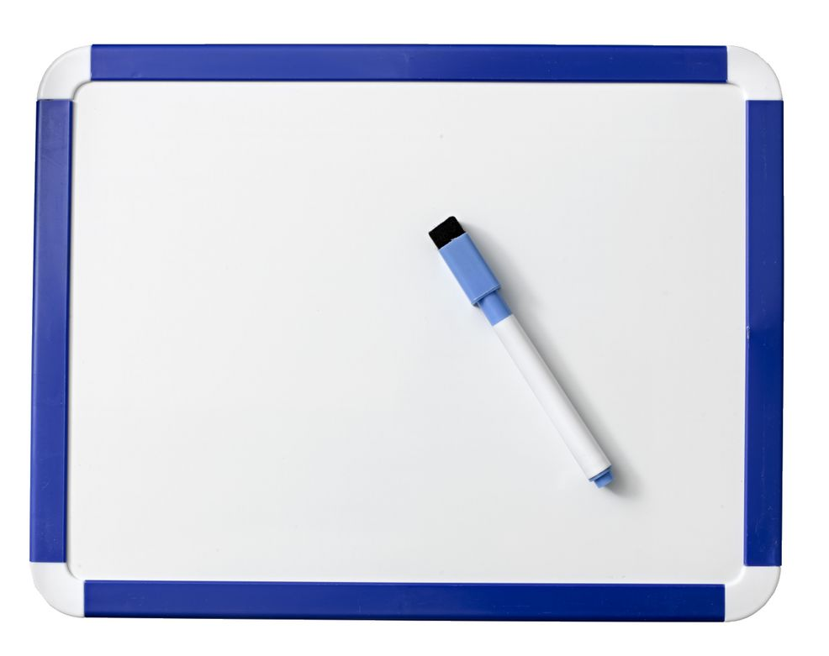
Board race

Slide 4

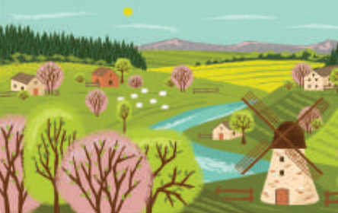
co_ntrysi_e
d
u
A. i/ u
B. u/ d
C. e/ o

Slide 5
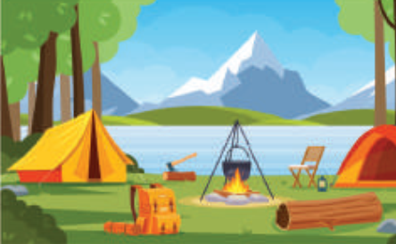
cam_sit_
p
e
A. p/ e
B. t/ a
C. d/ e

Slide 6

_ea_h
b
c
A. d/ c
B. p/ t
C. b/ c

Slide 7
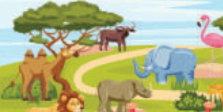
_o_
z
o
A. z/ o
B. s/ r
C. d/ e

Slide 8

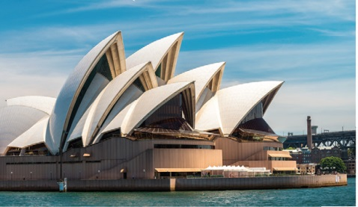
A. Sydney
B. London

Slide 9
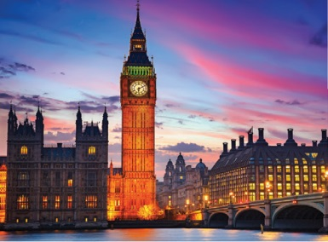
A. London
B. Tokyo

Slide 10
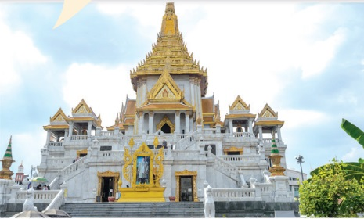
A. Tokyo
B. Bangkok

Slide 11
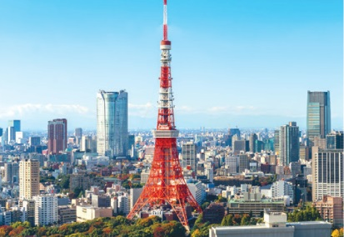
A. Tokyo
B. Sydney

Slide 12
02
Activity 1
Listen and repeat.

Slide 13
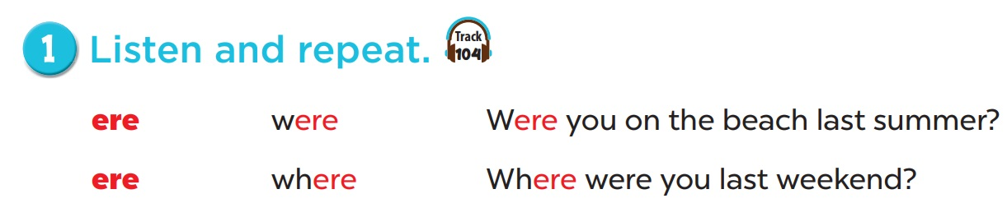


Slide 14
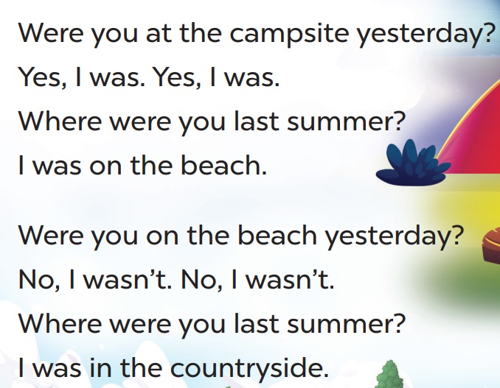
Read. Circle were and underline where.

Slide 15
Look and guesswere orwhere.
1
2
3
4
where
where
were
where

Slide 16
Look and guesswere orwhere.
1
2
3
4
5
were
where
were
where
where

Slide 17
Look and guesswere orwhere.
1
2
3
4
5
were
were
where
where
were
6
7
where
were

Slide 18
03
Activity 2
Listen and circle.

Slide 19
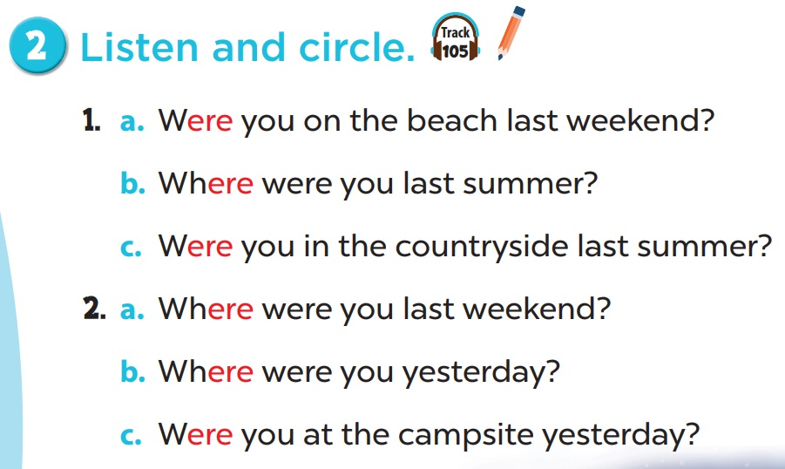

Slide 20
04
Activity 3
Let’s chant.

Slide 21
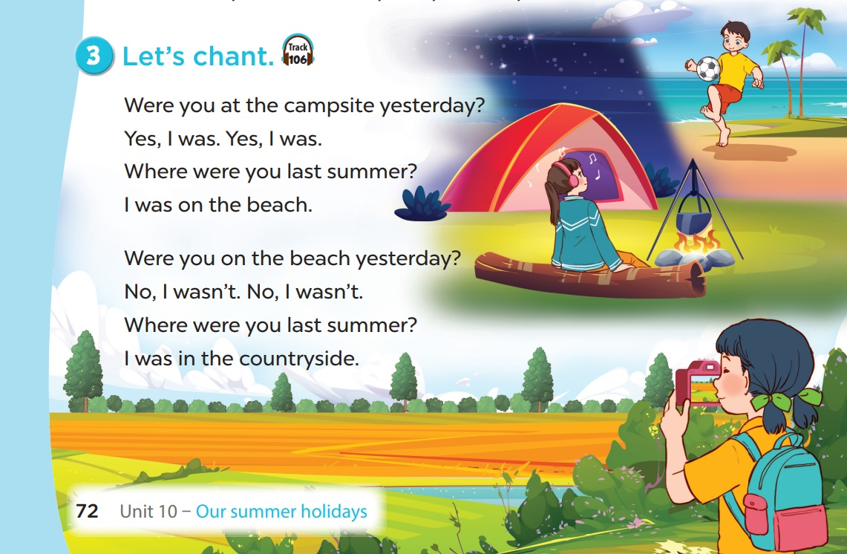

Slide 22
05
FUN TIME
Plants vs Zombies

Slide 23






Fishing Game
Let’s go !!

Slide 24











Slide 25



____ you at the zoo
yesterday?
C. Were
A. Where
D. Was
C. Were
B. What

Slide 26
Where were you
last summer?
D. I was in Sydney.
A. I’m swimming.
B. Yes, I was.
C. At seven.
D. I was in Sydney.

Slide 27
A. wasn’t
I ___ in London.
I was in Bangkok.
A. wasn’t
D. was
C. were
C. not

Slide 28
D. Yes, it is.
Is Tokyo a big city?
A. Yes, I was.
B. Yes, it was.
C. It’s in Japan.
D. Yes, it is.

Slide 29
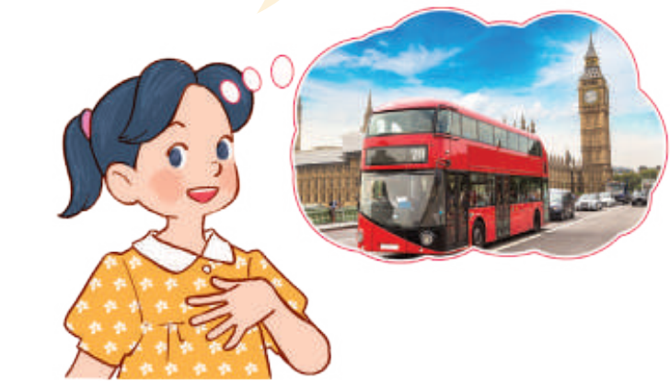
C. I was in London.
A. I was in Sydney.
D. I was in Bangkok.
B. I was in Tokyo.
C. I was in London.

Slide 30
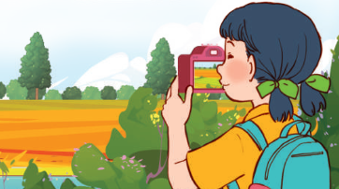
A. I was in the countryside.
A. I was in the countryside.
D. I was on the beach.
B I was at the campsite.
C. I was at the zoo.

Slide 31
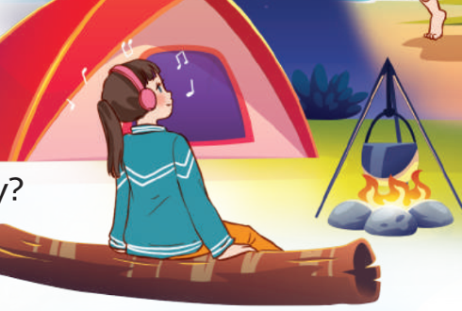
A. I was at the campsite.
A. I was at the campsite.
D. I was on the beach.
C. I was at the zoo.
C. I was in the countryside.

Slide 32
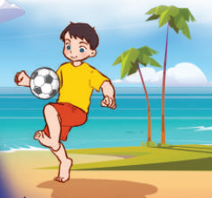
C. I was on the beach.
A.I was at the campsite.
D. I was at the zoo.
C. I was on the beach.
B. I was in the countryside.

