Slide 1


Slide 2



Slide 3
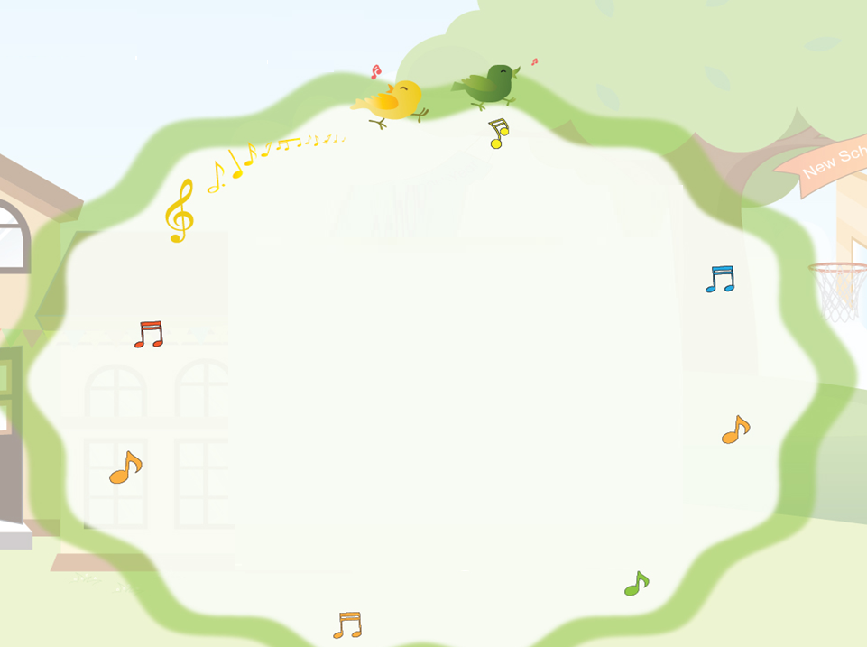

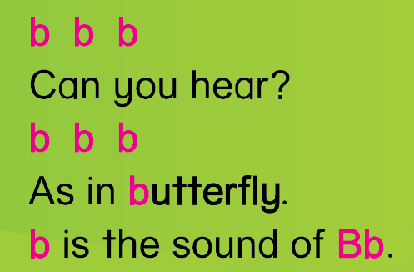

Slide 4

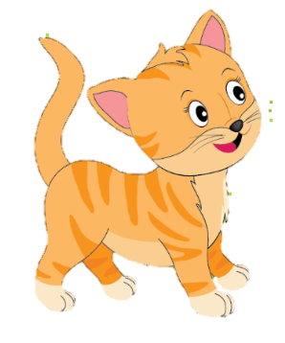
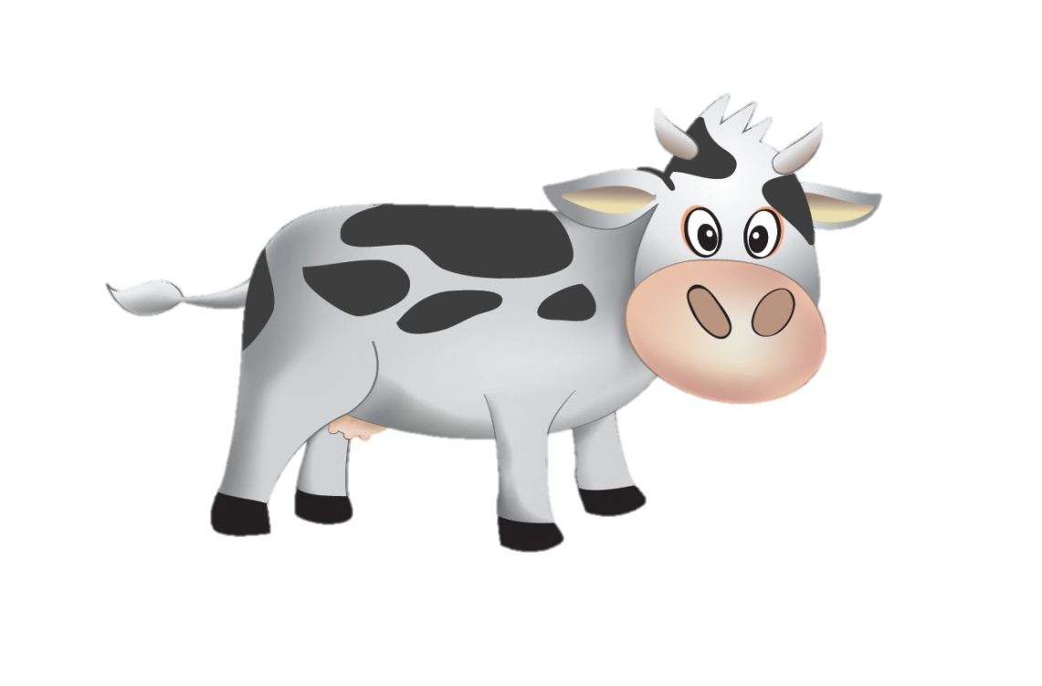
Unit 3
Lesson 1

Slide 5


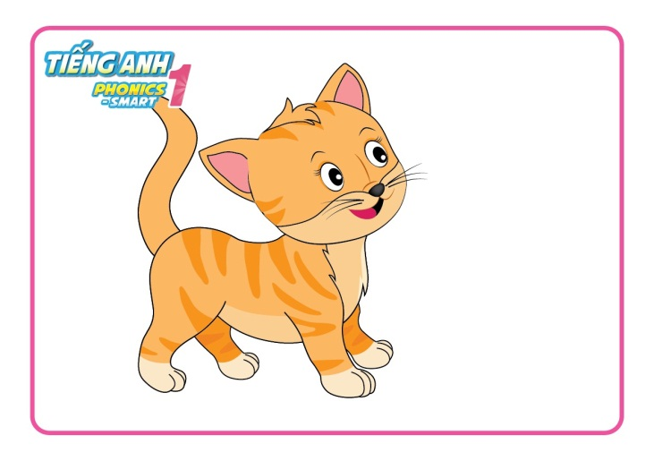
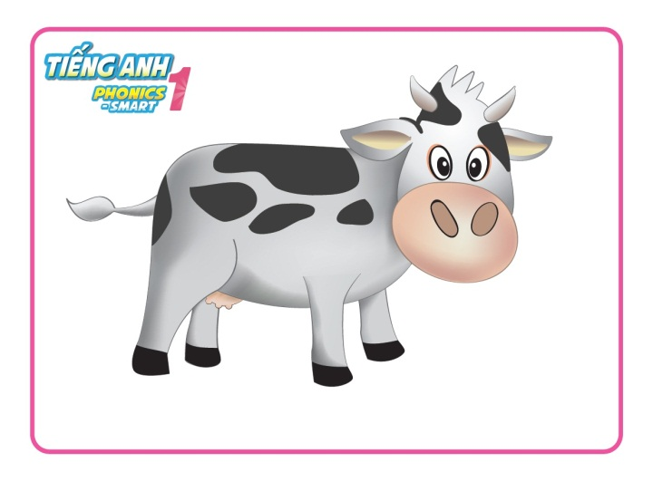
Unit 3:
Lesson 1:
C c
1. Look, listen and repeat.
cat
cow
Notes:
- Click vào hình loa hoặc click vào từng tranh để nghe audio

Slide 6


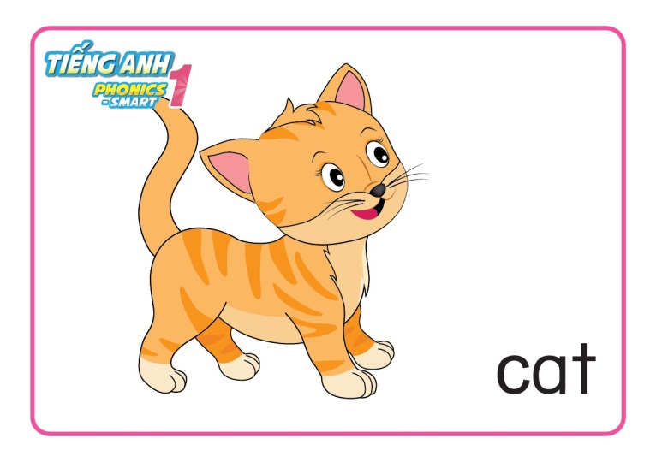
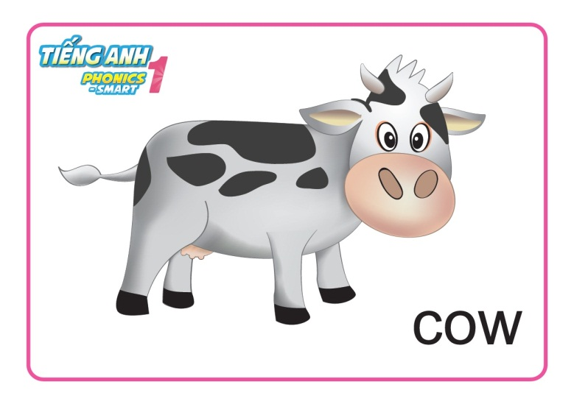
Unit 3:
Lesson 1:
C c
1. Look, listen and repeat.
Game
Say what you see
Notes:
- Audio: letter A, /a/, apple, ant

Slide 7


Game
Say what you see

Slide 8


Game
Say what you see

Slide 9
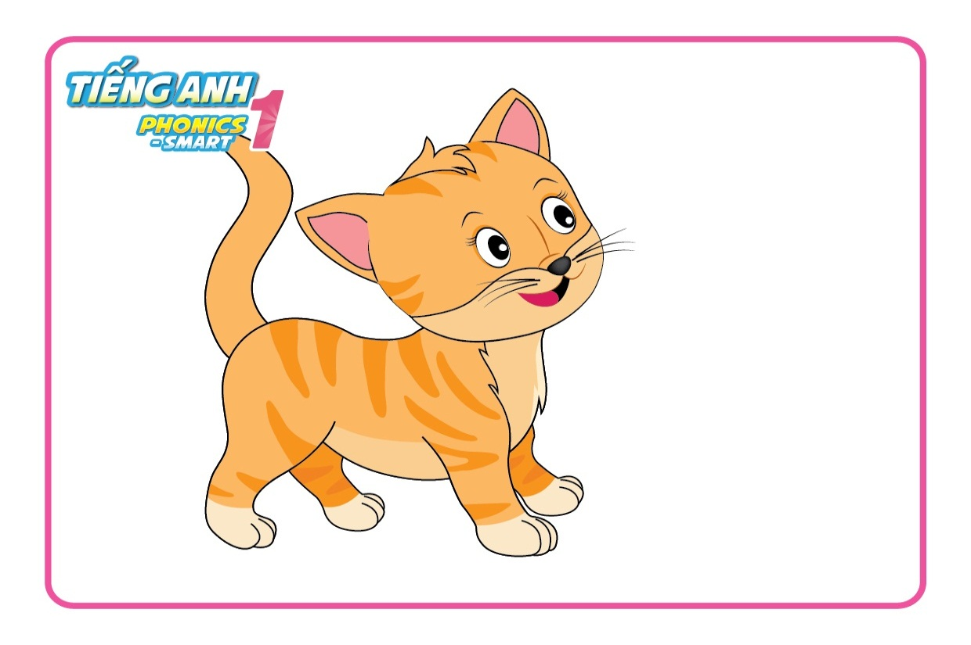
Game
Say what you see
Notes:
- Audio: letter A, /a/, apple, ant

Slide 10

Game
Say what you see
Notes:
- Audio: letter A, /a/, apple, ant

Slide 11
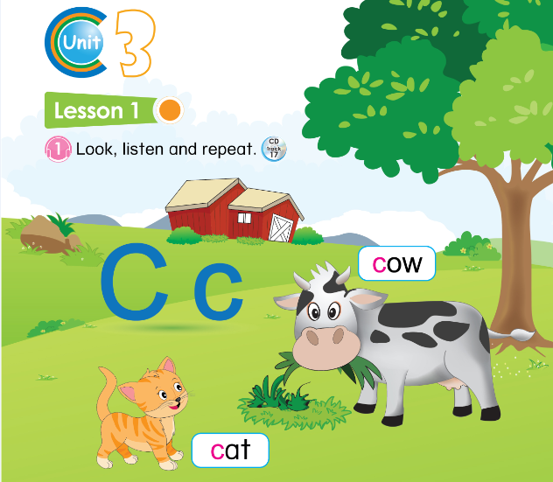

14
Notes:
- GV hướng dẫn HS sử dụng SGK (nghe, chỉ tay vào sách và nói)

Slide 12





Unit 3:
Lesson 1:
C c
1. Look, listen and repeat.
2. Let’s chant.

Slide 13

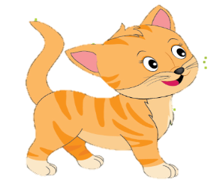
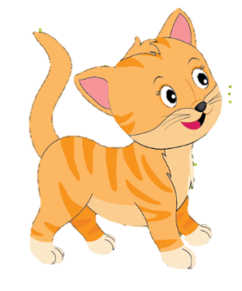

Unit 3:
Lesson 1:
C c
1. Look, listen and repeat.
2. Let’s chant.
C
c

Slide 14


