Slide 1




Our toys
17
LESSON 1
Period 2

Slide 2
Warm-up and review
Warm-up and review
1
1
1
Game: A letter to Santa Claus

Slide 3

Listen and number.
2
2

Slide 4
Look, complete and read.
3
3

Slide 5
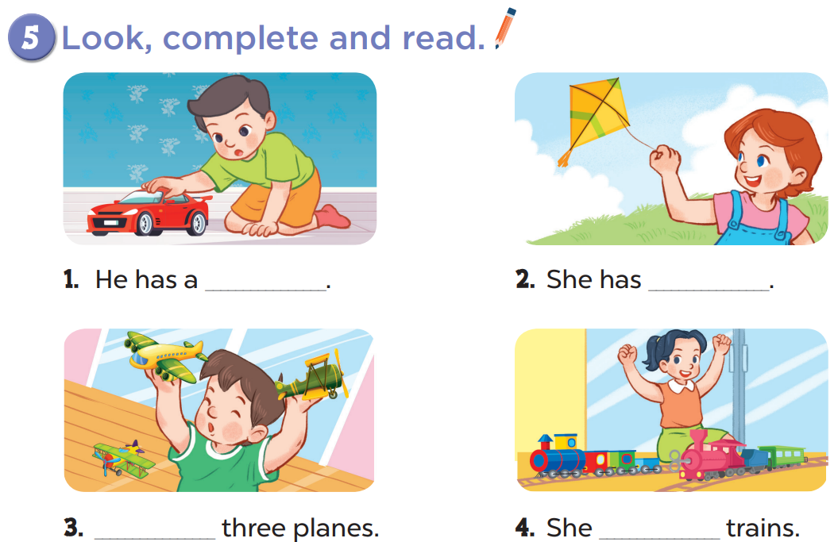

Slide 6

Let’s sing.
4
4

Slide 7
Moving time!!!
Sing and dance
Notes:
Step 1: Divide the class into 4 teams.
Step 2: Ask each team to stand up, then sing and dance. The team that sing and dance the most beautiful will get points.
Step 3: Encourage pupils to join in this activity.
Step 4: Give points for team.

Slide 8
Fun corner and wrap-up
5
5

