Slide 1

Unit 18 Means of transport
Lesson 1 – Activity 1-3

Slide 2


Table of contents
01
Warm-up and Review
02
Look, listen and repeat.
03
Listen, point and say.
04
Let’s talk.
05
Fun corner and Wrap-up

Slide 3
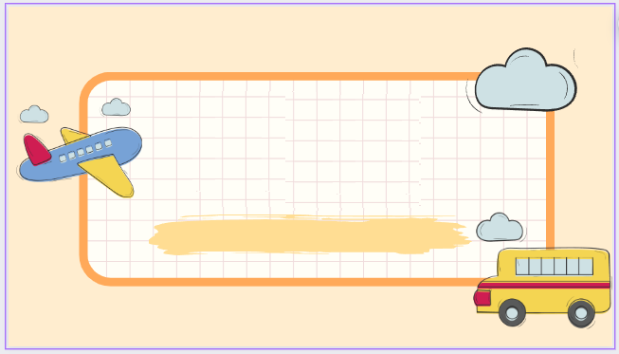
01
Warm-up and Review

Slide 4

Travel through the screen.

Slide 5
02
Look, listen and repeat.

Slide 6

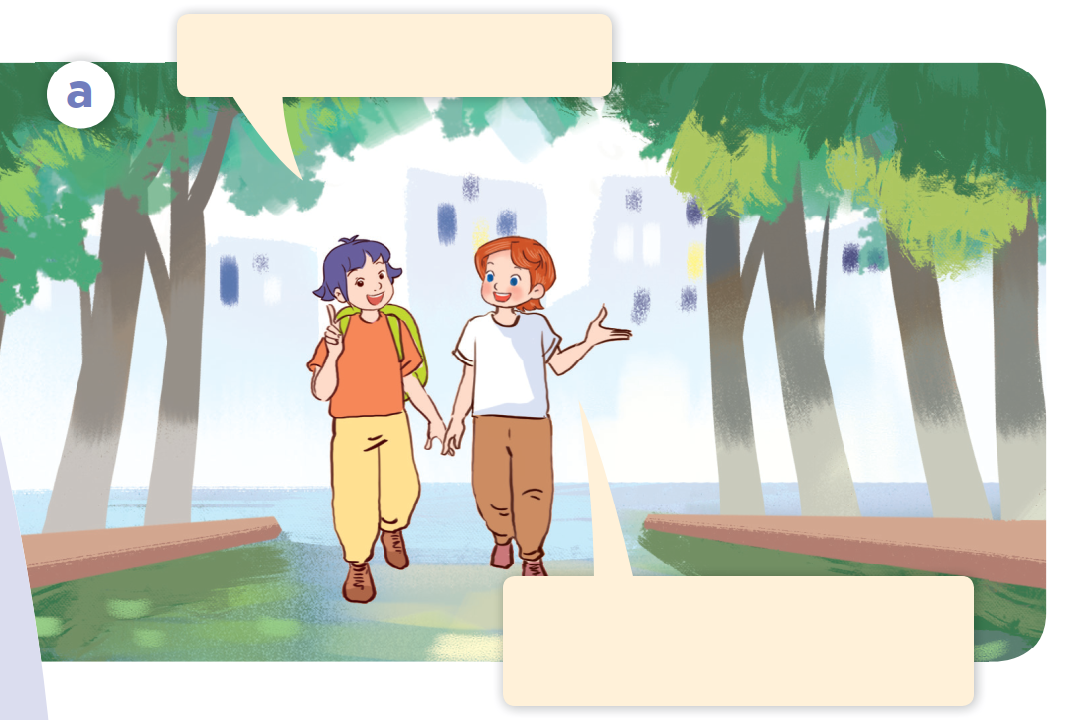
Look.

Slide 7
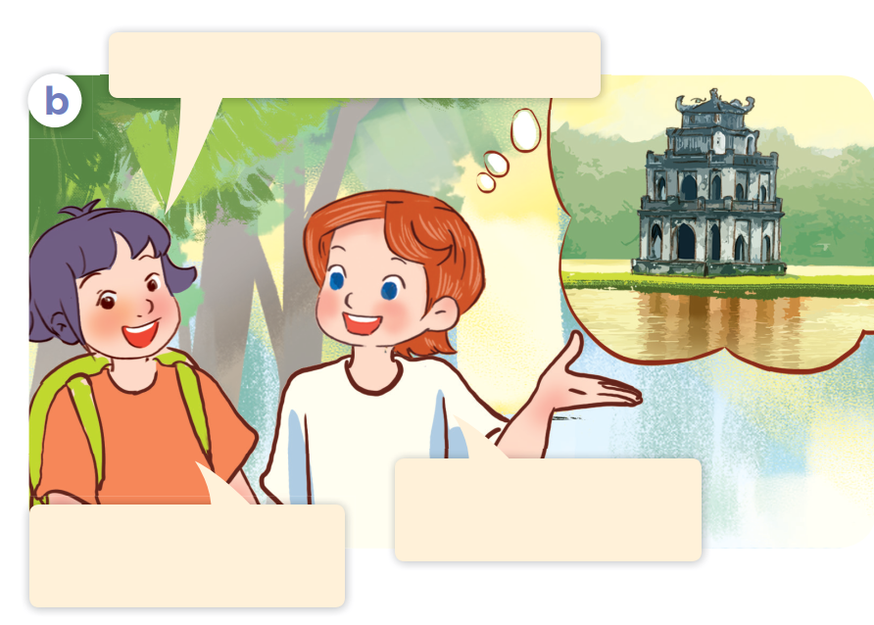
Look.

Slide 8

Look, listen and repeat.

Slide 9
Look, listen and repeat.
Is it time for a trip?
That’s a great idea!
Let’s go somewhere.
Notes:
Nháy vào hội thoại để nghe lại âm thanh từng câu.

Slide 10
Look, listen and repeat.
Where do you want to visit?
I want to visit Hoan Kiem Lake.
Sounds good!
I can’t wait to go.
Notes:
Nháy vào hội thoại để nghe lại âm thanh từng câu.

Slide 11

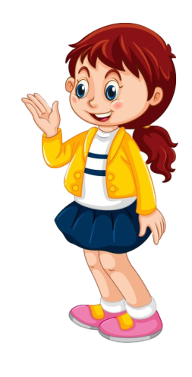
Look, listen and repeat.
Is it time for a trip?
Where do you want to visit?
I want to visit Hoan Kiem Lake.
That’s a great idea!
Let’s go somewhere.
Sounds good!
I can’t wait to go.

Slide 12
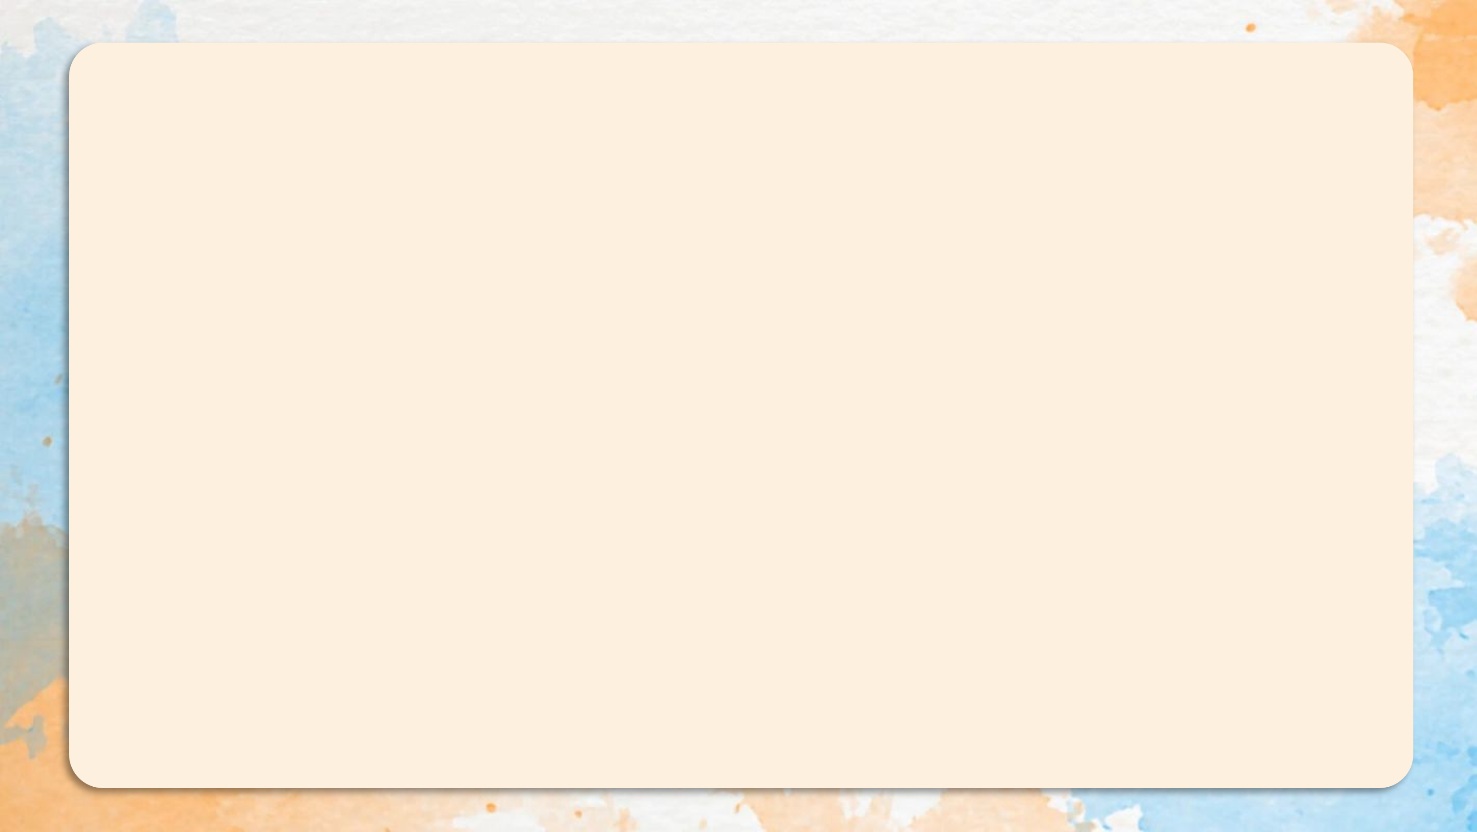
Where do you want to visit?
I want to visit Hoan Kiem Lake.

Slide 13
03
Listen, point and say.

Slide 14
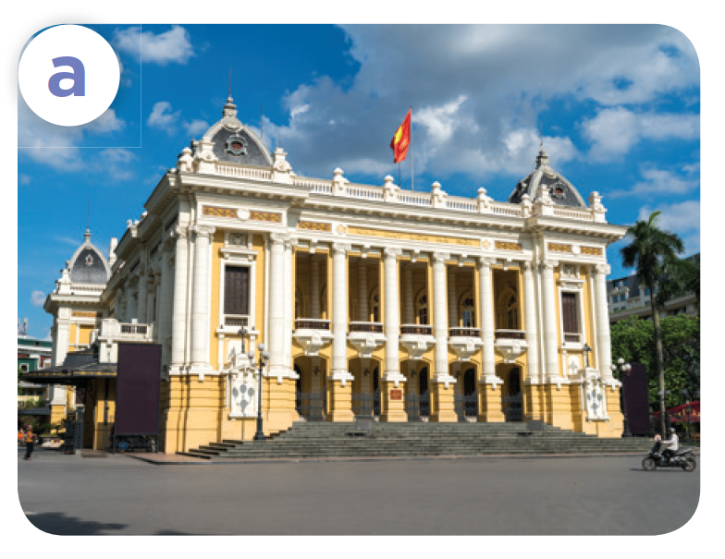
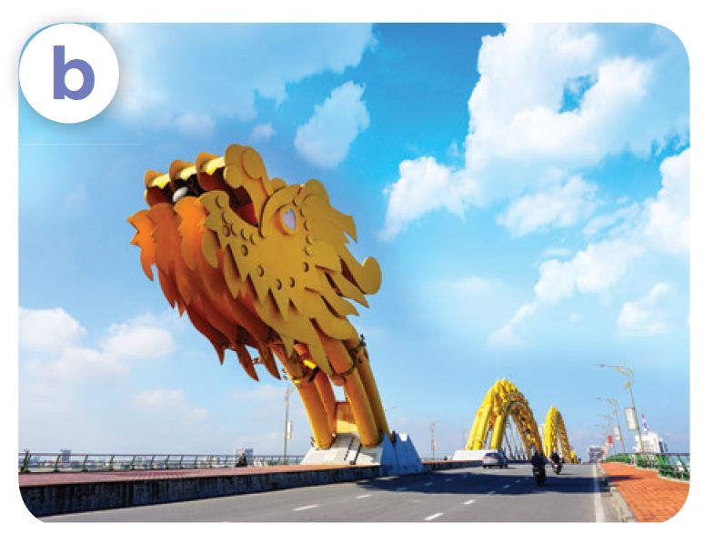
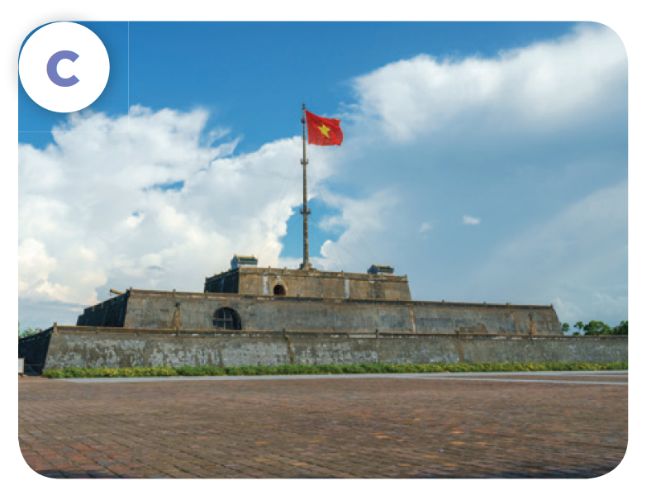

Listen, point and say.
Ha Noi Opera House
Dragon Bridge
Ho Chi Minh City Museum
Ngo Mon Square

Slide 15

Listen, point and say.
Ha Noi Opera House

Slide 16

Listen, point and say.
Dragon Bridge

Slide 17

Listen, point and say.
Ngo Mon Square

Slide 18

Listen, point and say.
Ho Chi Minh City Museum

Slide 19
Where do you want to visit?
I want to visit ___.

Slide 20
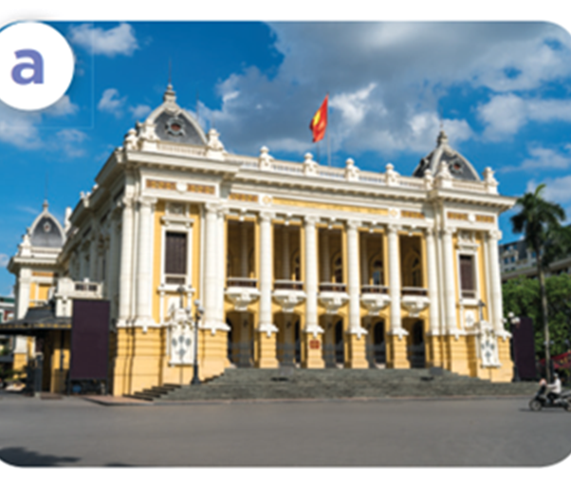
Listen, point and say.
Where do you want to visit?
I want to visit Ha Noi Opera House.
Ha Noi Opera House

Slide 21
Listen, point and say.
Where do you want to visit?
I want to visit Dragon Bridge.
Dragon Bridge

Slide 22
Listen, point and say.
Where do you want to visit?
I want to visit Ngo Mon Square.
Ngo Mon Square

Slide 23

Listen, point and say.
Where do you want
to visit?
I want to visit Ho Chi Minh City Museum.
Ho Chi Minh City Museum

Slide 24
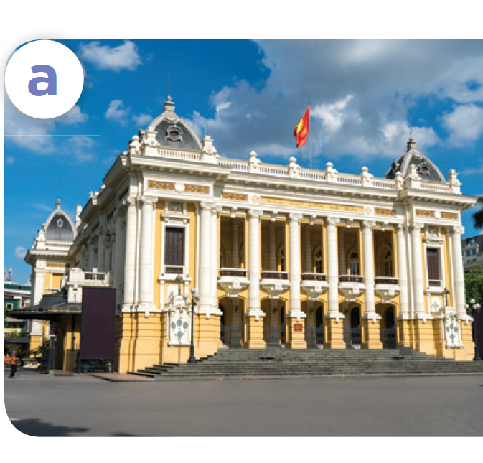
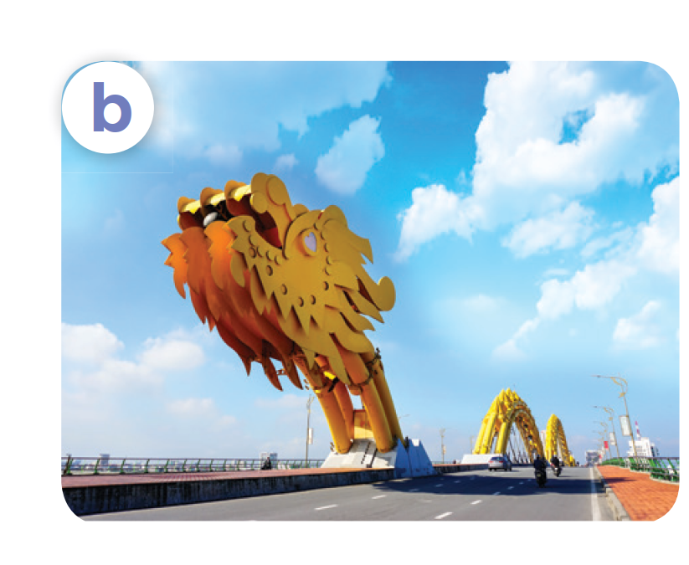
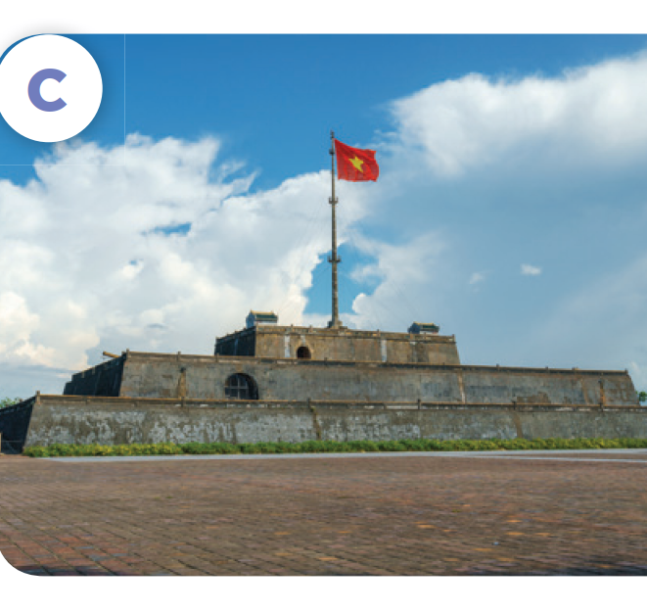
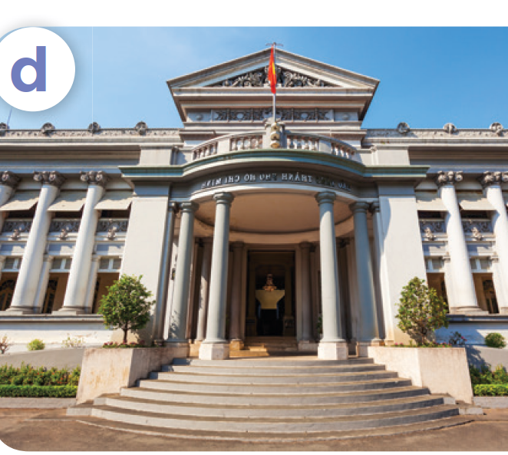
Where do you want to visit?
I want to visit ____.
Ha Noi Opera House
Dragon Bridge
Ngo Mon Square
Ho Chi Minh
City Museum

Slide 25
04
Let’s talk.

Slide 26
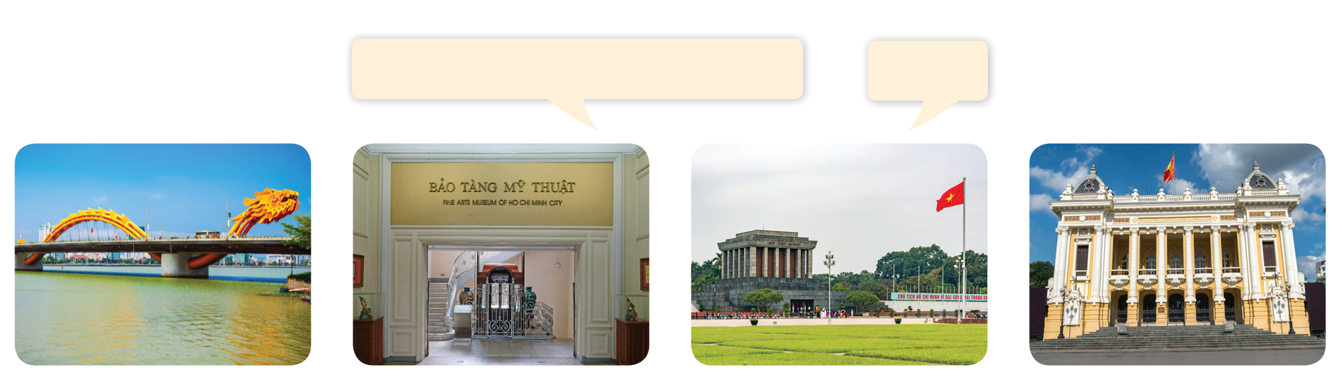
Let’s talk.
Where do you want to visit?
____.

Slide 27
Where do you want to visit?
_______.

Slide 28
05
Fun corner and Wrap-up

Slide 29

Questions and answers

Slide 30

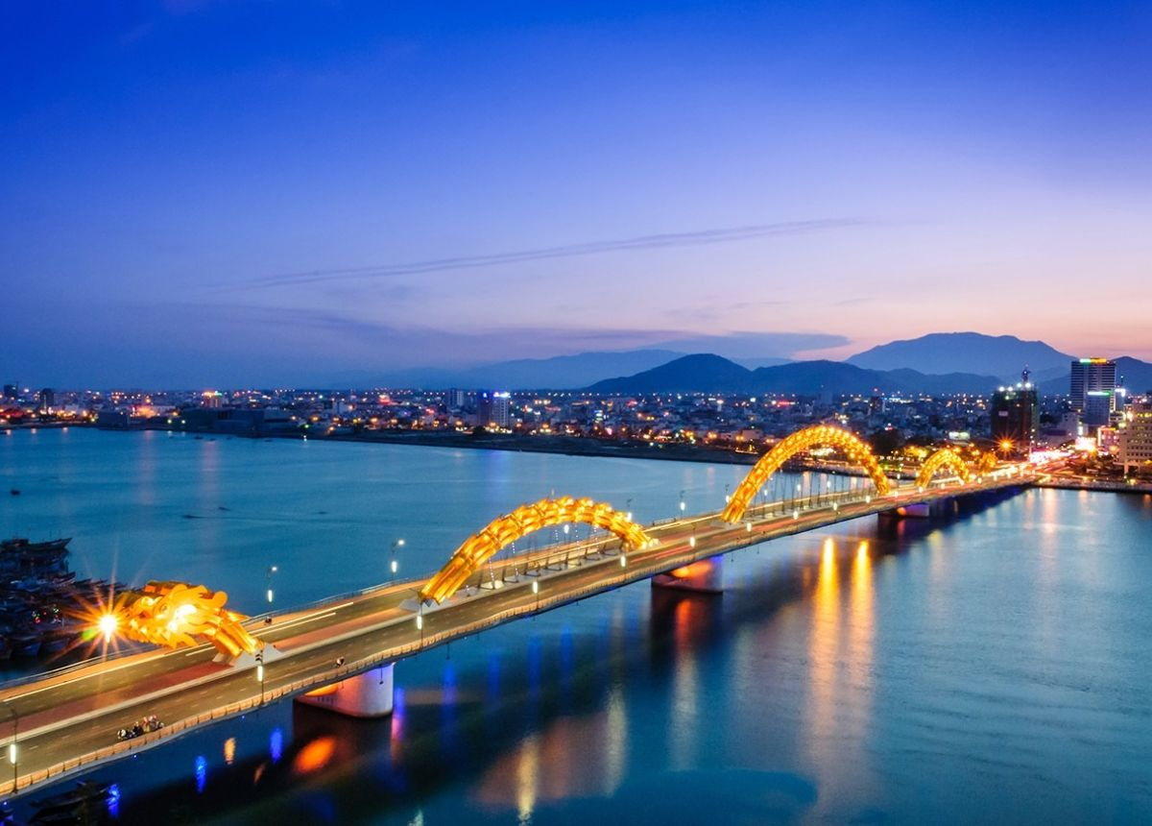
Questions and answers
______.
______?

Slide 31
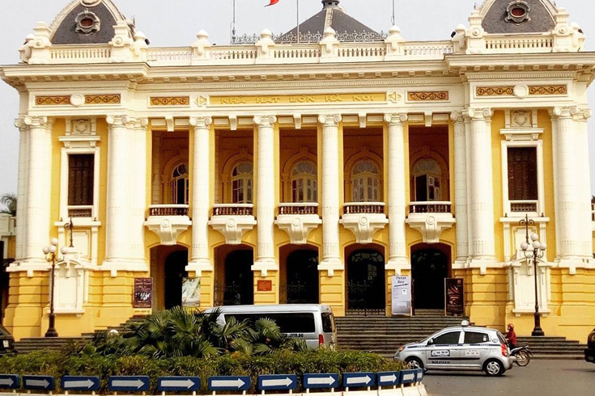
Questions and answers
______?
______.

Slide 32
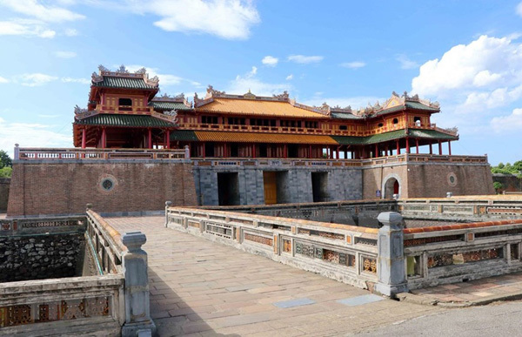
Questions and answers
______.
______?

Slide 33
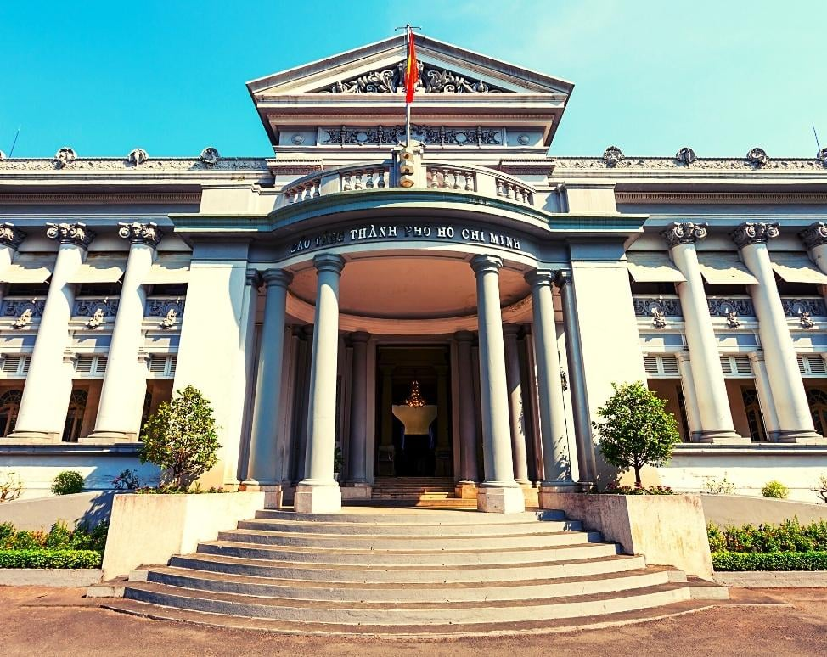
Questions and answers
_______.
______?

Slide 34
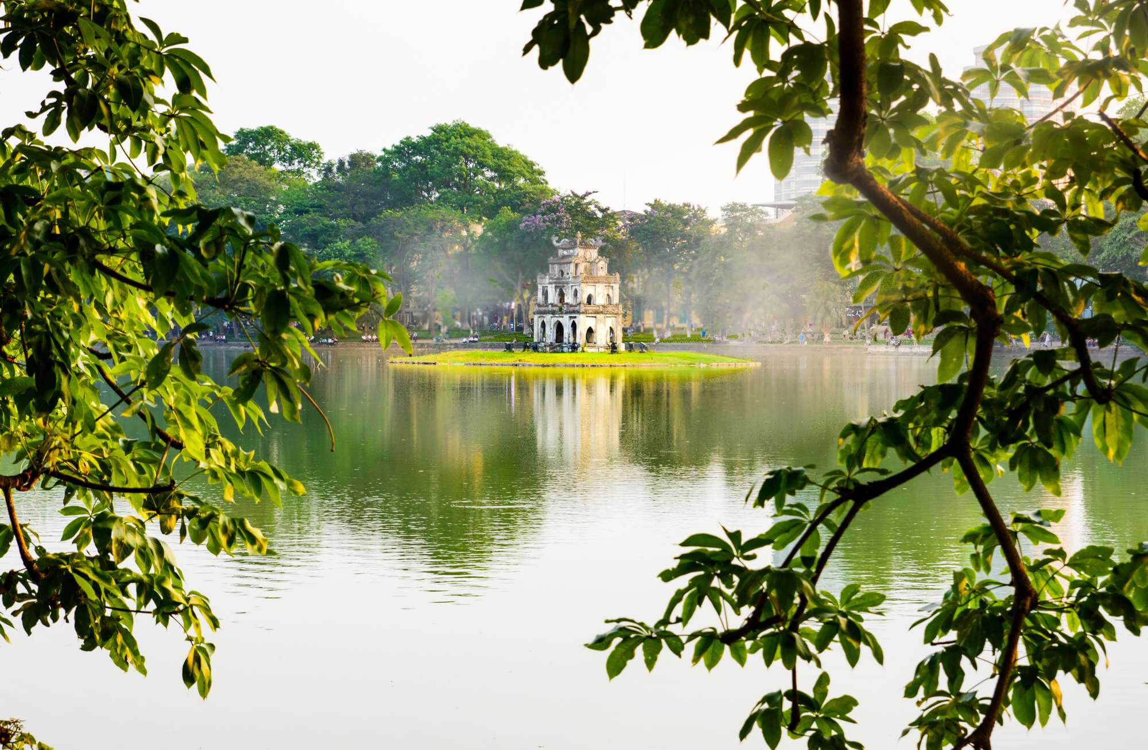
Questions and answers
______?
______.

