Slide 1



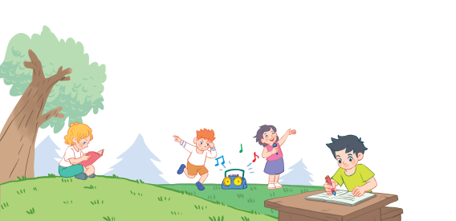
18
Period 1

Slide 2
1. Warm-up and review

Slide 3
2. Look, listen and repeat.

Slide 4
3. Listen, point and say.

Slide 5
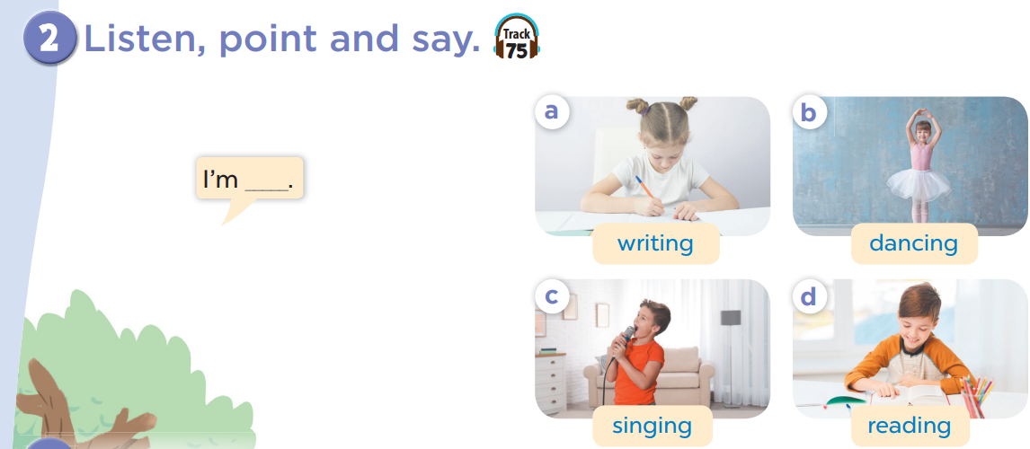


Slide 6
4. Let’s talk.

Slide 7
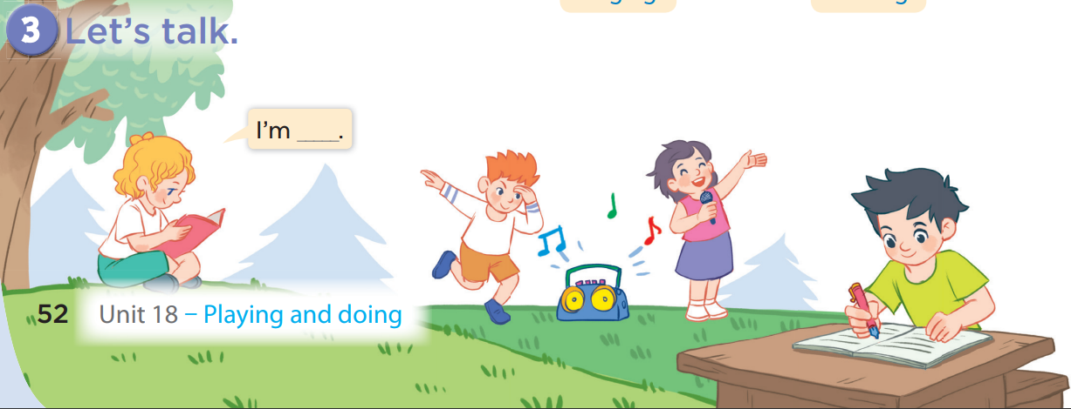
I am singing.
I am reading.

Slide 8
5. Fun corner and wrap-up

