Slide 1



19
The animal world
LESSON 1 – Activity 1 - 3

Slide 2
Table of Contents
01
02
Look, listen and repeat.
Warm-up
03
Listen, point and say.
04
Let’s talk.
05
Game

Slide 3
1
Warm-up

Slide 4

Notes:
https://youtu.be/yS1zl4g7HLA

Slide 5
2
Look, listen and repeat.

Slide 6

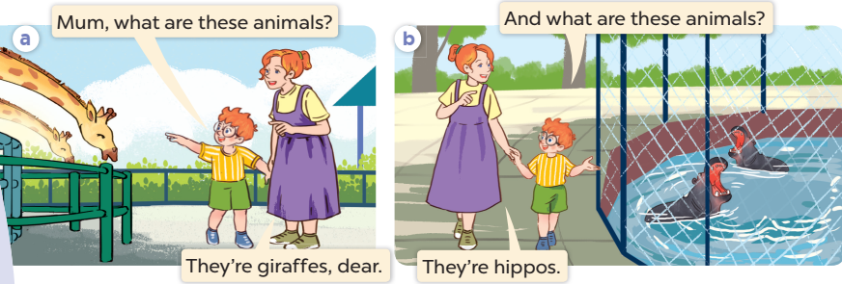
Listen and repeat.

Slide 7
3
Listen, point and say.

Slide 8
New words

Slide 9
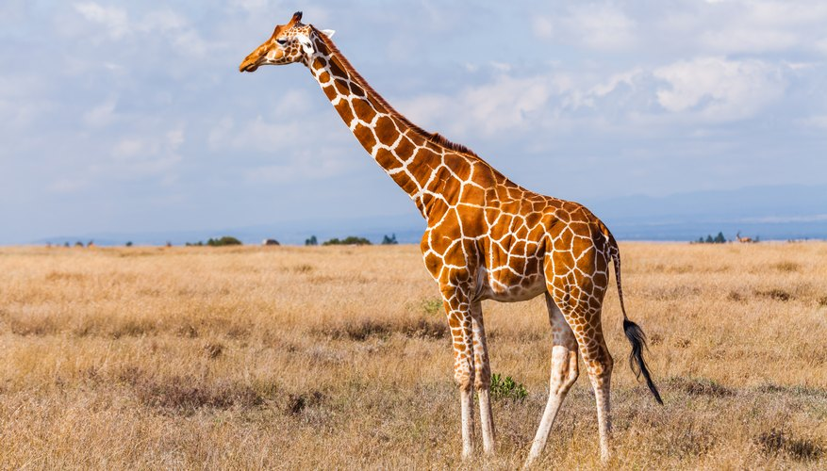
a giraffe

Slide 10
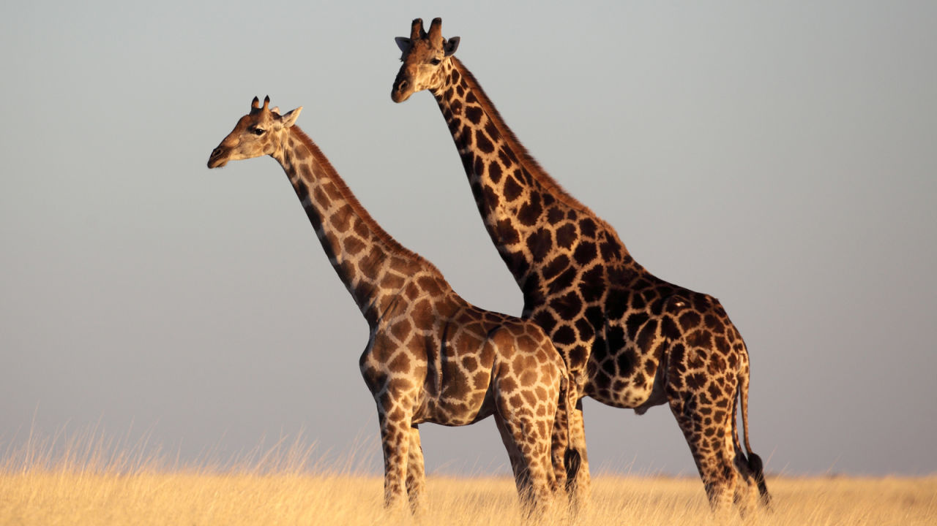
giraffes

Slide 11
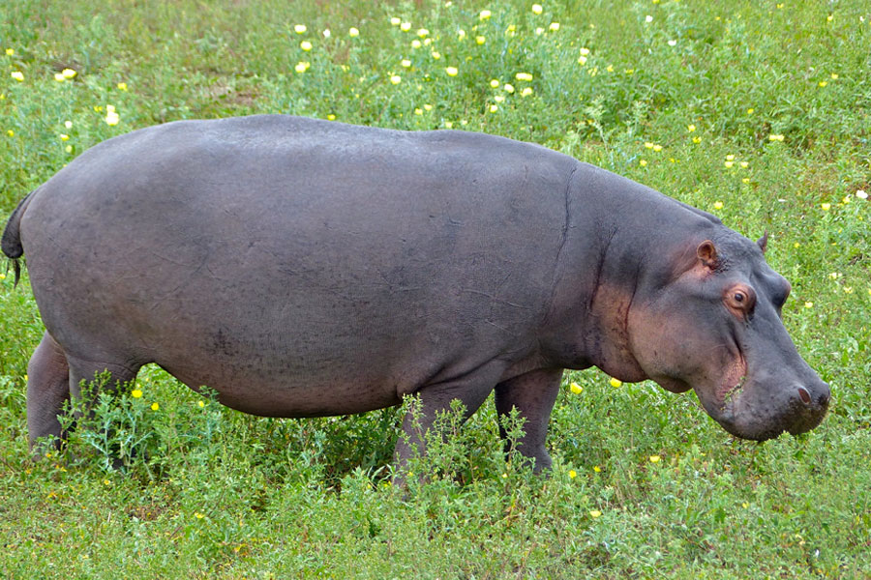
a hippo

Slide 12
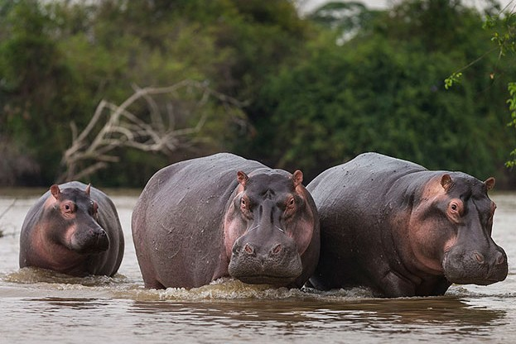
hippos

Slide 13
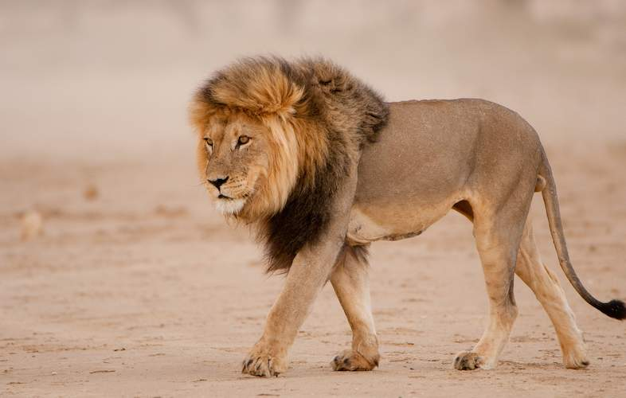
a lion

Slide 14
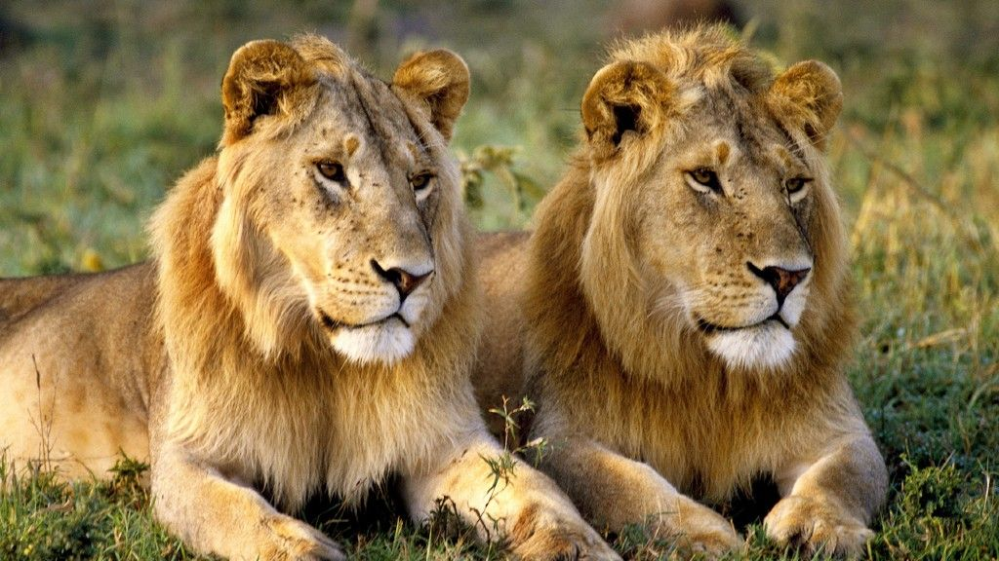
lions

Slide 15
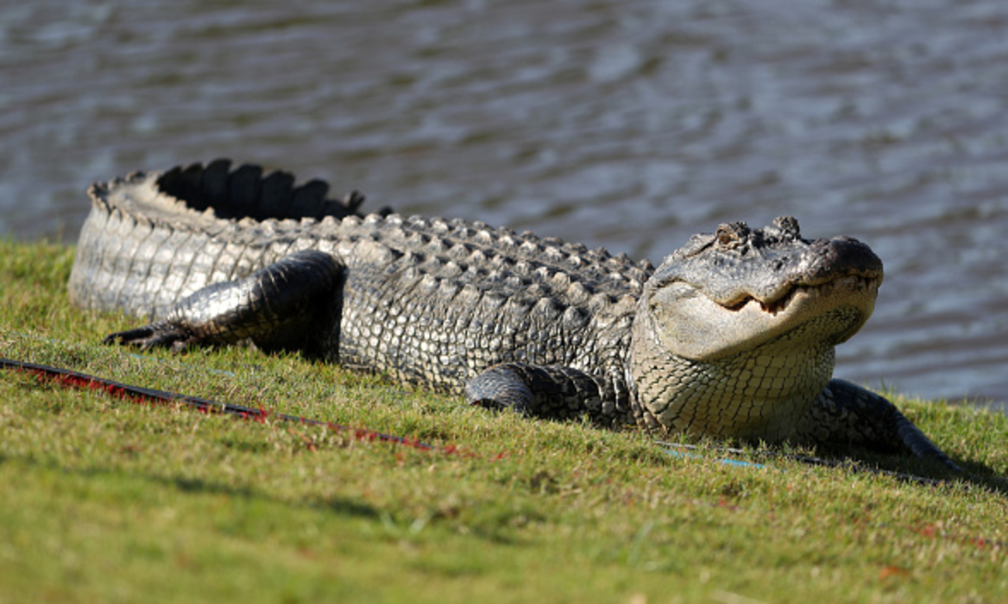
a crocodile

Slide 16
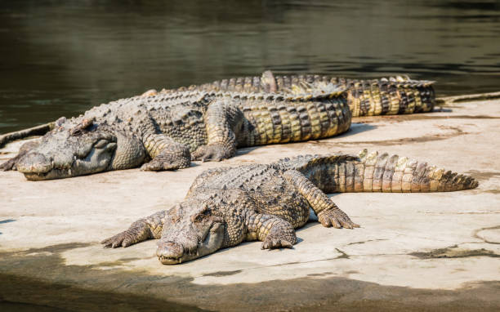
crocodiles

Slide 17
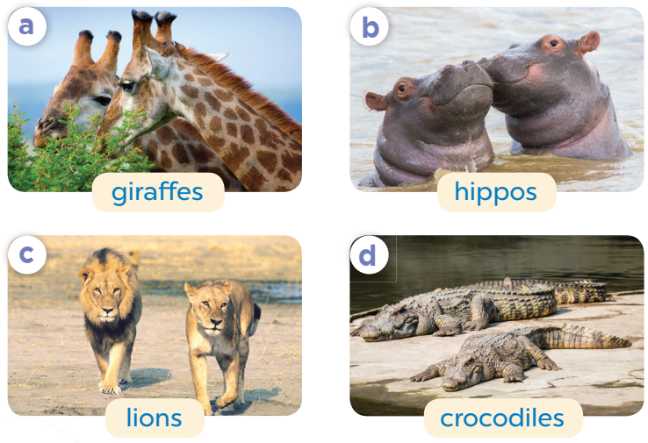
Listen, point and say.
What are these animals?
They’re ___.

Slide 18
What are these animals?
They’re giraffes.

Slide 19
What are these animals?
They’re hippos.

Slide 20
What are these animals?
They’re lions.

Slide 21
What are these animals?
They’re crocodiles.

Slide 22
4
Let’s talk.

Slide 23
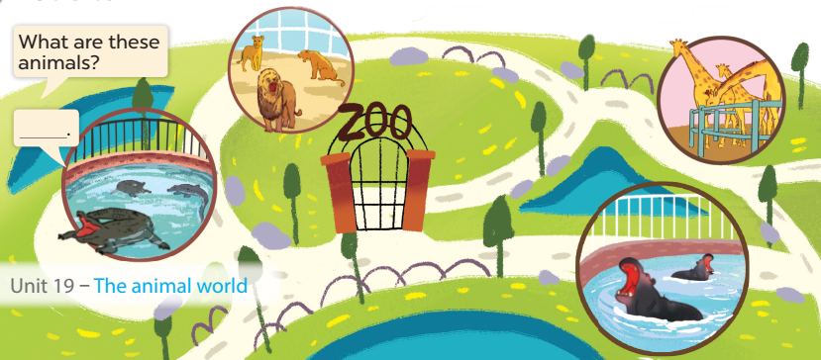
They’re lions.
They’re giraffes.
Look and answer.
They’re crocodiles.
They’re hippos.

Slide 24
Work in pairs. Ask and answer.

Slide 25
5
Game

Slide 26







Collect some cookies.
GIRLS
BOYS
Notes:
- Divide the class into 2 teams (boys & girls)
- Each team takes turns to choose a number and answer the question.
- Click the numbers to choose questions.
- Click Play symbol to give 2 teams the number of cookies they get for each correct answer.

Slide 27
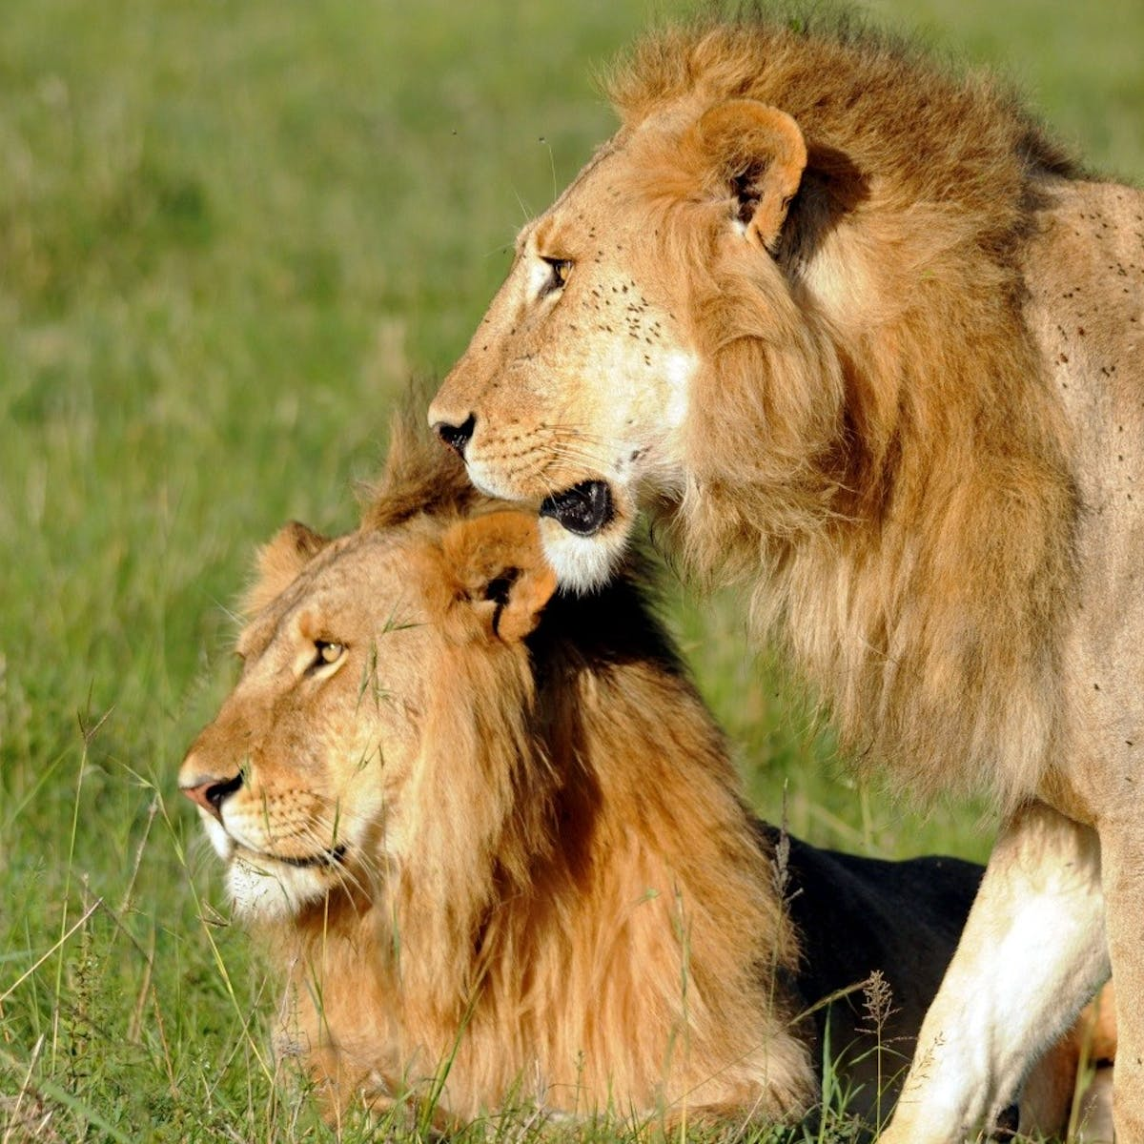

What are these animals?
They’re ………….
lions
Notes:
- Click to show question and answer
- Click again to show the amount of the cookies
- Click Home to get back to the menu

Slide 28
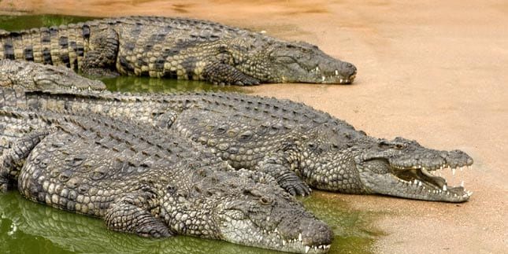
…………………………………………?
What are these animals
They’re crocodiles.

Slide 29
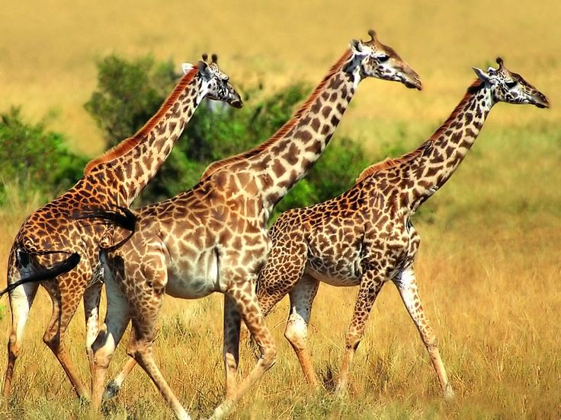
What are these animals?
They’re ……………..... .
giraffes

Slide 30
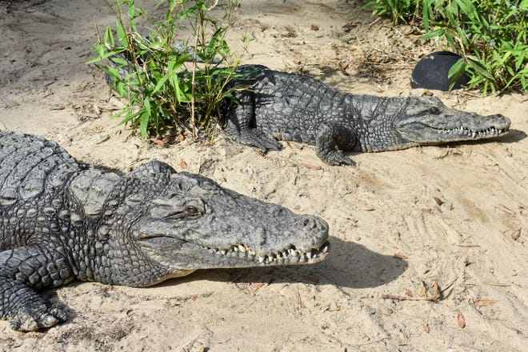
What are these animals?
crocodiles
They’re ……………….. .

Slide 31
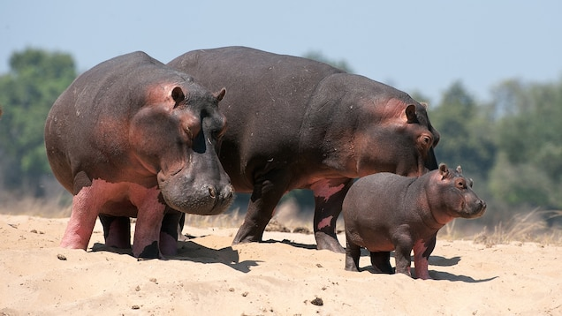
What are these animals?
They’re …………..... .
hippos

Slide 32
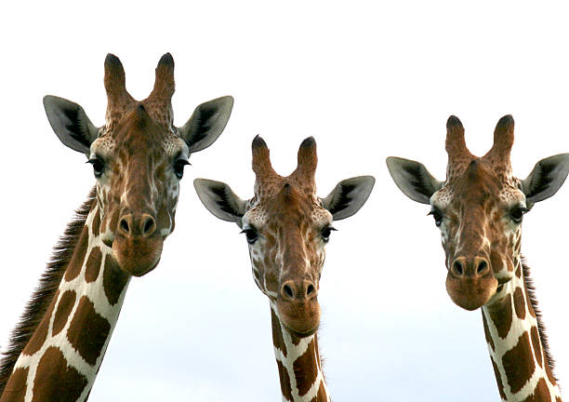
animals
……….… are these ……………..?
What
They’re giraffes.

