Slide 1



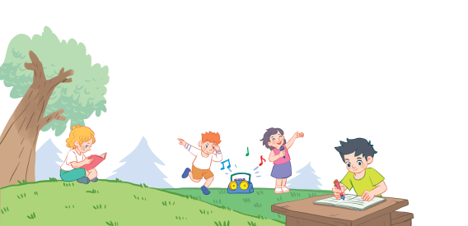
18
Period 4

Slide 2

Notes:
Game: Matching pairs
Divide the class into two teams. (Boys and Girls)
Ask pupils to choose the matching pairs. (words with pictures)
Pupils come to the front and choose the pictures in order to match with the words. Who can make it will have points for the team.
Give points for the pupils. Encourage the pupils to join the activity.

Slide 3
2.Listen and number.

Slide 4
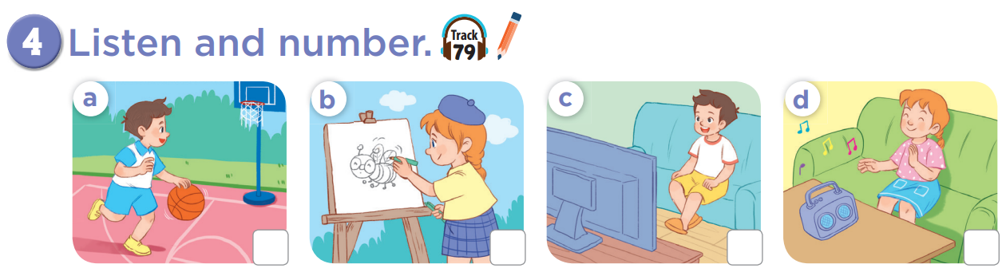
3
2
1
4

Slide 5
What’s missing?
listening
to music

Slide 6
What’s missing?
playing basketball
watching TV

Slide 7
What’s missing?
drawing
a picture
listening
to music

Slide 8
3. Look, complete and read.

Slide 9
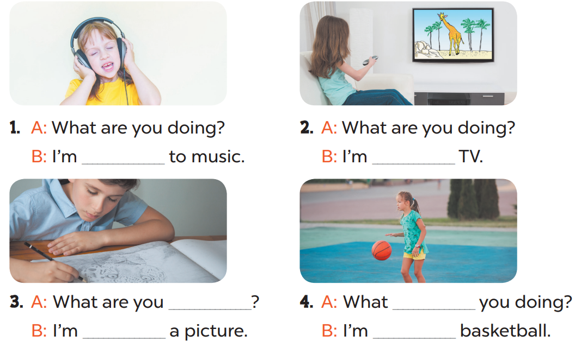

Slide 10
4. Let’s sing.

Slide 11
5. Fun corner and wrap-up

