Slide 1



Slide 2
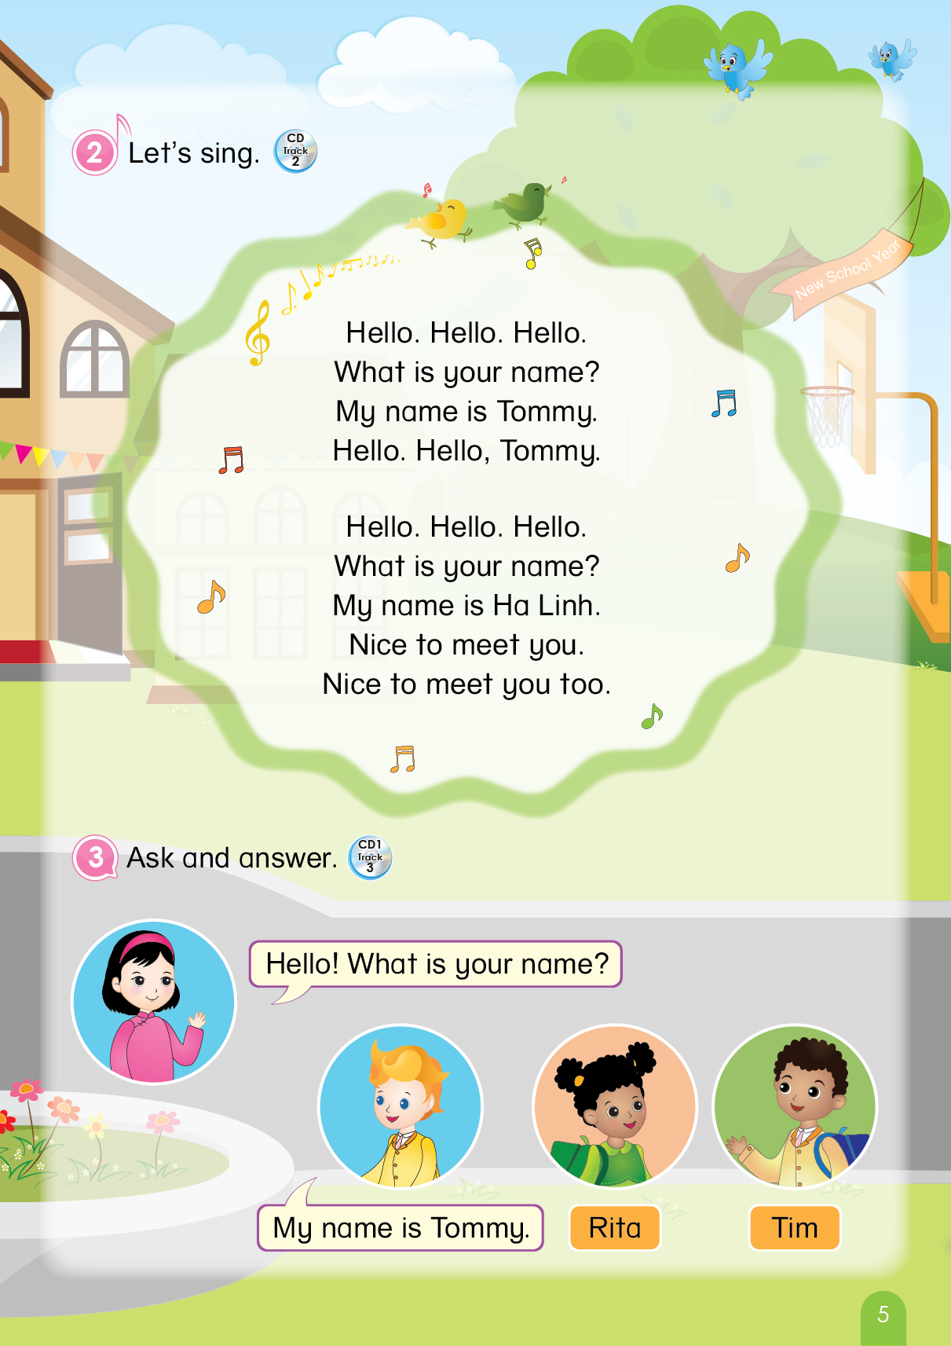

Notes:
Teacher says “Hello, everyone. How are you? How’s the weather? Is it sunny? Great! Now, let’s sing a song with me.”
Warm up: Sing “Hello song” – “Excellent! You sing very well.”
Divide class into 2 groups (optional) – “Today, we will have 2 groups – Group 1 and Group 2. You are Group 1, you are Group 2.”

Slide 3
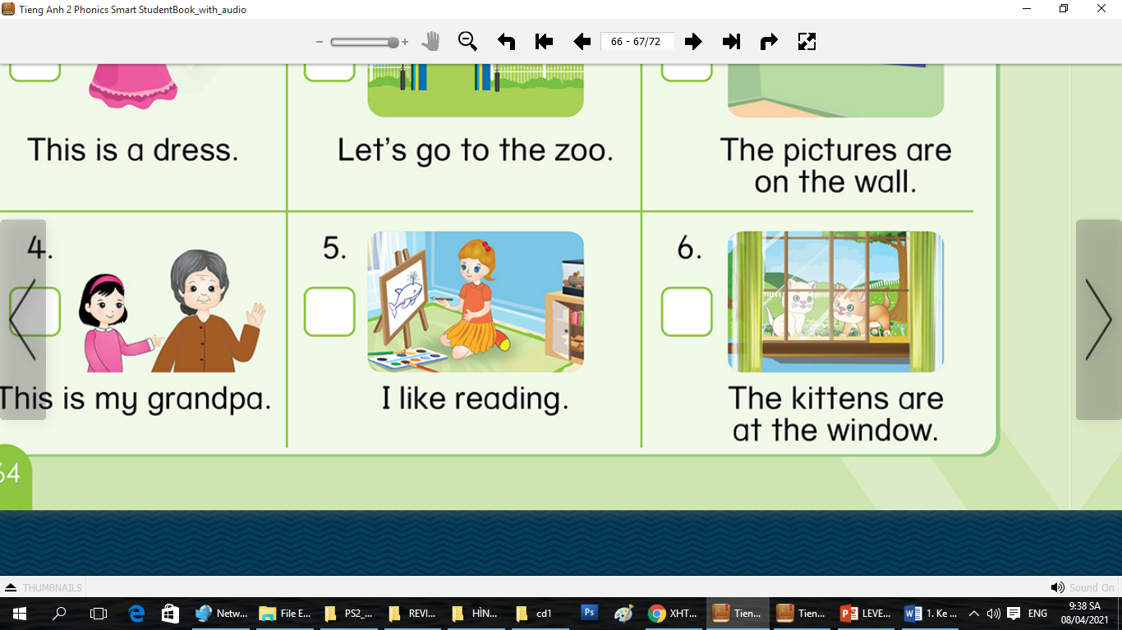
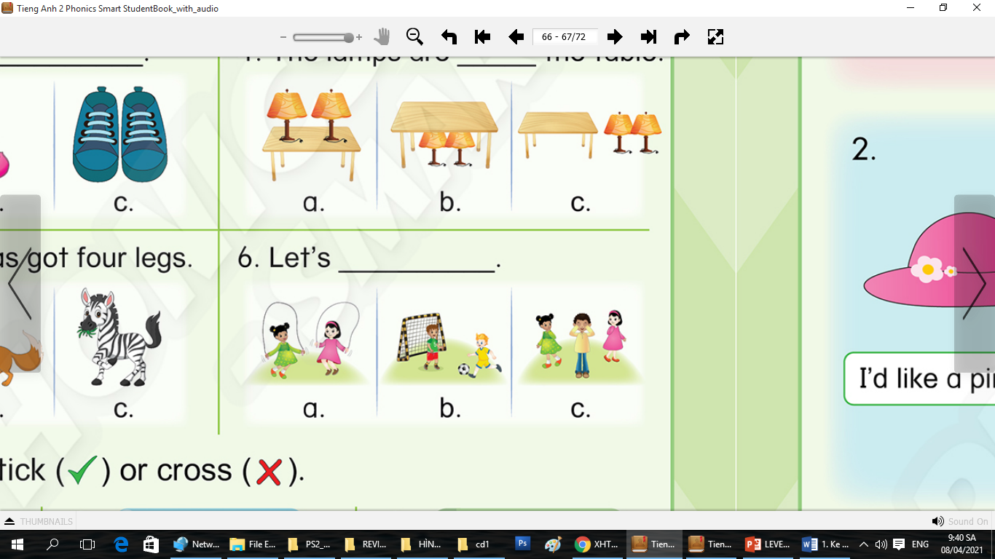
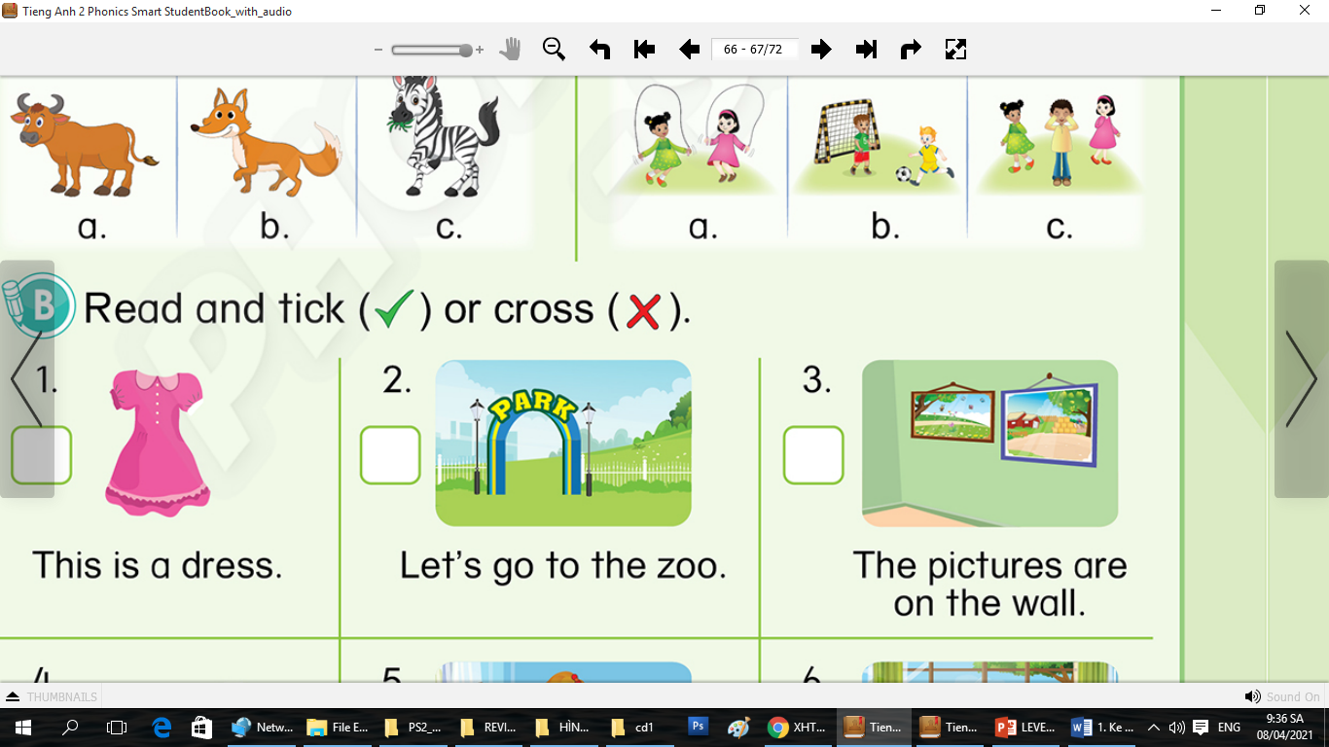
REVIEW 4
(Period 1)
Notes:
Teacher leads to the lesson: “OK. From lesson 11 to lesson 13, we’ve met a lot of friends. Do you remember them? OK. We will meet all of them in today’s lesson. Are you excited?”. “Good. So let’s go to part A.”

Slide 4

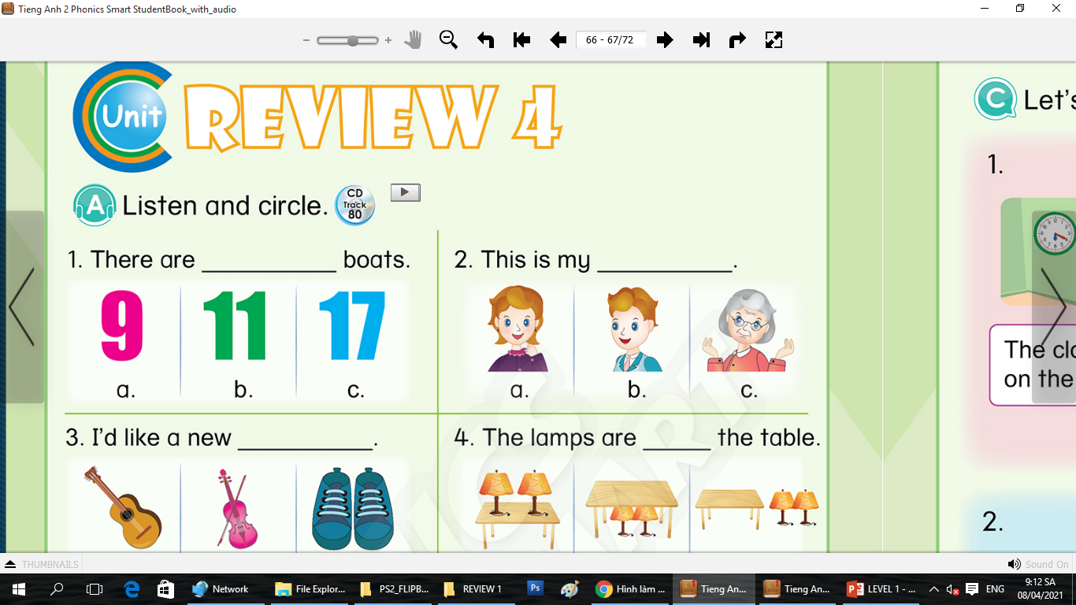
REVIEW 4
A. Listen and circle.
1. There are ______________ shoes
a
b
c
Notes:
Teacher corrects the answers: “Let’s correct. Now, look at the screen. One. You listen.” “So, what number is it?”. “Well done. It is an eleven. Circle b.”

Slide 5
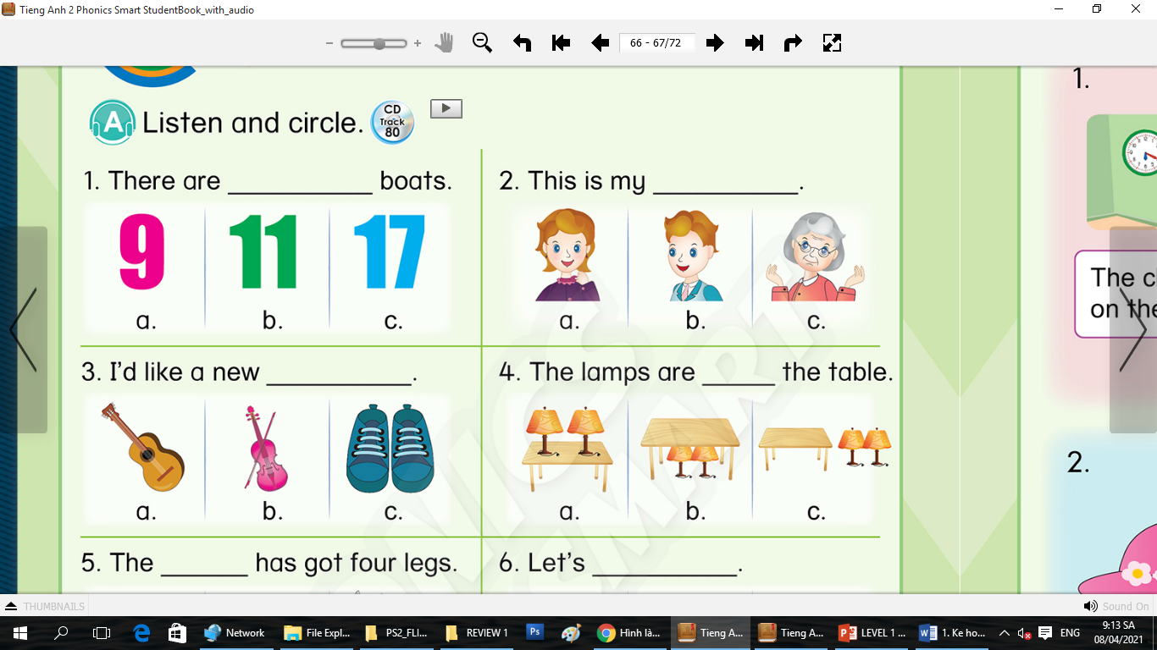
REVIEW 4
A. Listen and circle.
2. This is my _____________
c
a
b
Notes:
Teacher corrects the answers: “Two. Listen!” “So, who is it”. “Good job. grandma. Circle c.”

Slide 6


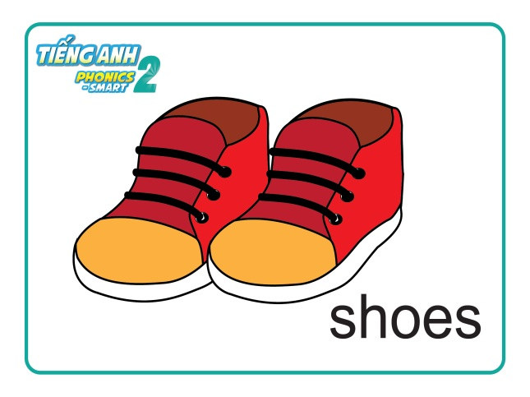
REVIEW 4
A. Listen and circle.
3. I’d like a new ____________
c
a
b
Notes:
Teacher corrects the answers: “Three. Listen!” “So, what is it”. “Great. Guitar. Circle a.”

Slide 7

REVIEW 4
A. Listen and circle.
4. The lamps are _____ the table
a
b
c
Notes:
Teacher corrects the answers: “Three. Listen!” “So, what is the colour of the cow?”. “Great. Brown. Circle b.”

Slide 8
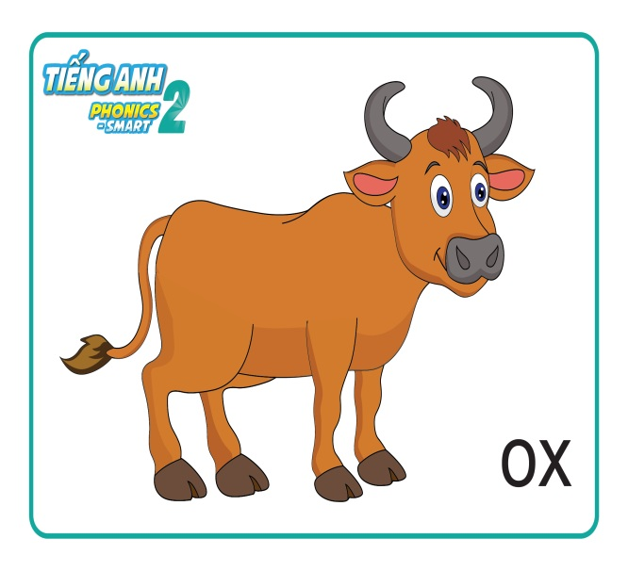
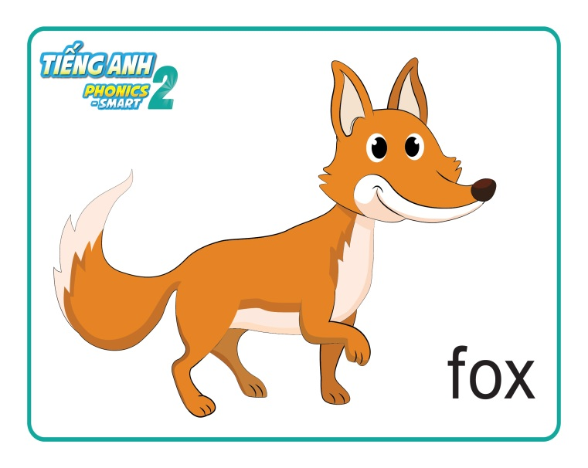
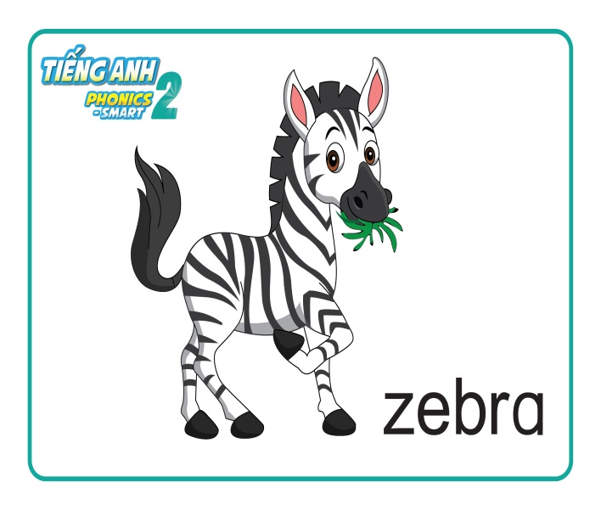
REVIEW 4
A. Listen and circle.
5. The ______ has got four legs.
a
b
c
Notes:
Teacher corrects the answers: “Three. Listen!” “So, what is the colour of the cow?”. “Great. Brown. Circle b.”

Slide 9
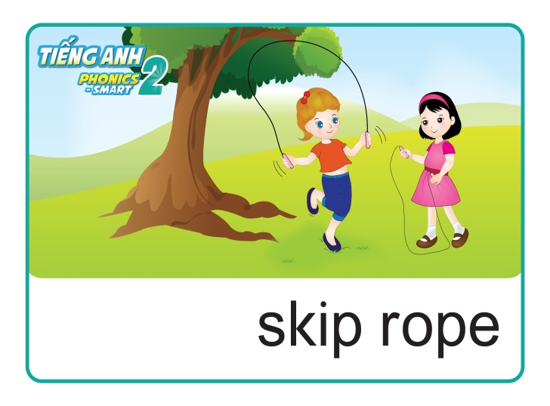
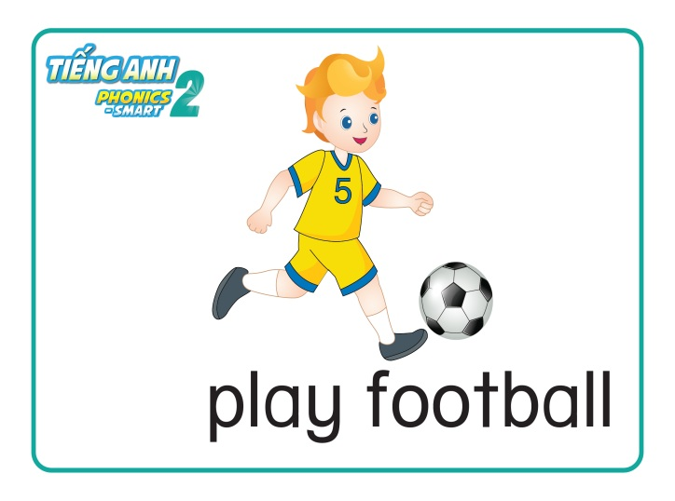
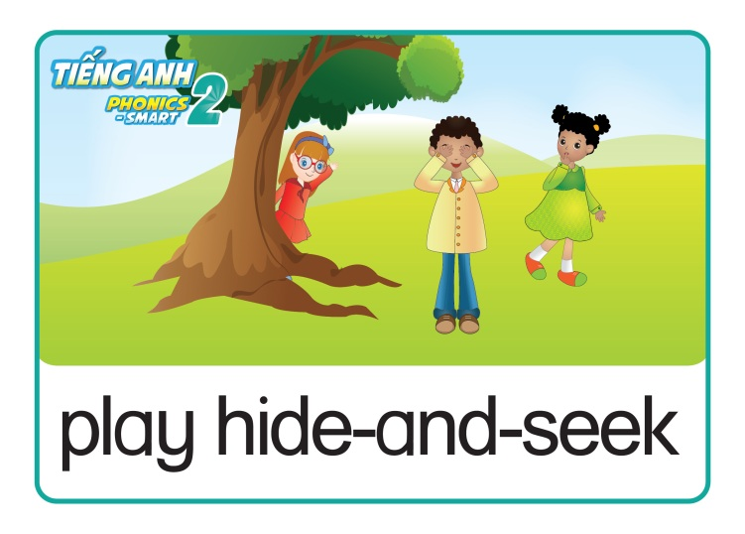
REVIEW 4
A. Listen and circle.
6. Let’s _____________.
a
b
c
Notes:
Teacher corrects the answers: “Three. Listen!” “So, what is the colour of the cow?”. “Great. Brown. Circle b.”

Slide 10
REVIEW 4
A. Listen and circle.
Let’s correct!
Notes:
Teacher corrects the answers: “Three. Listen!” “So, what is the colour of the cow?”. “Great. Brown. Circle b.”

Slide 11
REVIEW 4
A. Listen and circle.
Let’s correct!
1. There are ______________ shoes
a
b
c
Notes:
Teacher corrects the answers: “Let’s correct. Now, look at the screen. One. You listen.” “So, what number is it?”. “Well done. It is an eleven. Circle b.”

Slide 12
REVIEW 4
A. Listen and circle.
Let’s correct!
2. This is my _____________
c
a
b
Notes:
Teacher corrects the answers: “Two. Listen!” “So, who is it”. “Good job. grandma. Circle c.”

Slide 13
REVIEW 4
A. Listen and circle.
Let’s correct!
3. I’d like a new ____________
c
a
b
Notes:
Teacher corrects the answers: “Three. Listen!” “So, what is it”. “Great. Guitar. Circle a.”

Slide 14
REVIEW 4
A. Listen and circle.
Let’s correct!
4. The lamps are _____ the table
a
b
c
Notes:
Teacher corrects the answers: “Three. Listen!” “So, what is the colour of the cow?”. “Great. Brown. Circle b.”

Slide 15
REVIEW 4
A. Listen and circle.
Let’s correct!
5. The ______ has got four legs.
a
b
c
Notes:
Teacher corrects the answers: “Three. Listen!” “So, what is the colour of the cow?”. “Great. Brown. Circle b.”

Slide 16
REVIEW 4
A. Listen and circle.
Let’s correct!
6. Let’s _____________.
a
b
c
Notes:
Teacher corrects the answers: “Three. Listen!” “So, what is the colour of the cow?”. “Great. Brown. Circle b.”

Slide 17

REVIEW 4
A. Listen and circle.
Notes:
Teacher gives praises: “Well done. Now, we move to part B.”

Slide 18

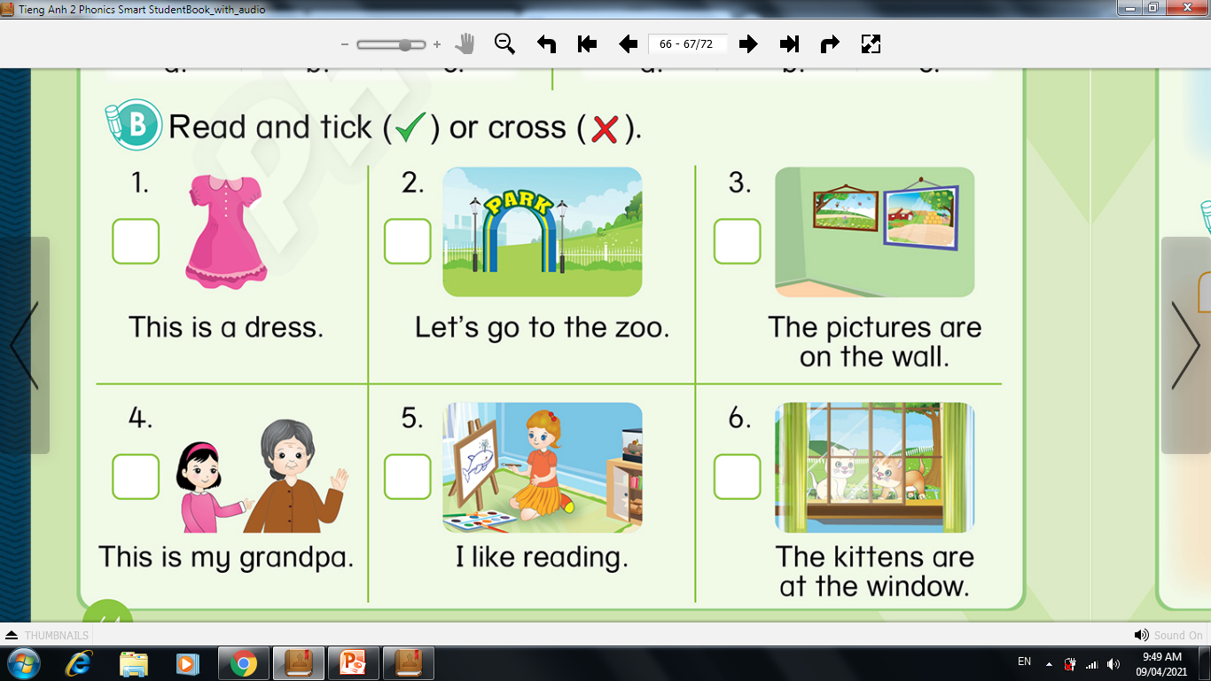
REVIEW 4
B. Read and tick (✓) or cross (✗).
64
LOOK
AT
YOUR
BOOK!
Notes:
Teacher asks students to look at the book: “Look at your book, page 64. Part B. Can you see the pictures? Good.”
Teacher gives instructions and asks them to do the task: “Now you read, tick or cross in 3 minutes.”

Slide 19
REVIEW 4
B. Read and tick (✓) or cross (✗).
Let’s correct!
✓
Notes:
Teacher corrects the answers: “Now it’s time to correct. Look at the screen. One. It is a dress. Tick or cross?”. “Well done. It is a tick. So tick it.”

Slide 20
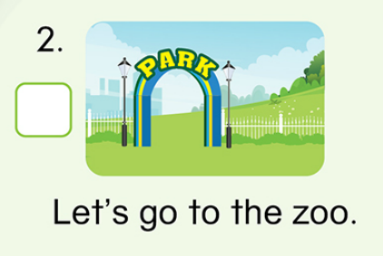
REVIEW 4
B. Read and tick (✓) or cross (✗).
Let’s correct!
✗
Notes:
Tương tự GV hướng dẫn HS ở các câu còn lại.

Slide 21
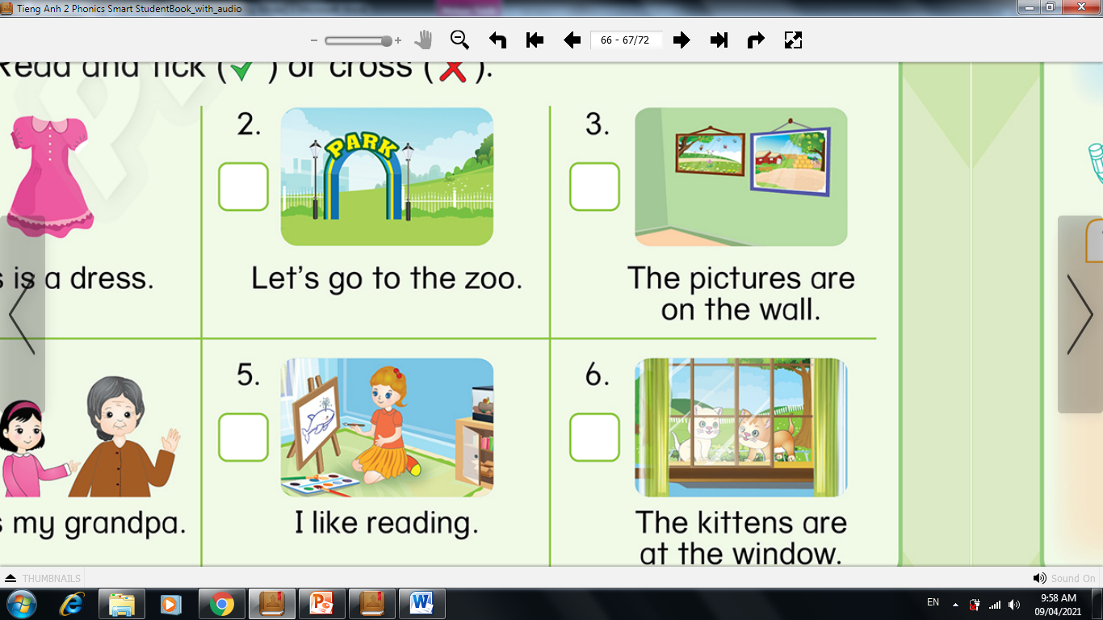
REVIEW 4
B. Read and tick (✓) or cross (✗).
Let’s correct!
✓

Slide 22
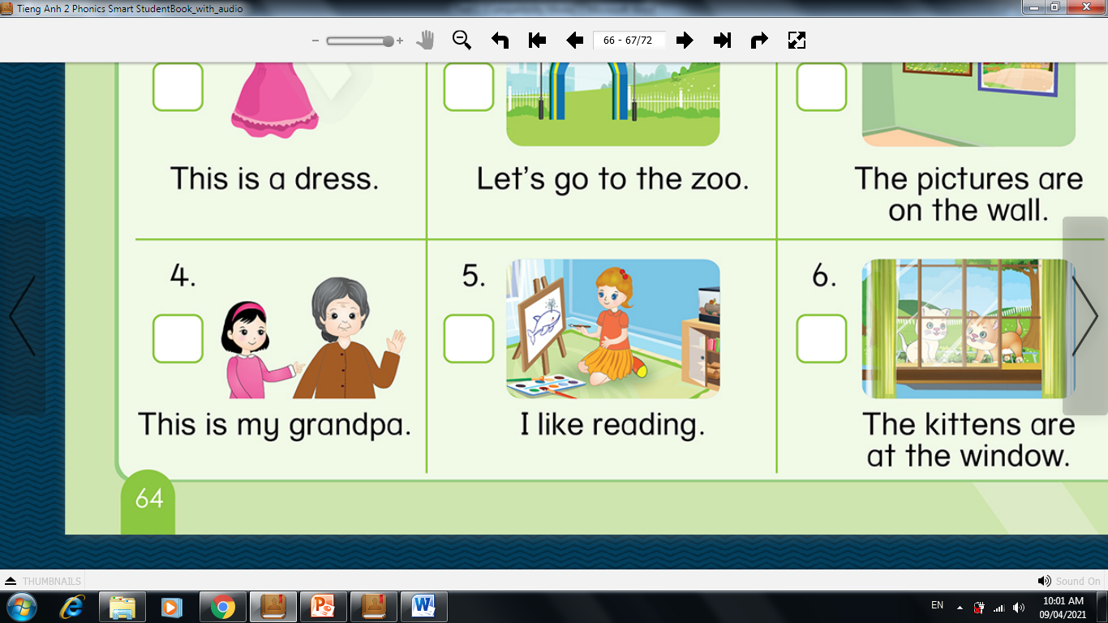
REVIEW 4
B. Read and tick (✓) or cross (✗).
Let’s correct!
✗

Slide 23
REVIEW 4
B. Read and tick (✓) or cross (✗).
Let’s correct!
✗

Slide 24
REVIEW 4
B. Read and tick (✓) or cross (✗).
Let’s correct!
✓

Slide 25
REVIEW 4
B. Read and tick (✓) or cross (✗).
64
LOOK
AT
YOUR
BOOK!
✓
✗
✓
✗
✗
✓
Notes:
Teacher asks students to look at the book: “Look at your book, page 64. Part B. “ And check again your answer.

Slide 26
REVIEW 2
B. Read and tick (✓) or cross (✗).
Notes:
Teacher gives praises: “Well done class. Now, let’s play game”

Slide 27


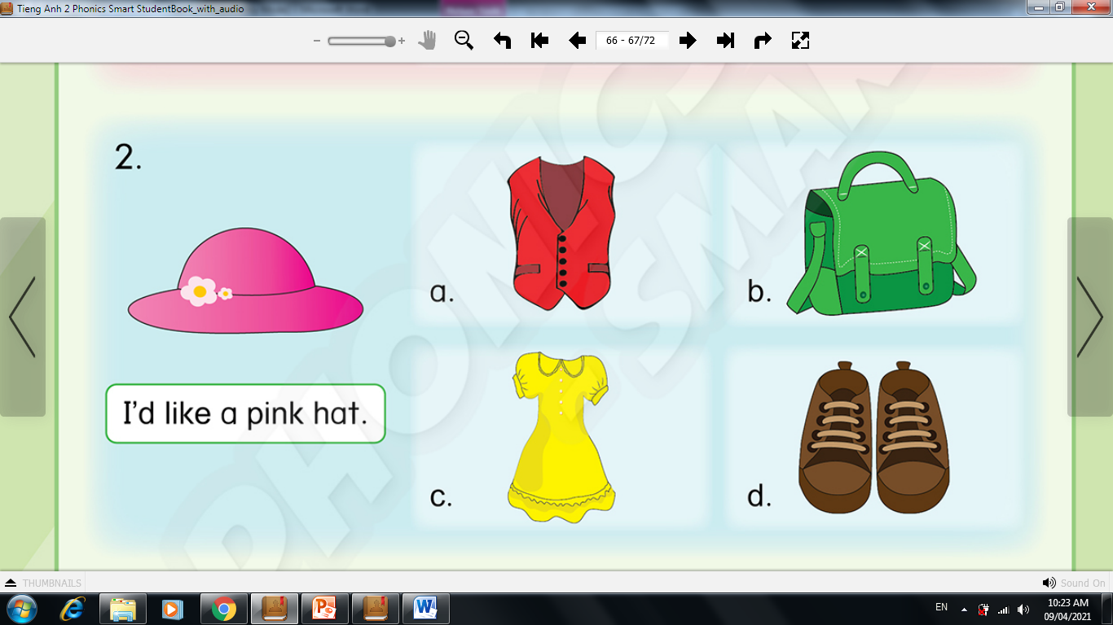
Game: Can you guess?
What colour is it?
Remove Box
Yellow.
Next Slide
Notes:
Teacher gives instructions: “I will remove the box one by one, and you guess what it is. OK?”. “Good”
Teacher may say: “What is it? Do you know it? Guess.”
After the picture is shown, teacher asks: “So what colour ?, class?”. “yellow. Great.”. “Let’s meet another friend.”

Slide 28
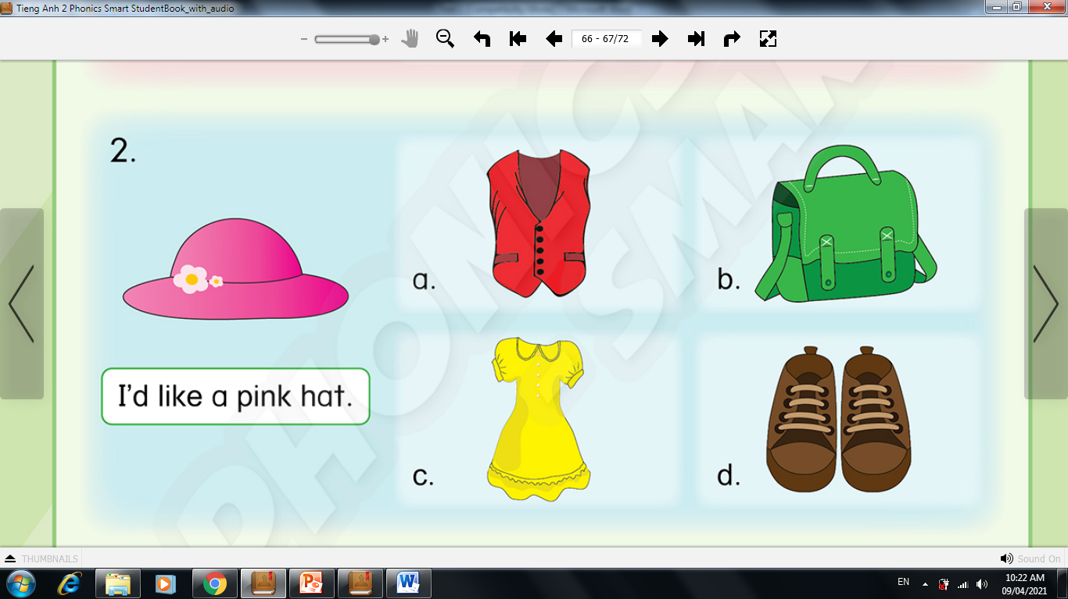
Game: Can you guess?
What
is it?
Remove Box
It is a vest.
Next Slide
Notes:
Tương tự phần ví dụ GV cho HS lần lượt tiếp tục trò chơi và ghi điểm cho các đội.

Slide 29
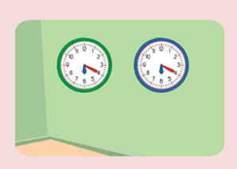
Game: Can you guess?
Where are the clocks?
Remove Box
The clocks are on the wall.
Next Slide

Slide 30
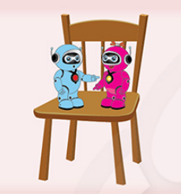
Game: Can you guess?
Where are the robot?
Remove Box
The robots are on the chair.
Next Slide

Slide 31
Notes:
Teacher gives praises, and asks students to write the words in their book: “Well done class”

Slide 32

REVIEW 1
Notes:
Teacher says Goodbye. – “It’s time to say Goodbye. Goodbye, and see you.”

