Slide 1


My pets Lesson 2 – Activity 4-6
16

Slide 2
1
2
3
Warm-up and review
4
5
Fun corner and wrap-up
Listen and number.
Look, complete and read.
Let’s play.

Slide 3
1
Warm-up and review

Slide 4
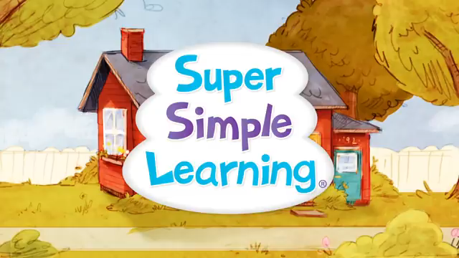
Let’s sing together!
Notes:
https://www.youtube.com/watch?v=pWepfJ-8XU0

Slide 5
2
Listen and number.

Slide 6

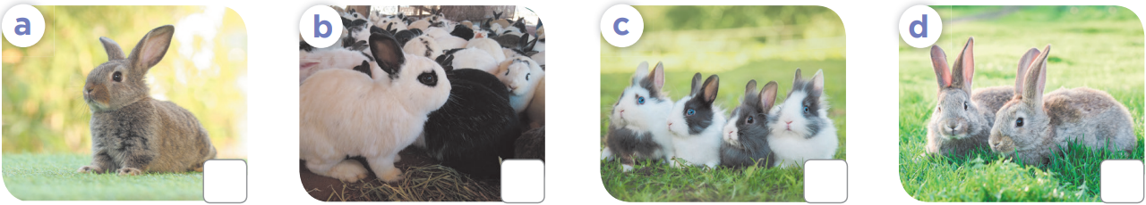
4
1
2
3

Slide 7
3
Look, complete and read.

Slide 8

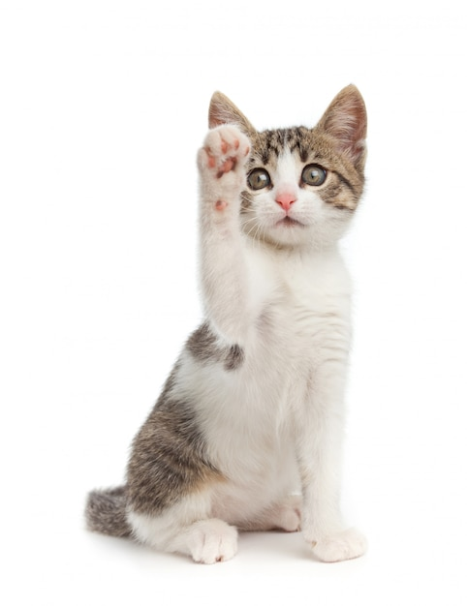






How many ………..do you have?
cat
a cat
cats

Slide 9
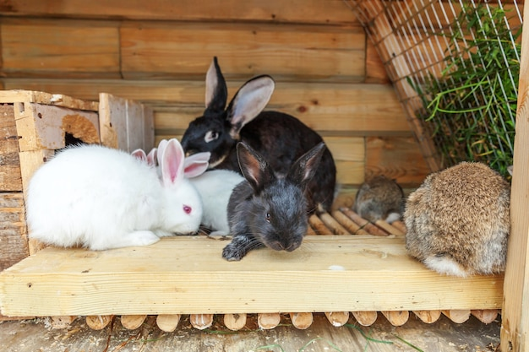
……………… many rabbits do you have?
How
What
Who

Slide 10
How many cats do you have?
I have one cat.
I have some cats.
I have many cats.

Slide 11
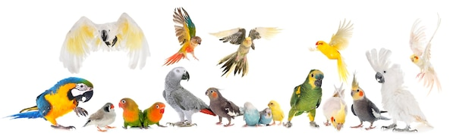
How many parrots do you have?
I have one parrot.
I have some parrots.
I have many parrots.

Slide 12
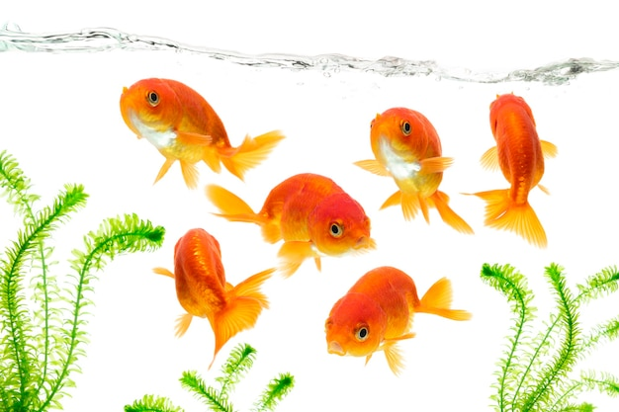
How many fish do you have?
I have one fish.
I have some fish.
I have many fish.

Slide 13
Open your book!

Slide 14
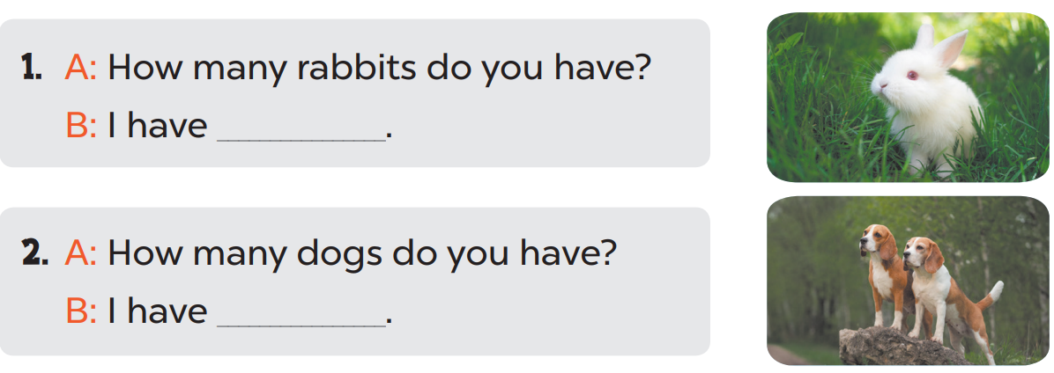
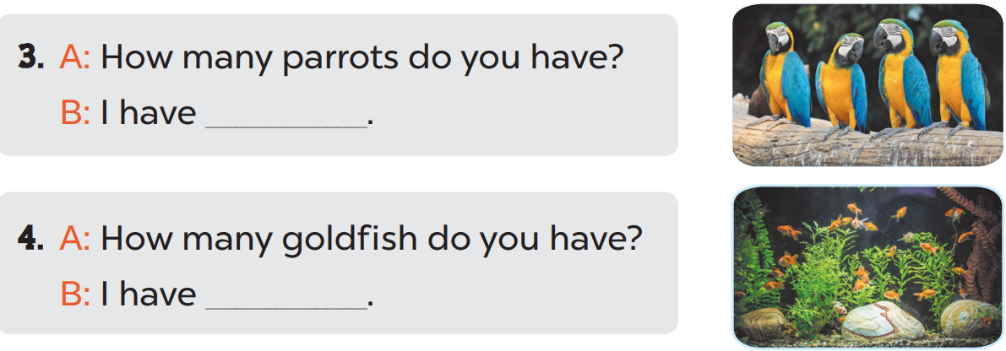
one rabbit.
two dogs.
some parrots.
many goldfish.

Slide 15
4
Let’s play.

Slide 16
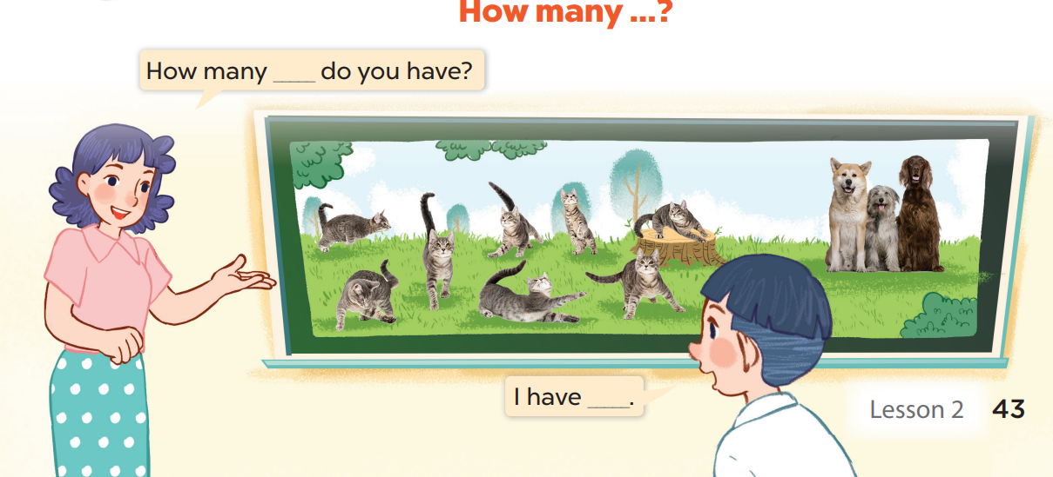

Slide 17
5
Fun corner and wrap-up

Slide 18


5
10
1
7
8
SPIN
-5
3
9
-3
4
6
2
tekhnologic
Notes:
Divide the class into teams.
Teacher calls one pupil to answer the question. (Gọi 2 hs từ mỗi đội lên hỏi và trả lời theo mẫu trong bài)
Pupils/ teacher click on the “spin” button to get points.

