Slide 1



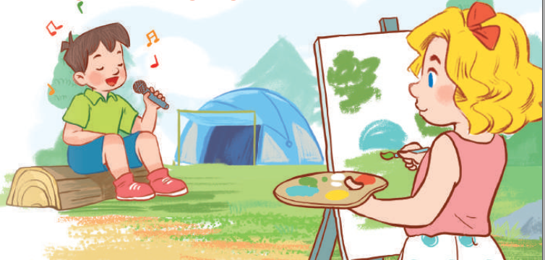
19
Outdoor activities
LESSON 3 – PERIOD 6

Slide 2


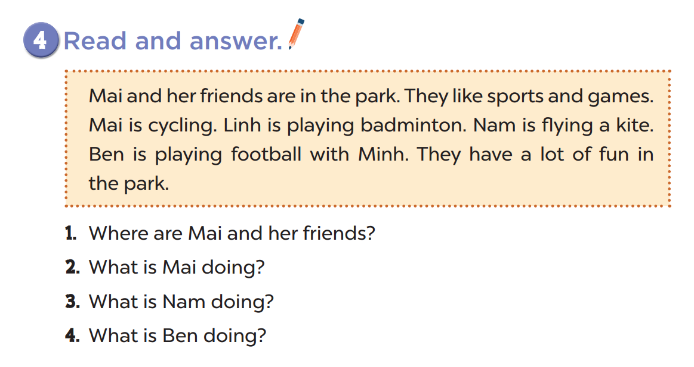
They’re in the park.
She’s cycling.
He’s flying a kite.
He’s playing football.

Slide 3
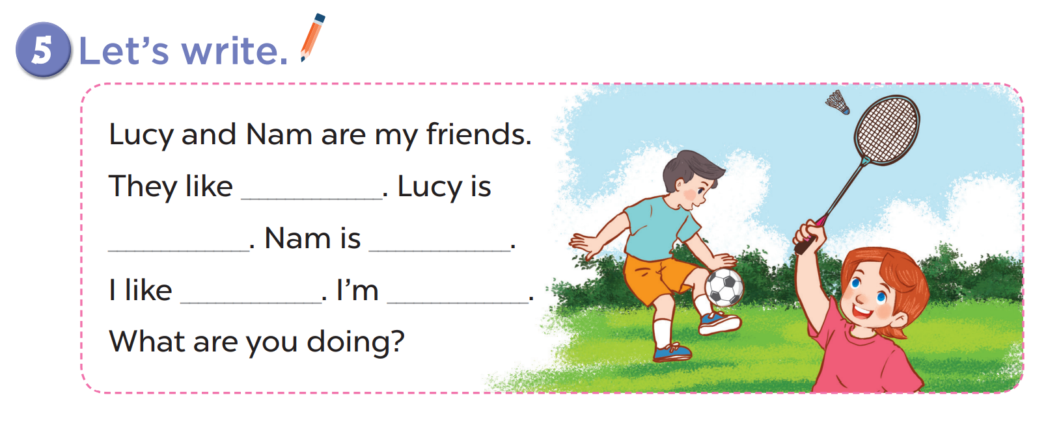

Slide 4
