Slide 1



Slide 2

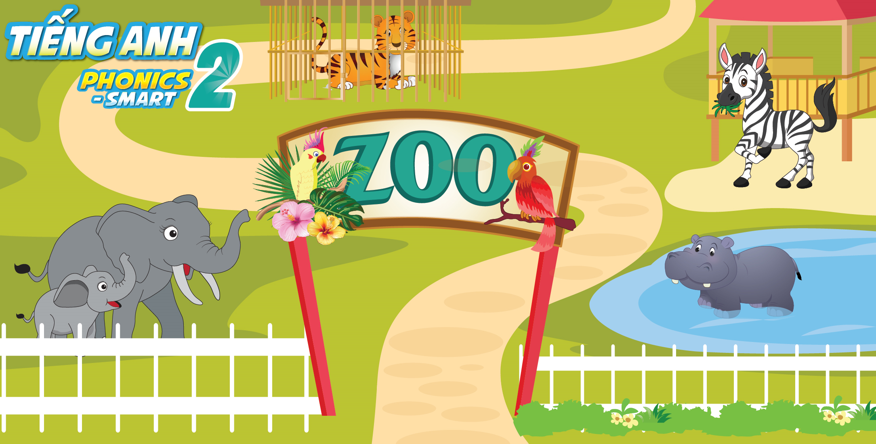
Unit 13
Lesson 3

Slide 3
Dot to Dot Game
3
2
4
1
5
6
7
10
8
9
Notes:
Teacher can

Slide 4


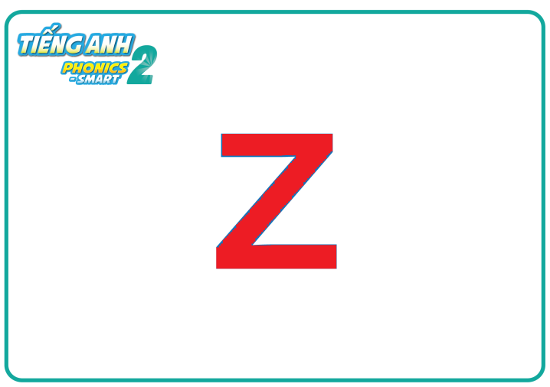


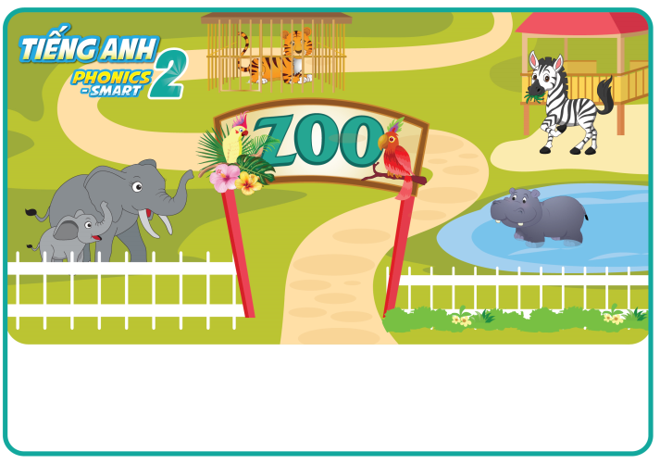
Unit 13:
Lesson 3
Revision

Slide 5

Unit 13:
Lesson 3
1. Trace the letters.
1
2
1
2
3
3
Notes:
Teacher instructs students steps to write the letter.

Slide 6




Unit 13:
Lesson 3
1. Trace the letters.
Let’s write in the air
Let’s write in the palm
Z
z
z
Z

Slide 7
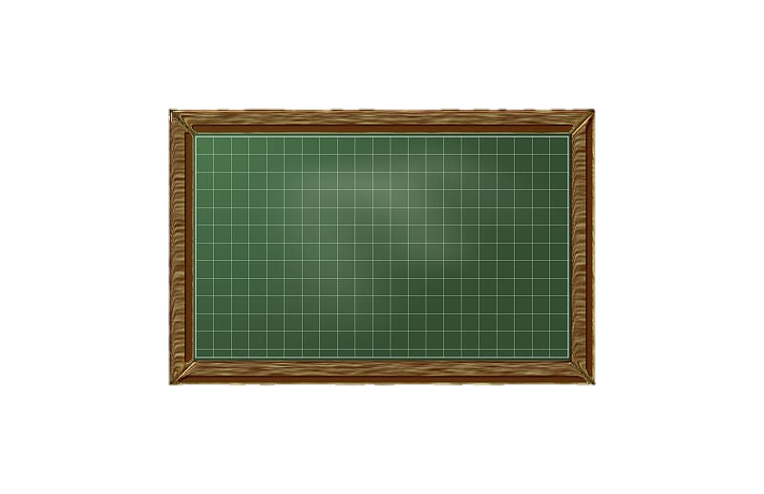
Unit 13:
Lesson 3
1. Trace the letters.
Z
z
Let’s write
z
Z

Slide 8


Unit 13:
Lesson 3
1. Trace the letters.
Z
Z
zebra
zoo
Notes:
Hướng dẫn học sinh tô chữ trong sách

Slide 9






Unit 13:
Lesson 3
2. Look, write and say.
Tim | ✓
Rita |  |  | ✓
Ha Linh |  | ✓
Tommy |  |  |  | ✓
I like ……………………...
running
a

Slide 10





Unit 13:
Lesson 3
2. Look, write and say.
Tim | ✓
Rita |  |  | ✓
Ha Linh |  | ✓
Tommy |  |  |  | ✓
skipping rope
I like ……………………............
b
I like ……………………………...
watching zebra
c
swimming
I like ……………………...........
d

Slide 11

Read and choose
A: watching zebras
B: running
C: singing
D: skipping rope

Slide 12

A: playing football
B: reading
C: drawing
D: watching zebras

Slide 13

A: watching zebras
B: swimming
C: singing
D:reading

Slide 14



Unit 13:
Lesson 3
1. Trace the letters.
2. Look and say.
I like ……….

