Slide 1
Review 4
Activity 1 - 2

Slide 2
Table of contents
01
02
04
03
Warm-up and review
Listen and tick.
Fun corner and wrap-up
Ask and answer.

Slide 3
01
Warm-up
Sing a song

Slide 4

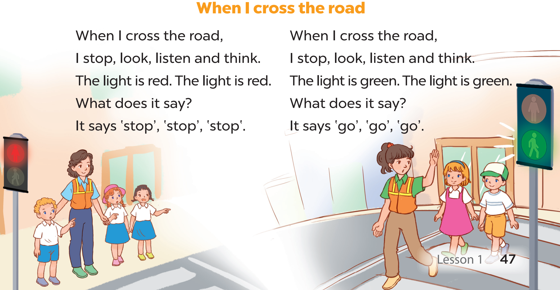
Notes:
Animation video: https://www.youtube.com/watch?v=Wow9ZiM6_gA&list=PL8_ETpRL2xNay3h-a-vBjWhplE1wXFpSJ&index=35

Slide 5
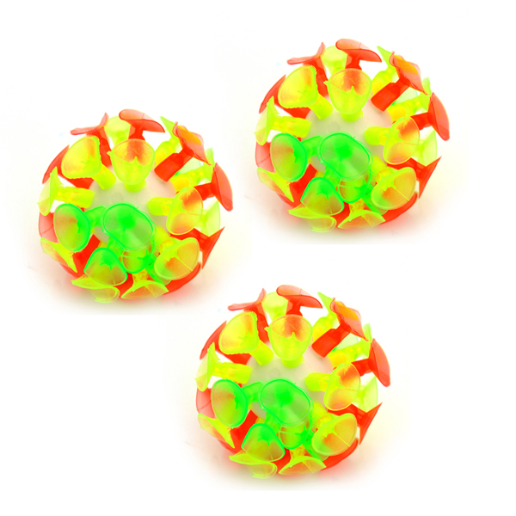
Choose and throw
Notes:
Pupils throw sticky ball at the answer.
Teacher marks the place where they throw at.
Teacher reveals the score.

Slide 6


- What was the weather like?
– It’s……… .
A. rainy
B. sunny
10
5
3

Slide 7
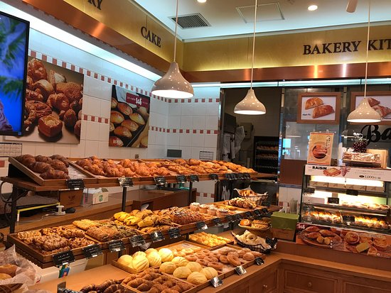
- Do you want to go to the __?
– Great. Let’s go!
A. bookshop
B. bakery
10
5
3
1

Slide 8
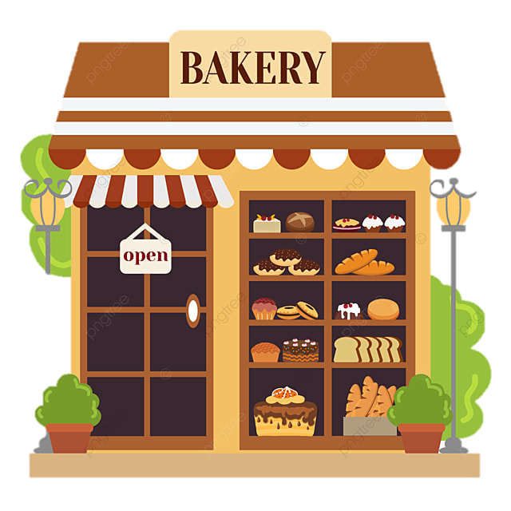
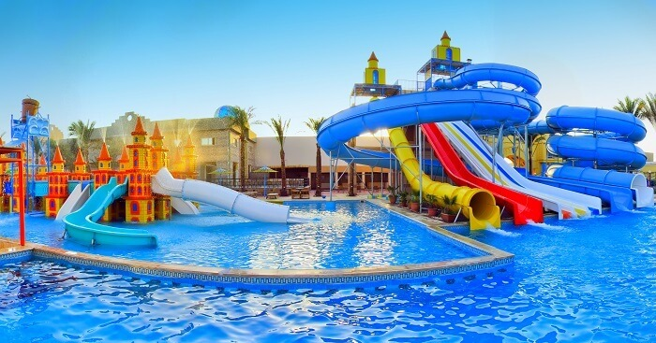
- Where is the bakery?
- It’s ___ the water park.
A. behind
B. near
10
5
3

Slide 9
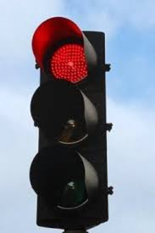
- What does it say?
- It says ‘____’.
A. stop
B. go
10
5
3

Slide 10
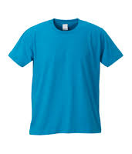

- How much is the T-shirt?
- It’s ___ thousand dong.
50.000đ
A. fivety
B. fifty
10
5
3

Slide 11
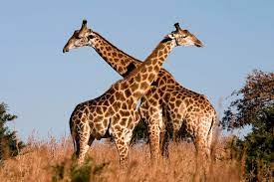
- What are these animals?
- They’re ____.
A. giraffes
B. hippos
10
5
3

Slide 12
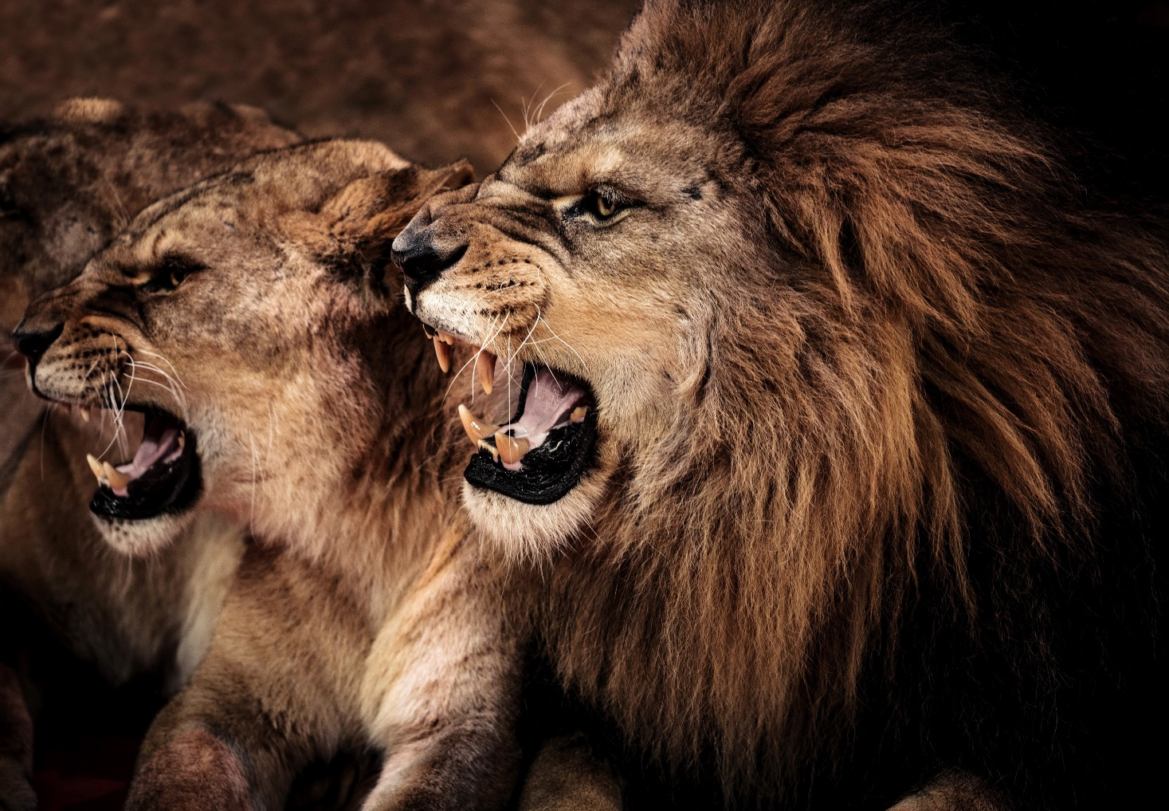
- Why do you like lions?
- Because they ____ loudly.
A. roar
B. dance
10
5
3

Slide 13
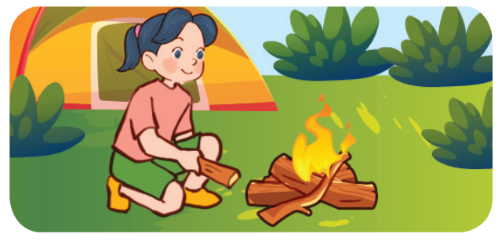
- What’s she doing?
- She’s building a ___.
A. tent
B. campsite
10
5
3

Slide 14
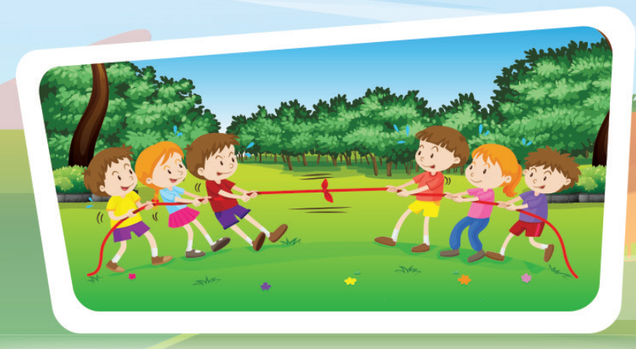
- What are they doing?
- They’re playing ___.
A. card games
B. tug of war
10
5
3
1

Slide 15
Well done!

Slide 16
02
Listen and tick.

Slide 17
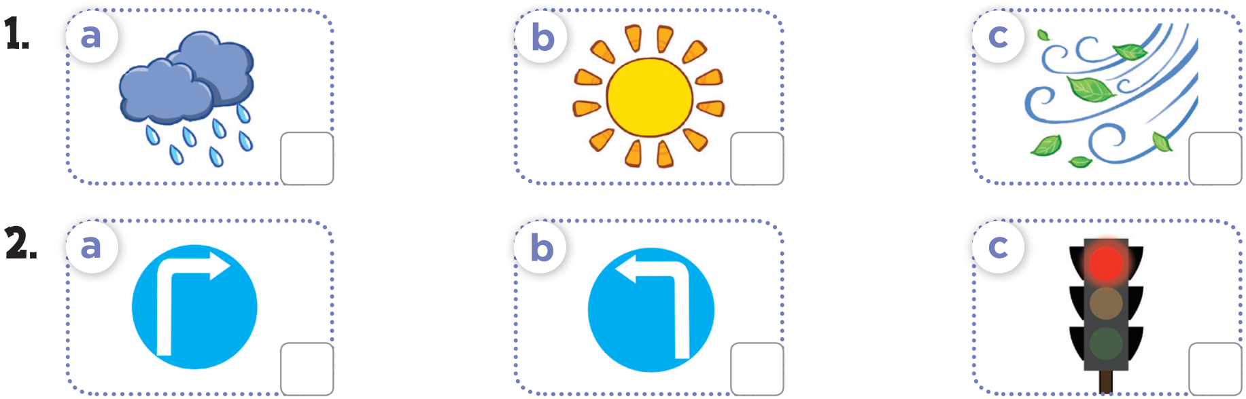
✓
✓

Slide 18
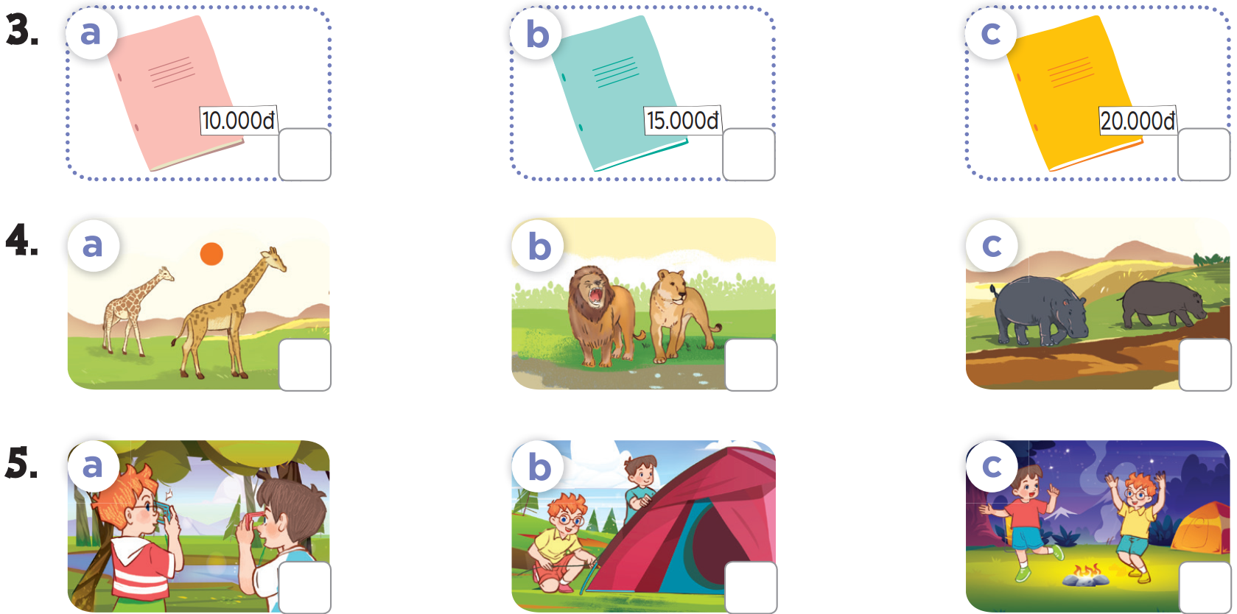
✓
✓
✓

Slide 19
Ask and answer.
04

Slide 20
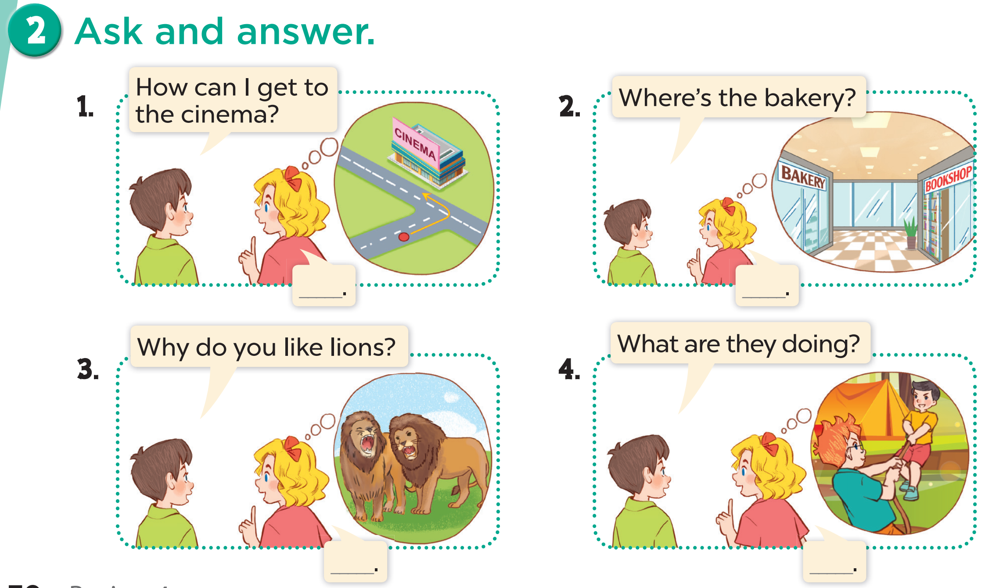

Slide 21
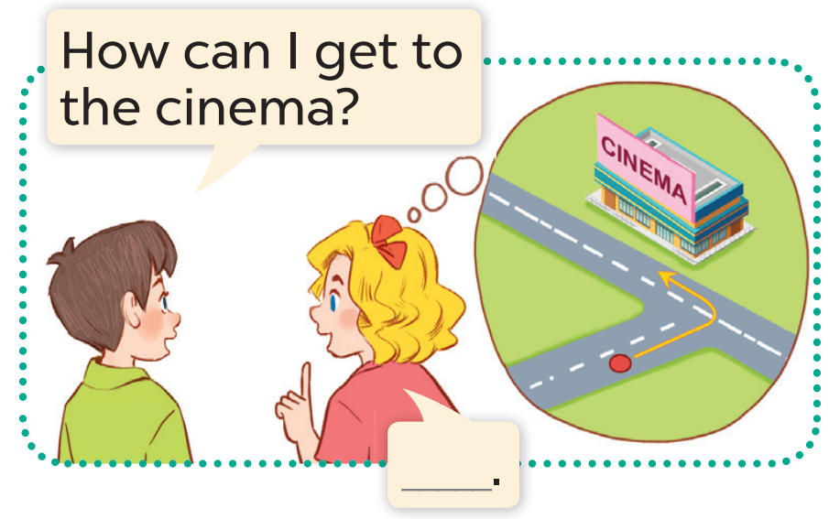
Turn left.

Slide 22
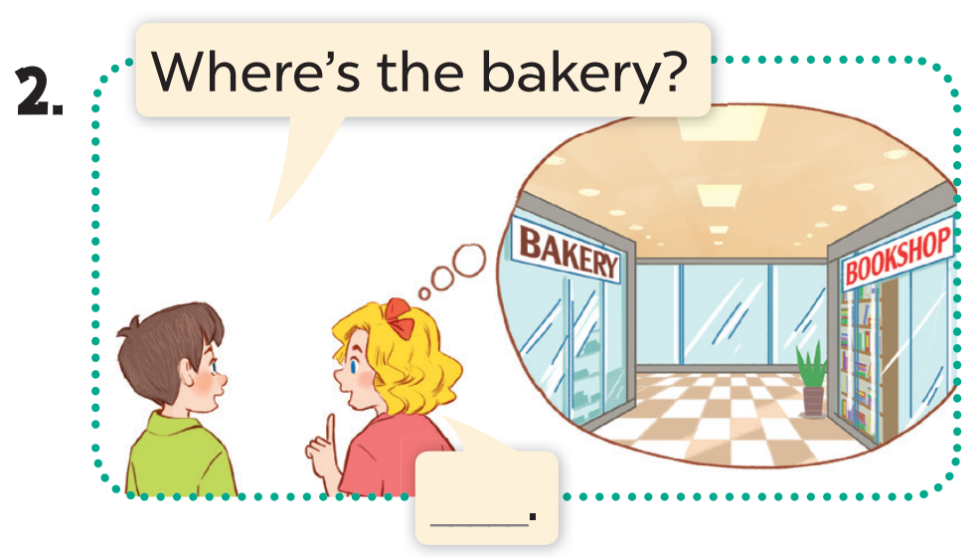
It’s opposite the bookshop.

Slide 23
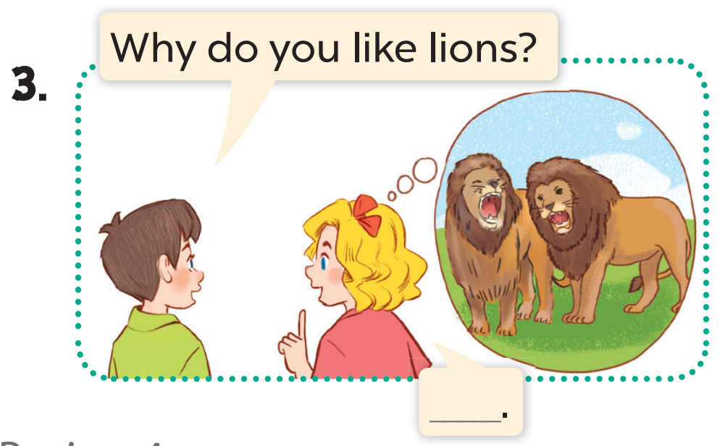
Because they roar loudly.

Slide 24
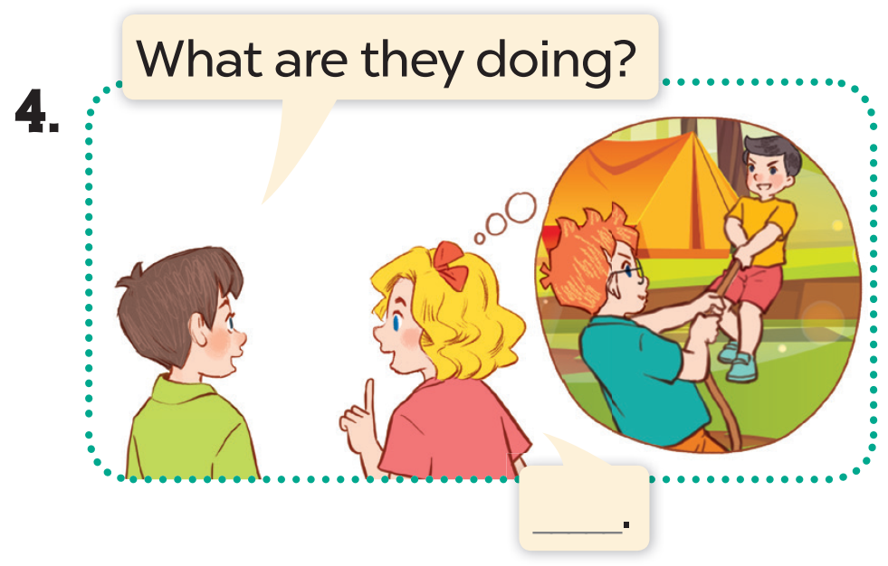
They’re playing tug of war.

Slide 25
05
Fun corner

Slide 26
REVIEW GAME

Slide 27

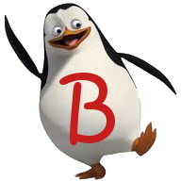

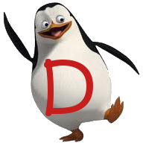
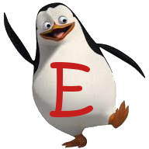
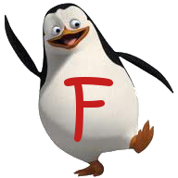

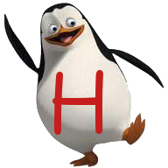
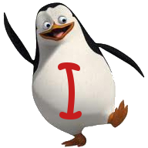
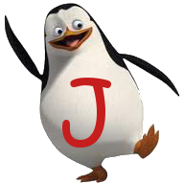
END
Notes:
Students choose 1 letter from A-J and answer the question.
They may take 1- 10 points, lose point or steal points from other teams.

Slide 28

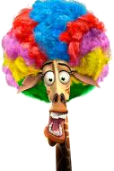
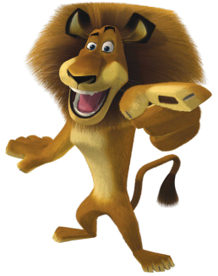
What was the weather like last weekend?
It was sunny.

Slide 29






1 point

Slide 30
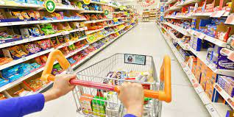
PUT IN ORDER
Do/ go/ to/ me/ the supermarket/ want/ you/ with/ to /?/
Do you want to go to the supermarket with me?

Slide 31
6 points

Slide 32
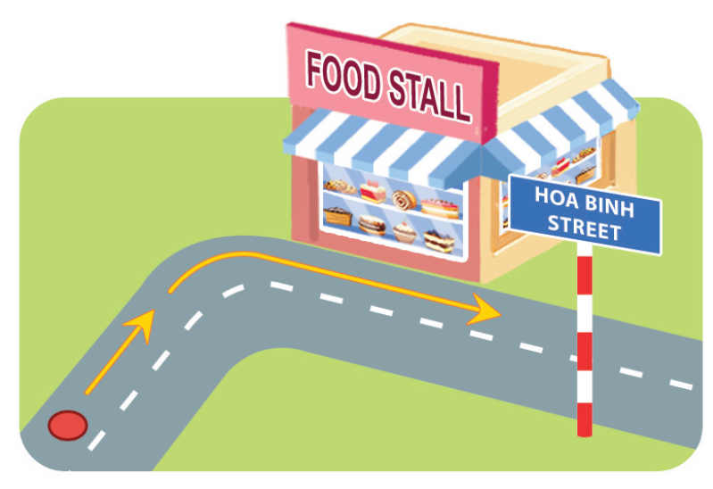
CORRECT THE MISTAKE
- How can I get to the food stall?
- Go straight and turn left.
right

Slide 33
2 points

Slide 34
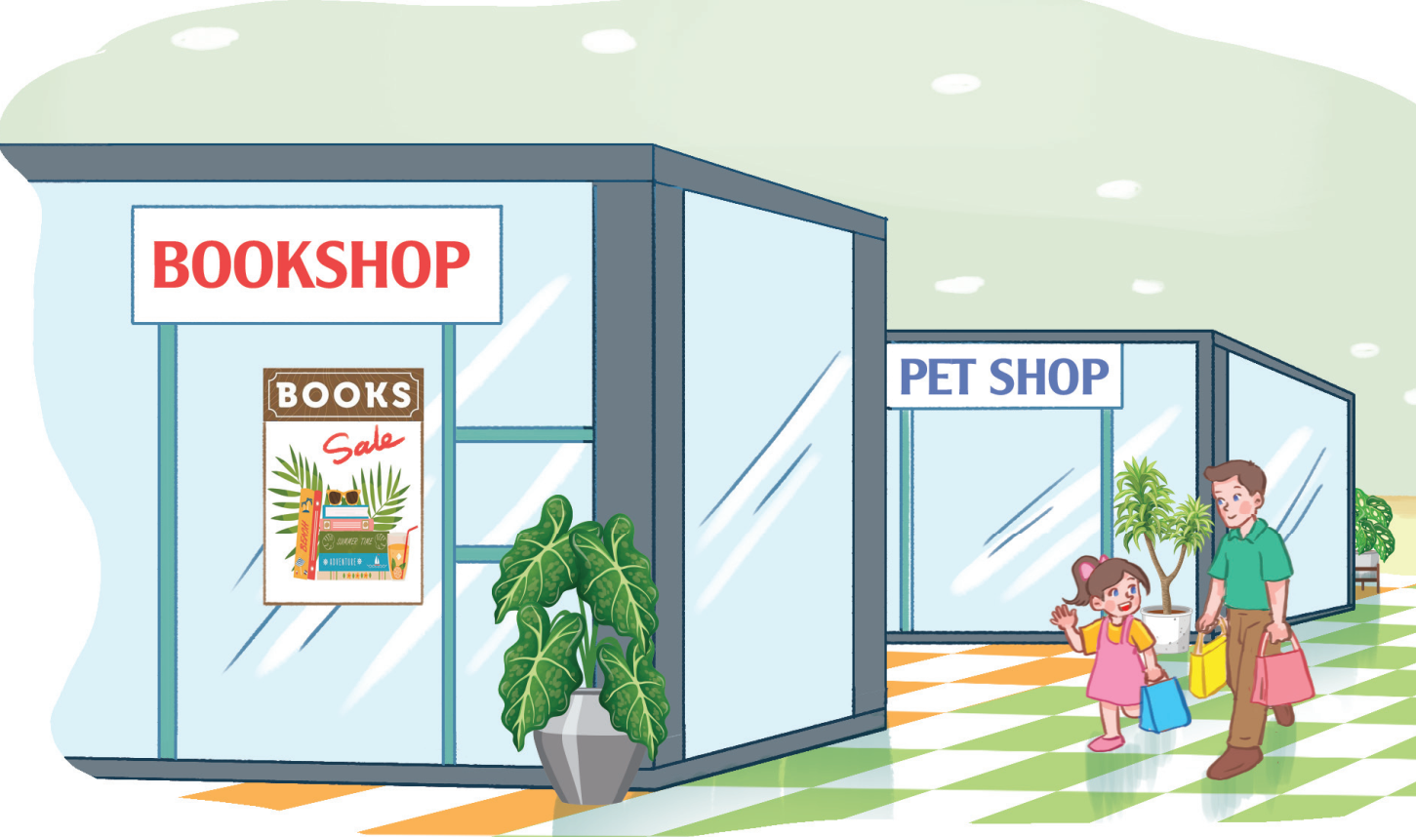
PUT IN ORDER
The/ is/ pet shop/ the/ behind/ book shop/./
The pet shop is behind the book shop.

Slide 35



Pick a crate!

Slide 36
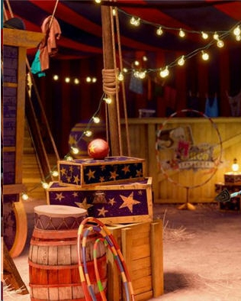
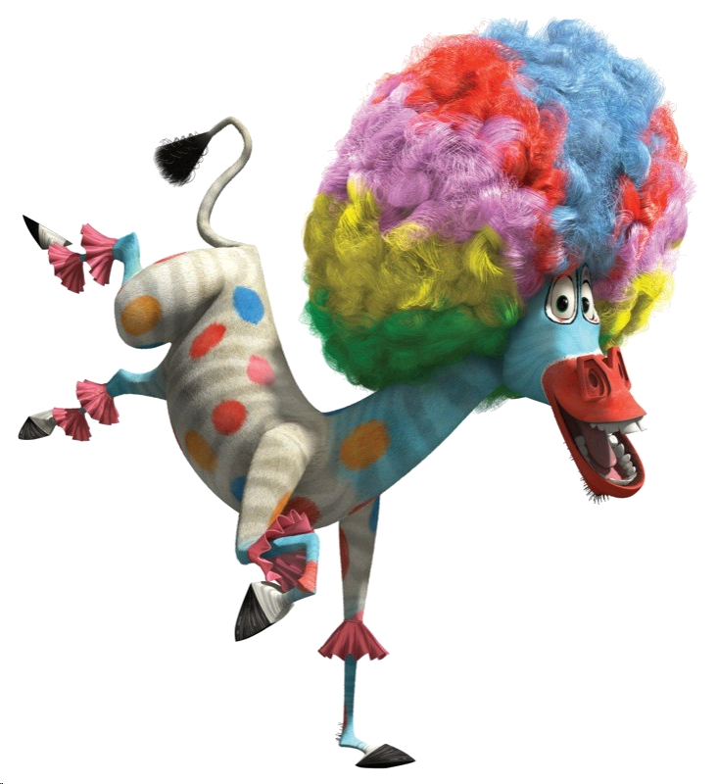
add 10 points

Slide 37
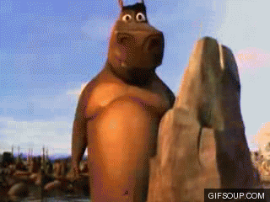

Steal 3 points.

Slide 38
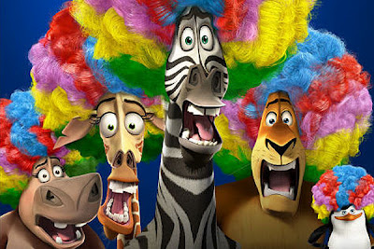
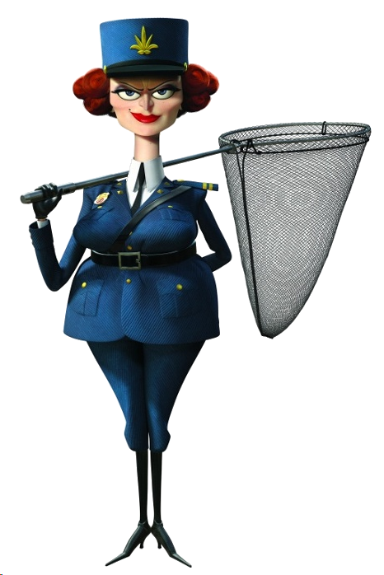
Everyone lose 5 points

Slide 39

What does it say?
It says ‘turn right’.

Slide 40
5 points

Slide 41
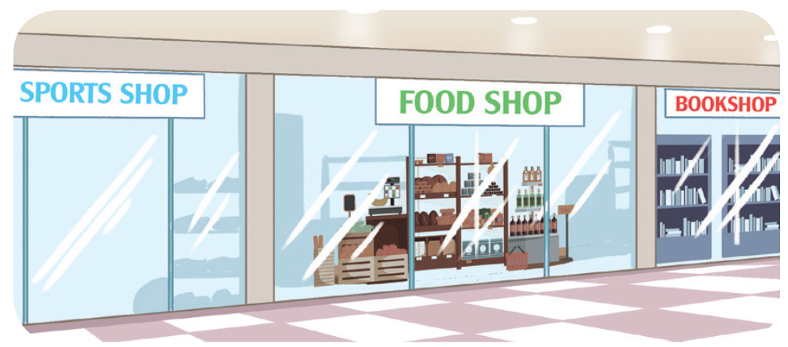
READ AND CHOOSE
The food shop is ___the sports shop and the bookshop.
opposite
between

Slide 42
Pick a crate!

Slide 43
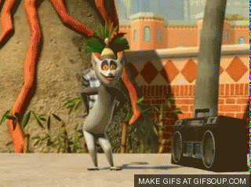
9 points
You like to move it!

Slide 44
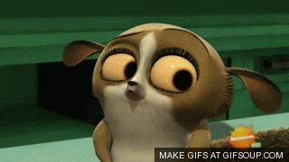
Lose 2 points.

Slide 45
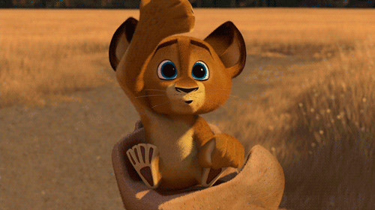
Steal 3 points.

Slide 46
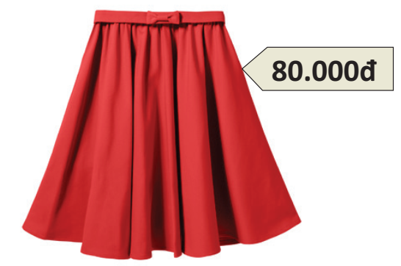
READ AND CHOOSE
How ____ is the skirt?
many
much

Slide 47
4 points

Slide 48
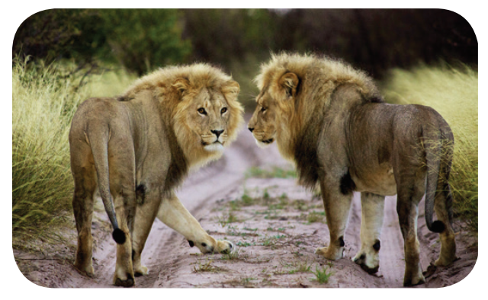
CORRECT THE MISTAKES
- What animals are these?
- They’re tigers.
lions

Slide 49
Pick a crate!

Slide 50
Lose 3 points.

Slide 51
Steal 3 points.

Slide 52
You like to move it!
8 points

Slide 53
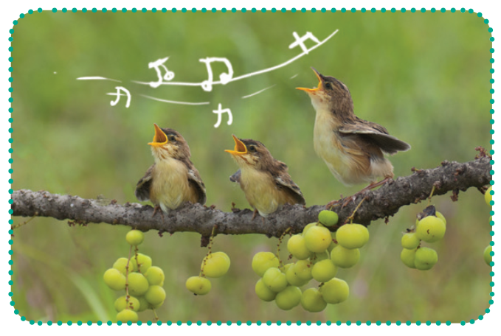
Why do you like birds?
Because they sing merrily.

Slide 54
5 points

Slide 55
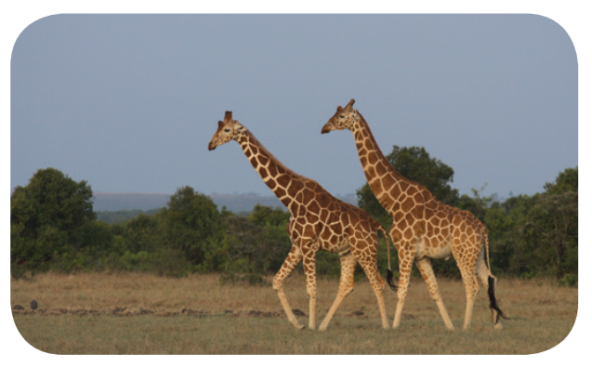
What animals are these?
They’re giraffes.

Slide 56
Pick a crate!

Slide 57
Lose 2 points.

Slide 58
You like to move it!
10 points

Slide 59
Steal 3 points.

