Slide 2
Review 4
Period 2

Slide 3
Warm-up and Review
01
Racing game

Slide 4
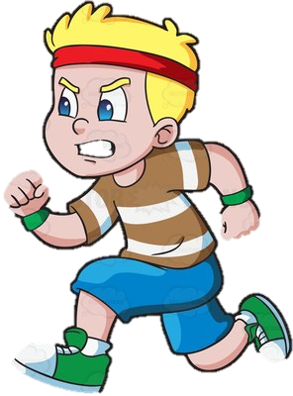

1
3
5
7
2
4
8
6
A
B
NEXT
Notes:
If team A gives the right answer, click circle A so that the boy can move.
If team B gives the right answer, click circle B so that the girl can move.

Slide 5



How’s the weather
in Hai Duong in summer?
It’s sunny and hot.
Notes:
Click picture to move back

Slide 6

What do you usually wear in winter?
I wear ___.
Notes:
Click picture to move back

Slide 7
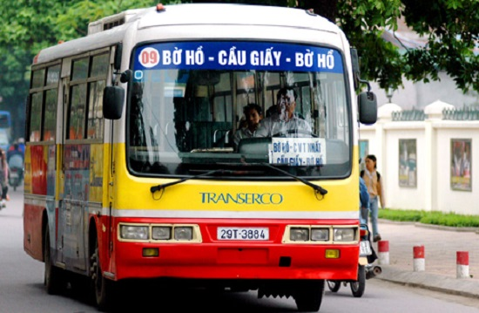
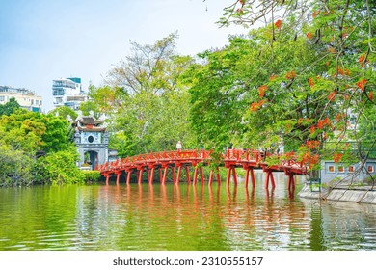
How can I go to Hoan Kiem Lake?
You can get there by bus.
Notes:
Click picture to move back

Slide 8
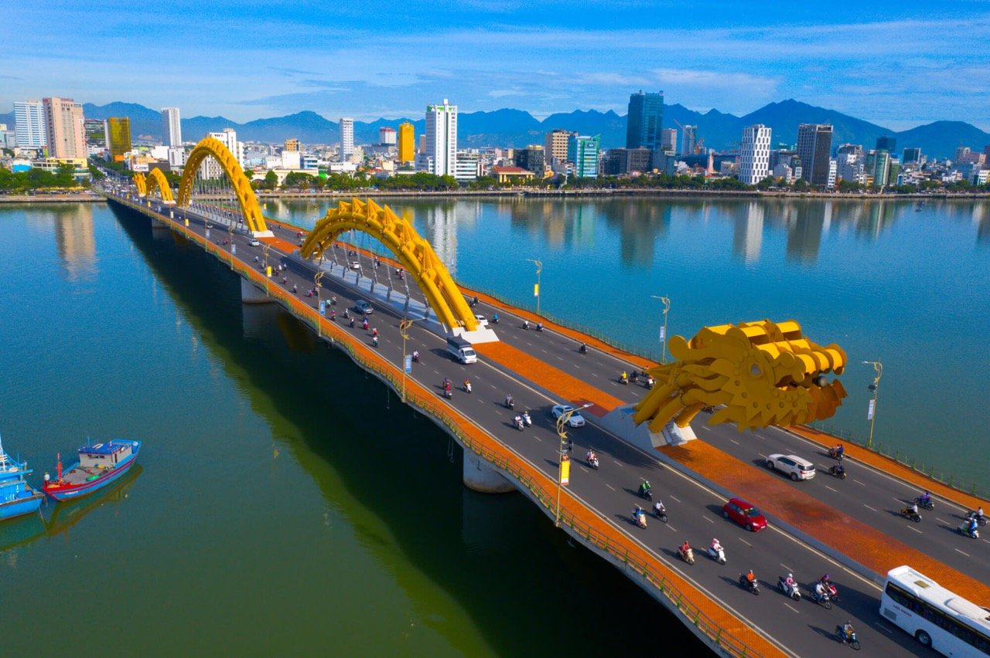
Where do you want to visit?
I want to visit Dragon bridge.
Notes:
Click picture to move back

Slide 9
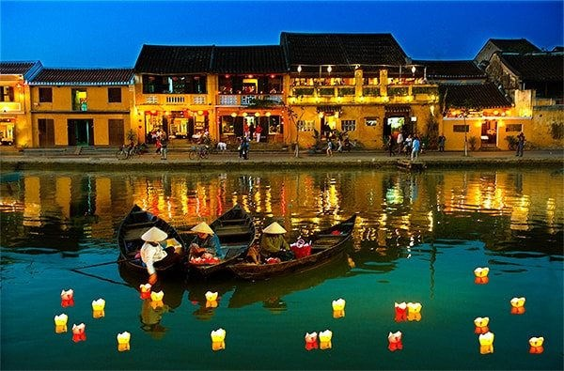
What do you think of Hoi An Old Town?
I think it’s ____.
Notes:
Click picture to move back

Slide 10
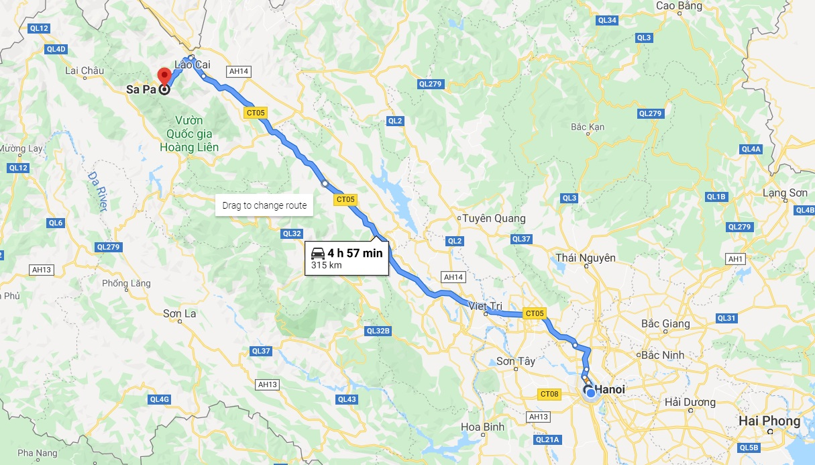
How far is it from Ha Noi to Sa Pa?
SA PA
315 km
HA NOI
It’s about 315 kilometres.
Notes:
Click picture to move back

Slide 11

Where are you going to visit this summer?
I’m going to visit Phu Quoc island.
Notes:
Click picture to move back

Slide 12

What are you going to do this summer?
I’m going to go camping.
Notes:
Click picture to move back

Slide 13
02
Read and match.

Slide 14
1. What do you usually wear
in autumn?
a. I think it’s fantastic.
b. I want to visit Dragon
Bridge.
2. Who are the main characters
in the story?
c. I’m going to practise
swimming.
3. Where do you want to visit?
4. What do you think of
Ha Long Bay?
d. I wear jeans and a
T-shirt.
5. What are you going to do
this summer?
e. They’re Snow White
and the seven dwarfs.

Slide 15
Look and read.
1. What do you usually wear in autumn?
d. I wear jeans and a T-shirt.

Slide 16
Look and read.
2. Who are the main characters in the story?
e. They’re Snow White and the seven dwarfs.

Slide 17
Look and read.
3. Where do you want to visit?
b. I want to visit Dragon Bridge.

Slide 18
Look and read.
4. What do you think of Ha Long Bay?
a. I think it’s fantastic.

Slide 19
Look and read.
5. What are you going to do this summer?
c. I’m going to practise swimming.

Slide 20
03
Read and circle.

Slide 21
Read the text.
This summer, Tom is going to visit Phu Quoc for a holiday. It is about three hundred and ninety kilometres from Ho Chi Minh City. He is going to get to the island by car and ferry. He is going to stay in a big hotel in the centre of Phu Quoc. He is going to visit Vinpearl Safari Park. It is an interesting zoo, and he is going to take lots of photos there. He is going to take a cable car to Hon Thom Island. He is going to go shopping at the night market and buy some souvenirs. Tom thinks Phu Quoc is a fantastic place for a summer holiday.

Slide 22
This summer, Tom is going to visit Phu Quoc for a holiday. It is about three hundred and ninety kilometres from Ho Chi Minh City. He is going to get to the island by car and ferry. He is going to stay in a big hotel in the centre of Phu Quoc. He is going to visit Vinpearl Safari Park. It is an interesting zoo, and he is going to take lots of photos there. He is going to take a cable car to Hon Thom Island. He is going to go shopping at the night market and buy some souvenirs. Tom thinks Phu Quoc is a fantastic place for a summer holiday.
1. How far is it from Ho Chi Minh City to Phu Quoc?
a. About 90 km. b. About 300 km. c. About 390 km.

Slide 23
This summer, Tom is going to visit Phu Quoc for a holiday. It is about three hundred and ninety kilometres from Ho Chi Minh City. He is going to get to the island by car and ferry. He is going to stay in a big hotel in the centre of Phu Quoc. He is going to visit Vinpearl Safari Park. It is an interesting zoo, and he is going to take lots of photos there. He is going to take a cable car to Hon Thom Island. He is going to go shopping at the night market and buy some souvenirs. Tom thinks Phu Quoc is a fantastic place for a summer holiday.
2. Where is Tom going to stay?
a. In Vinpearl Safari Park. b. On Hon Thom Island. c. In a big hotel.

Slide 24
This summer, Tom is going to visit Phu Quoc for a holiday. It is about three hundred and ninety kilometres from Ho Chi Minh City. He is going to get to the island by car and ferry. He is going to stay in a big hotel in the centre of Phu Quoc. He is going to visit Vinpearl Safari Park. It is an interesting zoo, and he is going to take lots of photos there. He is going to take a cable car to Hon Thom Island. He is going to go shopping at the night market and buy some souvenirs. Tom thinks Phu Quoc is a fantastic place for a summer holiday.
3. How can he get to Hon Thom Island?
a. by plane. b. by car. c. by cable car.

Slide 25
This summer, Tom is going to visit Phu Quoc for a holiday. It is about three hundred and ninety kilometres from Ho Chi Minh City. He is going to get to the island by car and ferry. He is going to stay in a big hotel in the centre of Phu Quoc. He is going to visit Vinpearl Safari Park. It is an interesting zoo, and he is going to take lots of photos there. He is going to take a cable car to Hon Thom Island. He is going to go shopping at the night market and buy some souvenirs. Tom thinks Phu Quoc is a fantastic place for a summer holiday.
4. Where is he going to buy some souvenirs?
a. at the night market. b. In Vinpearl Safari Park.
c. on Hon Thom Island.

Slide 26
This summer, Tom is going to visit Phu Quoc for a holiday. It is about three hundred and ninety kilometres from Ho Chi Minh City. He is going to get to the island by car and ferry. He is going to stay in a big hotel in the centre of Phu Quoc. He is going to visit Vinpearl Safari Park. It is an interesting zoo, and he is going to take lots of photos there. He is going to take a cable car to Hon Thom Island. He is going to go shopping at the night market and buy some souvenirs. Tom thinks Phu Quoc is a fantastic place for a summer holiday.
5. What does he think of Phu Quoc?
a. peaceful. b. fantastic. c. exciting.

Slide 27
04
Let’s write.

Slide 28
Read the questions and underline keywords.
Write about your holiday. (about 40 words)
– Where are you going to visit on your holiday?
– How far is it?
– How can you get there?
– What are you going to do there?
– What do you think of the place?

Slide 29

Suggested answer:
I am going to visit Ba Na Hills in Da Nang this summer. I am going to get there by train. It is about eight hundred kilometres from Ha Noi. I am going to take the cable car to the centre of Ba Na Hills. I am going to walk on Golden Bridge. I am going to visit the old buildings and take photos there. I think Ba Na Hills is a beautiful place for a summer holiday.
I am going to visit Ba Na Hills in Da Nang this summer. I am going to get there by train. It is about eight hundred kilometres from Ha Noi. I am going to take the cable car to the centre of Ba Na Hills. I am going to walk on Golden Bridge. I am going to visit the buildings and take photos there. I think Ba Na Hills is a beautiful place for a summer holiday.

Slide 30
Fun corner and Wrap-up
05
Spin the wheel

Slide 31
Rule
Work in 3 teams.
Take turn to answer the question.
Spin the wheel to get points.

Slide 32





How’s the weather in Ha Noi in winter?
What do you usually wear in summer?
Where do you want to visit?
How can I get to the park?
What do you think of Ba Na Hills?
How far is it from your house
to school?
Where are you going to visit?
What are you going to do this summer?
5
1
-3
10
10
-1
4
2
TURN
Notes:
Click Turn to spin the wheel.
Click the wheel to stop.

