Slide 1













UNIT 19
Places of interest
Lesson 3-Activity 1 -3

Slide 2






行业PPT模板http://www.1ppt.com/hangye/
01
Warm-up and Review
02
Listen and repeat.
CONTENTS
03
Listen and repeat. Pay attention to the intonation.
04
Let’s chant.
05
Fun corner and Wrap-up

Slide 3







01
Warm-up and Review

Slide 4

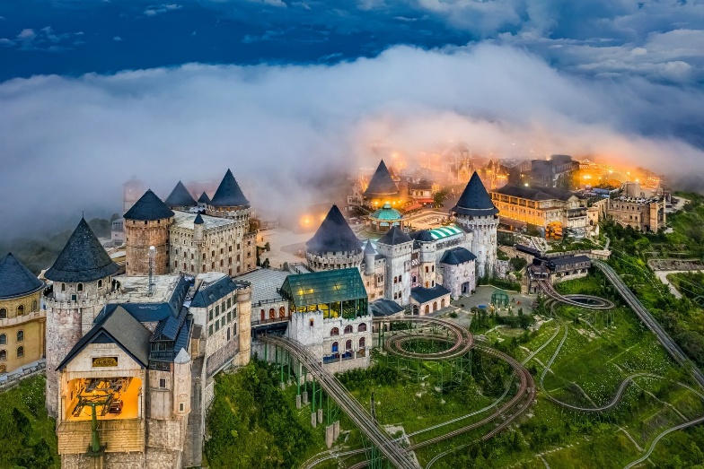
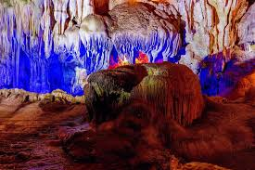
Let’s sing
What do you think of ...?
What do you think of Ba Na Hills?
I think it’s fantastic.
I think it’s exciting.
Ba Na Hills is fantastic and exciting.
What do you think of Dau Go Cave?
I think it’s peaceful.
I think it’s beautiful.
Dau Go Cave is peaceful and beautiful.

Slide 5
02
Listen and repeat.

Slide 6


Look at the question and the red mark.
When asking Wh-questions, our voice goes down at the end.
falling tune
What do you think of Ba Na Hills?
How far is it from Long An to Can Tho?

Slide 7
Work in pairs. Say the questions.
Listen and repeat.
What do you think of Ba Na Hills?
How far is it from Long An to Can Tho?

Slide 8
03
Listen and repeat.
Pay attention to the intonation.

Slide 9
Listen and focus on the falling tune at the end.
Work in pairs and read the questions.
Listen and repeat.
Read the question aloud.
1. What do you think of Hoan Kiem Lake?
2. What do you think of London?
3. How far is it from Hue to Da Nang?
4. How far is it from London to Manchester?

Slide 10
04
Let’s chant.

Slide 11
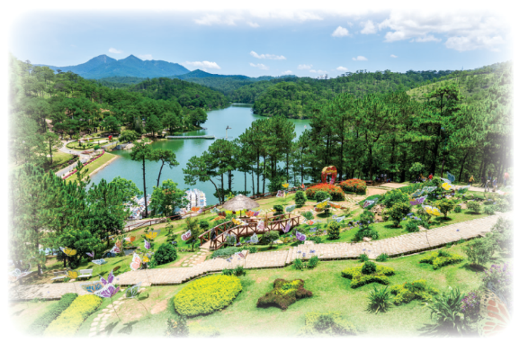
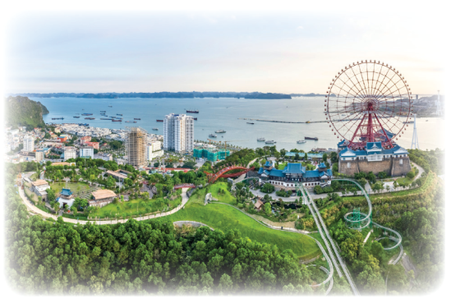
Chant and clap along.
Listen and repeat.
Look at the red mark.
Read aloud.
What do you think of Da Lat?
It’s pretty and peaceful.
How far is it from here?
It’s not far. It’s near.
What do you think of Ha Long?
It’s pretty and exciting.
How far is it from here?
It’s not near. It’s far.

Slide 12
05
Fun corner and Wrap-up
Spin the wheel

Slide 13







Notes:
Teacher divides the class into 2-3 teams. Each team take turn to read the question and pay attention to the intonation. If students say correctly, they can spin the wheel and get point. The team with more point is the winner.

Slide 14









Slide 15




Put in order. Say aloud. Pay attention to the intonation.
think / you / do / Waterfall? / of /
Ban Gioc / What
What do you think of
Ban Gioc Waterfall?

Slide 16
Put in order. Say aloud. Pay attention to the intonation.
Vung Tau / here / far / it / to /
is / Beach? / How / from
How far is it from here to Vung Tau Beach?

Slide 17
Put in order. Say aloud. Pay attention to the intonation.
you / think / do / park? / What / national / of / the
What do you think of the national park?

Slide 18
Put in order. Say aloud. Pay attention to the intonation.
to / it/ from / the park?/ How far/
our school / is
How far is it from our school to the park?

Slide 19
Put in order. Say aloud.
Pay attention to the intonation
What / think / of / lake? / Hoan Kiem / you / do/
What do you think of Hoan Kiem Lake?

Slide 20
Put in order. Say aloud. Pay attention to the intonation.
far/ it / How / is / to / Hue /
from / Da Nang?
How far is it from Hue to Da Nang?

Slide 21
Put in order. Say aloud. Pay attention to the intonation.
think / you / do / What /
Ha Long Bay? / of /
What do you think of Ha Long Bay?

Slide 22
Put in order. Say aloud. Pay attention to the intonation.
Hoi An? / you / of/ do/ think / What
What do you think of Hoi An?

