Slide 1



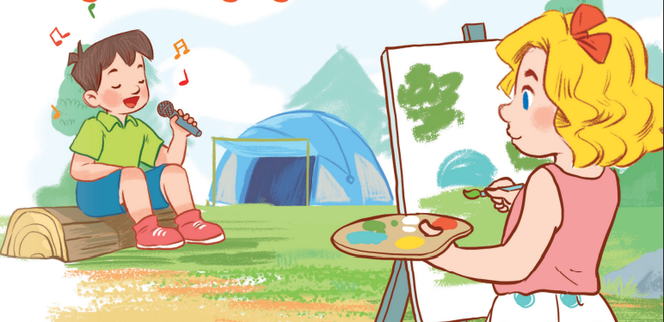
19
Outdoor activities
LESSON 2 – PERIOD 4

Slide 2


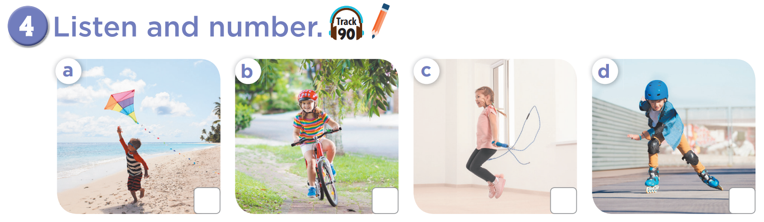

2
3
4
1

Slide 3
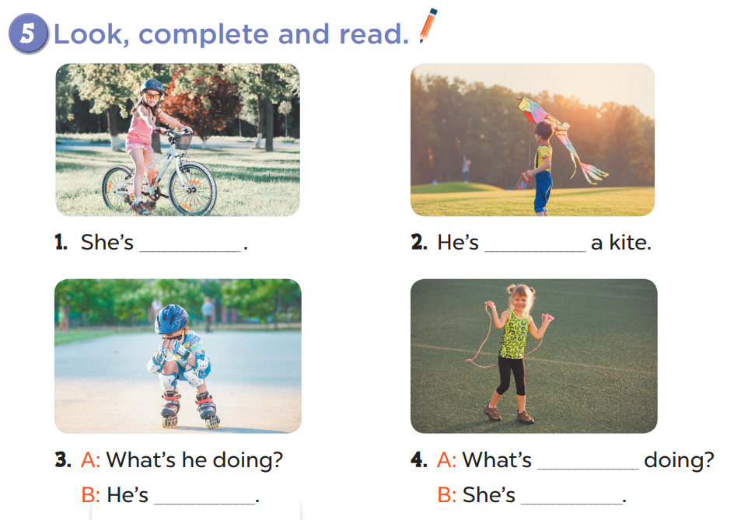
cycling
flying
she
skating
skipping

Slide 4
