Slide 1



Slide 2
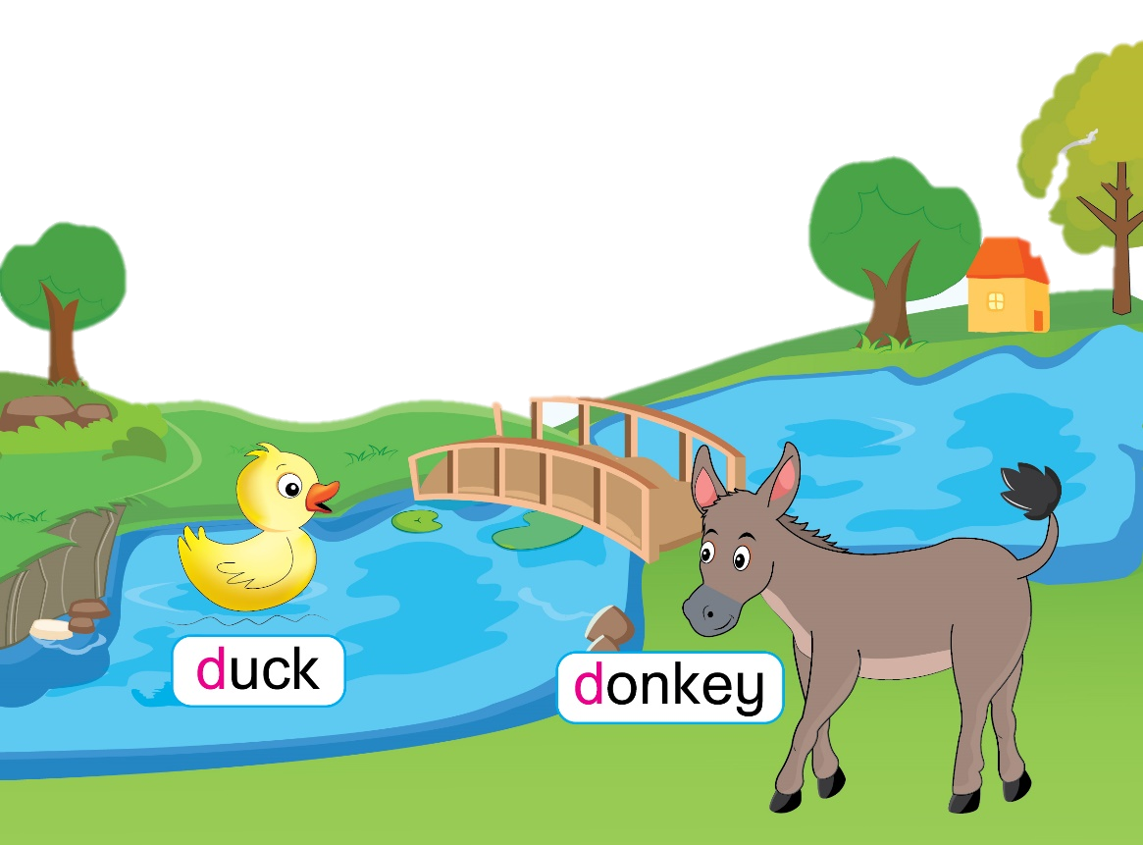
Unit 4
Lesson 3
Notes:
Hello children,
How are you? Are you good? I hope so.
How’s the weather today?
Welcome to our lesson today, Unit 4 – Lesson 3
Today, we will have 2 groups – group 1 and group 2. You are group 1, you are Group 2.

Slide 3
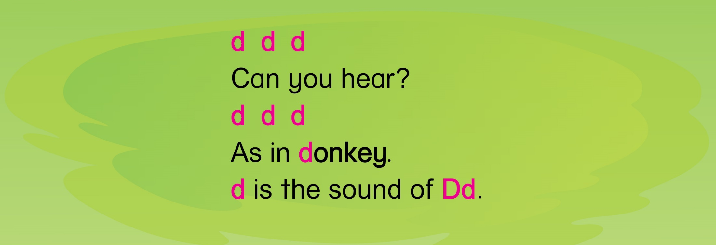

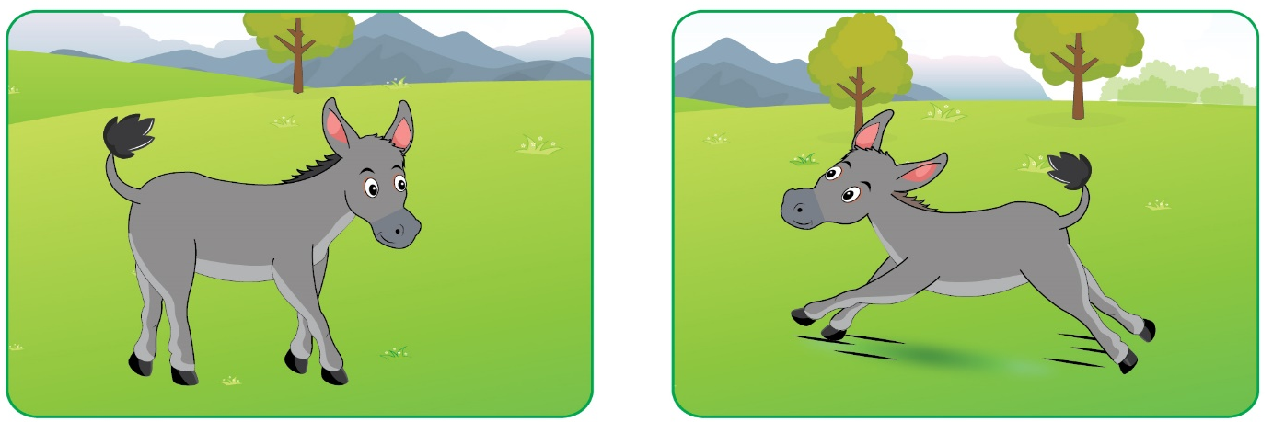
Unit 4 Lesson 3
Let’s chant
Notes:
Hello children!
Do you remember Letter D and its sound? Let’s chant about Letter D.
You chant very well!

Slide 4
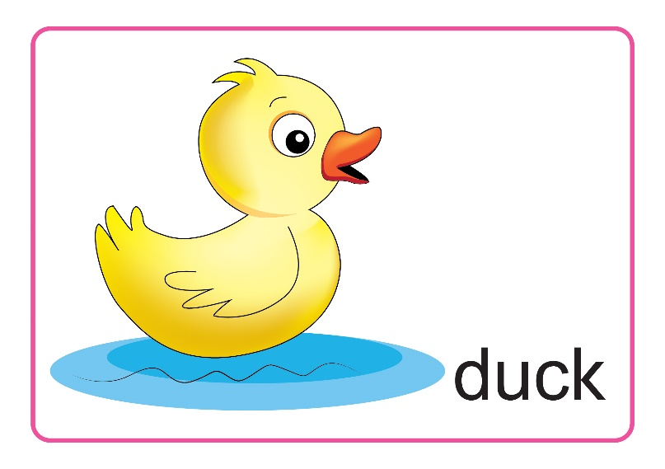

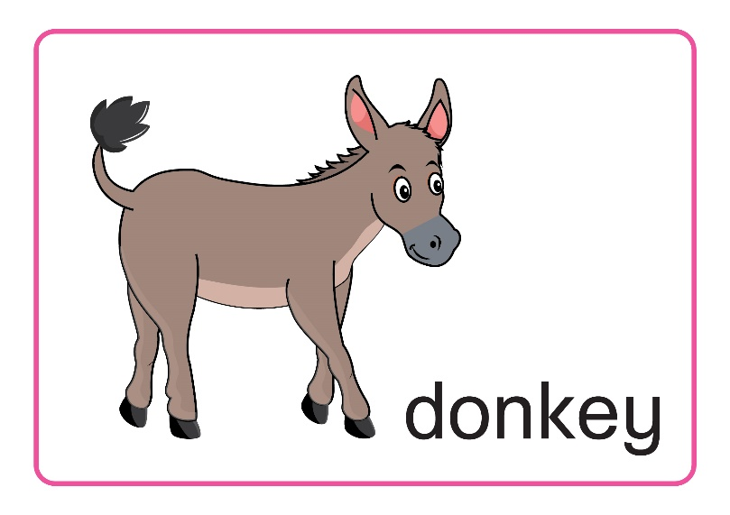
Unit 4 Lesson 3
Do you remember?
Notes:
In lesson 2, do you remember these words?
“D”, “duck”, “donkey” – Well done.

Slide 5
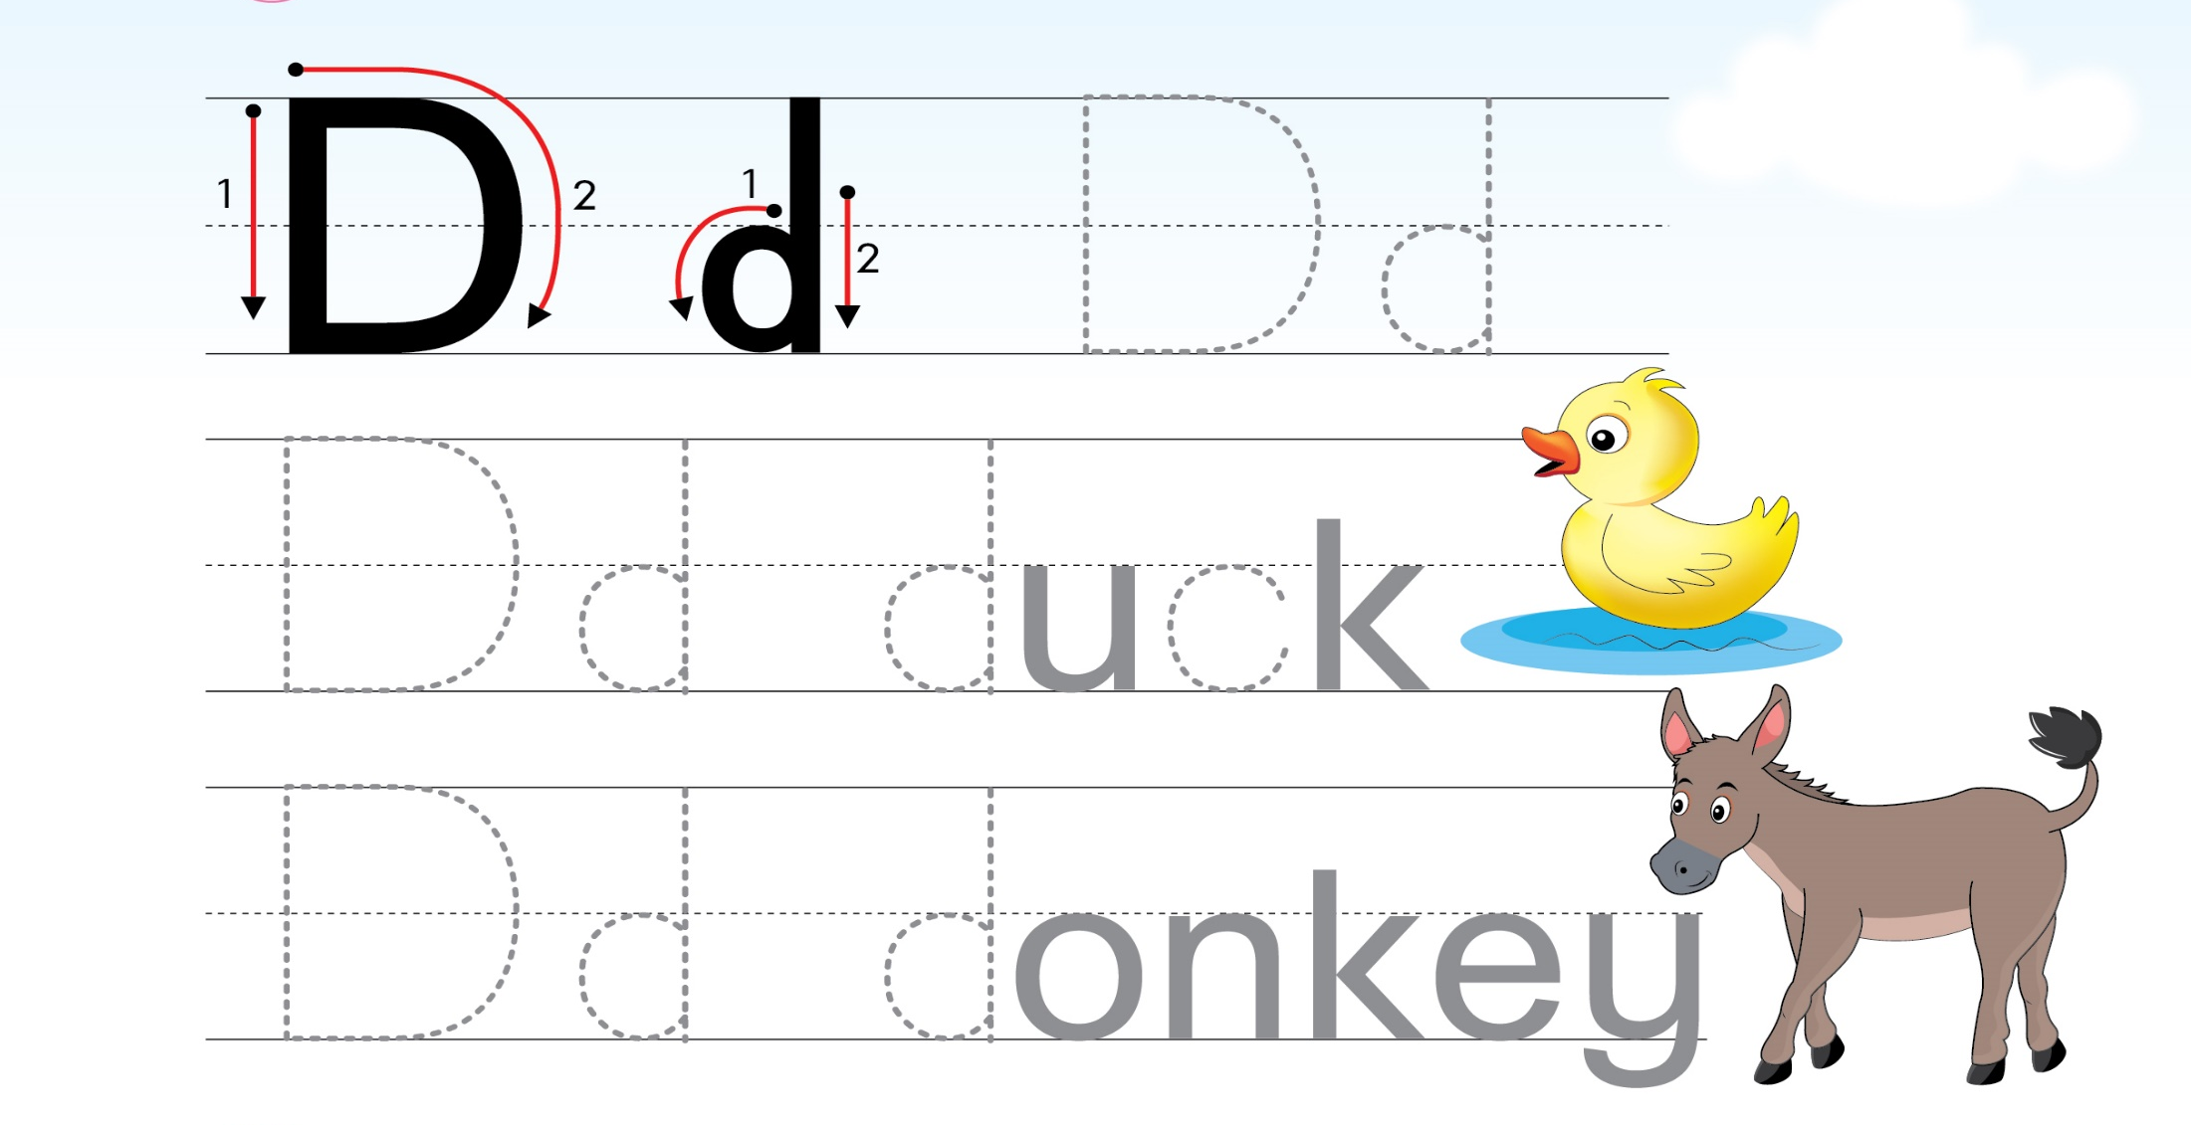
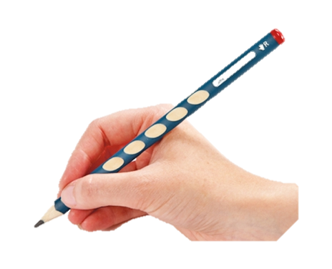
Unit 4 Lesson 3
1.Trace the letters
Page 20
Notes:
-Today, We learn how to trace Letter D. Unit 4 – Lesson 3, part 1- Trace the letters
-Now, let’s look.
-With big D: We have two strokes, like this One and Two
-With small d: How do we start? Let’s see. One – Two
-Now, let’s rise your fingers and follow ( back to tracing D and d)
-Ask SS to trace in their books D, d, duck, donkey.
- Now, you look at your book Page 20, let’s trace the letters and the words.

Slide 6

Unit 4 Lesson 3
1.Trace the letters
2.Look, tick and say
a. Example
b
c



Notes:
- It’s very easy to trace Letter D. Right?
- Now we move to Part 2 – Look, tick and say. You look at the picture. Read the sentences to tick in the correct box then say aloud. There is one example. (a)
- Click (a) “ What is it?” – We have two boxes. “It is a cat.” and “ It is a butterfly”. Can you see the tick? Now, let’s do it together.
- Click (b) “What is it?”; It is a duck.; It is a bird. Which one do you tick on? – Click- You’re right. It is a duck.
- Click (c) ) “What is it?”; It is a cow.; It is a donkey. – Click. It is a donkey. Well done.
With the correct answer, your group will have 1 point. Well done.

Slide 7
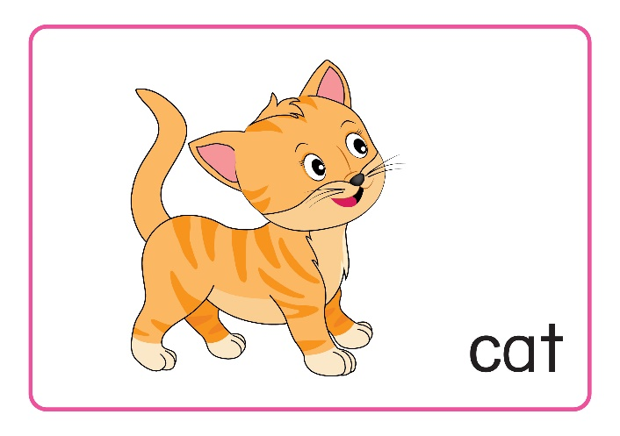


Unit 4 Lesson 3
What’s missing?
What is it?
Notes:
Let’s play a game “ What’s missing?”
One of four cards will missing. You must answer “ What is it?”
What do we have? – “cat”, “donkey”, “duck”, and “ Letter D”. Now, let’s start.

Slide 8

Unit 4 Lesson 3
What’s missing?
What is it?
?
Notes:
Well, what is it?
With the correct answer, your group will have 1 point. Well done.

Slide 9



Unit 4 Lesson 3
What’s missing?
?
What is it?
Notes:
What is it?
With the correct answer, your group will have 1 point. Good.

Slide 10

Unit 4 Lesson 3
What’s missing?
?
What is it?
Notes:
What is it?
With the correct answer, your group will have 1 point. Well done.

Slide 11

Unit 4 Lesson 3
What’s missing?
What is it?
?
Notes:
What is it?
1 point for your group. Good.

Slide 12

Unit 4
Look at your book page 20, please
Notes:
- Now, look at your Student’s Book page 20 again.
Did you complete Tracing Part 1? – Yes?- Good.
Now, let finish Part 1 & 2. Do you remember? – Very good.
It’s the end of Lesson 3.
- Let’s count your points
So the winner is group …. Group …, you also good, too.
Goodbye class

