Slide 1


Slide 2



6
Our school
LESSON 3 - PERIOD 5

Slide 3
Warm-up

Slide 4
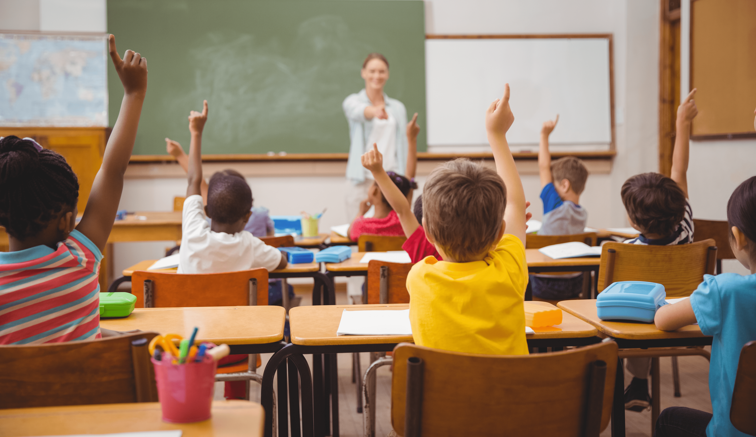

Is this your classroom?
Yes, it is.

Slide 5
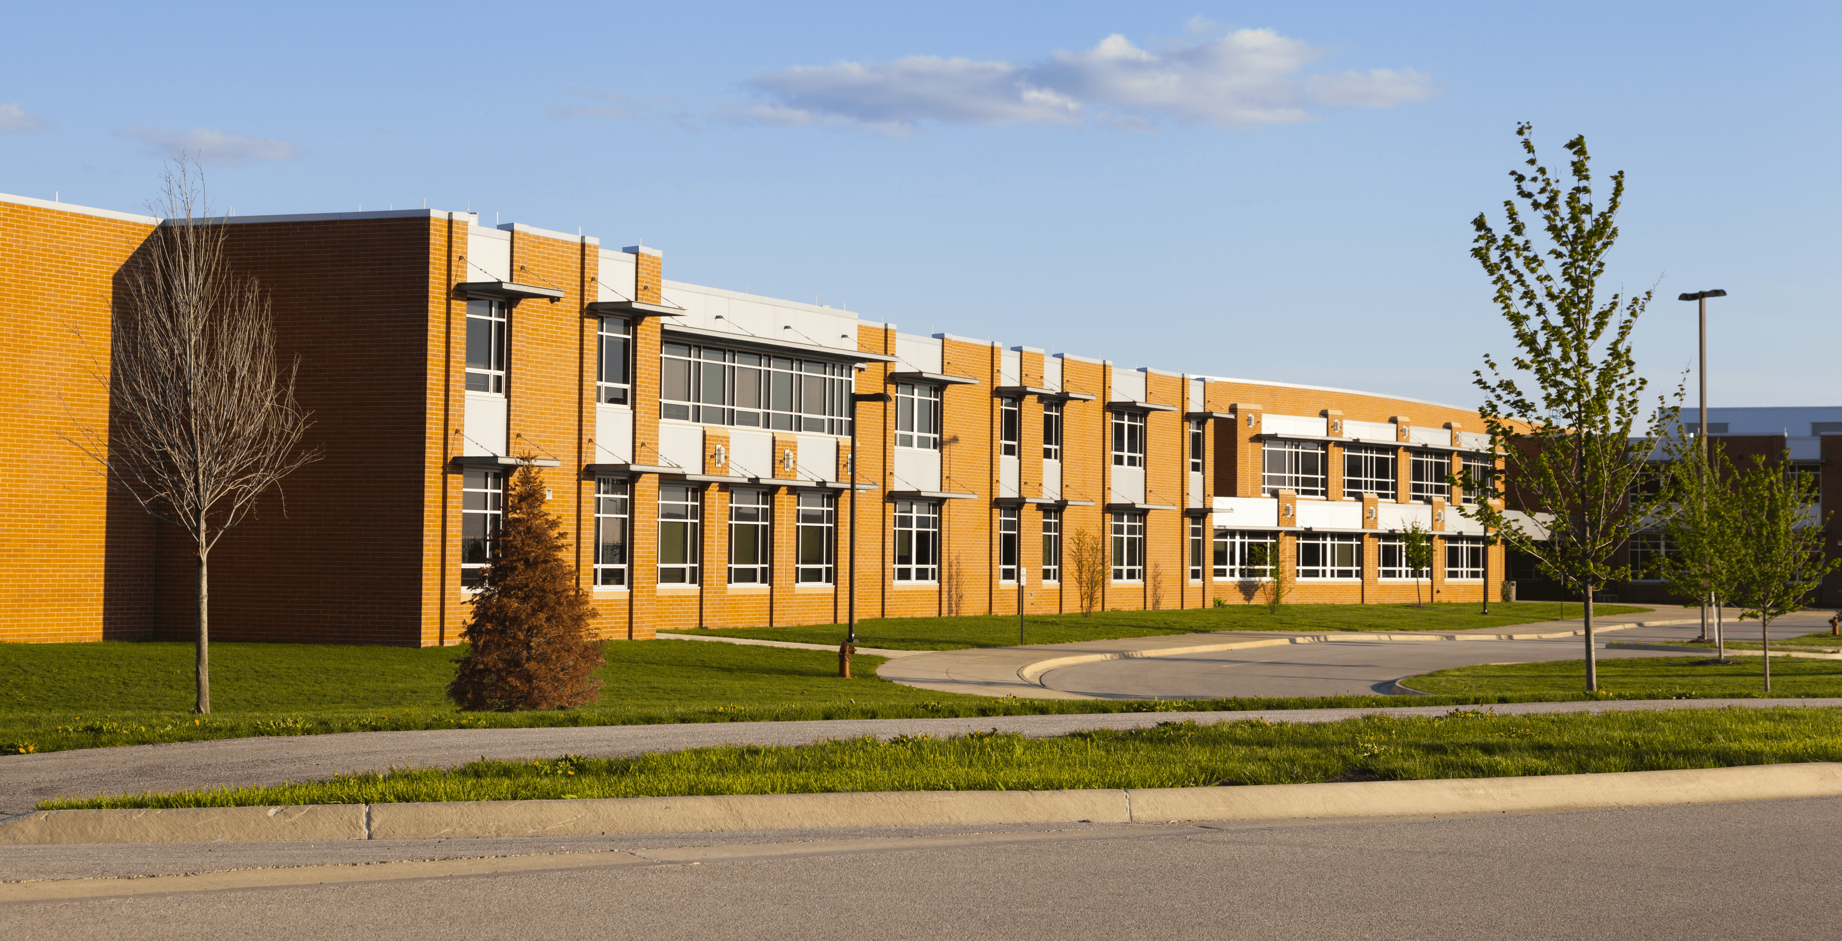
Is this your school?
Yes, it is.

Slide 6
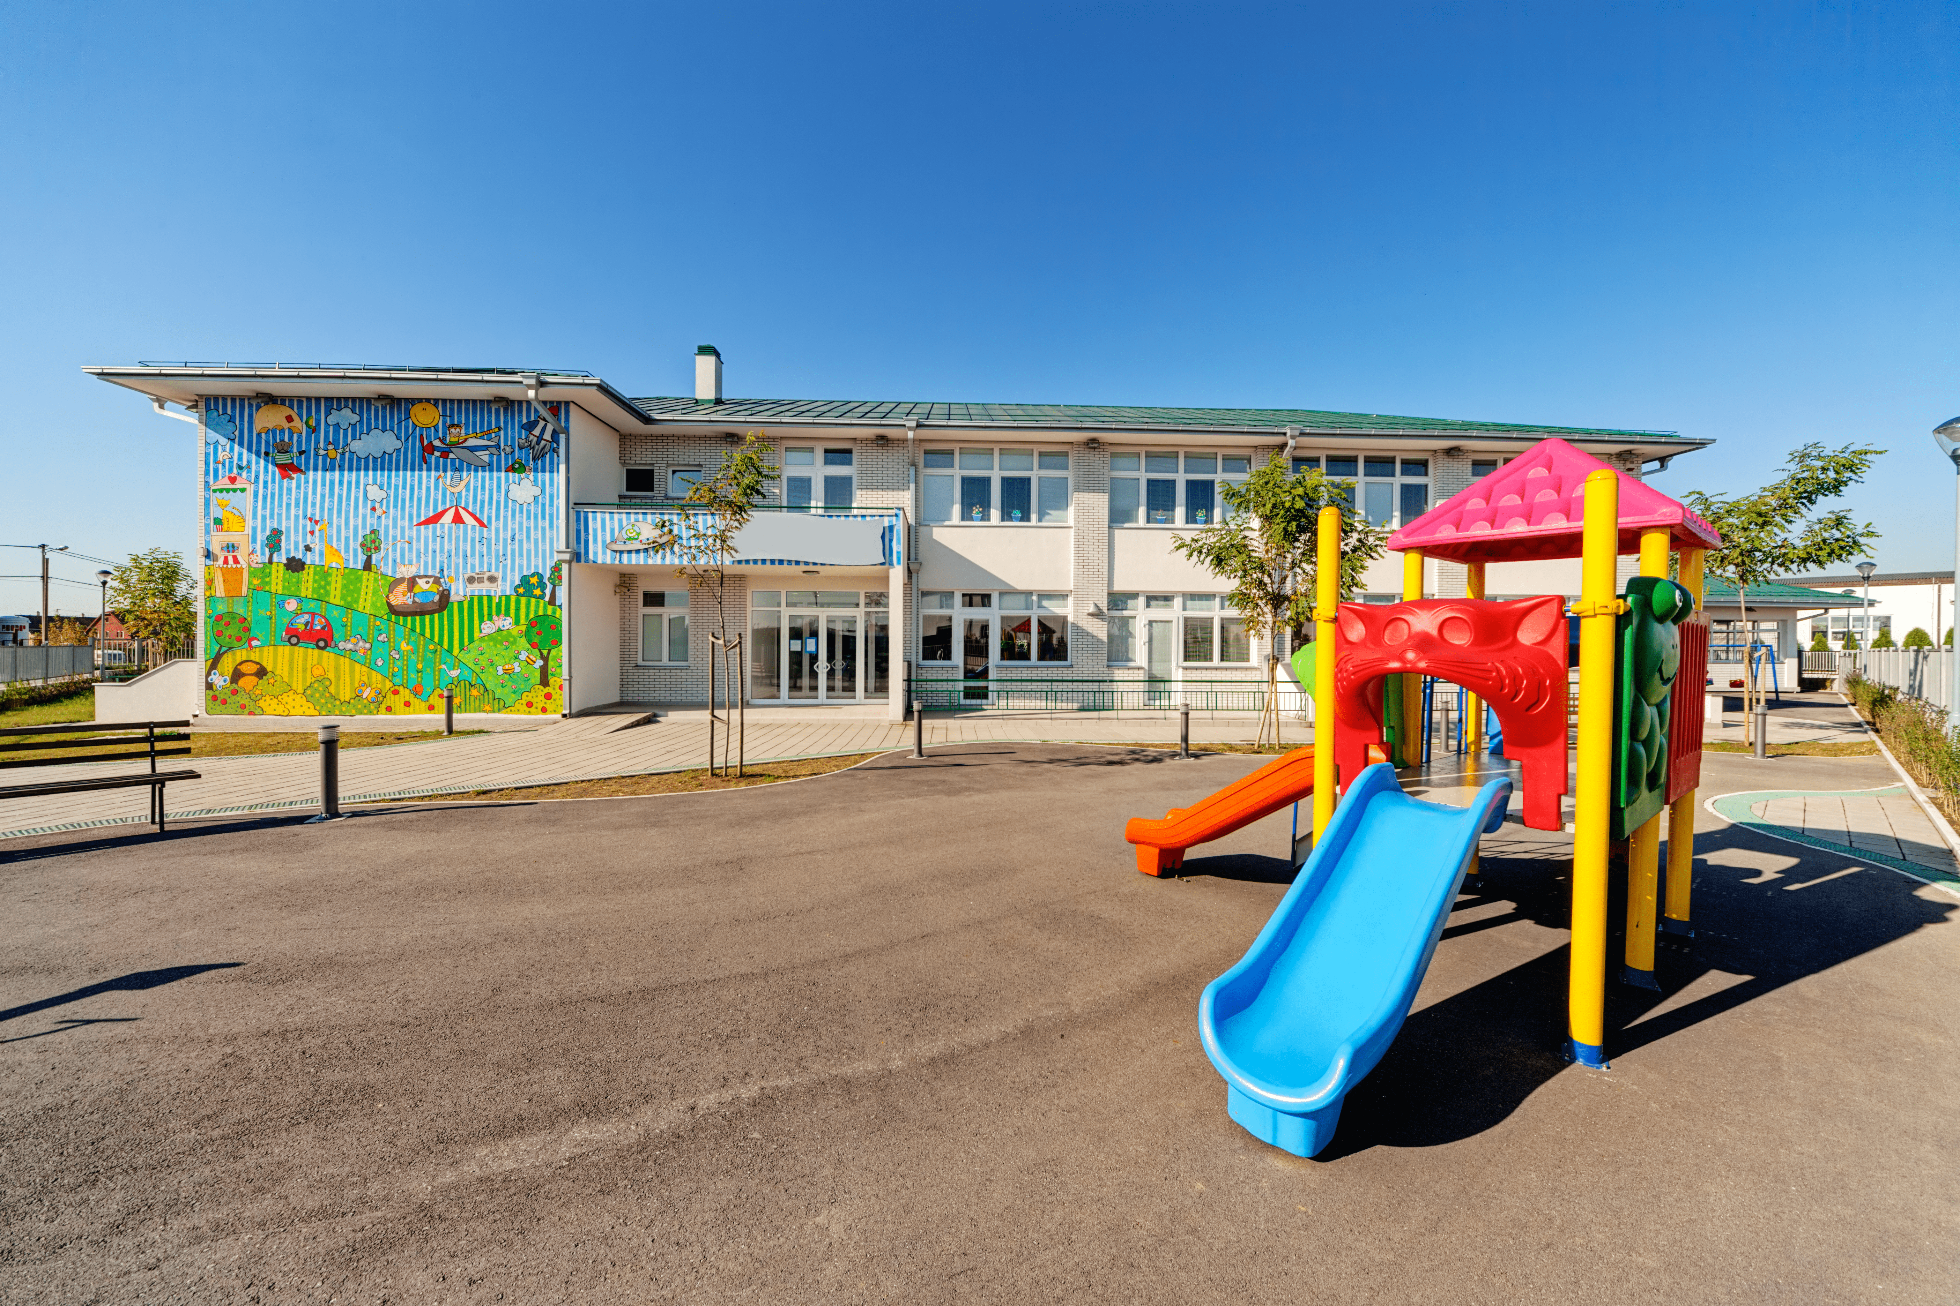
Is that our playground?
Yes, it is.

Slide 7
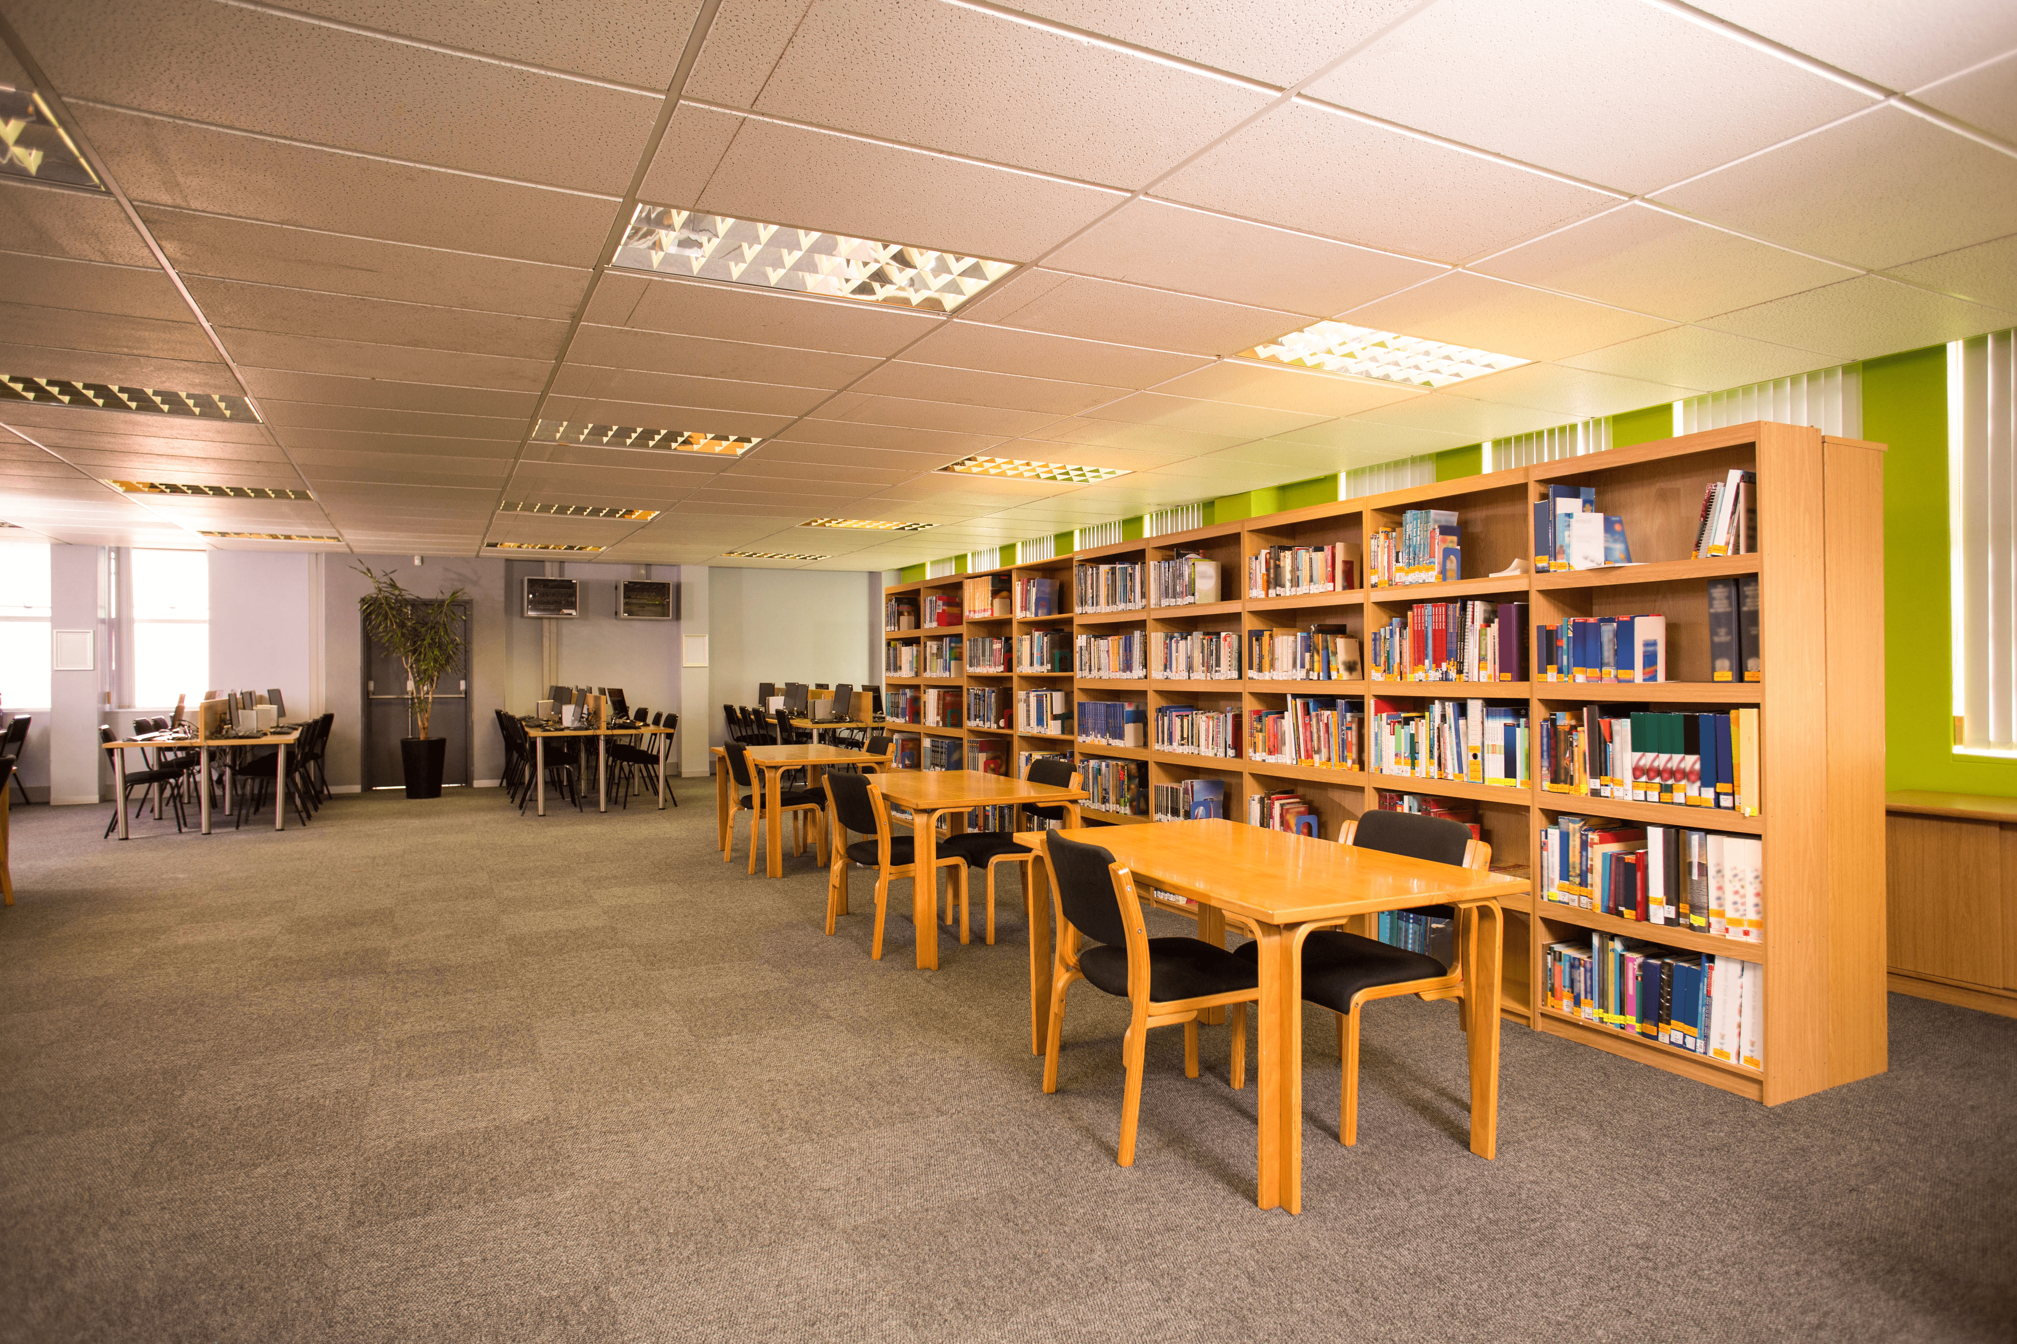
We like reading books.
Let’s go to the library.

Slide 8
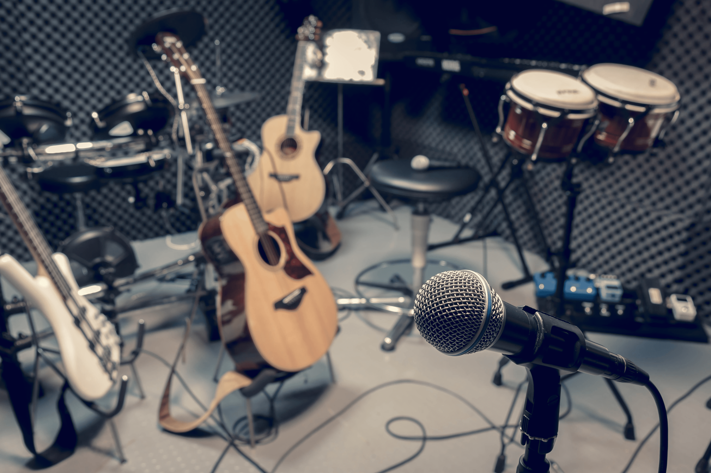
I like playing the piano.
Let’s go to the music room.

Slide 9
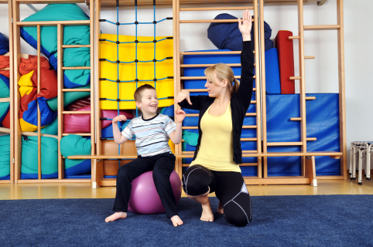
We like playing sports.
Let’s go to the gym.

Slide 10
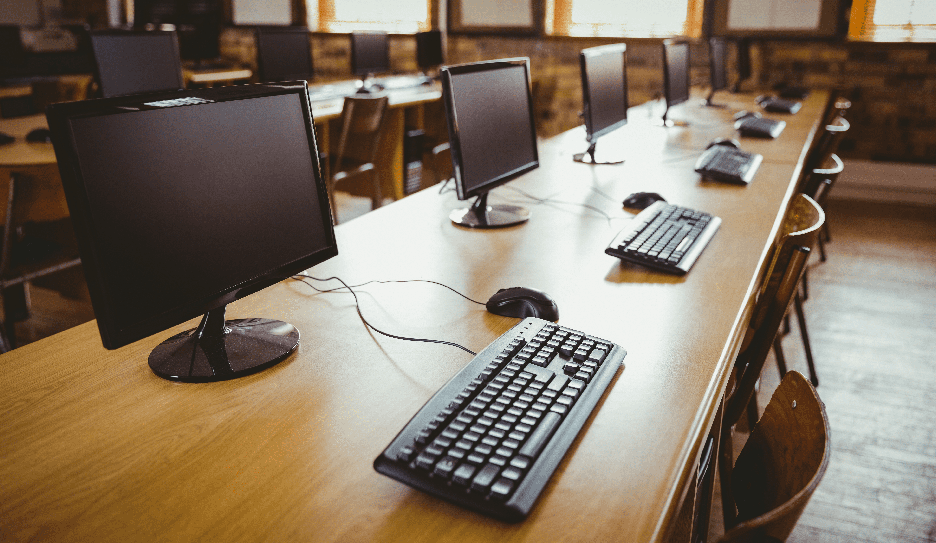
I like computers.
Let’s go to the computer room.

Slide 11
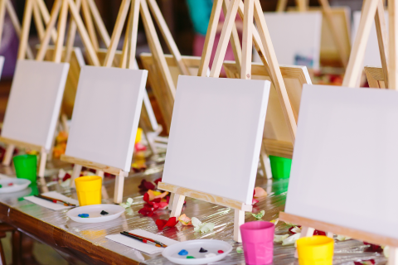
I like drawing pictures.
Let’s go to the art room.

Slide 12
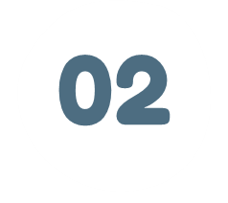
LISTEN AND REPEAT.

Slide 13


ayground
pl

Slide 14
assroom
cl

Slide 16

LISTEN AND CIRCLE.

Slide 18

LET’S CHANT.

Slide 20

FUN CORNER

