Slide 1



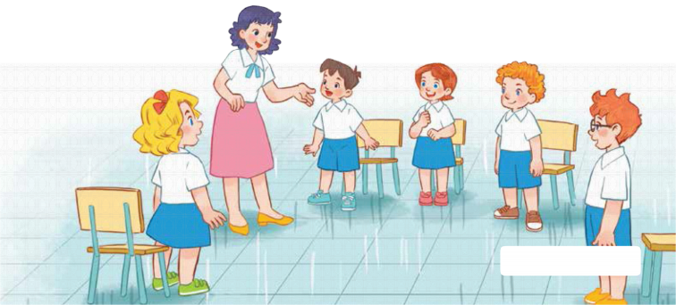
7
Classroom instructions
LESSON 2 – ACTIVITY 4-6

Slide 2

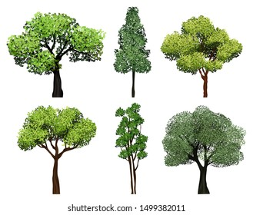

Green Earth
Warm-up & Review
Team A
Team B
1
2
3
4
5
6
7
8
Notes:
- Divide the class into 2 teams.
- Click the numbers to go to the question slide.
- When a team answers correctly, click one tree to grow it.

Slide 3
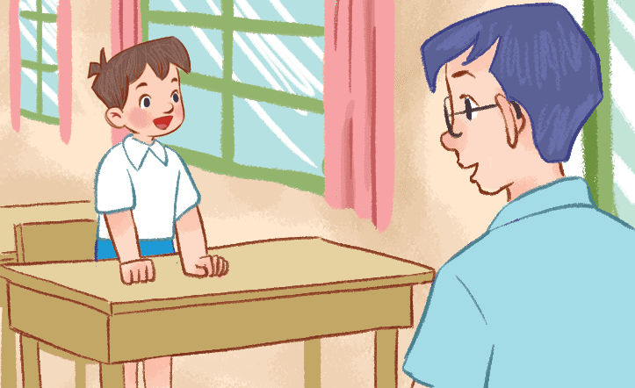



A. May I go out?
B. May I sit down?
C. May I come in?
Notes:
- Click each answer to check
- Click the Earth button to go back to the game.

Slide 4
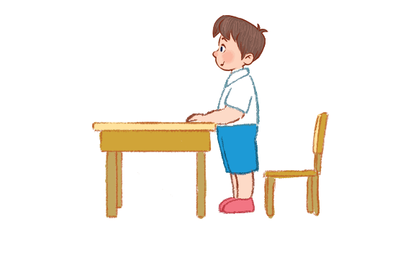
A. May I open the book?
B. May I sit down?
C. May I close the book?
Notes:
- Click each answer to check
- Click the Earth button to go back to the game.

Slide 5
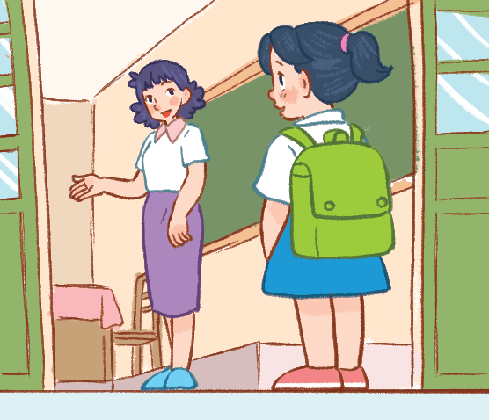
A. May I go out?
B. May I sit down?
C. May I come in?
Notes:
- Click each answer to check
- Click the Earth button to go back to the game.

Slide 6
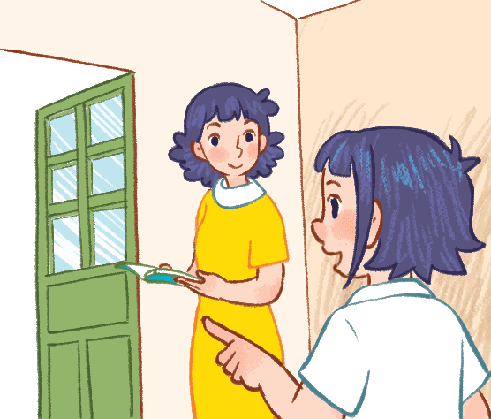
A. May I go out?
B. May I sit down?
C. May I come in?
Notes:
- Click each answer to check
- Click the Earth button to go back to the game.

Slide 7
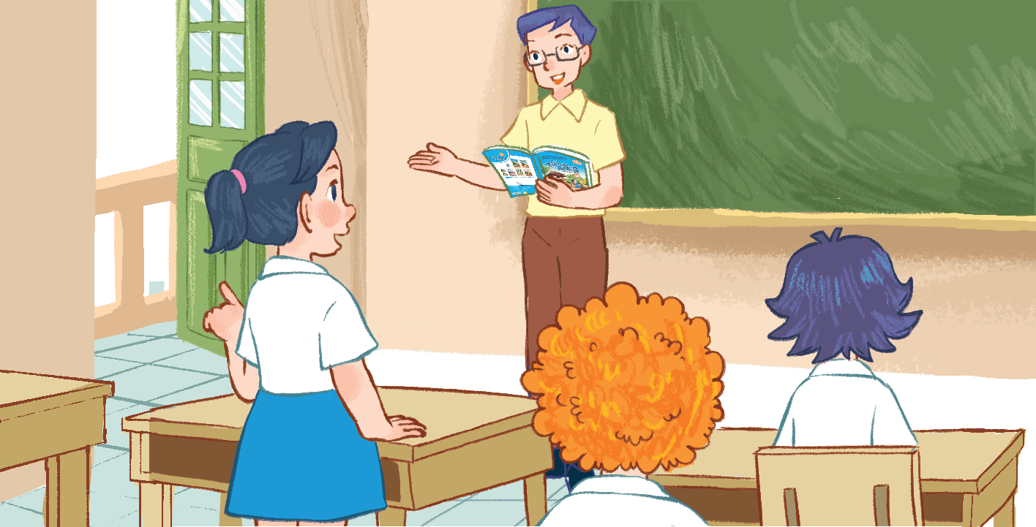
A. May I go to the board?
B. May I sit down?
C. May I go out?
Notes:
- Click each answer to check
- Click the Earth button to go back to the game.

Slide 8
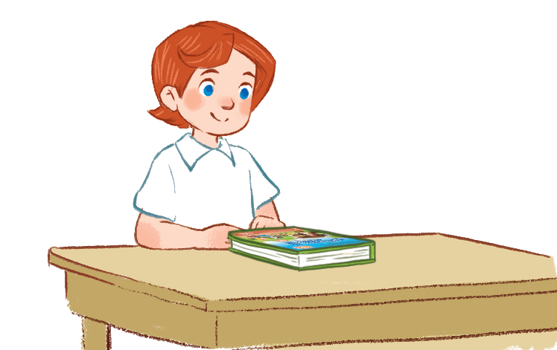
A. May I close the book?
B. May I open the book?
C. May I read the book?
Notes:
- Click each answer to check
- Click the Earth button to go back to the game.

Slide 9
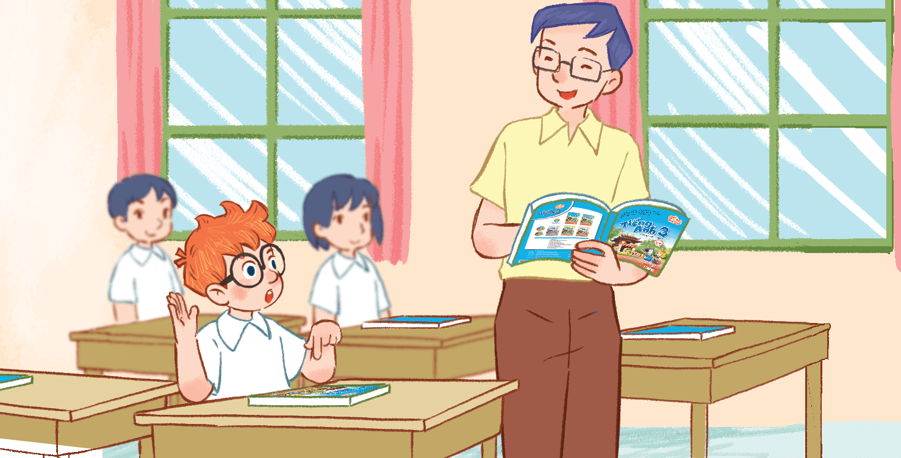
A. May I close the book?
A. May I read the book?
C. May I open the book?
Notes:
- Click each answer to check
- Click the Earth button to go back to the game.

Slide 10
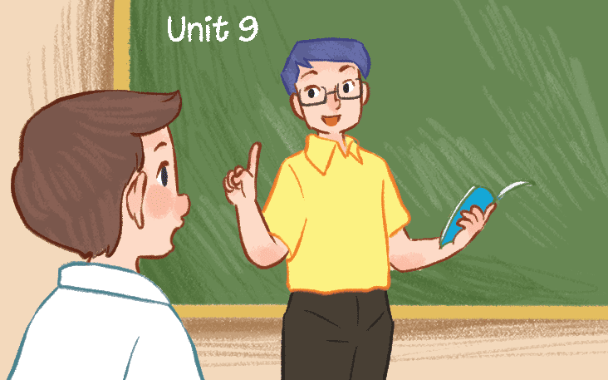
A. May I speak Vietnamese?
Vietnamese?
B. May I read a book?
C. May I speak English?
Notes:
- Click each answer to check
- Click the Earth button to go back to the game.

Slide 11

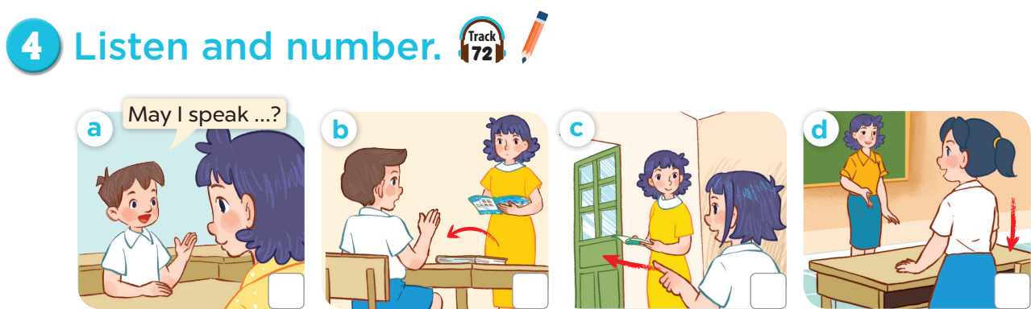

2
1
4
3

Slide 12
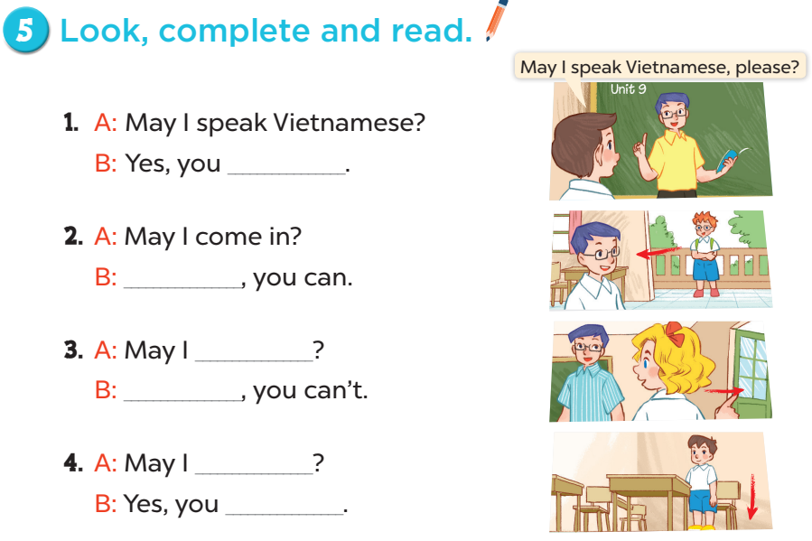
can
Yes
go out
No
sit down
can

Slide 13
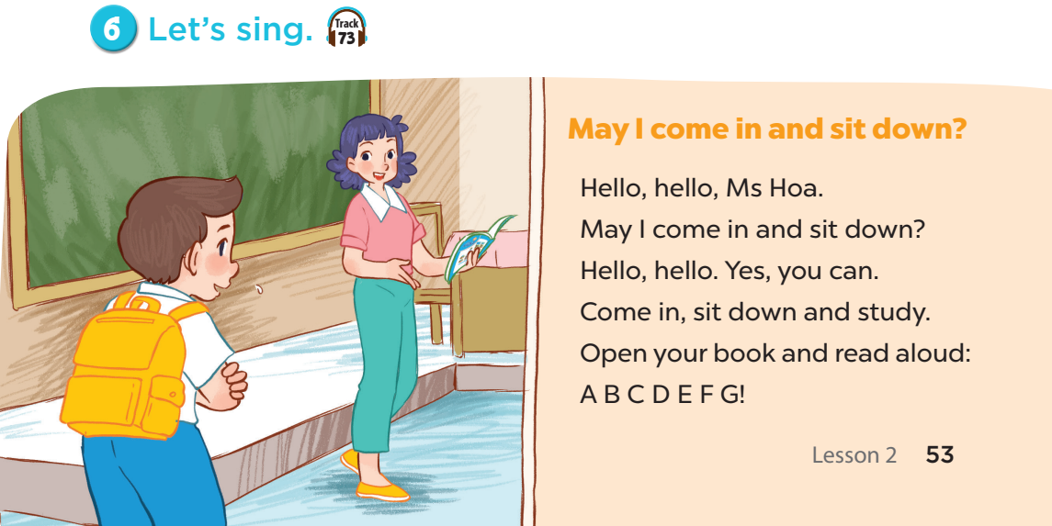

Slide 14
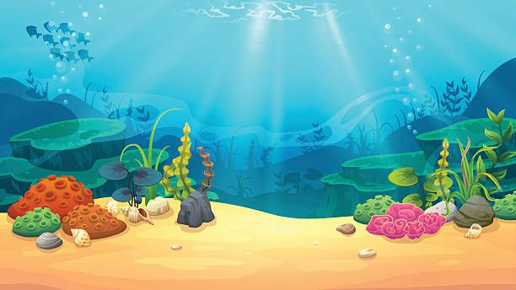
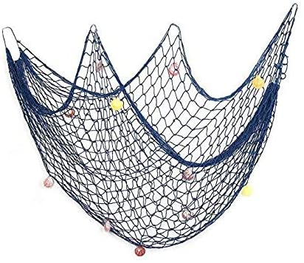
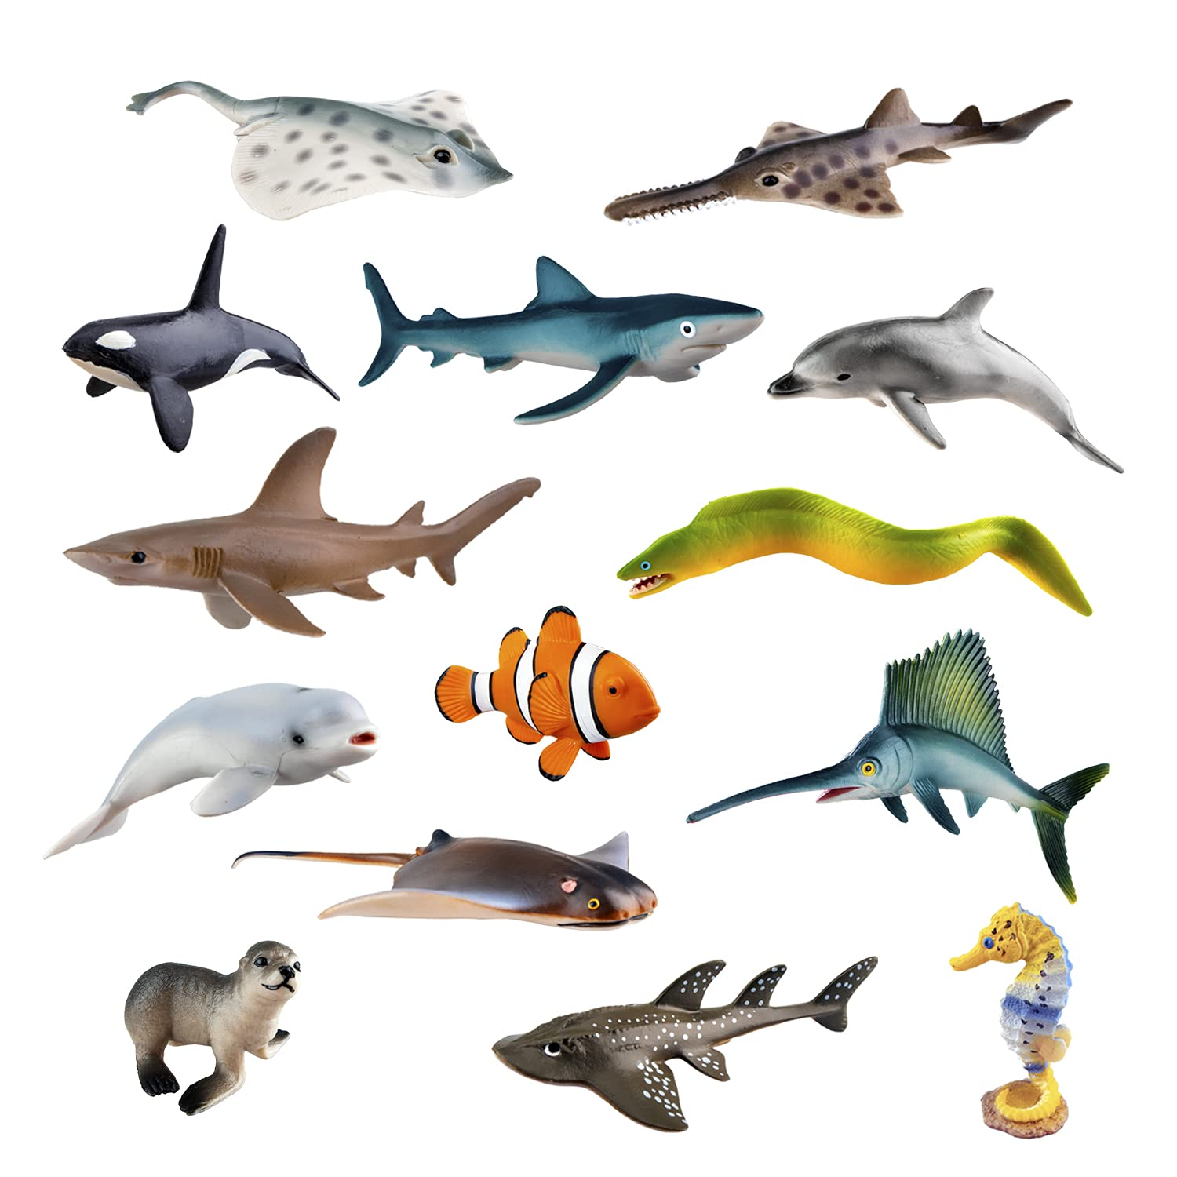
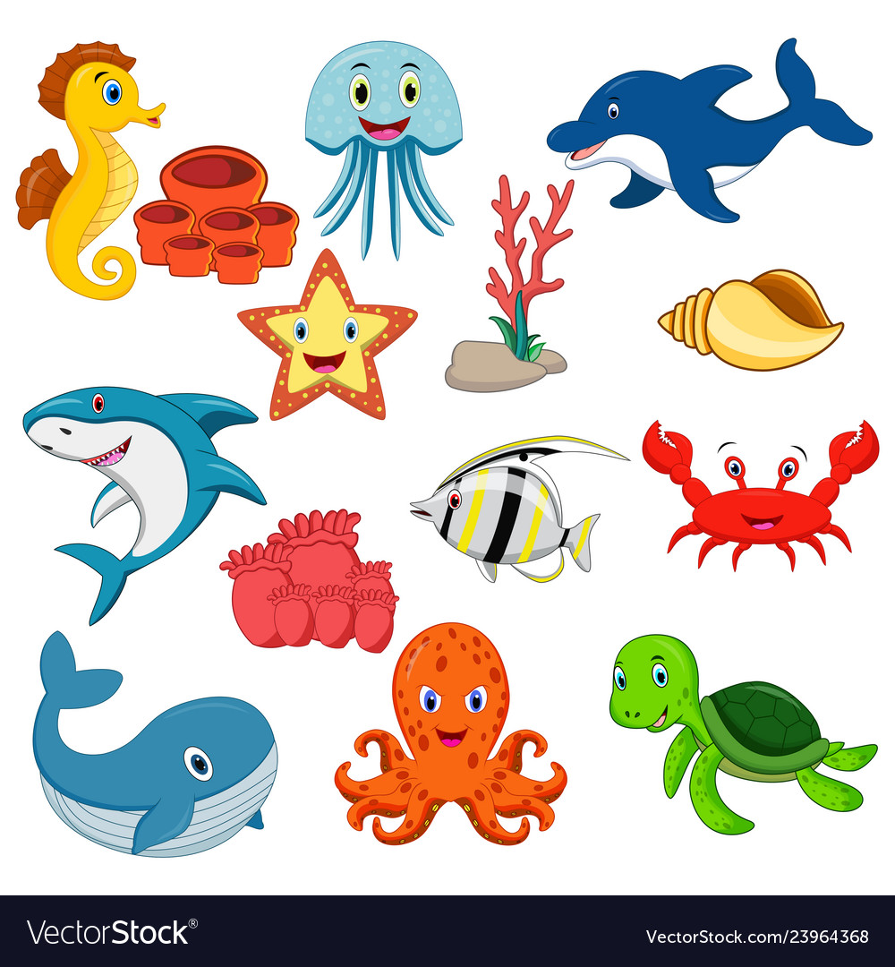
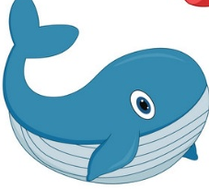
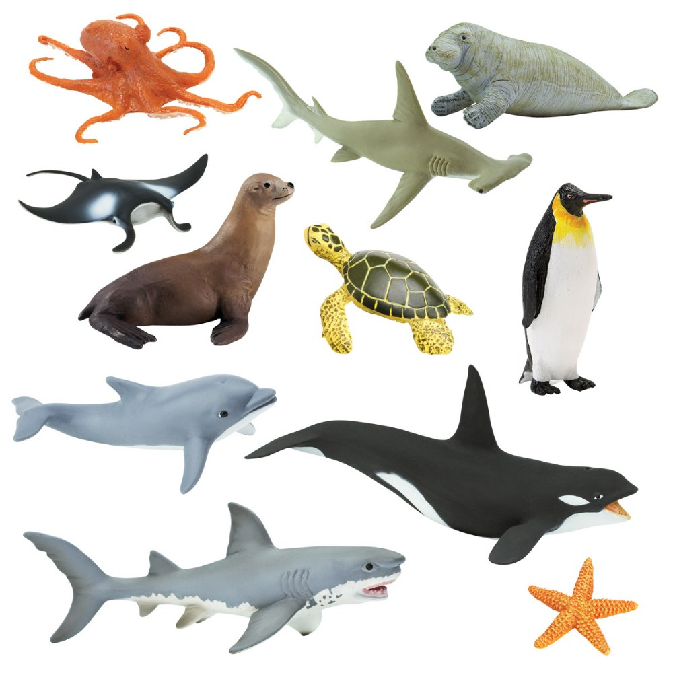
Save the ocean animals
BOYS
GIRLS
A
B
C
D
F
E
G
H
Notes:
- Divide the class into 2 teams.
- Each team chooses one letter to go to the question.
- Have pupils look, read and choose the right option.
- Back to the menu for another question.
- Pupils continue taking turns to play until they save all the sea creatures.
- The team who saves the most sea creatures is the winner.

Slide 15

May I go out?
No, you ………. .
can’t
A. can’t
B. can
C. can not
Notes:
- Click on each answer to check
- Click on the Earth button to go back to the game.

Slide 16
May I sit down?
………, you can.
Yes
A. No
B. Yes
C. Oh
Notes:
- Click on each answer to check
- Click on the Earth button to go back to the game.

Slide 17
May I __________?
Yes, you can.
come in
A. go home
B. go out
C. come in
Notes:
- Click on each answer to check
- Click on the Earth button to go back to the game.

Slide 18
May I _________?
No, you can’t.
go out
A. go out
B. come in
C. sit down
Notes:
- Click on each answer to check
- Click on the Earth button to go back to the game.

Slide 19
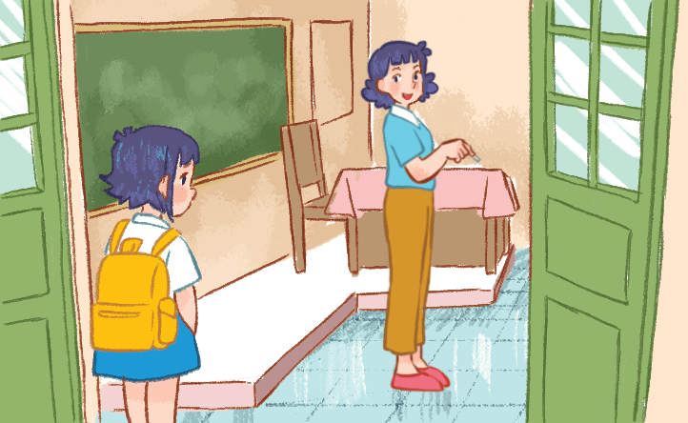
_________________and study.
Open your book and read aloud:
A B C D E F G!
Come in, sit down
A. Go out, sit down
B. Come in, stand up
C. Come in, sit down
Notes:
- Click on each answer to check
- Click on the Earth button to go back to the game.

Slide 20
Hello, hello, Ms Hoa.
May I ___________________________ ?
Hello, hello. Yes, you can.
come in and sit down
A. come in and close the book
B. come in and sit down
C. come in and open the book
Notes:
- Click on each answer to check
- Click on the Earth button to go back to the game.

Slide 21
May I __________________?
No, you can’t.
open the book
A. read the book
B. close the book
C. open the book
Notes:
- Click on each answer to check
- Click on the Earth button to go back to the game.

Slide 22
May I speak Vietnamese?
No, you can’t.
_____________, please.
Speak English
A. Speak English
B. Read a book
C. Speak Vietnamese
Notes:
- Click on each answer to check
- Click on the Earth button to go back to the game.

