Slide 1



Slide 2

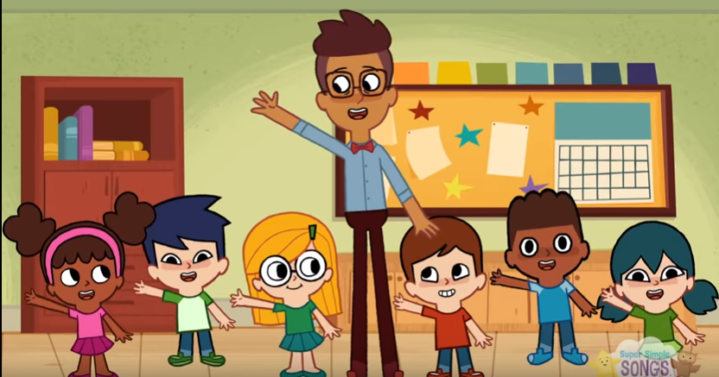
Let’s sing and do actions!
Hello. How are you?

Slide 3
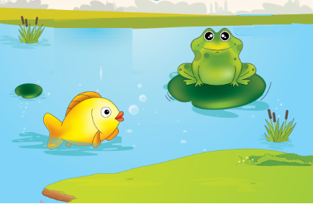
Unit 6
Lesson 1

Slide 4


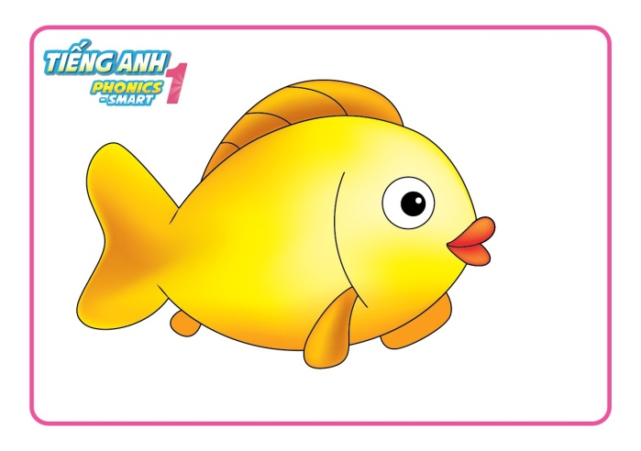
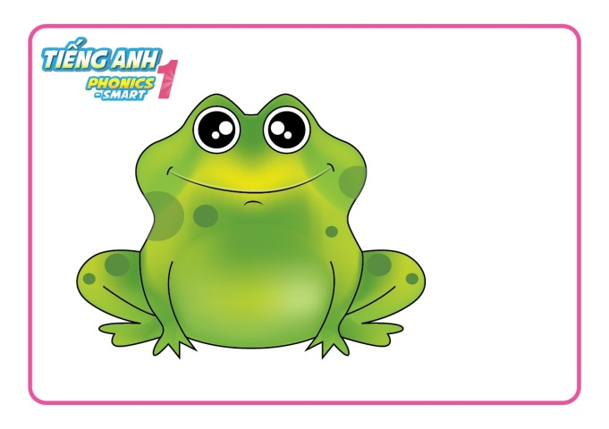
Unit 6:
Lesson 1:
F f
1. Look, listen and repeat.
fish
frog

Slide 5

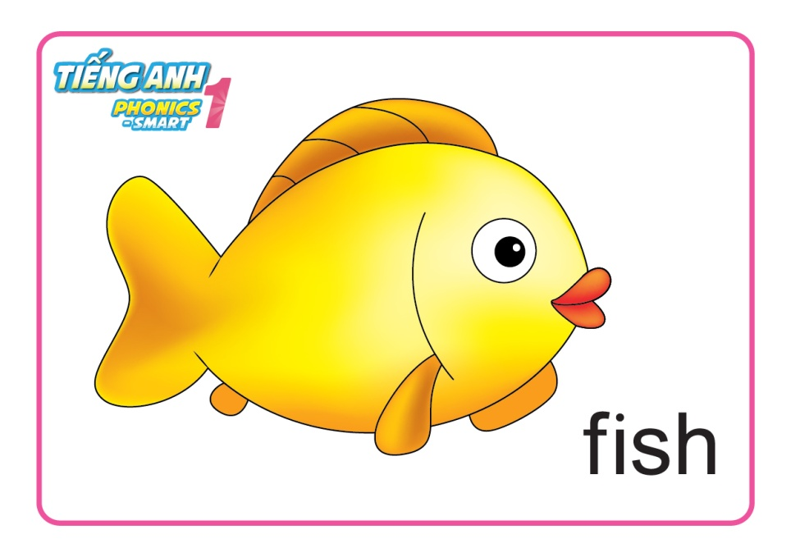
Unit 6:
Lesson 1:
F f
1. Look, listen and repeat.
Game: act out
Notes:
Teacher points to a word on board.

Slide 6
Unit 6:
Lesson 1:
F f
1. Look, listen and repeat.
Game: act out
Notes:
Teacher points to a word on board.

Slide 7

Unit 6:
Lesson 1:
F f
1. Look, listen and repeat.
Game: act out
Notes:
Teacher points to a word on board.

Slide 8
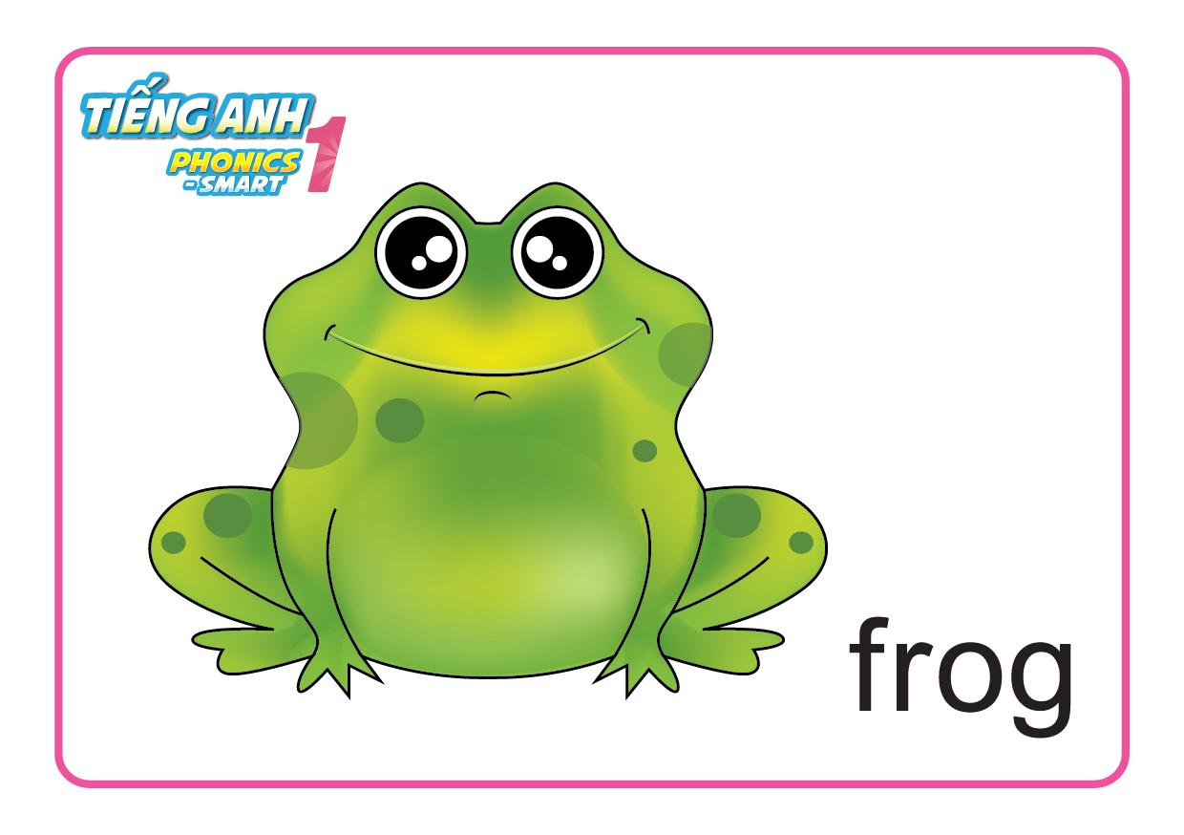
Unit 6:
Lesson 1:
F f
1. Look, listen and repeat.
Game: act out
Notes:
Teacher points to a word on board.

Slide 9
Unit 6:
Lesson 1:
F f
1. Look, listen and repeat.
Game: act out
Notes:
Teacher points to a word on board.

Slide 10
Unit 6:
Lesson 1:
F f
1. Look, listen and repeat.
Game: act out
Notes:
Teacher points to a word on board.

Slide 11
Unit 6:
Lesson 1:
F f
1. Look, listen and repeat.
Game: act out
Notes:
Teacher points to a word on board.

Slide 12
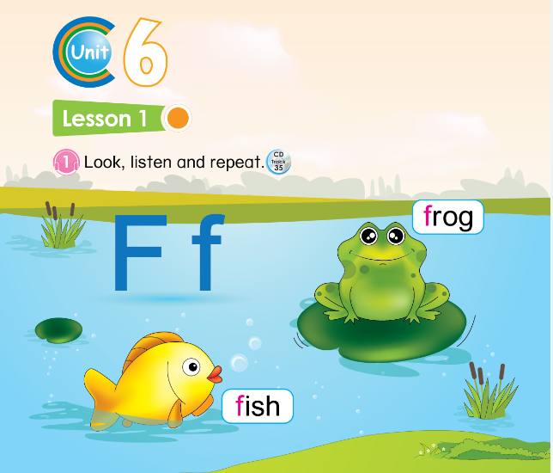

Slide 13
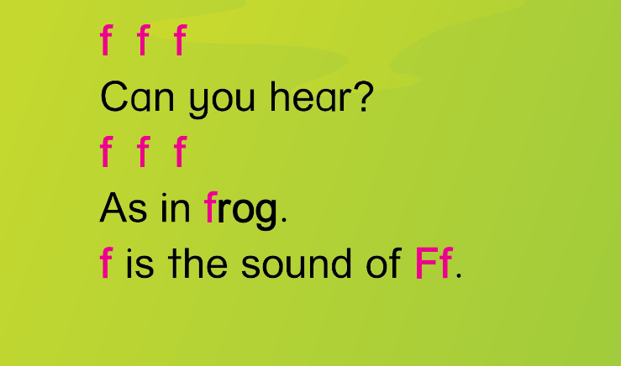




Unit 6:
Lesson 1:
Ff
1. Look, listen and repeat.
2. Let’s chant.

Slide 14
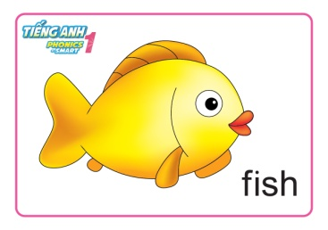

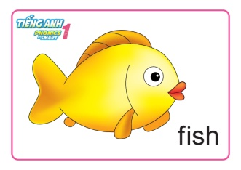
Unit 6:
Lesson 1:
F f
1. Look, listen and repeat.
2. Let’s chant.
F
f

