Slide 1



Slide 2
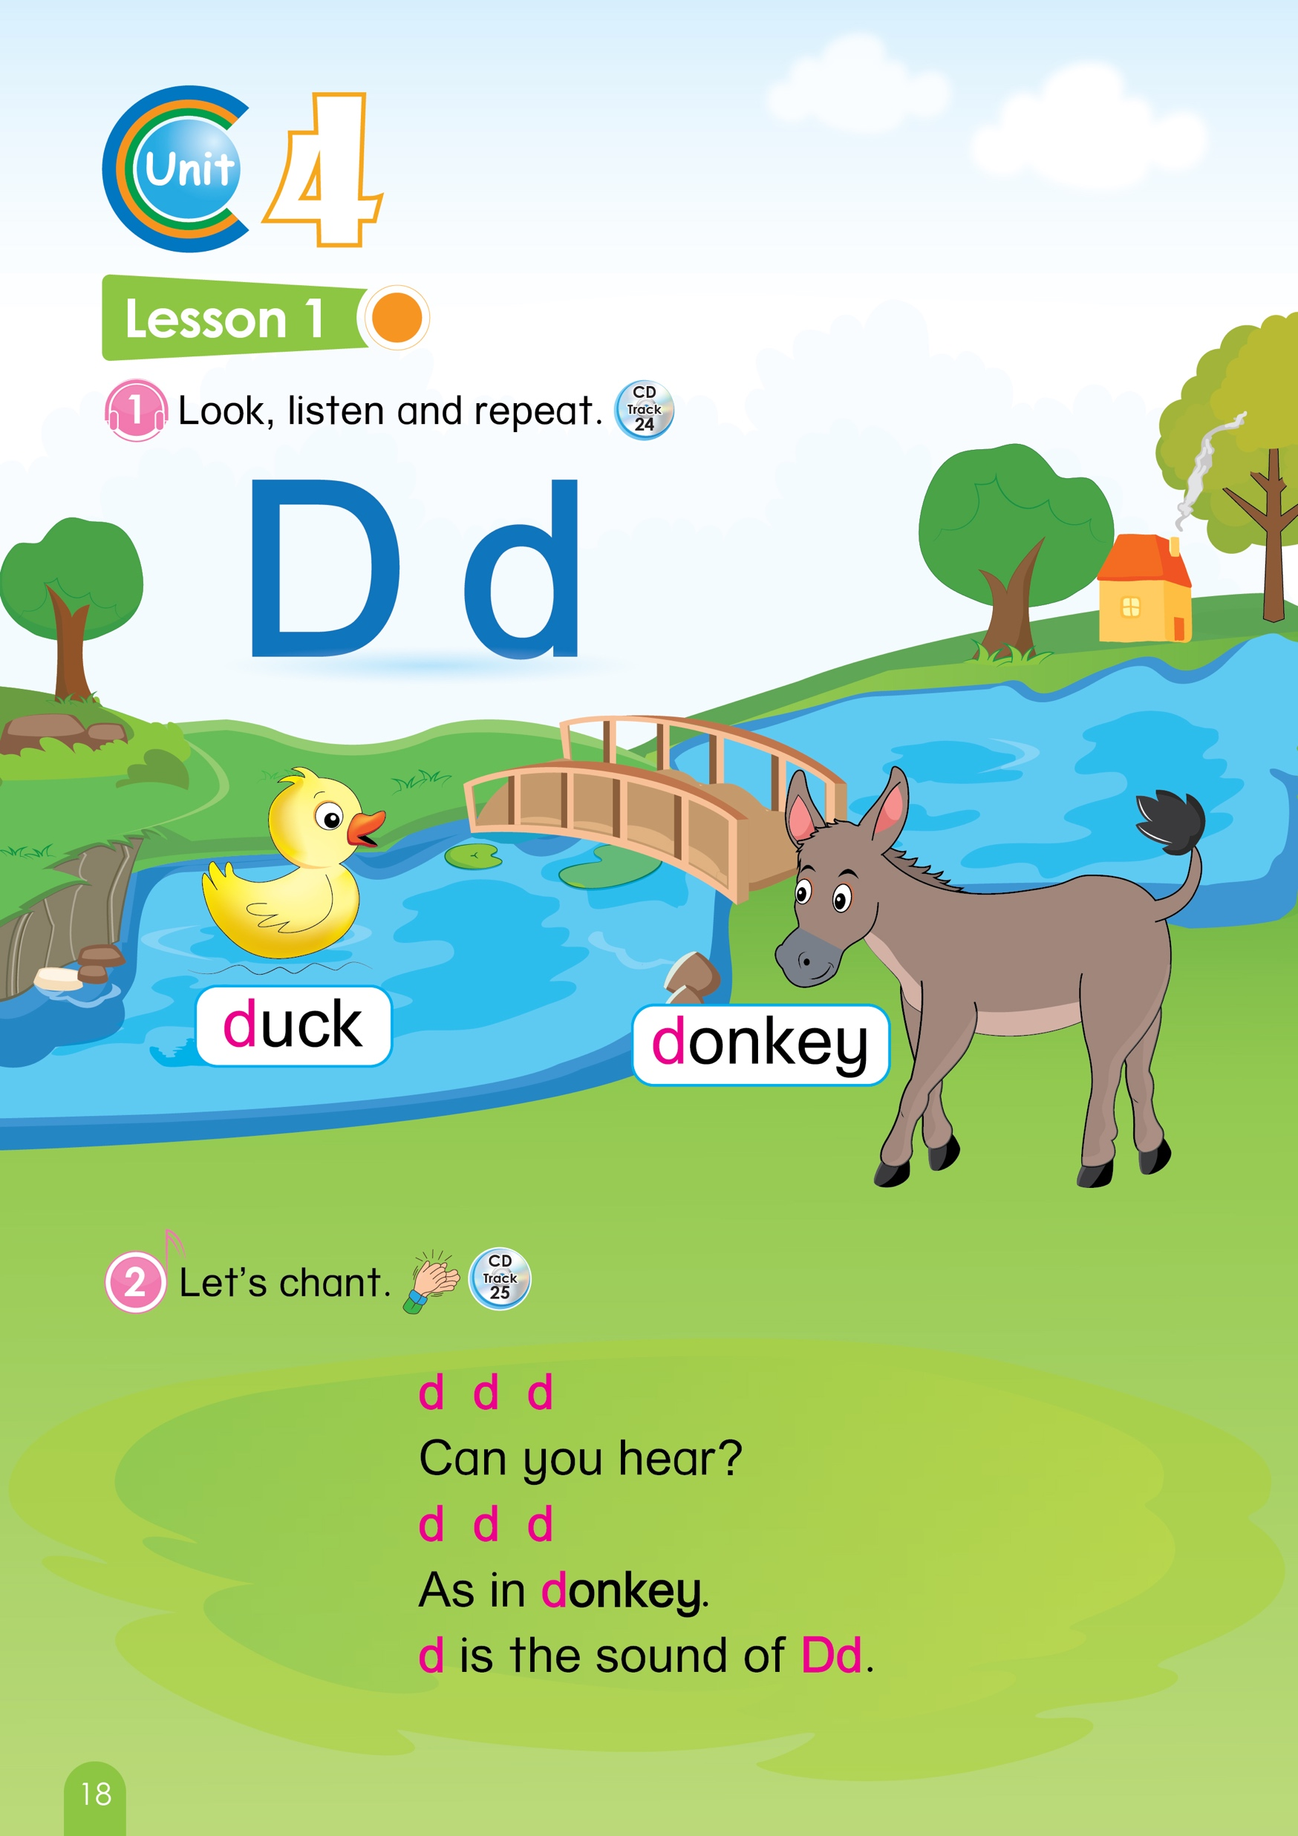


WARM UP
GAME : TEACHER SAYS
Notes:
Greetings: T says “ Hello, everyone. How are you? How’s the weather? Is it sunny? Great!
Split the class into 2 groups – “Today, we will have 2 groups – group 1 and group 2. You are group 1, you are Group 2.”
3. Teacher lets the Sts play the game “ Teacher says”
– Do what teacher says, don’t follow what teacher does
Teacher says “stand up”, but teacher sits down --> Students stand up
Teacher says “sit down”, teacher sits down → students sit down

Slide 3


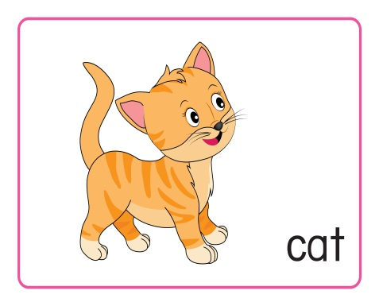
UNIT 4
LESSON 1
Notes:
Introduction: New lesson: Unit 4- Lesson 1
1. T says: “Today, we are going to learn Unit 4 – Lesson 1”

Slide 4

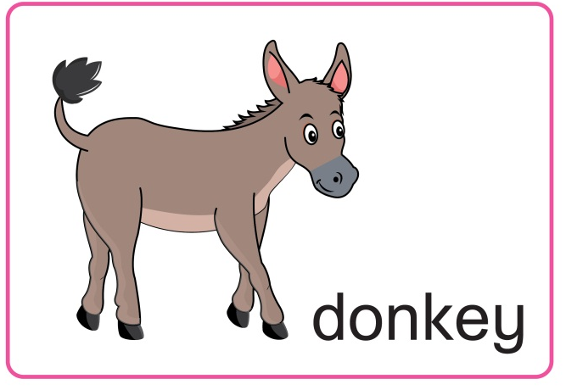
Unit 4:
Lesson 1:
D d
1. Look, listen and repeat.
D d
d
duck
donkey
Notes:
Part 1: Look, listen and repeat
Teacher asks Students to listen the audio file 2 – 3 times for each.
Then asks them to repeat
T says : “Now, we go to part 1: Look, listen and repeat”
T says: “Letter Dd” – click the first sound icon 2 times , then “listen and repeat, please”. – “Dd – good”
T says : “Sound /d/ “– click the second sound icon 2 times , then “listen and repeat, please”- “ /d/ very good”
T says : “Duck” – click the third sound icon 2 times , then “listen and repeat, please”. “Duck – excellent. Can you do like a duck ? Good”
T says : “Donkey” – click the fourth sound icon 2 times , then “listen and repeat, please”. “Donkey – well done. What sound does a donkey make? – Hee haw. Yeah”

Slide 5
Unit 4:
Lesson 1:
D d
1. Look, listen and repeat.
Circle the right pictures
D d
d
Notes:
Activities: Game “ Circle the right pictures”
1.T says: “There are 2 pictures that you need to choose the right one after listening to me.
2. Teacher says: “Please circle the letter Dd, which one? “(click) “Yes, Dd “
3. With the correct answer, that team will have 1 point.

Slide 6



Unit 4:
Lesson 1:
D d
1. Look, listen and repeat.
Circle the right pictures
Notes:
Activities: Game “ Circle the right pictures”
Teacher says: “Please circle the Donkey, which one? “ (click) “Yes, donkey “
With the correct answer, that team will have 1 point.

Slide 7


Unit 4:
Lesson 1:
D d
1. Look, listen and repeat.
D d
d
Circle the right pictures
Notes:
Activities: Game “ Circle the right pictures”
Teacher says: “ This is the last turn. Please circle the Duck, please > which one?” (click) “Yes, duck “
With the correct answer, that team will have 1 point.

Slide 8


Slide 9
Unit 4:
Lesson 1:
D d
Review after playing game
D d
d
duck
donkey
Notes:
After playing game, Teacher asks Sts to review and say loudly in whole class one more time.
T says: “Now listen and say all 1 more time”
Letter Dd – T says: “listen and repeat, please”. Click the first sound icon – “Dd – good”
Sound /d/ – T says: “listen and repeat, please” .Click the second sound icon. “/d/ very good”
Duck – T says”“listen and repeat, please”. Click the third sound icon. “ Duck – excellent. “
Donkey– T says: “listen and repeat, please”. Click the four sound icon. “Donkey – well done”.
With the correct answer, that team will have 1 point.

Slide 10
Look at your book, please
Page 18
Notes:
Book using: Look, point and say
Teacher guides the students use the books.
- Work in pair to practice.
The students can use their fingers point and say.
“ Now open your book page 18, please.”
“ You point and say.”

Slide 11
Unit 4:
Lesson 1:
D d
2. Let’s chant.
d d d
Can you hear ?
d d d
As in donkey
d is the sound of D
Notes:
Part 2: Let’s chant
Teacher will play the audio file twice and asks the students to listen.(click the green sound icon)
After that, The whole class will repeat sentence by sentence.(click the sound icon in each line)
Teacher can ask the students to chant in teams and put them in a competition.
Or Teacher can change the style of the chant, for example: Clap hands, using instruments.
1. Teacher says: “Let’s go to part 2: Let’s chant”
2. Teacher says: “Now we will listen the chant 2 times. Listen. “(click blue icon 2 times) Ok
Now listen and repeat “
(Click )” d d d -> d d d
(Click) Can you hear> -Can you hear ? Good.
(Click) d d d -> d d d
(Click)As in donkey -> As in donkey. Very good.
(Click) d is the sound of D d->d is the sound of D d . Well done”

Slide 12

Unit 4:
Lesson 1:
D d
Guessing game
Next Slide
Remove Box
Notes:
Guessing game:
There is a picture behind the squares.
Teacher clicks on the “ Remove box” to open the picture.
Ask the students to guess what it is after each square opened.
The first picture is “ Duck”.
T says: “What is it?- Duck” good. Do like a duck, please ☺”
With the correct answer, that team will have 1 point.

Slide 13
Unit 4:
Lesson 1:
D d
Guessing game
Next Slide
D d
Remove Box
Notes:
1. T says : “Now let’s guess what it is.” Click remove box
“What is it? Yes, Letter Dd”
With the correct answer, that team will have 1 point.
The second picture is “ D d”.

Slide 14

Unit 4:
Lesson 1:
D d
Guessing game
Next Slide
Remove Box
Notes:
The third picture is “ Donkey”.
1. T says : “Now let’s guess what it is.” Click remove box
“What is it? Yes, It’s a donkey. Hee haw, hee haw”
2. With the correct answer, that team will have 1 point.

Slide 15
Unit 4:
Lesson 1:
D d
Guessing game
Next Slide
d
Remove Box
Notes:
The fourth picture is “ /d/”.
1. T says : “Now let’s guess what it is.” Click remove box
“What is it? Yes, the sound /d/”
2. With the correct answer, that team will have 1 point.

Slide 16

Notes:
Good job

Slide 17
Unit 4:
Lesson 1:
D d
Review after playing game
D d
d
duck
donkey
Notes:
After playing game, teacher will review the lesson.
1. T says : “We review one more time”
“Dd. /d/, duck, donkey
Very good.”

Slide 18
Goodbye
Notes:
Sum up – It’s time to say good bye today”.
Count the points of each group.
Group having more points will be the winner.-“So the winner is group …. Group …, you also good, too.”
Say goodbye. “Goodbye class”

