Slide 1



Slide 2


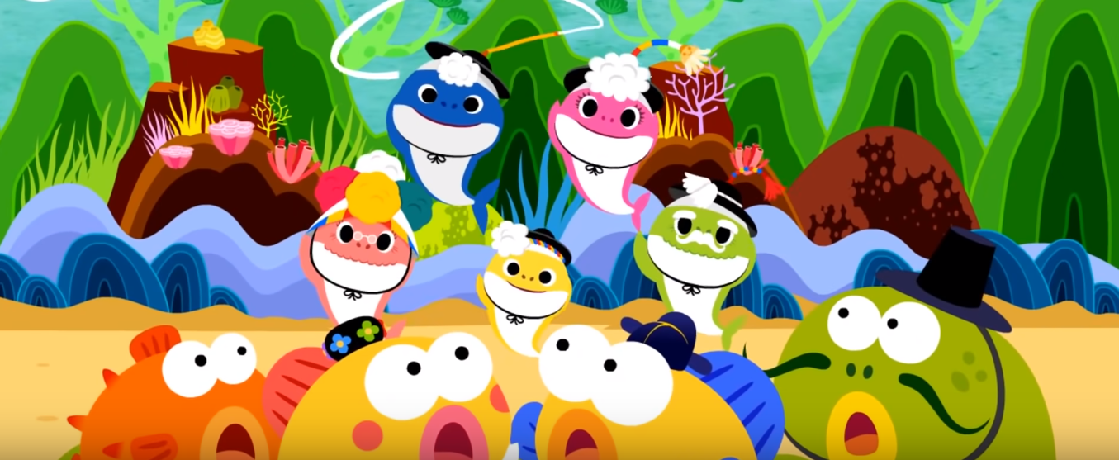
LET’S WARM UP
https://www.youtube.com/watch?v=3XWRT0JZd5k
Notes:
Warm-up song: Baby shark new version: https://www.youtube.com/watch?v=3XWRT0JZd5k
After warm –up: T divides class into 4 groups: horse, bee, cow and rabbit.

Slide 3

Unit 6:
Lesson 3
1. Trace the letters.
a. How to write Big F
WHERE’S YOUR FINGER?
Notes:
T asks Ss “ Where your finger?”
- Intructs Ss to raise index finger and response “ Here here here”

Slide 4


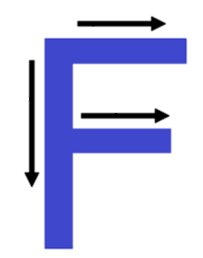


Unit 6
Lesson 3

Slide 5
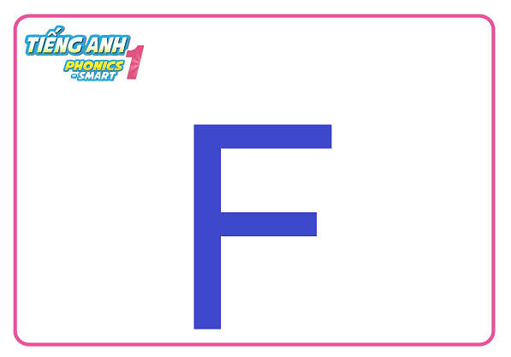
Unit 6:
Lesson 3
1. Trace the letters.
a. How to write Big F
2
3
1
Notes:
How to write big F?

Slide 6



Unit 6:
Lesson 3
1. Trace the letters.
WHERE’S YOUR FINGER?
a. How to write Big F
2
Let’s write in the air
3
1
Notes:
Has Ss practice writing letter F in the air
Calls each team to practice

Slide 7

Unit 2:
Lesson 3
1. Trace the letters.
WHERE’S YOUR FINGER?
a. How to write Big F
2
Let’s write in the palm
3
1
Notes:
Has Ss practice writing letter F in the palm
Calls each team to practice

Slide 8
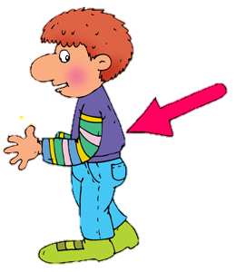
Unit 2:
Lesson 3
1. Trace the letters.
WHERE’S YOUR FINGER?
a. How to write Big F
Let’s turn left and write
2
3
1
Notes:
Turn left and write on the friend’s back

Slide 9


Unit 6:
Lesson 3
1. Trace the letters.
2
Let’s write
1
3
2
1
Notes:
Ask students to take out their own boards and chalks.
T will give some commands along with writing on the board, for example: “ Write big F, write small f”
- Students will write on their own boards, then raise their board for teacher’s checking.

Slide 10

Unit 6:
Lesson 3
1. Trace the letters.
a. How to write small F
1
2
Notes:
How to write small F?

Slide 11
Unit 6:
Lesson 3
1. Trace the letters.
WHERE’S YOUR FINGER?
a. How to write small f
1
2
Let’s write in the air
Notes:
Has Ss practice writing letter f in the air
Calls each team to practice

Slide 12
Unit 2:
Lesson 3
1. Trace the letters.
WHERE’S YOUR FINGER?
a. How to write small f
Let’s turn right and write
1
2
Notes:
Turn right and write on the friend’s back

Slide 13
Unit 6:
Lesson 3
1. Trace the letters.
F
F
f
Notes:
1st round
- T give commands: Wrtie Big F, big F, small f
- After 1-2 minutes, ask Ss to raise the board
- T check with whole class
- Correct answer: Big F, big F, small f

Slide 14
Unit 6:
Lesson 3
1. Trace the letters.
F
F
f
f
F
f
Notes:
2nd round:
- T reads aloud slowly the commands: Write small f, big F, small f
- Students will write on their own boards, then raise their board for teacher’s checking.

Slide 15

Well done

Slide 16
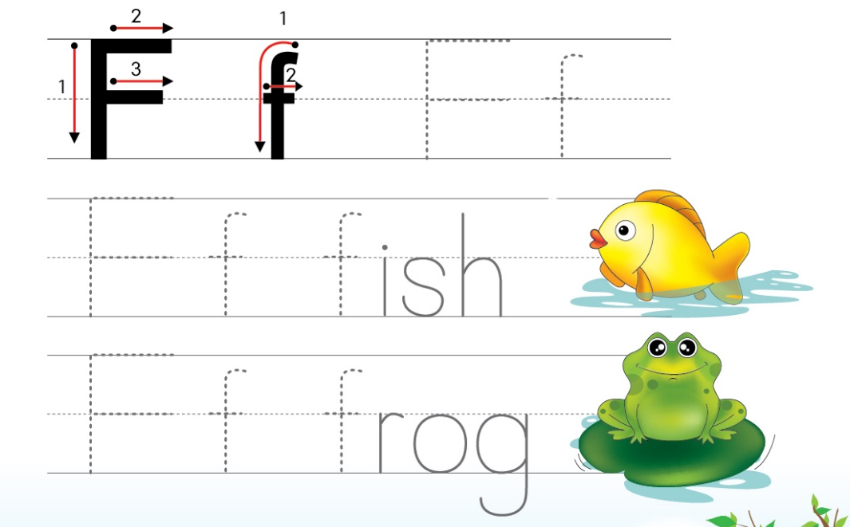
Unit 6:
Lesson 3
1. Trace the letters. (p28)
F
f
F
f
f
F
f
f
Notes:
- Asks Ss to open the book and trace letter Ff .

Slide 17
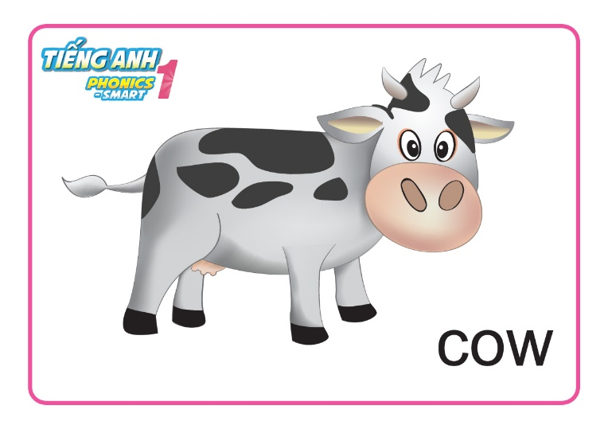
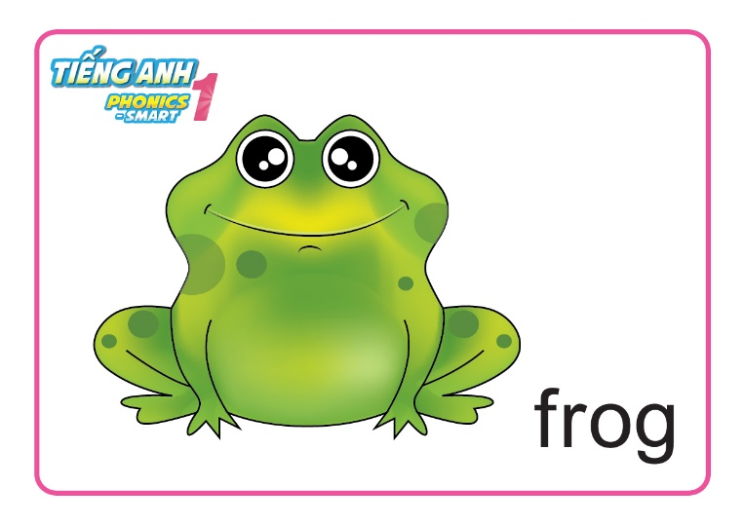
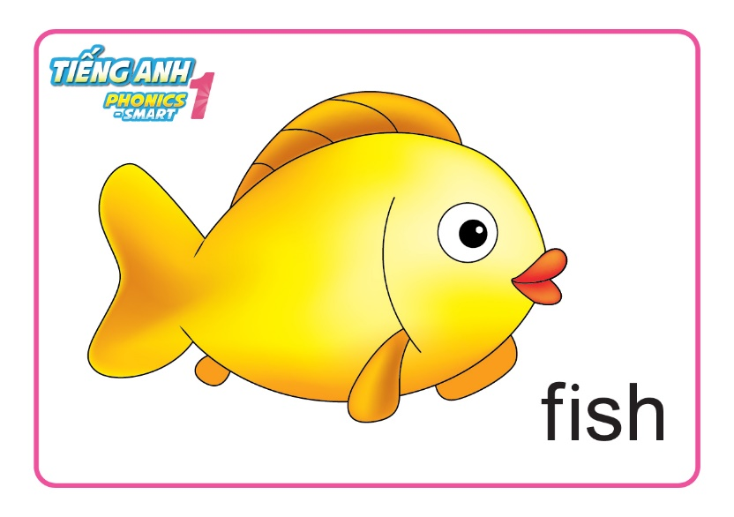
Unit 6:
Lesson 3
1. Trace the letters.
2. Point and say.
Notes:
Review some words before doing part 2: fish, frog, cow
Play small game: Show half of the flashcard and ask Ss if they know what the animal it is.
Check the answer by clicking to reveal the other half
T has Ss read the words twice.

Slide 18

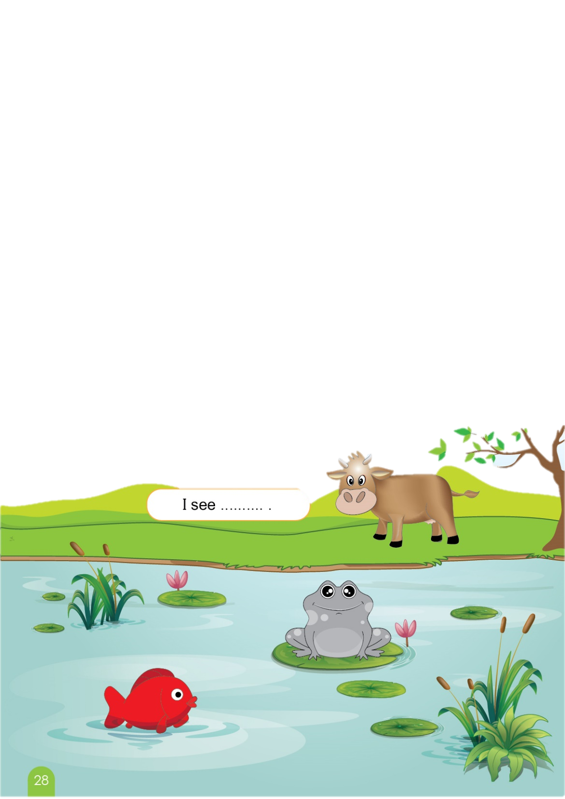


Unit 6:
Lesson 3
1. Trace the letters.
2. Point and say.
I see a fish.
I see a frog.
I see a cow.
Notes:
T asks Ss to open the book p28.
Instructs Ss to do the task
Reminds Ss to use the structure “ I see….”
T can do an example with the picture “cow” by clicking to the cow in the picture -> The sentence will show up.
T has Ss read point to the cow in their book and repeat the sentence.
T click to the cow again to hide the sentence.
** With the frog and fish picture, T repeat the process.

Slide 19

SAY IT RIGHT?
Notes:
Give hat of animals for 3 players.
- Teacher stands behind players and act out a word.
- Whole class say : I see ....
- The players look and say .: A .... can ...
- The faster will be the winner.

Slide 20


SAY IT RIGHT?
Hide/
unhide
Check answer
I see a fish.
A fish can swim.

Slide 21
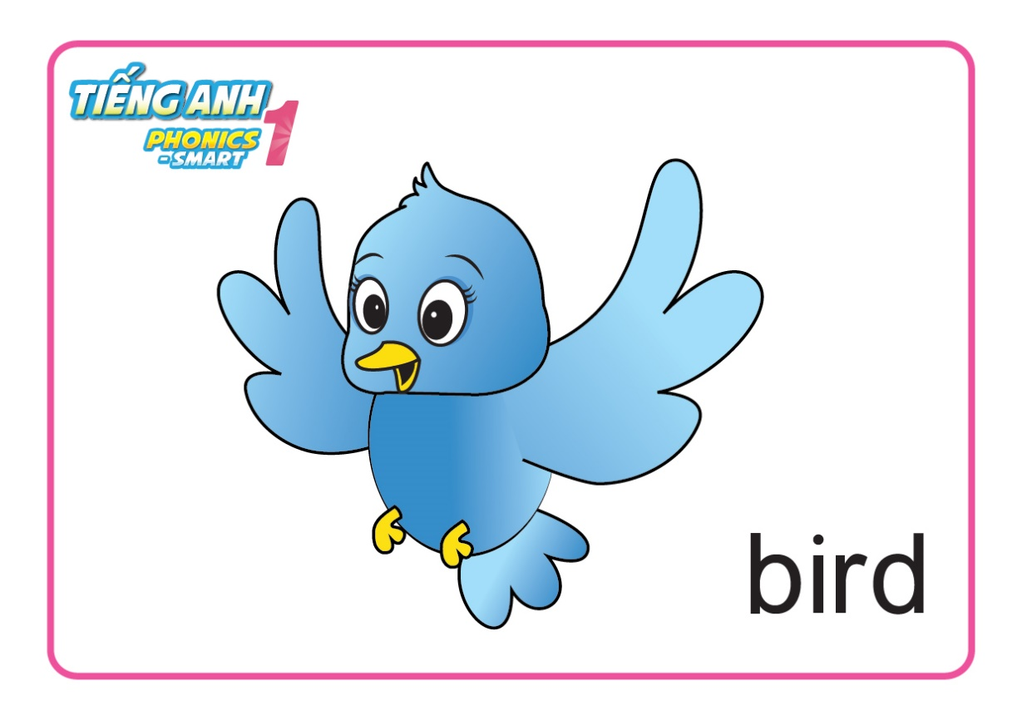
SAY IT RIGHT?
Hide/
unhide
Check answer
I see a bird.
A bird can fly.

Slide 22

SAY IT RIGHT?
Hide/
unhide
Check answer
I see a frog.
A frog can jump.

Slide 23

Unit 6:
Lesson 3
1. Trace the letters.
2. Point and say.
Notes:
T asks Ss to open the book p28.
Instructs Ss to do the task
Reminds Ss to use the structure “ I see….”
T can do an example with the picture “cow” by clicking to the cow in the picture -> The sentence will show up.
T has Ss read point to the cow in their book and repeat the sentence.
T click to the cow again to hide the sentence.
** With the frog and fish picture, T repeat the process.

