Slide 1







9
Colours
LESSON 2
Period 3

Slide 2
01
Warm-up and review

Slide 3
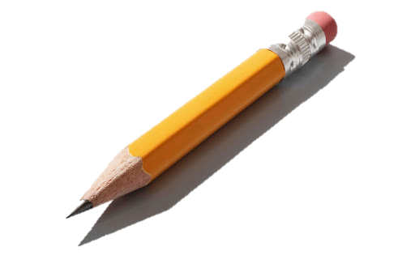

a pencil
pencils

Slide 4

an eraser
erasers

Slide 5
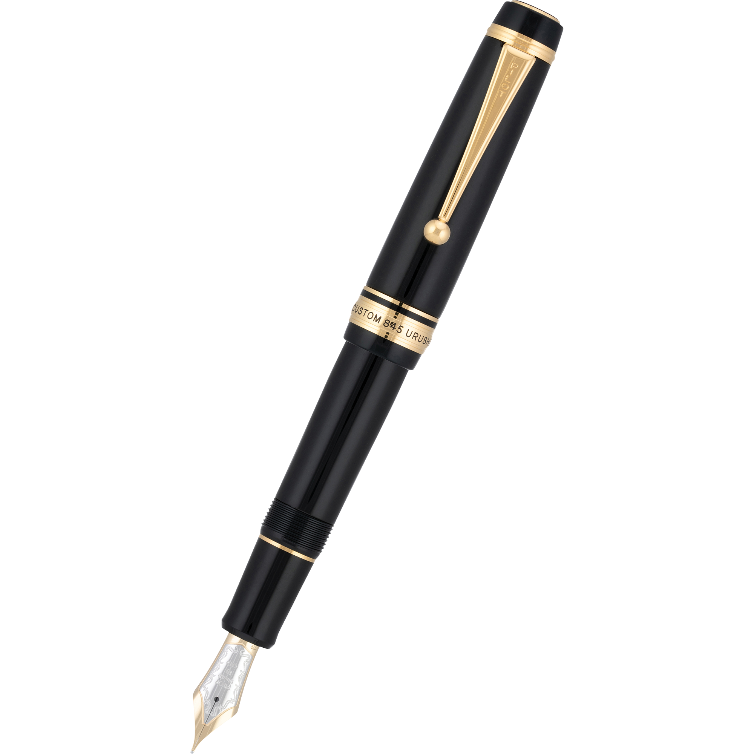
a pen
pens

Slide 6
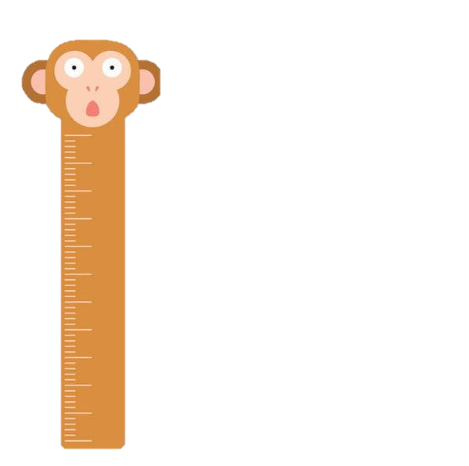
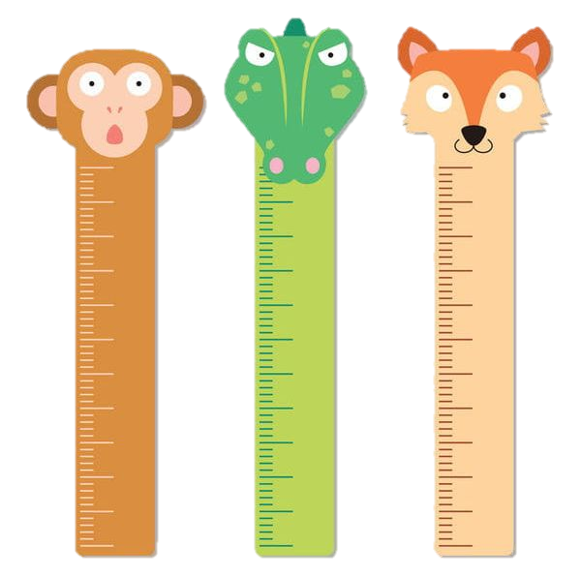
a ruler
rulers

Slide 7
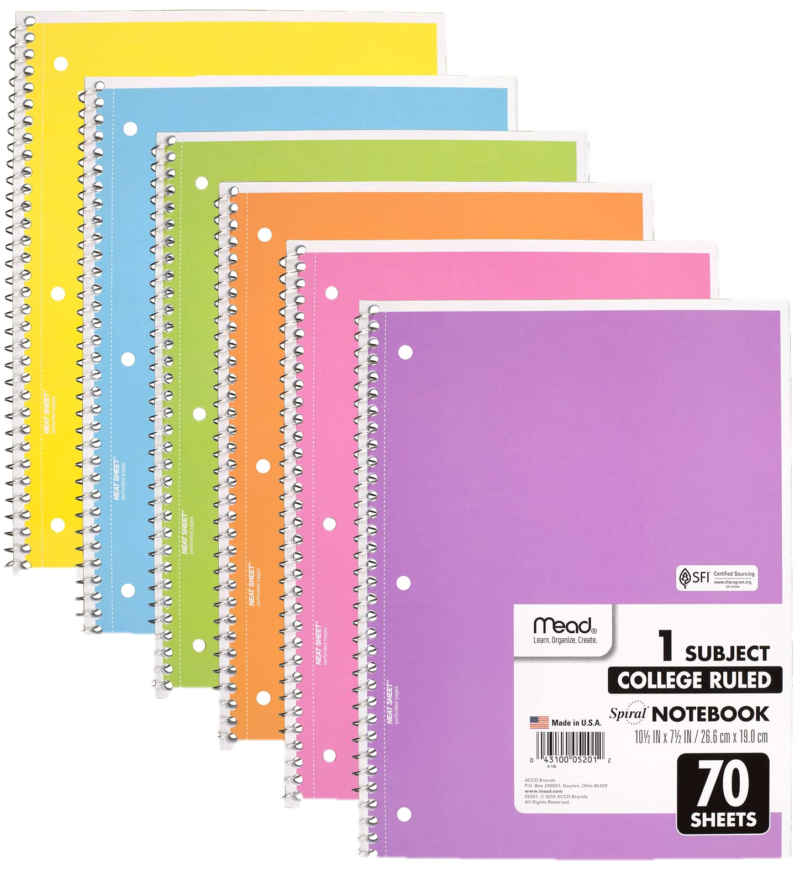
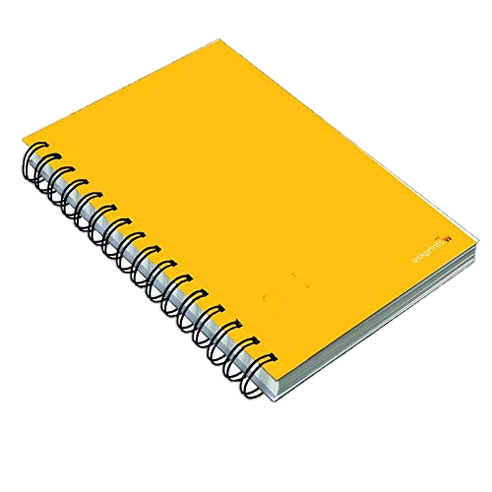
a notebook
notebooks

Slide 8


a book
books

Slide 9
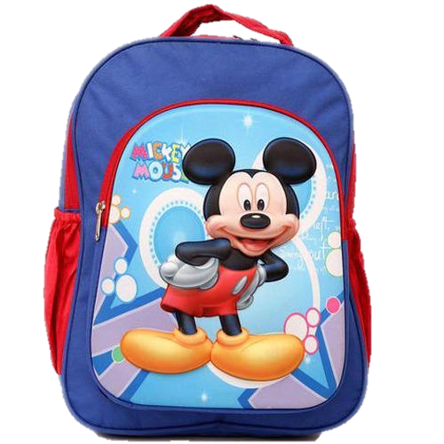
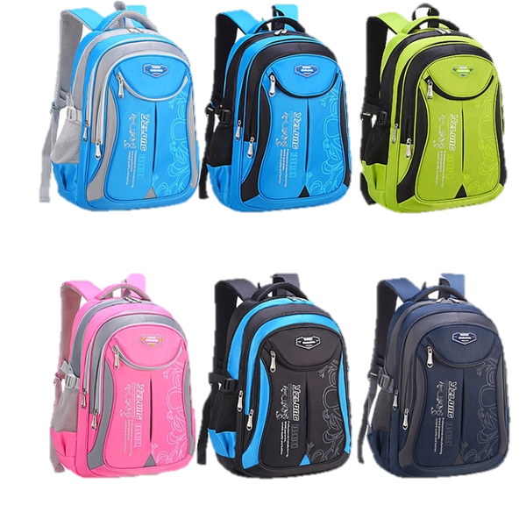
a school bag
school bags

Slide 10

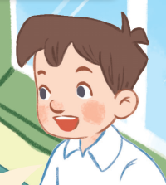
Do you have ......................?
erasers
Yes, I do.

Slide 11

Do you have ......................?
pencils
Yes, I do.

Slide 12

Do you have ......................?
pens
Yes, I do.

Slide 13
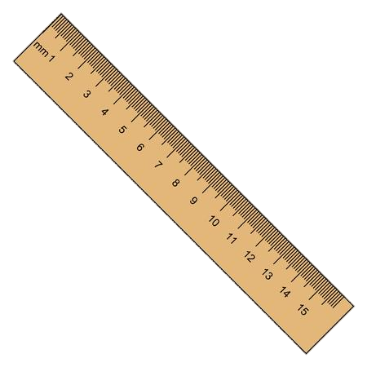
Do you have ......................?
rulers
Yes, I do.

Slide 14

Look, listen and repeat.

Slide 15


What colour are they?
What are these?
They are green.
They are pencils.

Slide 16
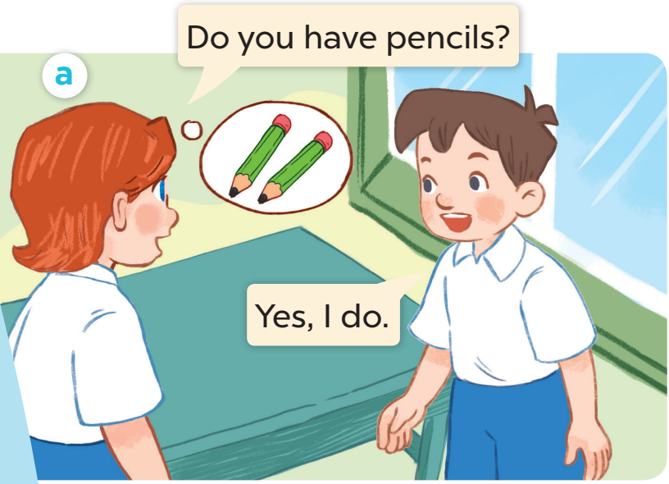
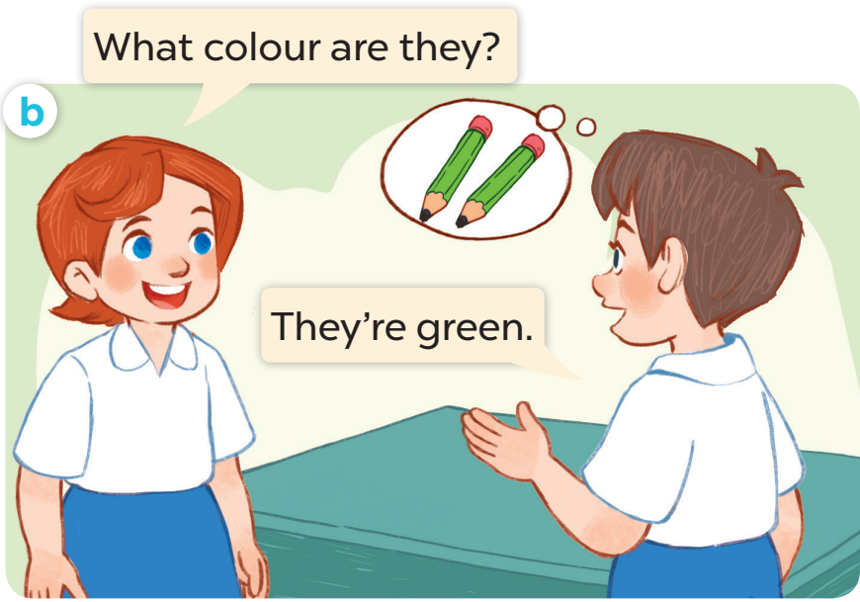

Slide 17

Listen, point and say.

Slide 18

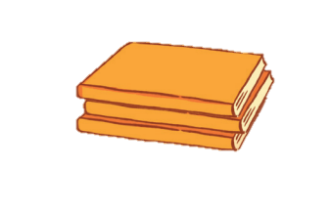

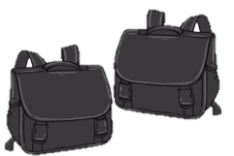
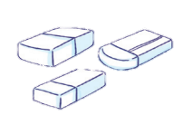
Orange
Green
White
Black

Slide 19

Let’s talk.

Slide 20
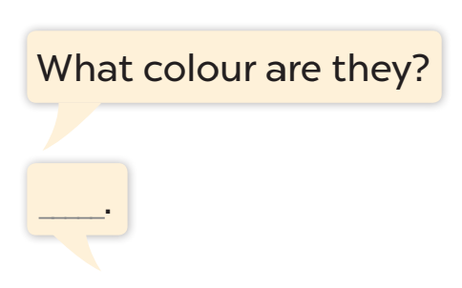
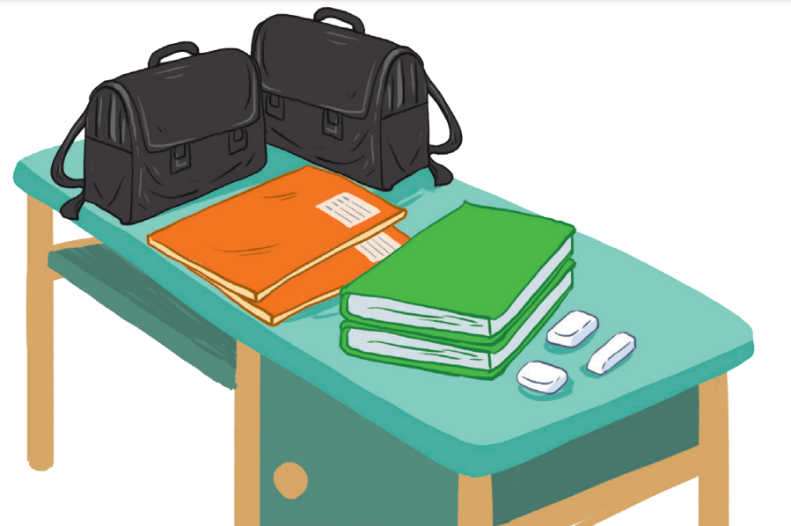

Slide 21

Fun corner and wrap-up

Slide 22



















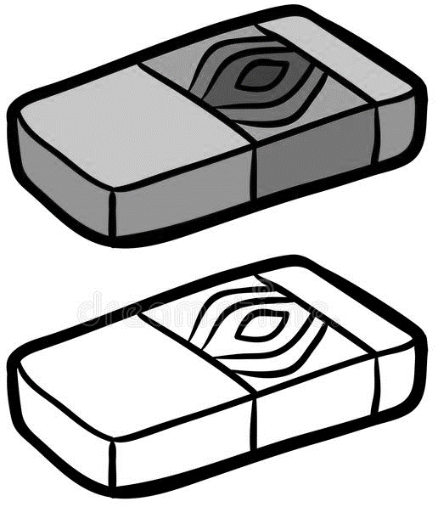
A
B
C
D
1
-1
Choose 1 box to open. Beware of bombs or dynamites.
Green Gem +1pt
Purple Gem +5pts
Trophy +10 pts
Crying face -3 pts
2
-5
3
4
-2
Notes:
Game: Lucky number
Divide the class into groups of 2 (boys and girls).
Each team then chooses a pair of number and letter.
For example: 1 A. Then they must identify the picture number 1 and color A. Two students in the team will have a dialog “what color are the notebooks?” and the answer must be “they are pink”.
The group with more points at the end of the game will be the winner.

