Slide 1



Slide 2
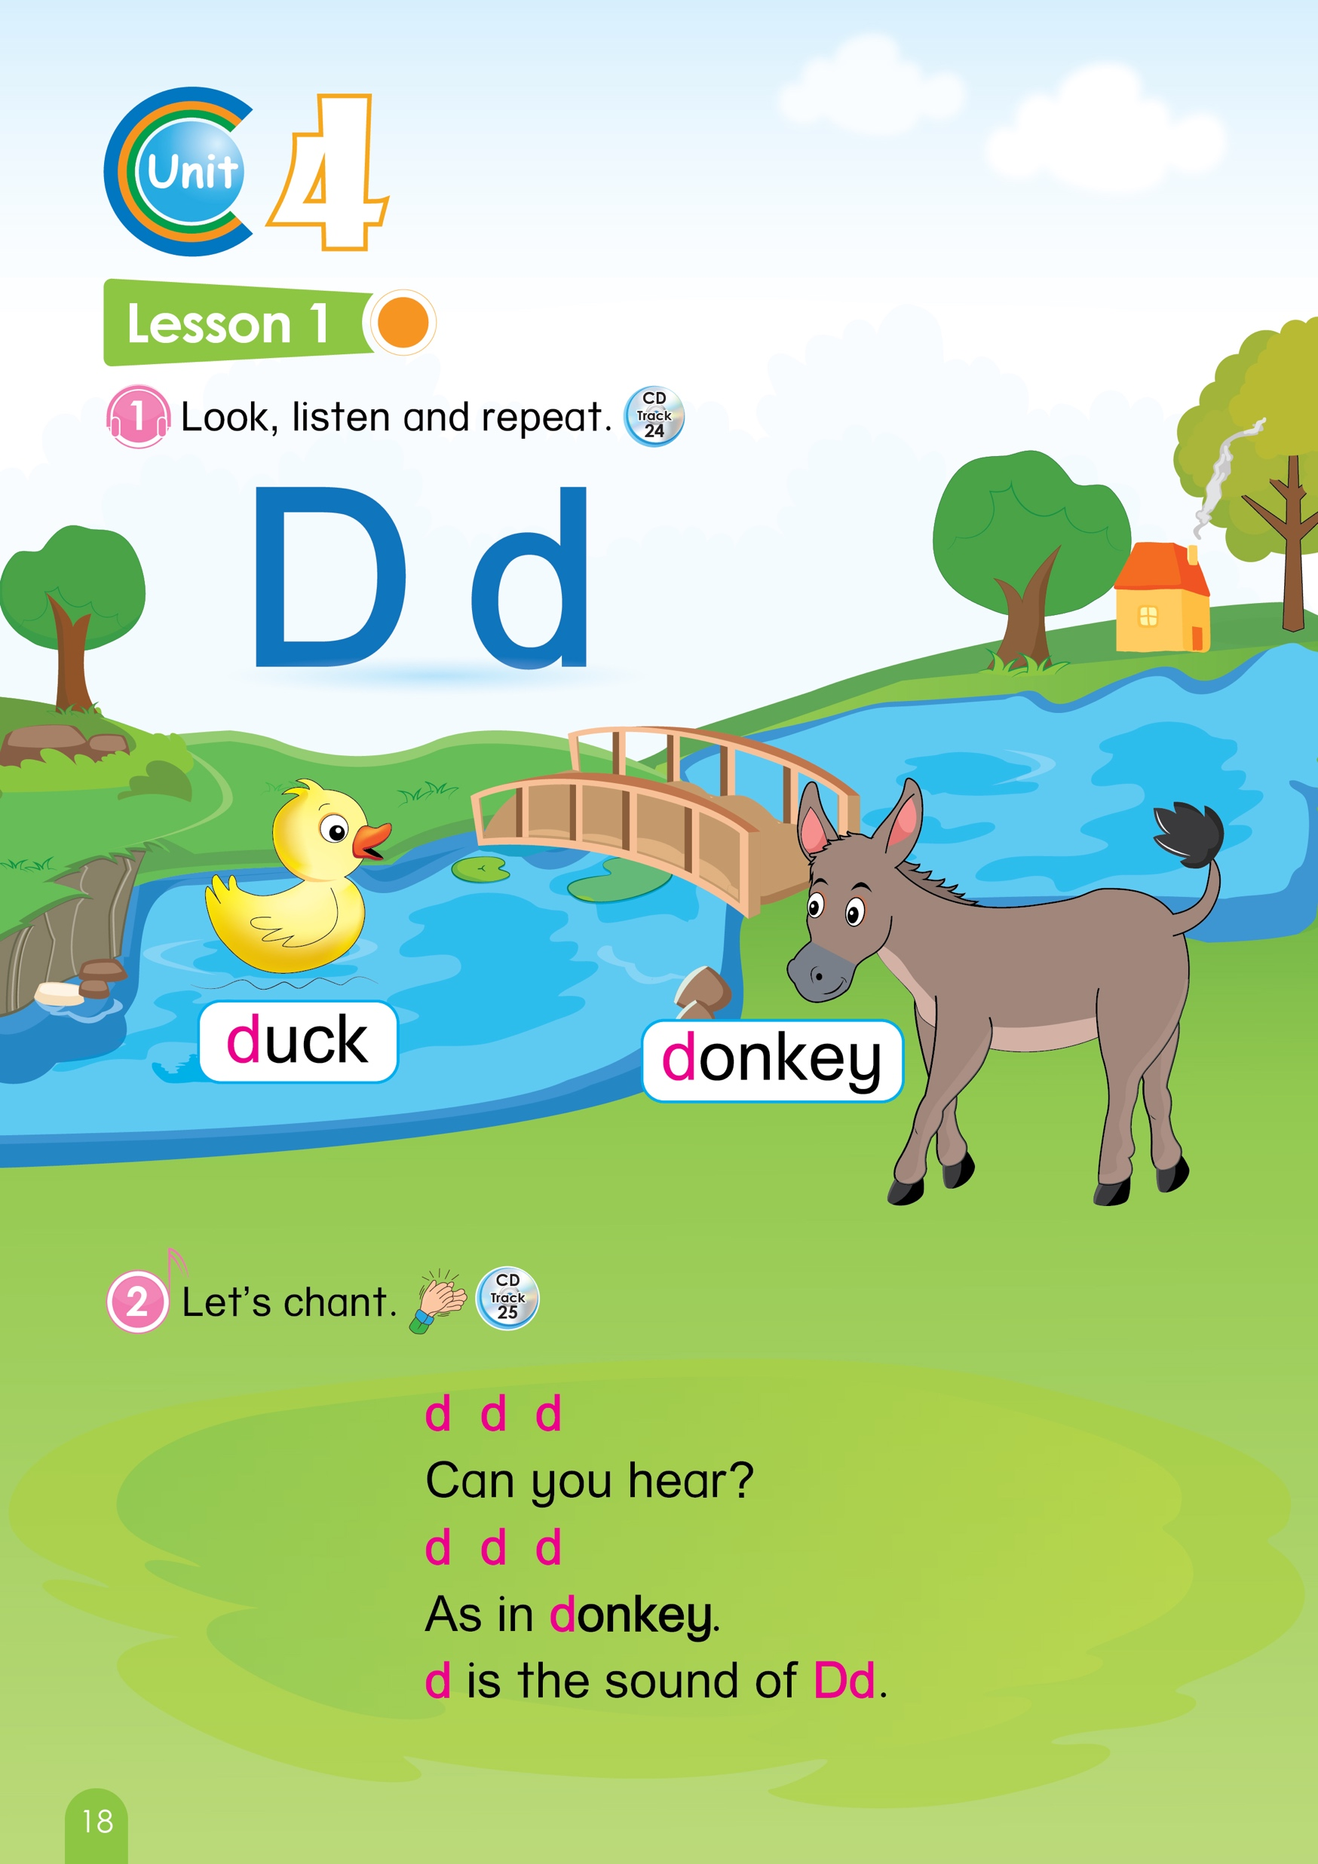

Let’s sing
Animals song
Notes:
Teacher says “ Hello, everyone. How are you? How’s the weather? Is it sunny? Great! Now, let’s sing a song with me.”
Warm up: Sing “Animals song” – “Excellent! You sing and dance very well.”
Split the class into 2 groups – “Today, we will have 2 groups – group 1 and group 2. You are group 1, you are Group 2.”
Chèn animals song

Slide 3
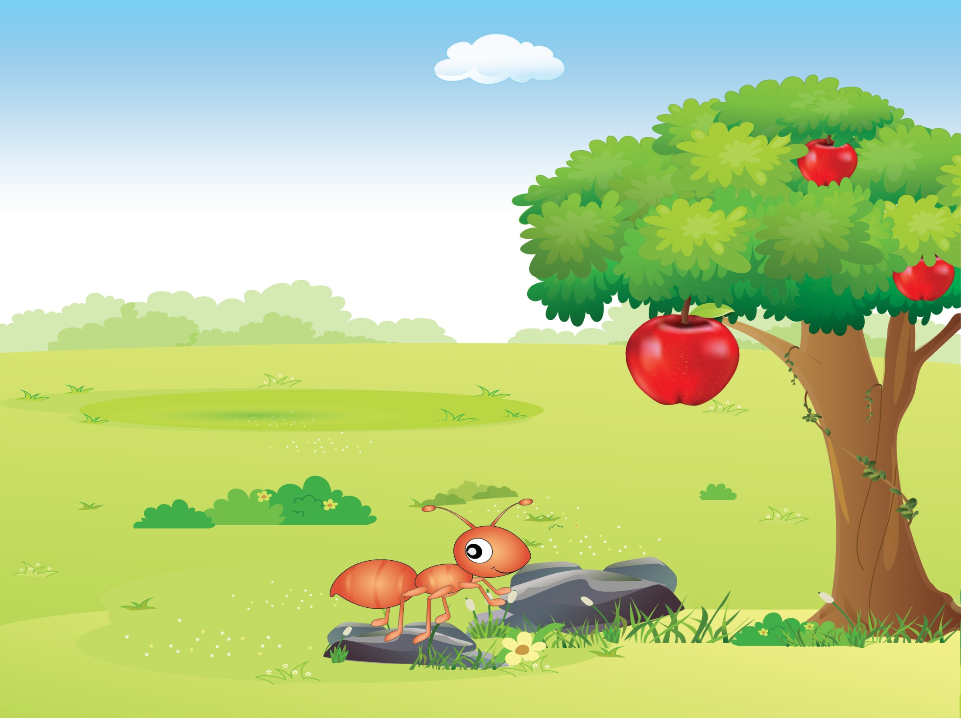

REVIEW
UNIT 4, 5, 6
(Period 1)
Notes:
Introduction: The lesson today is reviewing from Unit 1 to Unit 6
Teacher says “ We will meet our old friends. Do you remember? Let’s meet them right now.”

Slide 4

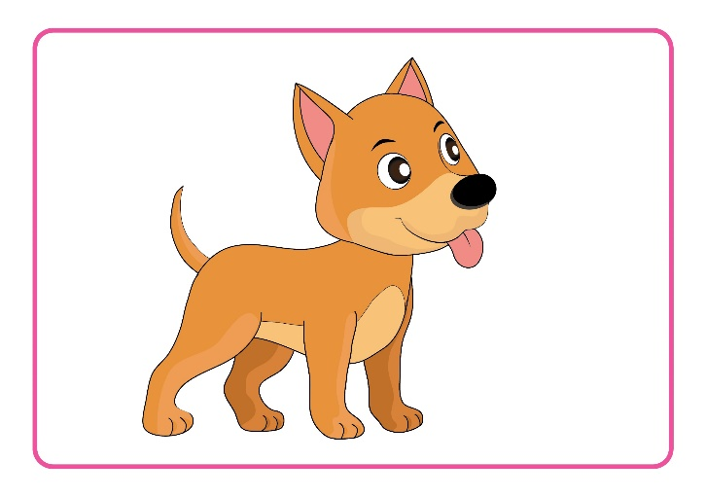

Review
Unit 4 – Unit 6
1. Look and say
Dd
d
Notes:
Teacher shows the letter Dd, sound /d/ and two pictures dog and duck one by one.
Teacher asks: What letter is it? – Dd , What is the sound of Dd? - /d/
Teacher asks: “What is it? – dog . What sound does a dog make? –woof woof”
Teacher asks : “What is it? – duck. What sound does a duck make? Quack Quack”

Slide 5
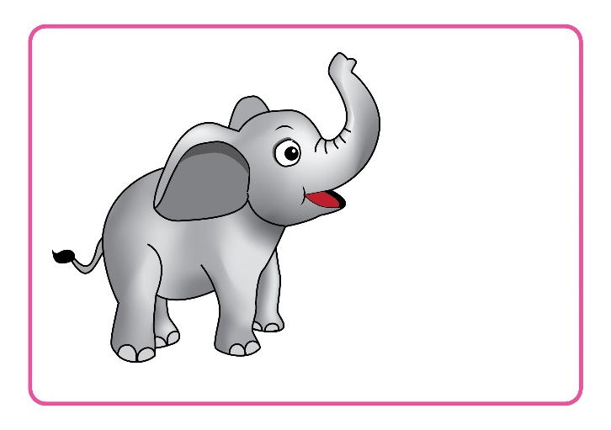
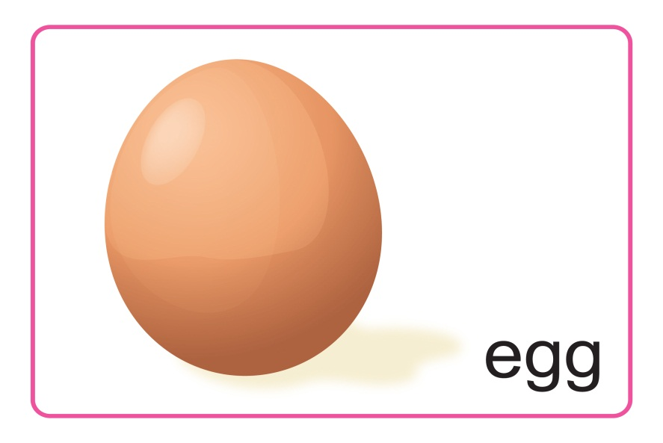
Review
Unit 4 – Unit 6
1. Look and say
Ee
e
Notes:
Teacher shows the letter Ee, sound /e/ and two pictures Elephant and Egg one by one.
Teacher asks:” What letter is it? – Ee , What is the sound of Ee? - /e/”
Teacher says: “What is it? – elephant”
Teacher says: "What is it? – egg. -> Good job. Now say say again E for elephant, E for Egg “
Teacher uses the body languages to describe an elephant, an egg.

Slide 6
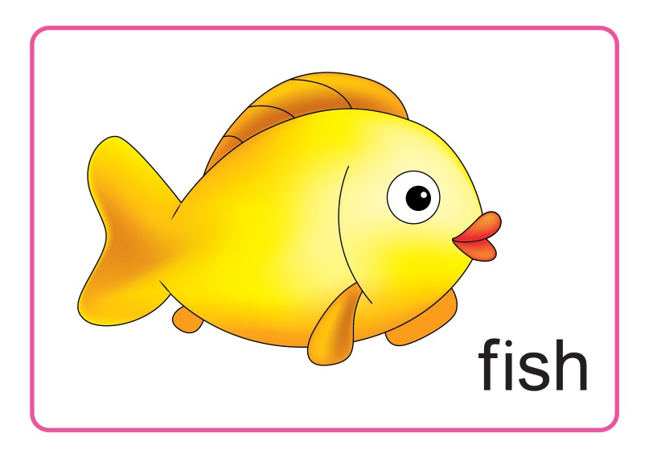
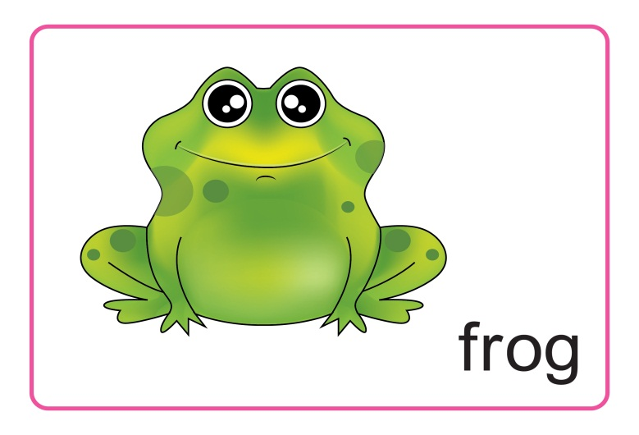
Review
Unit 4 – Unit 6
1. Look and say
Ff
f
Notes:
T shows the letter Ff, sound /f/ and two pictures fish and frog one by one.
Teacher asks: “What letter is it? – Ff , What is the sound of Ff? - /f/”
Teacher asks: “What is it? – fish. What can a fish do? – Can a fish fly ? No. Can a fish swim? Yes.”
Teacher asks: “What is it? – frog. What can a frog do? – Can a frog fly? No. Can a frog jump? Yes. -> Good job. “
Now say say again F for fish, F for frog. Teacher uses the body languages to describe a fish, a frog.

Slide 7

Notes:
Good job!

Slide 8



Review
Unit 4 – Unit 6
2.Can you choose ?
Notes:
T says: “Now, Let’s play a game called: Can you choose?”

Slide 9

fish
cat
bear
bird
Notes:
1. Teacher says: “Now, Look at the screen. What can you see? A fish.”
2. Teacher says: “You need to choose the word of fish. There are 4 answers, but only one is correct.”
3. Teacher says: “For example.” Teacher clicks the word “ cat” – The sound plays ten tèn→” It’s not fish.”
We can find the word ”fish”. Then click fish “yeah – Awesome “
Say it again “fish”
4. With the correct answer, that team will have 1 point.

Slide 10
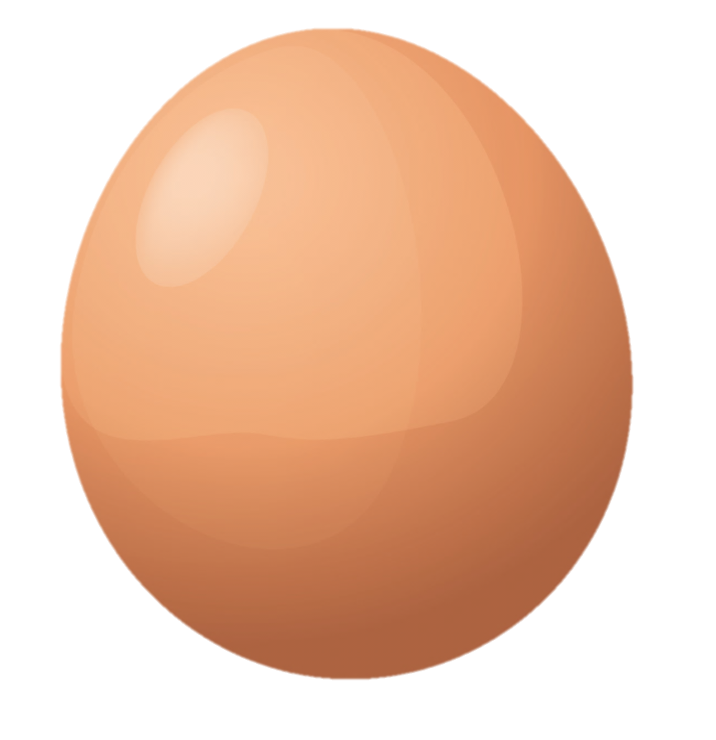
cat
cow
egg
apple
Notes:
1. T says: “Now, Look at the screen. What can you see? An egg.”
2. T says: “Is it the word egg?” Teacher clicks on cow – The sound plays ten tèn→” It’s not egg”
3. T says: “We can find the word egg”. Click egg ” yeah – very good”
4. T says: “Say it again egg”
5. With the correct answer, that team will have 1 point.

Slide 11
bird
fish
donkey
elephant
Notes:
1. Teacher says :”What is it? Yes, It is an elephant “
2. Teacher says: Where is the word “ elephant”? – click the word elephant- “here, good”
3. Teacher says: “Say it again elephant”
4. With the correct answer, that team will have 1 point.

Slide 12

fish
ant
frog
duck
Notes:
1. Teacher says : “What is it? Yes, It is a frog.”
2. Teacher says : “Where is the word “ frog”? –click the word frog.” Excellent”
3. Teacher says : “Say it again frog”
4. With the correct answer, that team will have 1 point.

Slide 13

apple
duck
egg
cat
Notes:
1. T says : “What is it? Yes, It is a duck.”
2. T says : “Where is the word “ duck”? – click the word duck.” Excellent”
3. T says : “Say it again duck”
4. With the correct answer, that team will have 1 point.

Slide 14
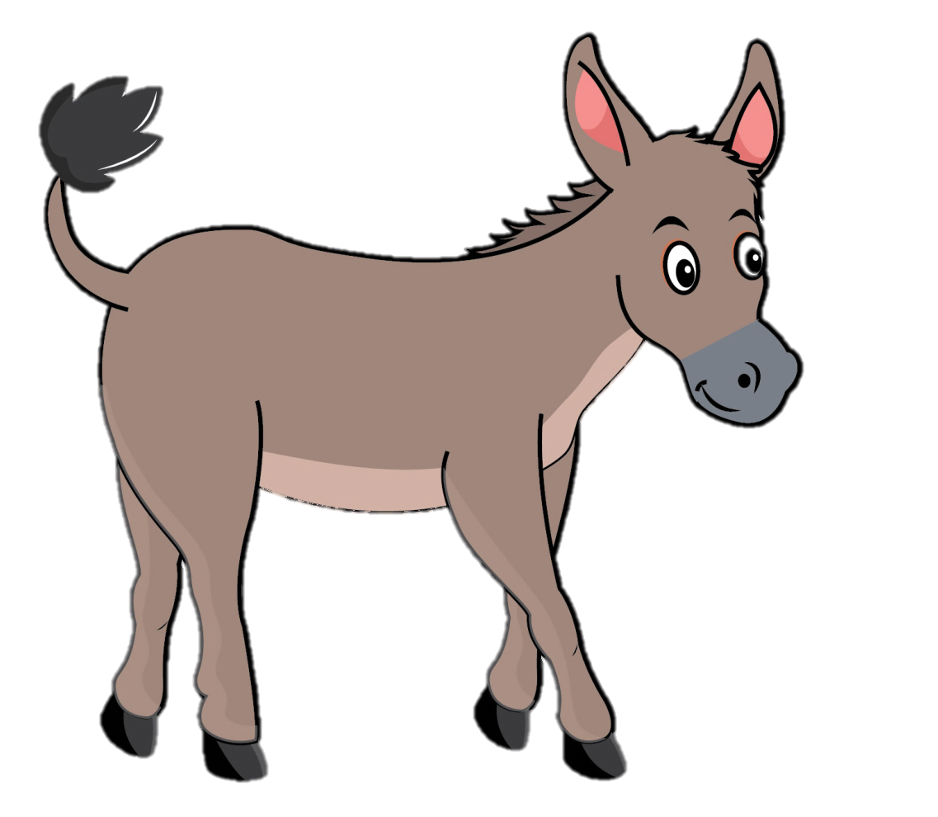
duck
dog
donkey
cow
Notes:
1. Teacher says: “How about this animal. What is it? Yes, It is a donkey.”
2. Teacher says: “Where is the word donkey?” – click donkey “Excellent”
3. Teacher says: “Say it again donkey”
4. With the correct answer, that team will have 1 point.

Slide 15


Slide 16

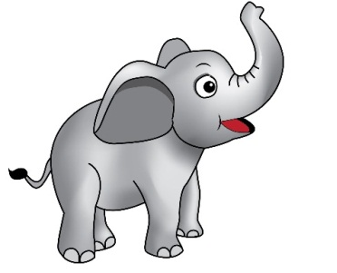
Review
Unit 4 – Unit 6
3. Look and match .
4
3
Notes:
T says : “Let’s go to part 3: Look and match”
T says : “What are they? Frogs – good”
T says : “What are they? Elephant – yes”
T says : “You need to count the frogs and the elephants then choose the right numbers.”
T says : “How many frogs? 3, ok match frogs with number 3” (click)
T says : “How about elephants? 4 “ (click)– “well done.”
7. With the correct answer, that team will have 1 point.

Slide 17
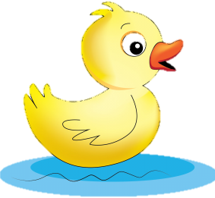
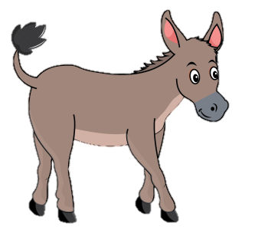
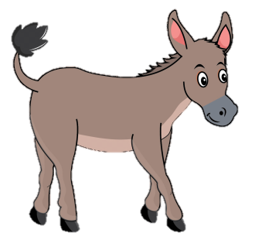
Review
Unit 4 – Unit 6
3. Look and match .
5
2
Notes:
T says : “What are they? ducks – good”
T says : “What are they? donkeys – yes”
T says : “How many ducks? 2, ok match birds with number 2”(click)
T says : “How about donkeys? 5 – well done. Let’s count 1,2,3,4,5 (click) “Yeah”
5. With the correct answer, that team will have 1 point.

Slide 18
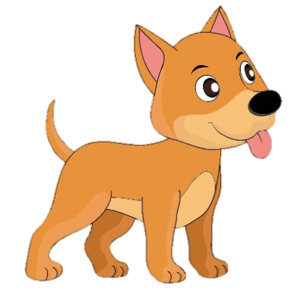
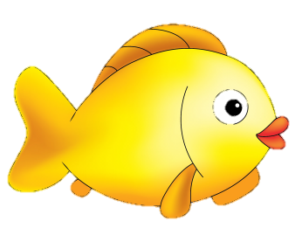
Review
Unit 4 – Unit 6
3. Look and match .
4
1
Notes:
T says : “What is it? dog – good.”
T says :”What are they? fish- yes, what color are these fish ? Yellow, yellow, yellow”
T says :”How many dogs? 1, “(click) “1 dog. Good”
T says : “How about fish? 4 – Let’s count 1,2,3,4 fish.”(click) “well done”
5. With the correct answer, that team will have 1 point.

Slide 20

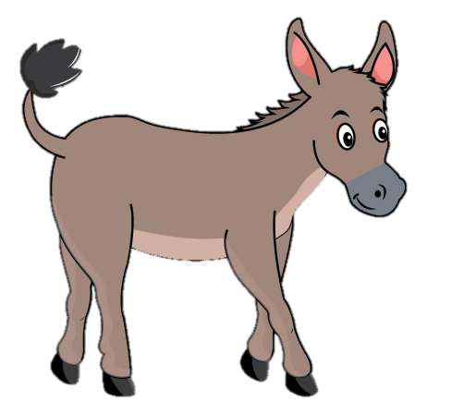
Review
Unit 4 – Unit 6
4. Look, read and tick the box .
dog.
1. It is a
duck.
elephant.
2. It is a
donkey.
Notes:
Teacher says : “We move to part 4: Look, read and tick the box”
Teacher says :”You need to choose the right answer by ticking the box.”
Teacher says : “For example: It is a ” What is it? – Dog. Yes – It is a dog.”
Teacher says: “Now tick the box with the word “ dog”. This box (duck) – No, This box (dog).(click) Yeah
Teacher says: “We continue It is a “ Donkey”- Choose the donkey box(click). Very good.”
6. With the correct answer, that team will have 1 point.

Slide 21

Review
Unit 4 – Unit 6
4. Look, read and tick the box .
dog.
3. It is a
duck.
egg.
4. It is an
apple.
Notes:
Teacher says: “We continue It is a “ Duck”- Choose the duck box.(click) – yeah”
Teacher says: “It is an “Egg”.- Choose the egg box. (click)- Good”
5. With the correct answer, that team will have 1 point.

Slide 22

Review
Unit 4 – Unit 6
4. Look, read and tick the box.
frog.
5. It is a
duck.
bee.
6. It is an
elephant.
Notes:
Teacher says: It is a “frog”- Choose the frog box (click)
Teacher says: It is an ”elephant”.- Choose the elephant box.(click)
3. With the correct answer, that team will have 1 point.

Slide 23

Review
Unit 4 – Unit 6
4. Look, read and tick the box .
run.
13. A can ___.
swim.
jump.
14. A can__
fly.
Notes:
Teacher says: “Now look at this: What is it? Yes, a fish. What can a fish do? “(Teacher does gestures : run, swim, fly and asks the students to choose) – “swim, good. So which box ? Yes – swim.”(click). Well done.
Teacher says: “What is it? – Frog. Can a frog fly? No. Can it jump? Yes . So which box? - Jump “. (click) “Good”
3. With the correct answer, that team will have 1 point.

Slide 24
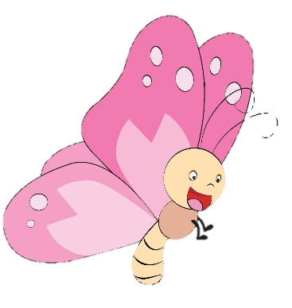
Review
Unit 4 – Unit 6
4. Look, read and tick the box .
fly.
15. A can ___.
jump.
fly.
16. A can__
run.
Notes:
T says: “Now look at this: What is it? Yes, a butterfly. What can a butterfly do?” (Teacher does gestures : run, swim, fly and asks the students to choose) – “fly, good. So which box ? Yes – fly.”(Click)
Teacher says: “What is it? – donkey, hee haw, hee haw. Can a donkey fly? No. Can it run? Yes . So which box? - run “.(click) “Good”
3. With the correct answer, that team will have 1 point.

Slide 25
Notes:
Well done.
Now, follow me: swim, fly, run, jump
- The students follow the teacher

Slide 26



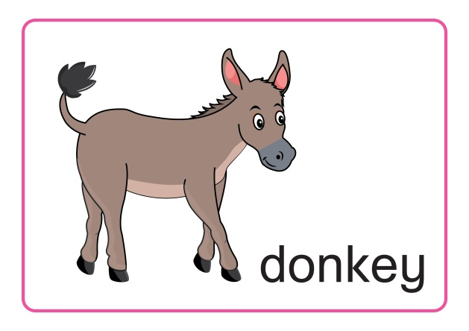


Review
Unit 4 – Unit 6
Notes:
Sum up – It’s time to say good bye to your friends today”.
Count the points of each group.
Group having more points will be the winner.-“So the winner is group …. Group …, you also good, too.”
Say goodbye. “Goodbye class, bye duck, bye donkey, bye egg, bye elephant, bye fish, bye frog.”

