Slide 1



Slide 2
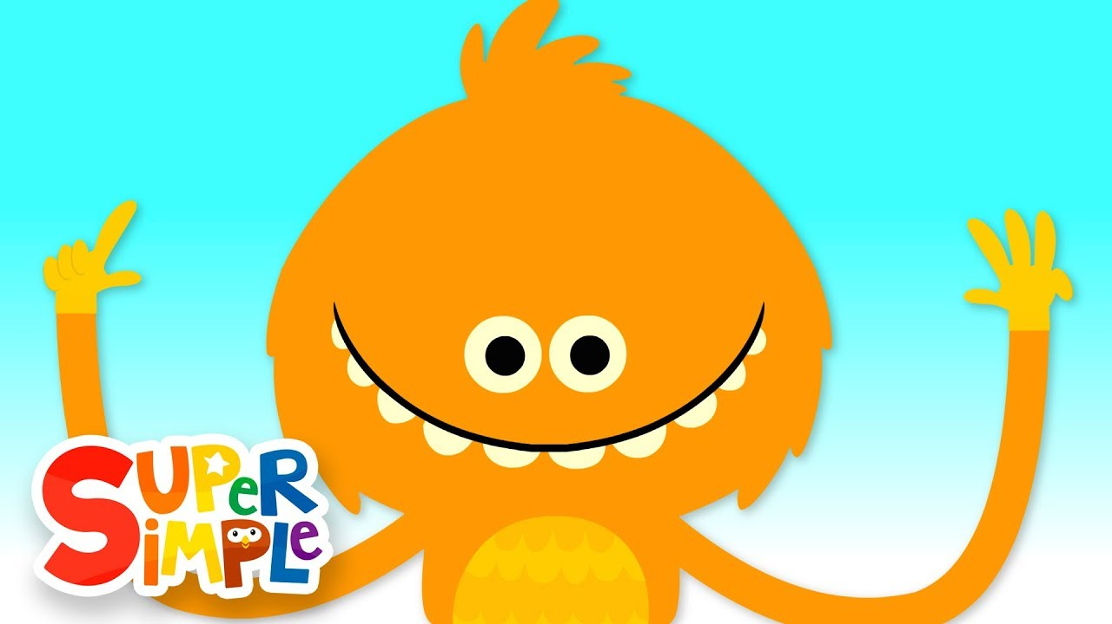
WARM - UP
Five fingers
Notes:
Sing “Animals” song in the Theme song of the software/ or play the clip in this slide
Press ESC to exit from the full screen while playing.

Slide 3
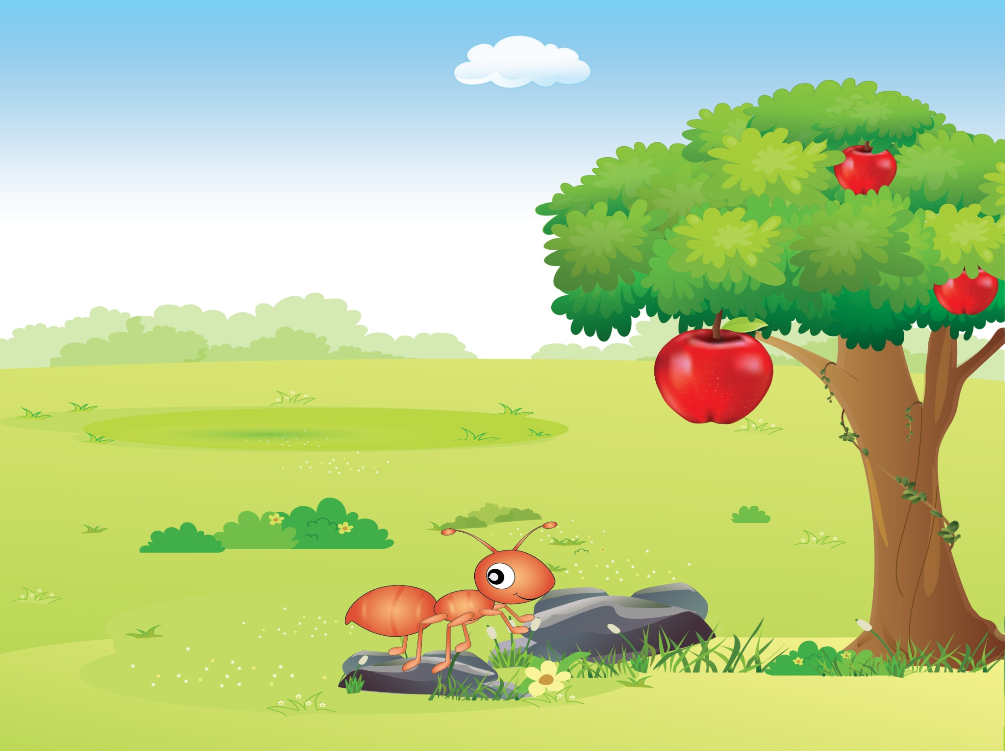

REVIEW
Unit 4,5,6
(Period 2)

Slide 4



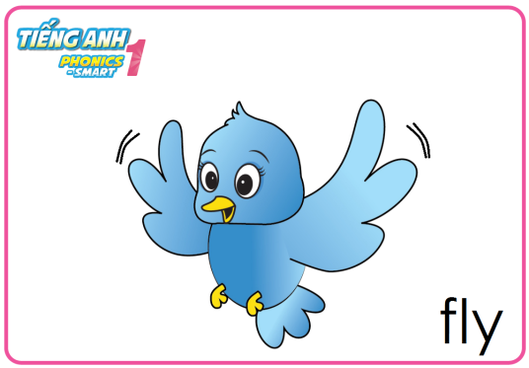
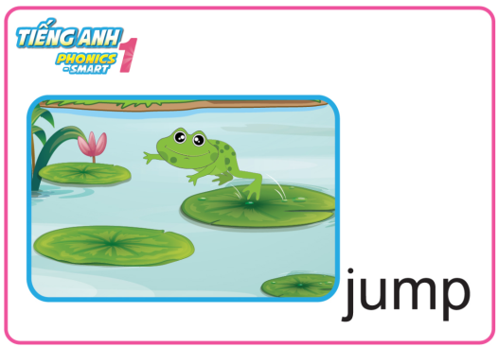
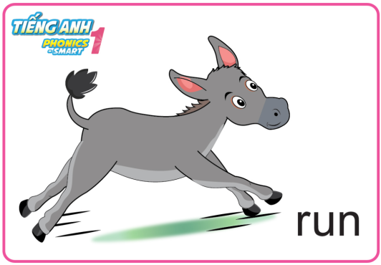

Review Unit 4 – 6 (P2)
Game: Slap the board
Notes:
- Review the words with body language/flashcards
- Play the game “Slap the board”

Slide 5
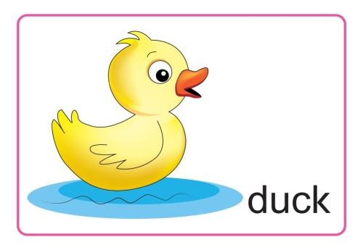
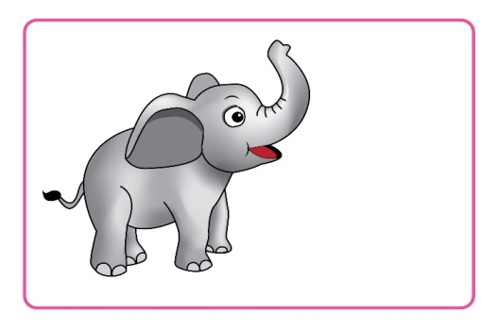
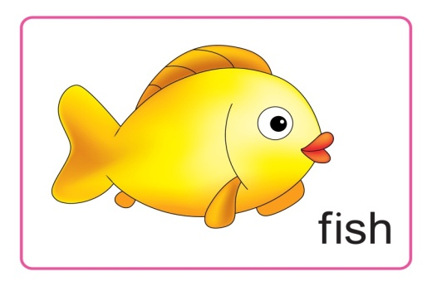
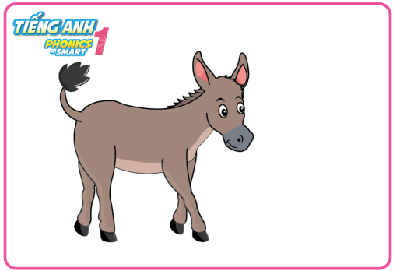

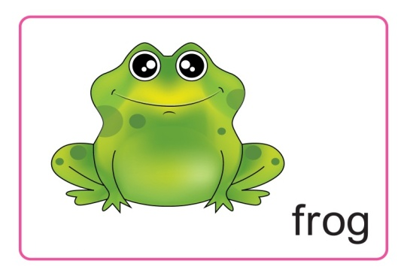
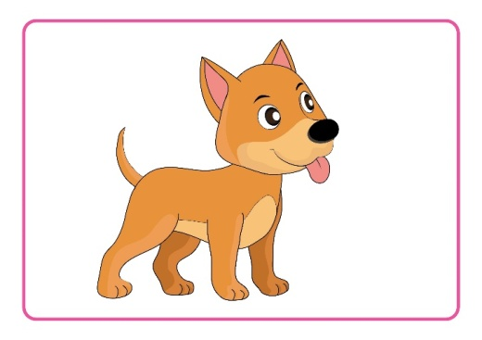
Review Unit 4 – 6 (P2)
Game:Animal escape
It is ....
The..... can.......
Notes:
After the game, has the whole class look and say all the animals

Slide 6
Review Unit 4 – 6 (P2)
Lucky number
1
2
3
4
5

Slide 7

Notes:
Well done.
Now, follow me: swim, fly, run, jump
- The students follow the teacher

Slide 8

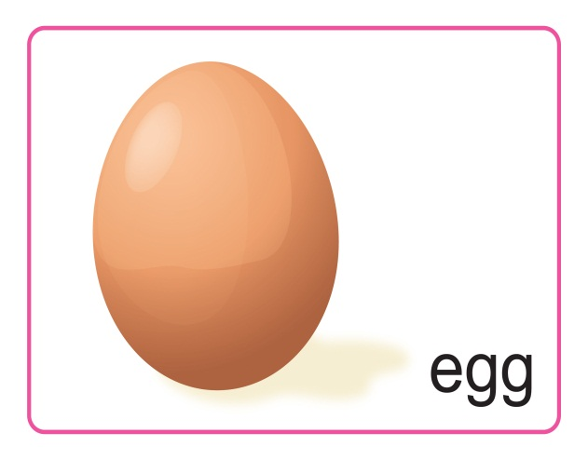

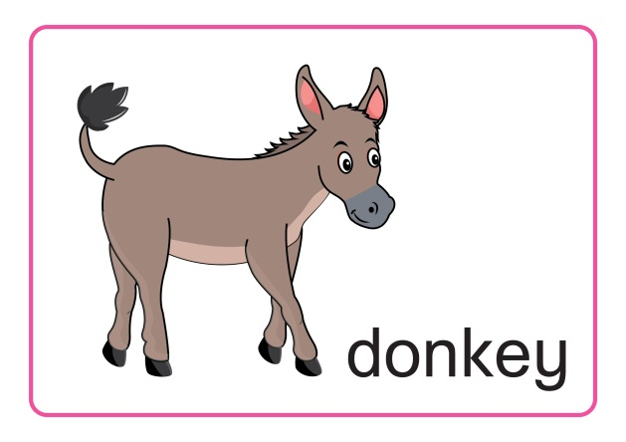


WRAP UP
Notes:
Wrap up the lesson

Slide 9


How many eggs?
A. three
B. four
B. four
C. five
BACK
Notes:
Mouse click to show answer
St with correct answer will receive the stars on the right corner

Slide 10
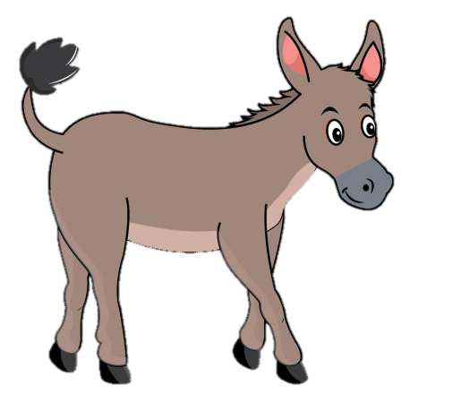
I see a ___.
A. dog
B. duck
C. donkey
C. donkey
BACK
Notes:
Mouse click to show answer
St with correct answer will receive the stars on the right corner

Slide 11

A fish can____.
A. swim
A. swim
B. run
C. fly
BACK
Notes:
Mouse click to show answer
St with correct answer will receive the stars on the right corner

Slide 12
_hicken
A. Letter C
A. Letter C
B. Letter D
C. Letter F
BACK
Notes:
Mouse click to show answer
St with correct answer will receive the stars on the right corner

Slide 13
e is the sound of __.
A
B
B
C
BACK
Notes:
Mouse click to show answer
St with correct answer will receive the stars on the right corner

