Slide 1


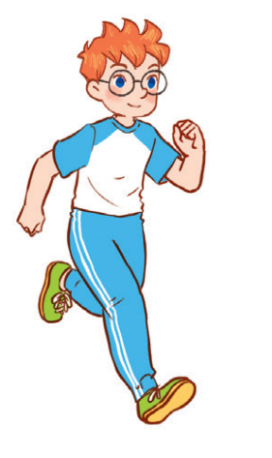
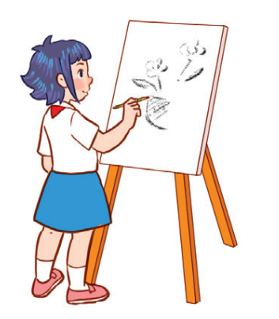

Unit 8
Activity 1-3

Slide 2
Warm-up and review
1
1
Watch a video.

Slide 3

Notes:
Link: https://www.youtube.com/watch?v=2G85e-xBPX4&t=14s

Slide 4
2
Look, listen and repeat.
2
4

Slide 5

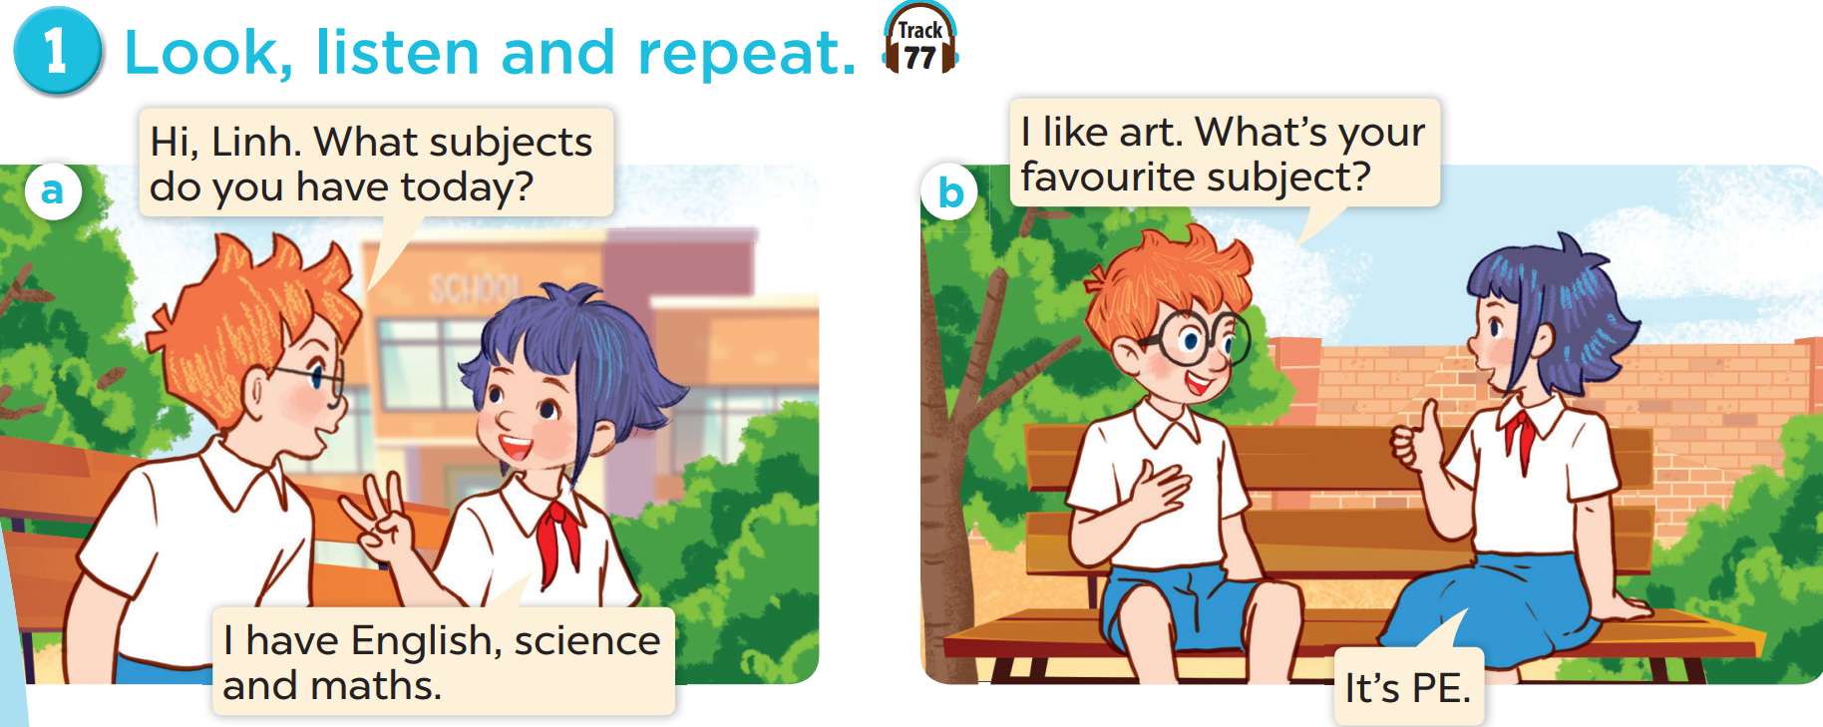

Slide 7
3
Listen, point and say.
3
7

Slide 8
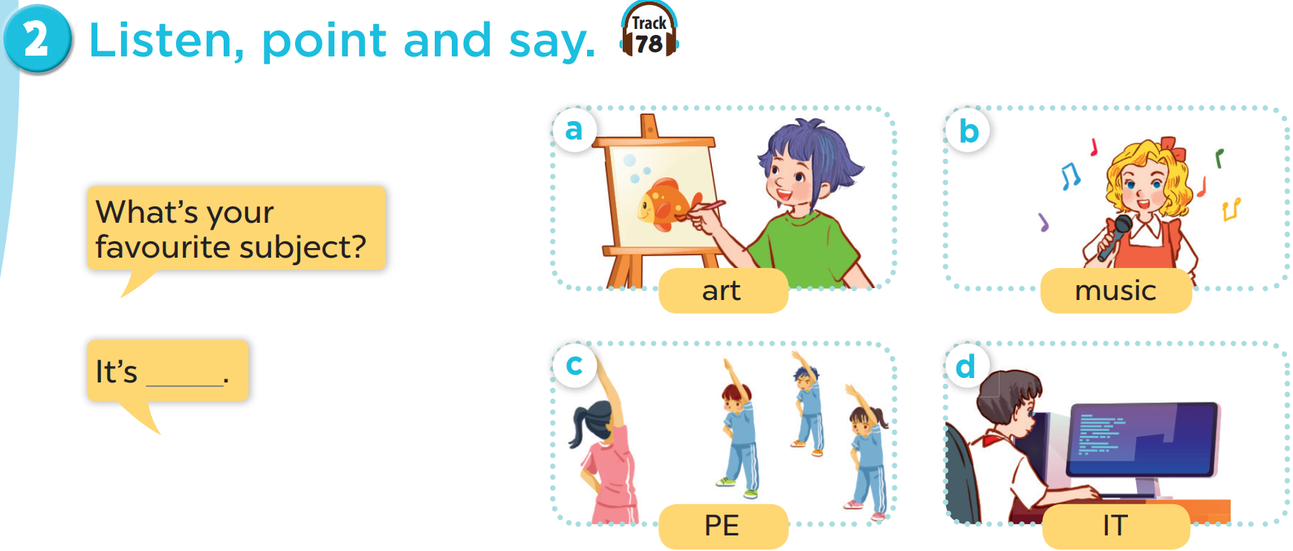

Slide 9
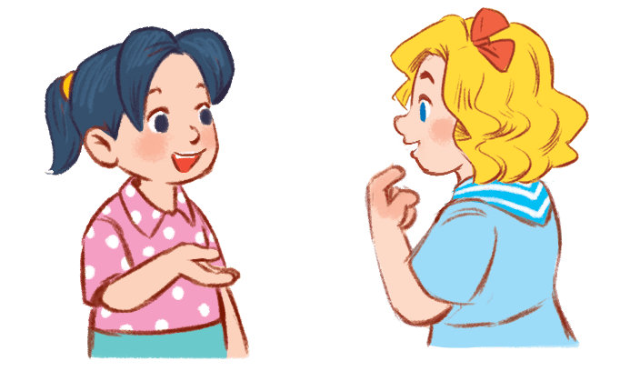
4
Let’s talk.
4
9

Slide 10
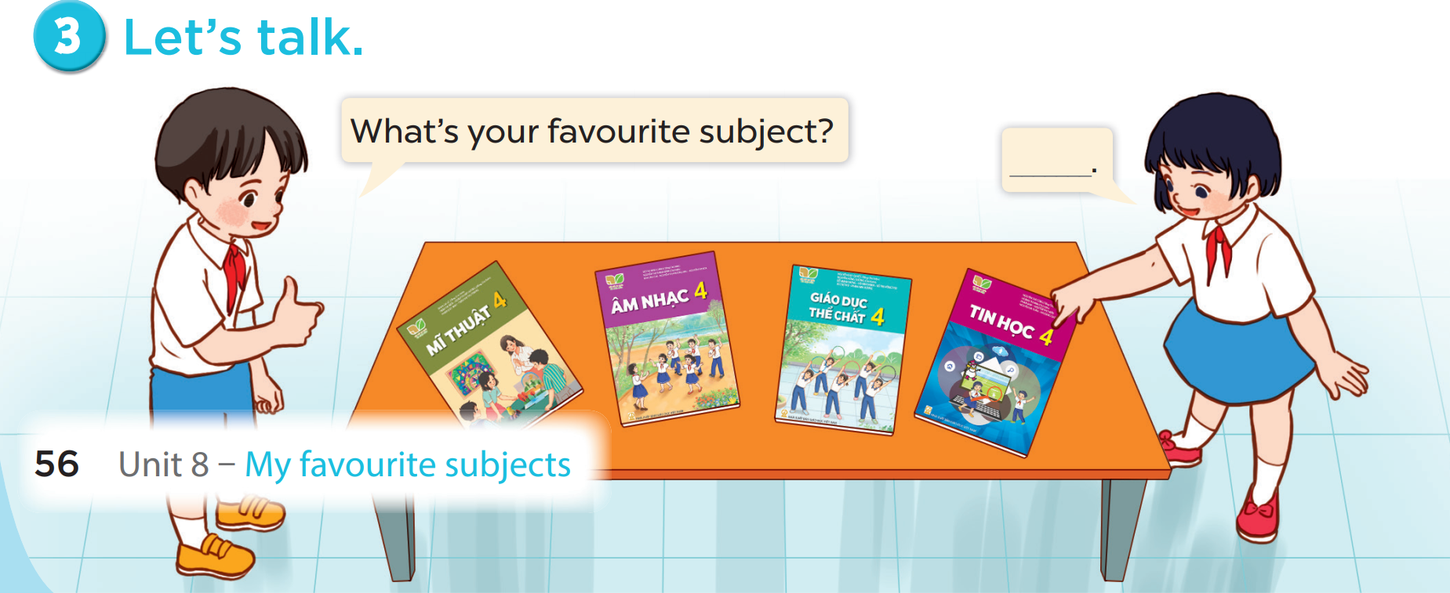

Slide 11
5
Fun corner and wrap-up
5
Game: Matching game

Slide 12





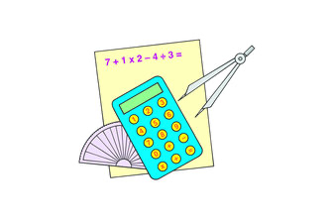
1
2
3
MATHS
4
5
6
PE
SCIENCE
7
8
9
ART
IT
MUSIC
10
11
12
Notes:
Click on the blue part to show pictures/words, if pupils get the correct pairs, leave the square open.
If pupils answer incorrectly, click on the red circle to cover the square again.
Repeat until pupils match all the words with the corresponding pictures.

