Slide 1





Slide 4

WARM-UP:
GUESS THE JOBS
Notes:
ask pupils to think fast and guess the jobs of the people in the picture
another option: show the picture in 1 minute, ask pupils to remember the jobs of those people.

Slide 5
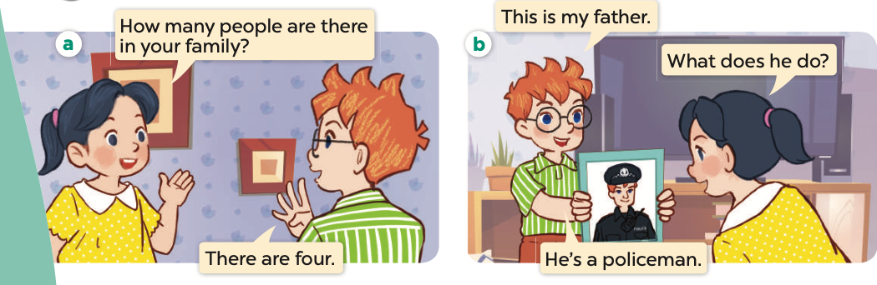
Notes:
askj pupils to look at the picture and give them some questions related

Slide 6

Notes:
ask pupils to listen and repeat

Slide 7
How many people are there in your family?
What does your father do?

Slide 8
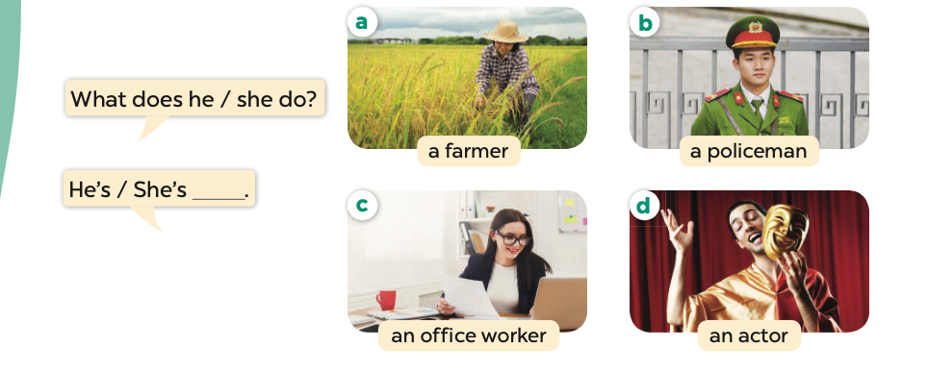

Slide 11
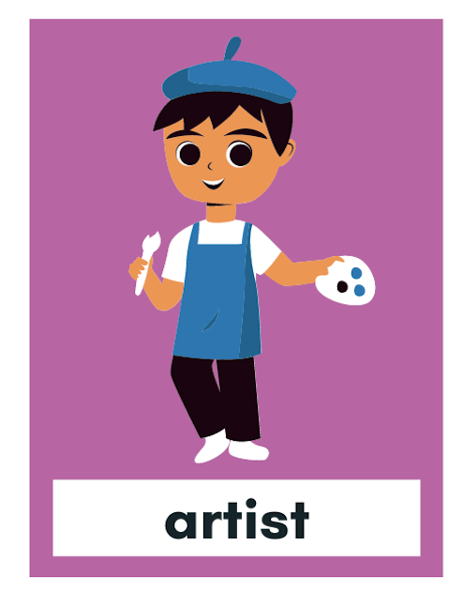




Slide 12
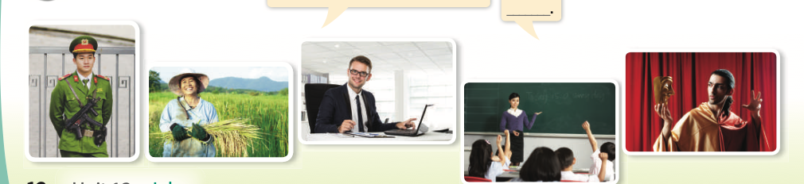
LET’S TALK
WHAT DOES HE/ SHE DO?

Slide 13
Notes:
MINI-GAME: ASK PUPILS TO WATCH THE PICTURE AND GUESS, ONE GROUP ASKS WHAT DOES HE/ SHE DO? THE OTHER GROUP ANSWERS BY GUESSING

Slide 14
Notes:
HIDDEN PEOPLE

Slide 15
Notes:
CHECK TOGETHER

