Slide 1







Our Summer Holidays
Lesson 2 – Activity 4 -6

Slide 2
Table of contents
01
02
Warm-up and Review
Listen and circle.
03
04
05
Read and complete.
Let’s play.
Fun corner
and Wrap-up

Slide 3
01
Warm-up and Review
Mr. Dog’s summer vacation

Slide 4

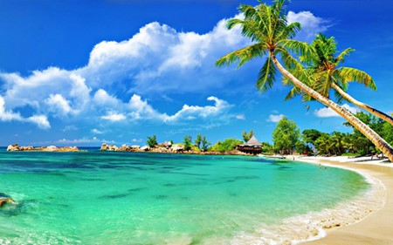





Where are you going to visit this summer?
Phu Quoc Island
Eco-farm
Phong Nha Cave
I’m going to visit Phu Quoc Island.

Slide 5
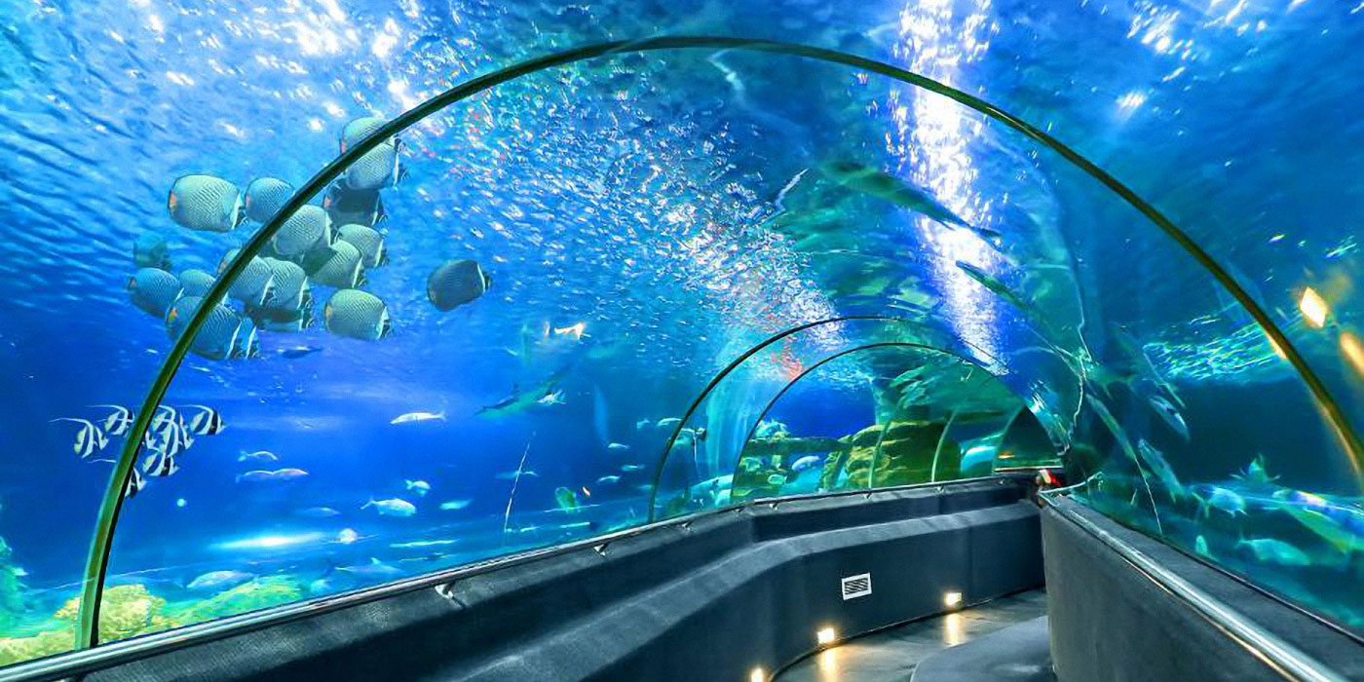



Where are you going to visit this summer?
lake
aquarium
beach
I’m going to visit Dam Sen aquarium.

Slide 6
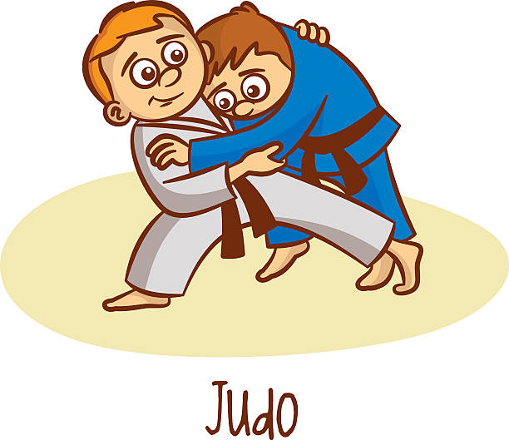


What are you going to do this summer?
join a
judo club
join a
music club
join an
art club
I’m going to join a judo club.

Slide 7
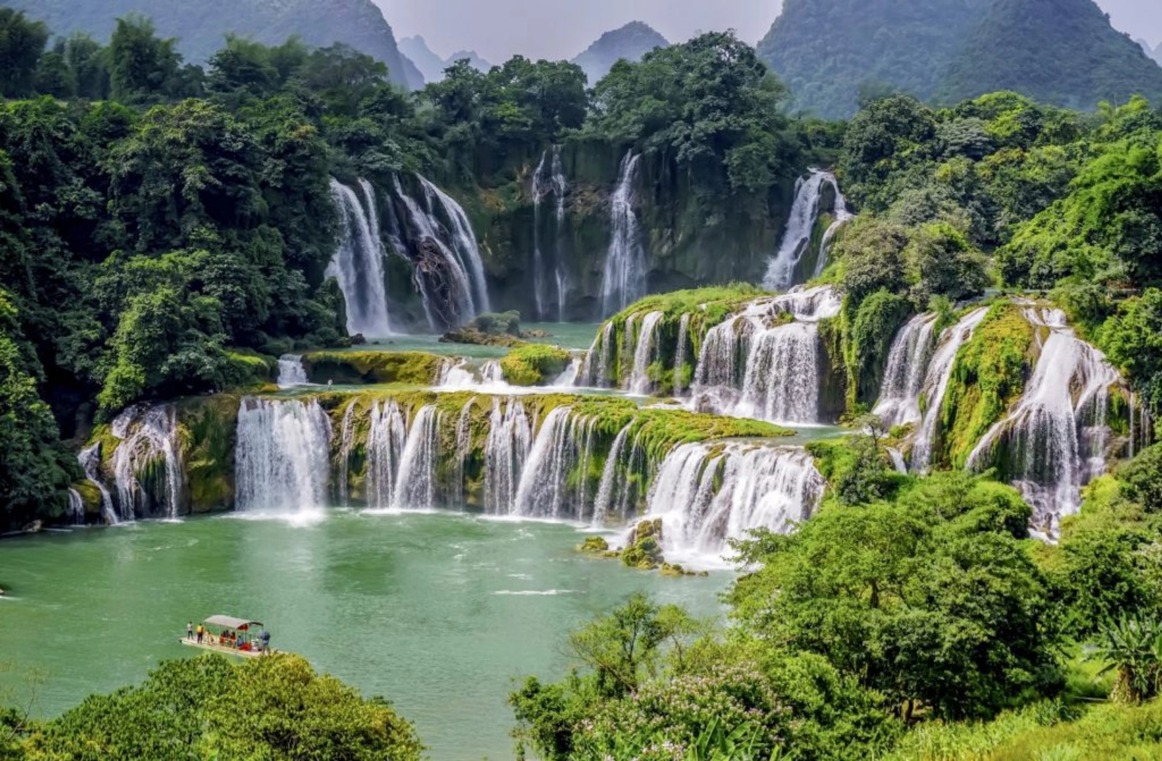


Where are you going to visit this summer?
river
waterfall
forest
I’m going to visit Ban Gioc waterfall.

Slide 8
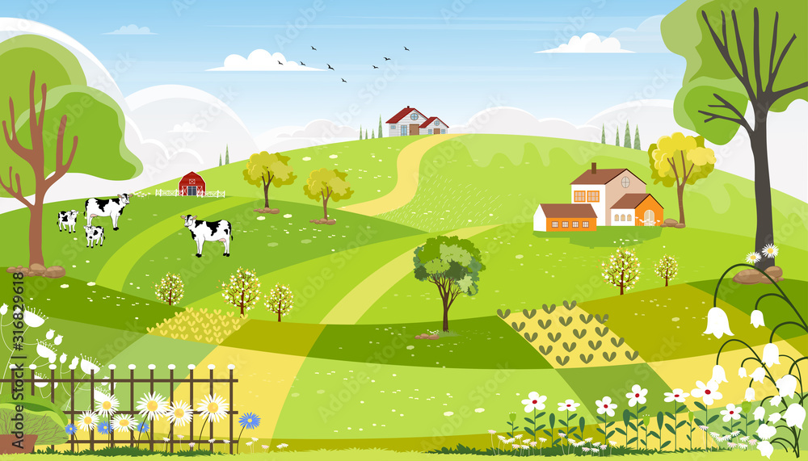


Where are you going to visit this summer?
practice swimming
take some photos
visit an eco-farm
I’m going to visit an eco-farm.

Slide 9
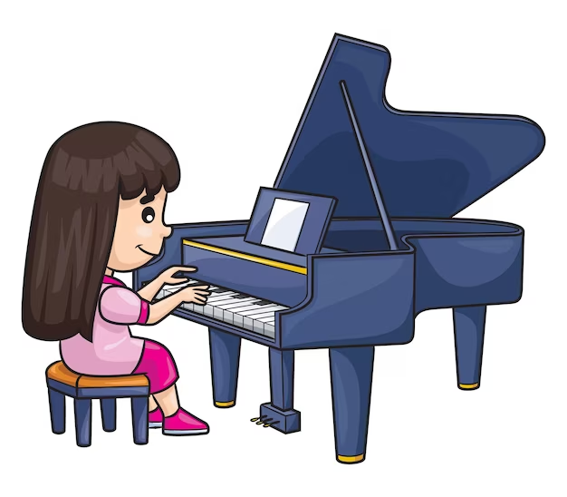


What are you going to do this summer?
practice swimming
take some photos
play the piano
I’m going to play the piano.

Slide 10
02
Listen and circle.

Slide 11
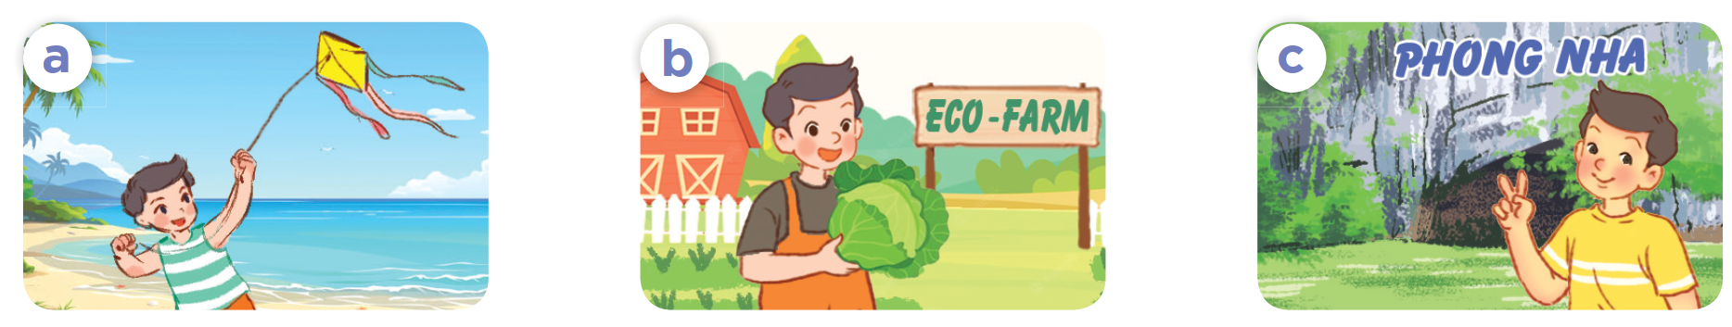
What place can you see in each picture?
a beach
an eco-farm
Phong Nha Cave

Slide 12
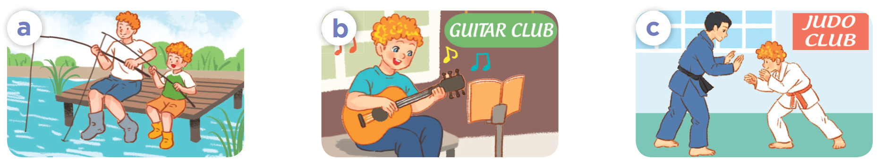
What activity can you see in each picture?
fishing
playing the guitar
join a judo club

Slide 13

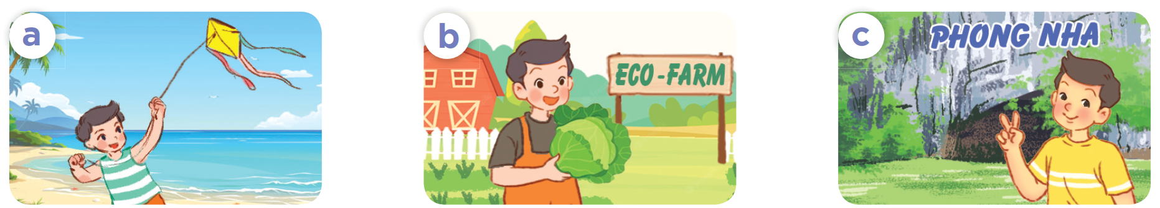
Listen and circle.
1. Where is Nam going to visit this summer?

Slide 14
Listen and circle.
2. What is Bill going to do this summer?

Slide 15


Let’s check!
1. Where is Nam going to visit this summer?
2. What is Bill going to do this summer?

Slide 16
03
Read and complete.

Slide 17
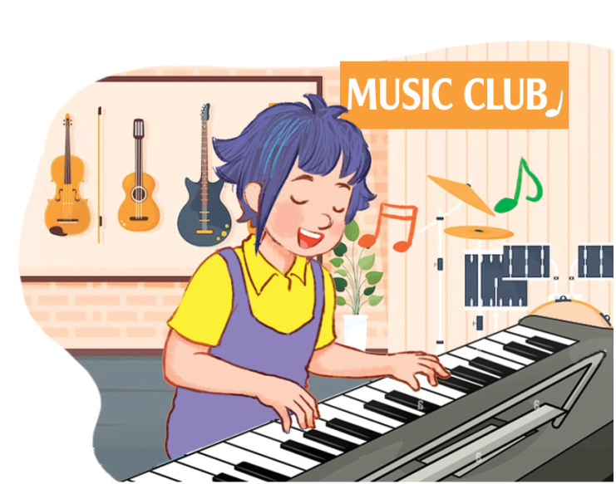
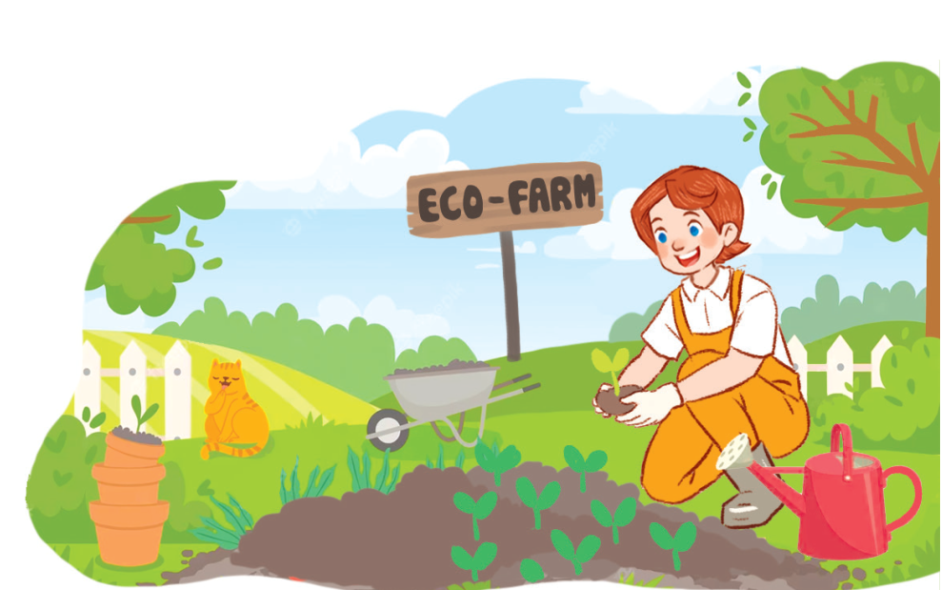
What place can you see in each picture?
a music club
an eco-farm

Slide 18
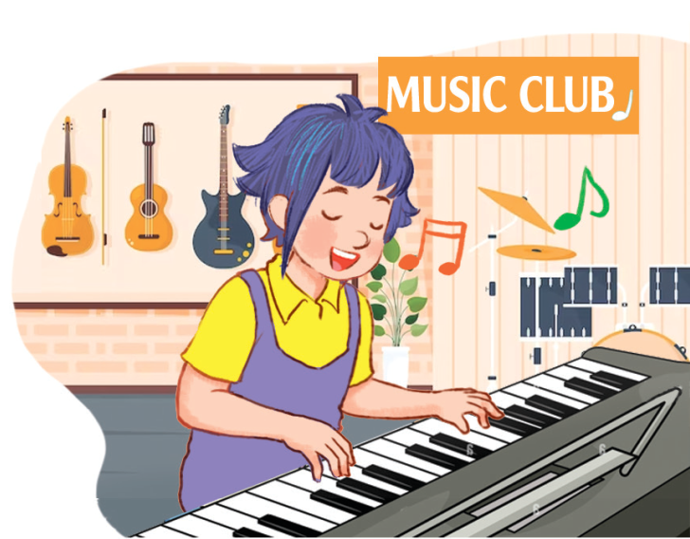
What activity can you see in each picture?
play the piano
grow vegetables

Slide 19

Read and complete.
A: What are you going to do this
summer?
B: I’m going to join _____________.
A: That sounds fun! What are
you going to learn to play?
B: I’m going to learn to play the
_______.
a music club
piano

Slide 20

Read and complete.
Where
2. A: ______ are you going to visit this summer?
B: I’m going to visit an _________.
A: What are you ____________?
B: I’m going to grow vegetables there.
eco-farm
going to do

Slide 21
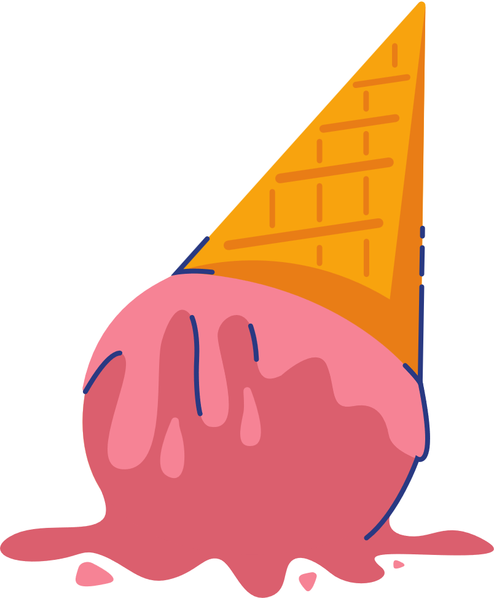
04
Let’s play.

Slide 22
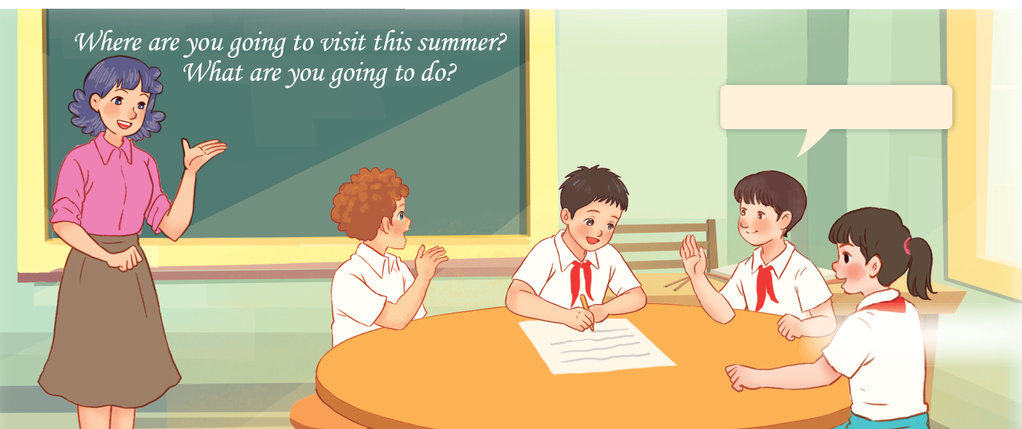
Let’s play.
Who has more correct answers?
I’m going to ___.

Slide 23
05
Fun corner and Wrap-up
Talk about your summer vacation plans.

Slide 24

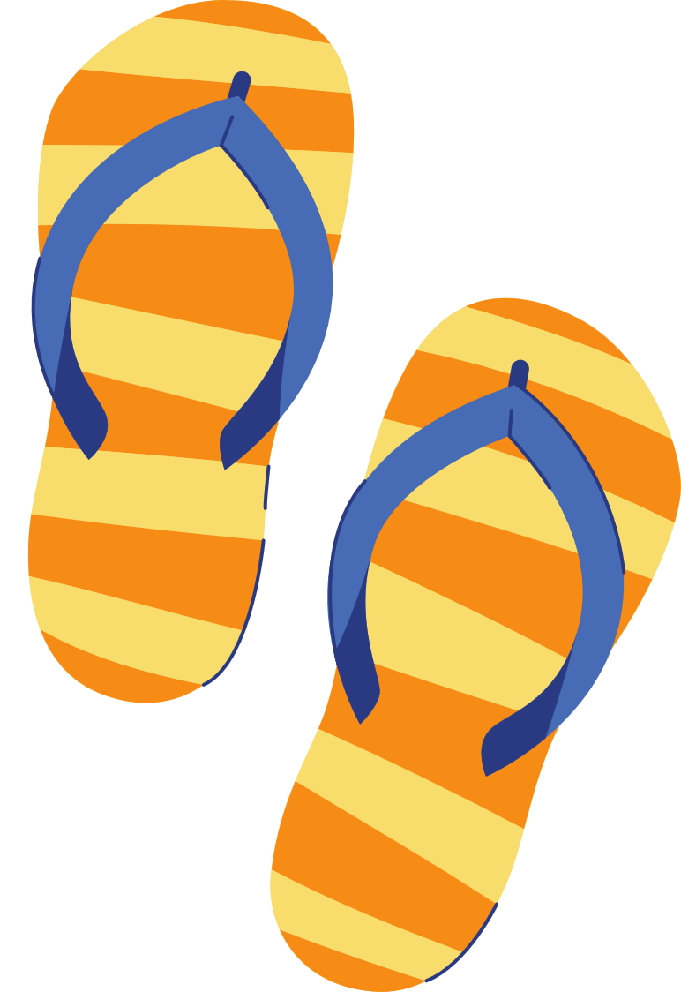

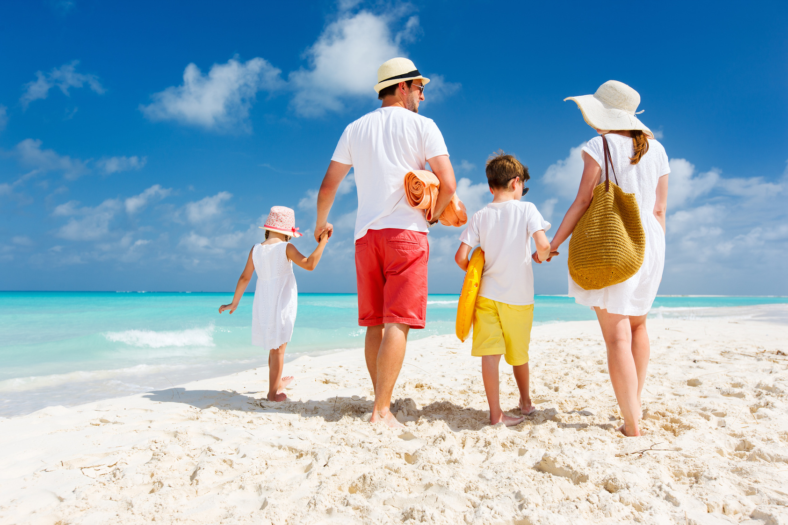
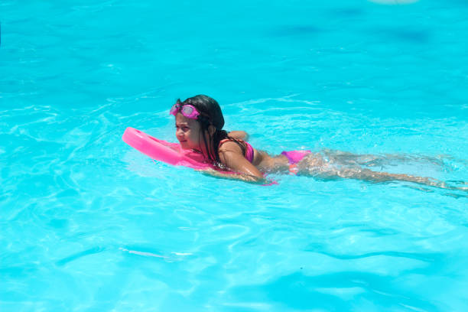
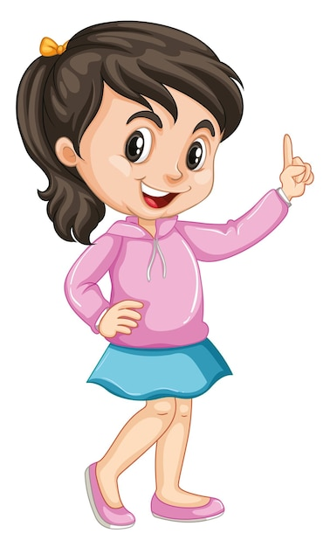

Where are you going to visit this summer?
What are you going to do there?
I’m going to
practise swimming.
I’m going to visit
My Khe beach.
My Khe Beach
practise swimming

Slide 25
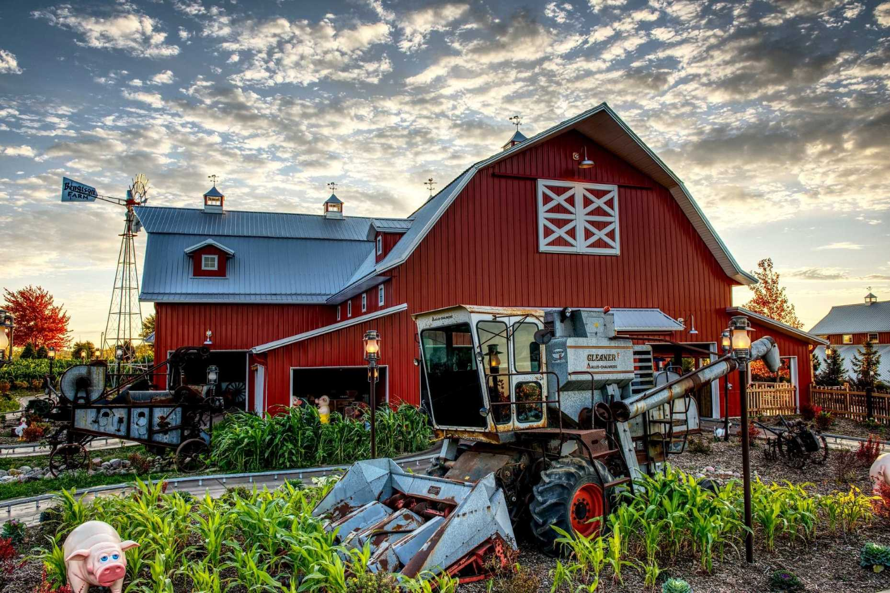
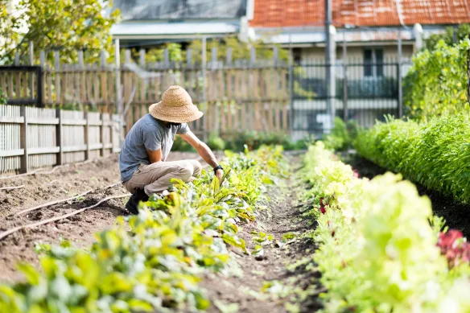
Where are you going to visit this summer?
What are you going to do there?
I’m going to
grow vegetables.
I’m going to visit
an eco-farm.
an eco-farm
grow vegetables

Slide 26
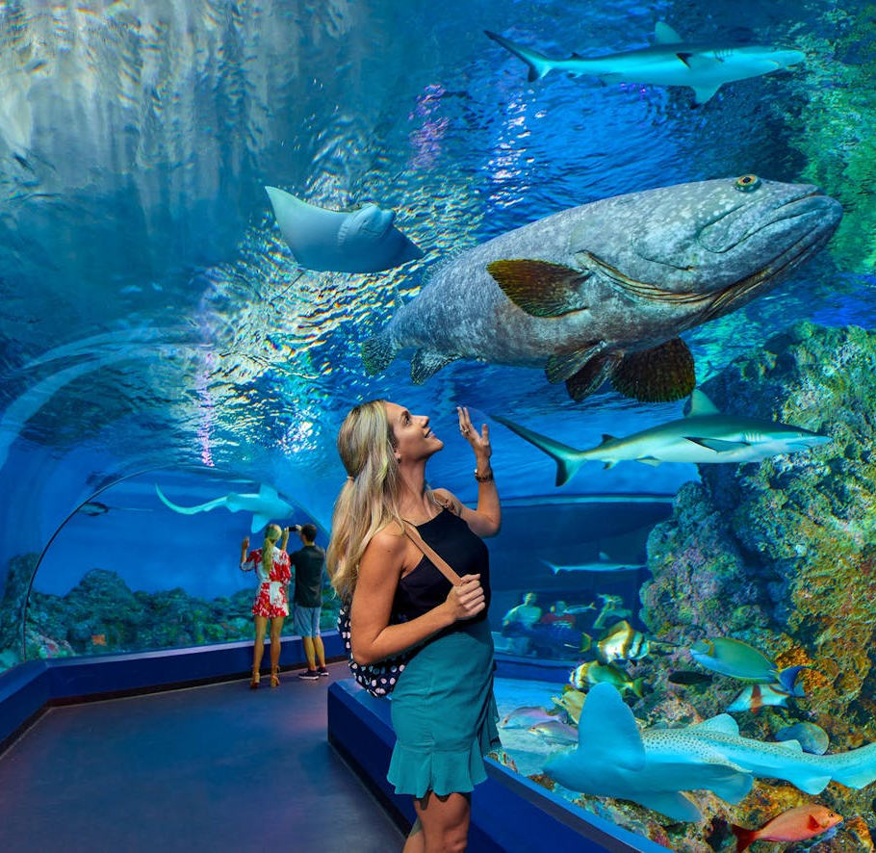
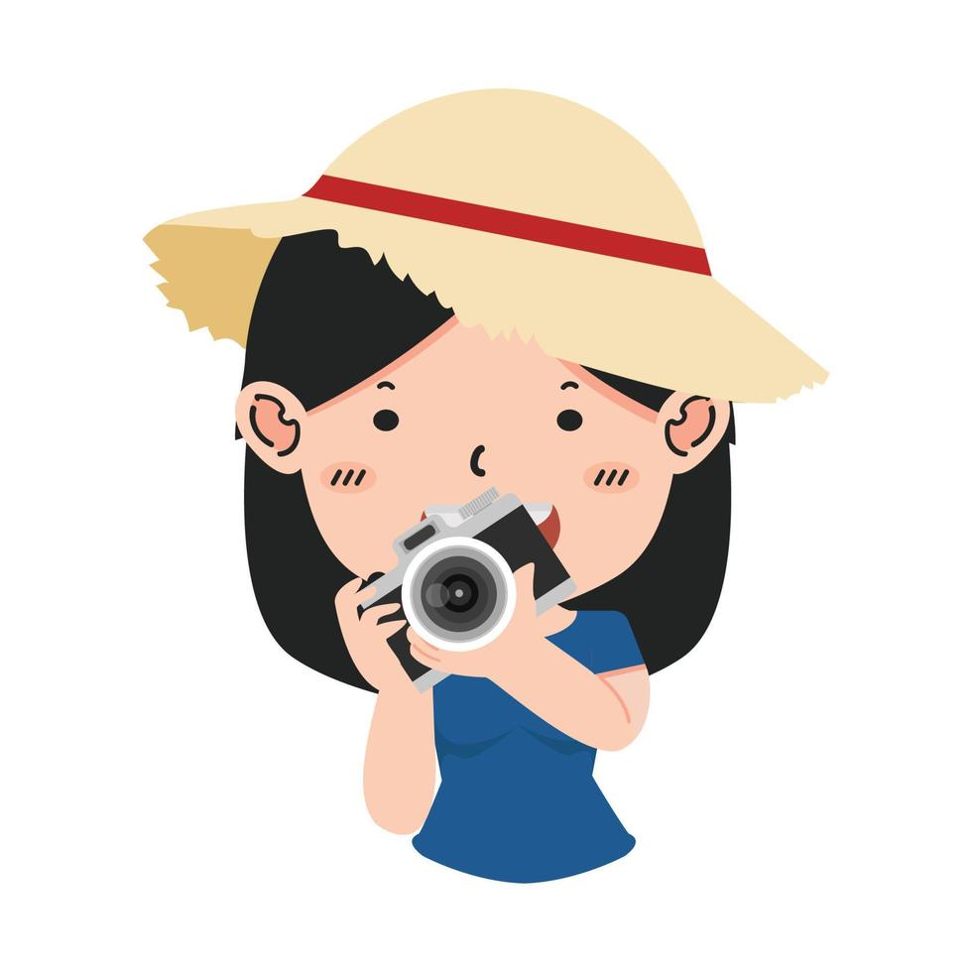
Where are you going to visit this summer?
What are you going to do there?
I’m going to
take pictures.
I’m going to visit
an aquarium.

Slide 27

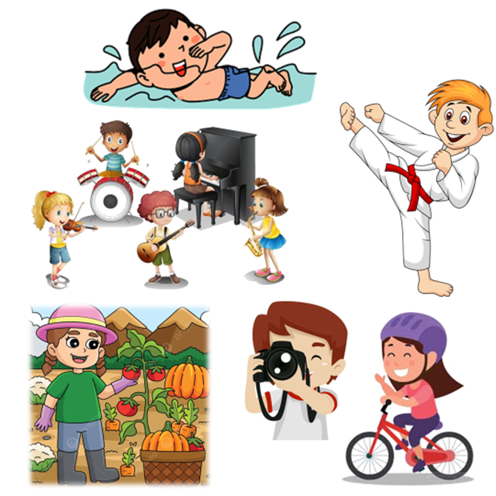
Where are you going to visit this summer?
What are you going to do there?
I’m going to __.

