Slide 1


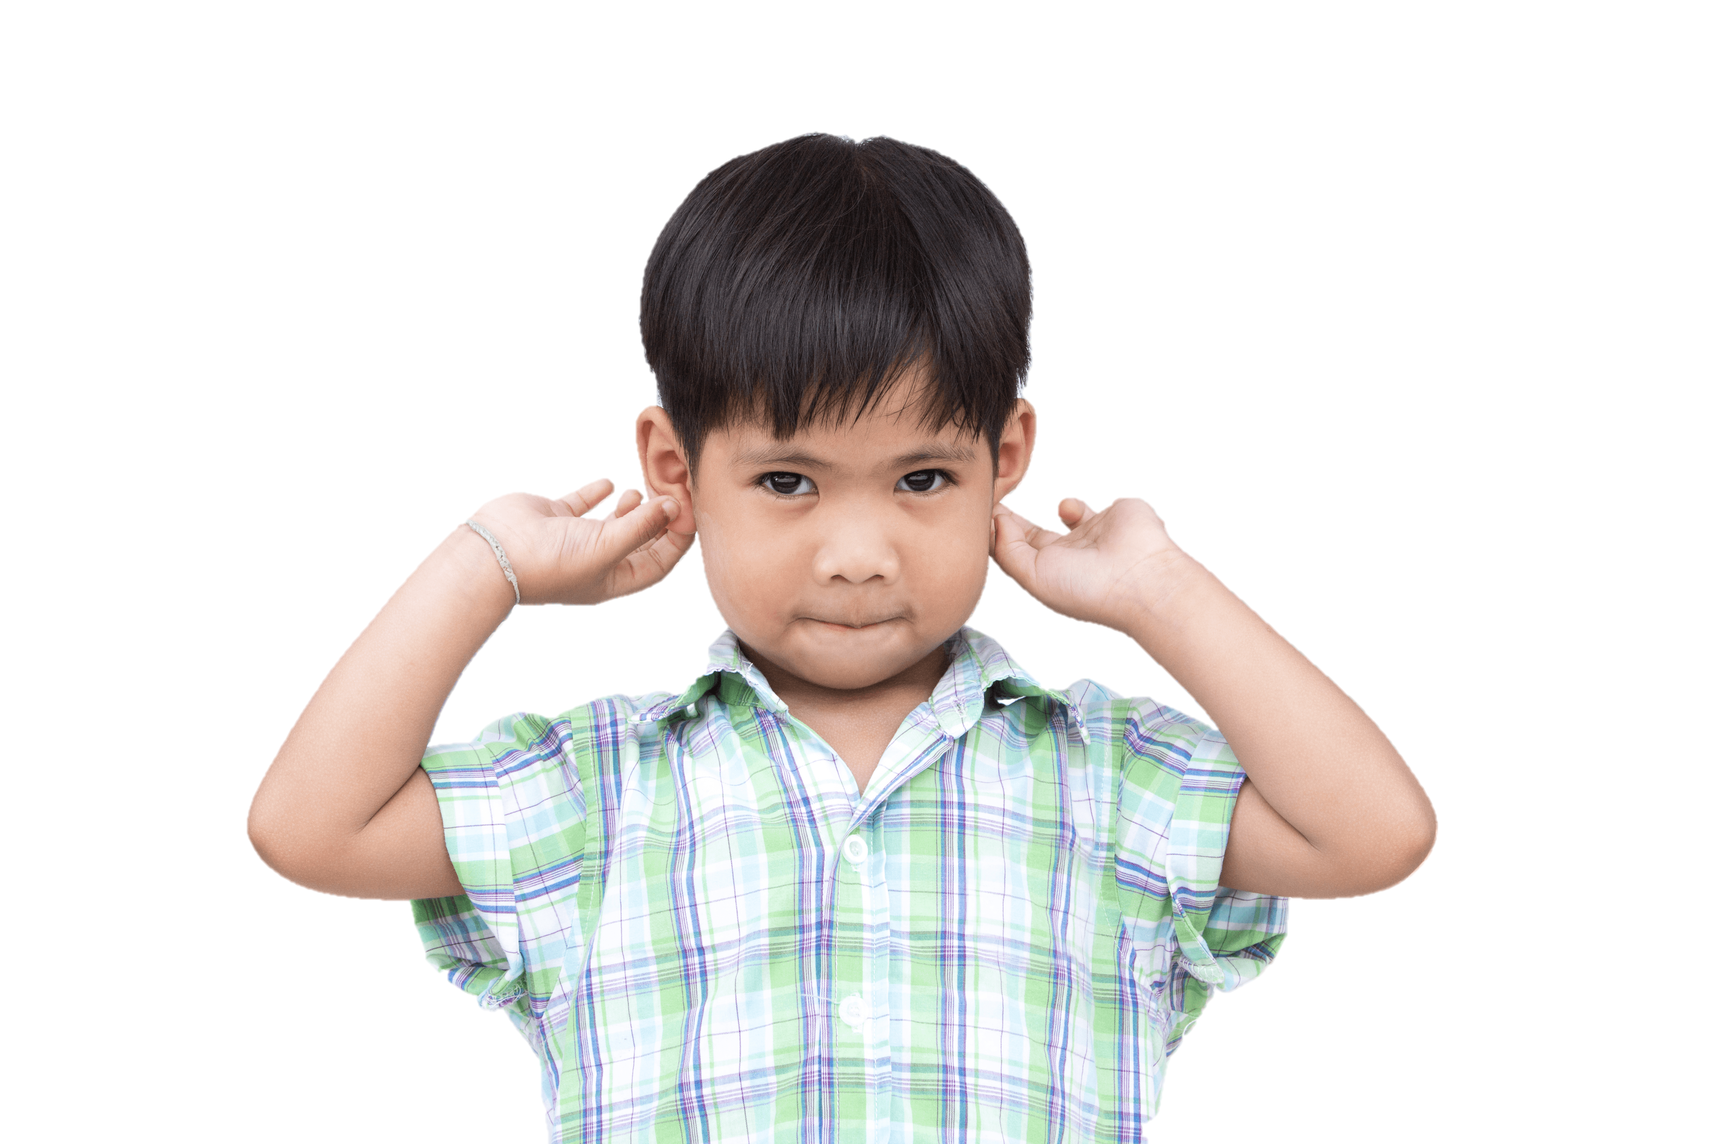
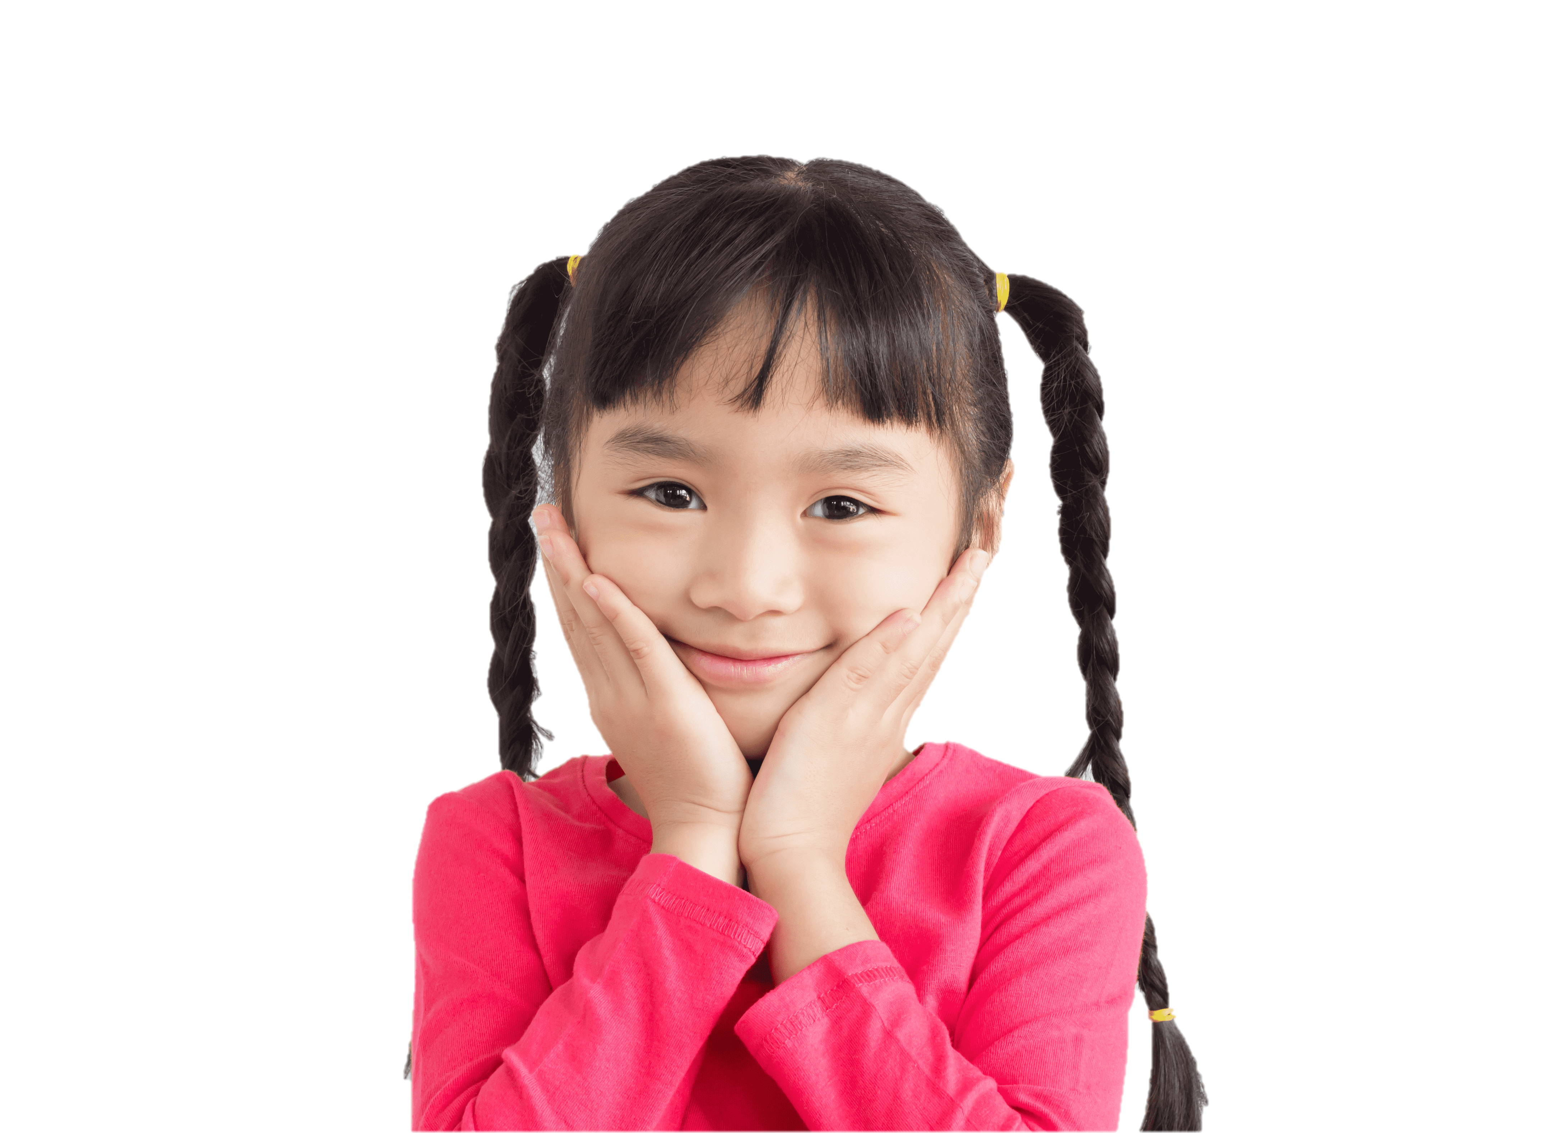

4
Our bodies
LESSON 2
Period 3

Slide 2



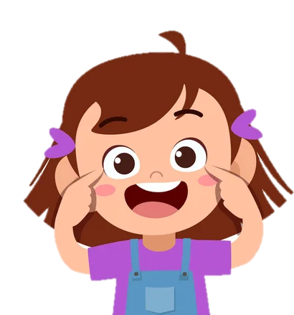


eyes
Notes:
Teacher: We use our ... to look. (Teacher pretends to wear glasses)
Pupils: eyes!

Slide 3

ears
Notes:
Teacher: We use our ... to listen. (Teacher pretends to listen to music)
Pupils: ears!

Slide 4
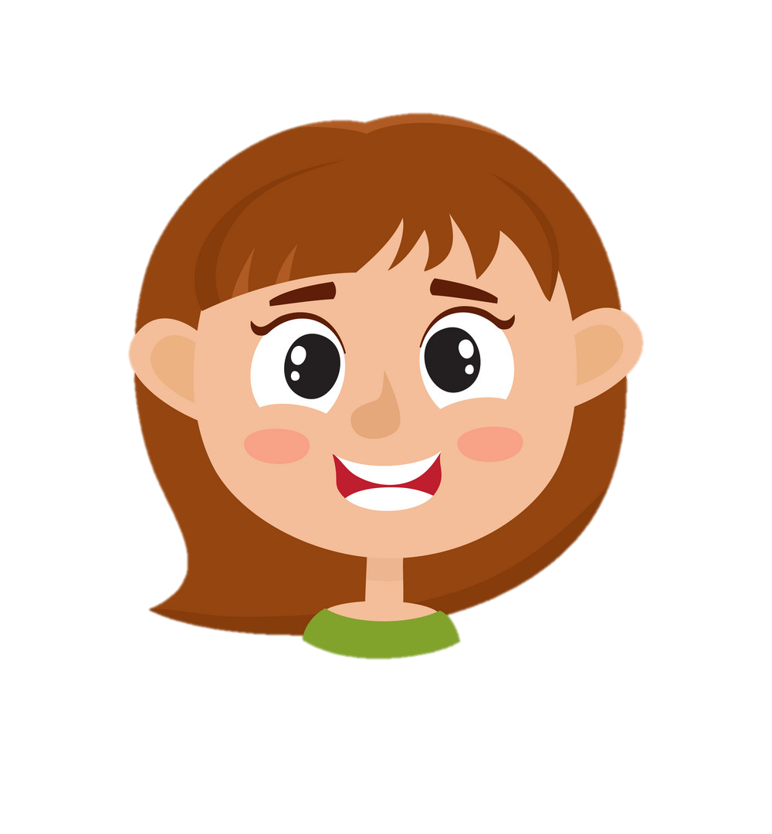
face
Notes:
Teacher: We put makeup on the ... (Teacher pretends to put on makeup)
Pupils: face!

Slide 5
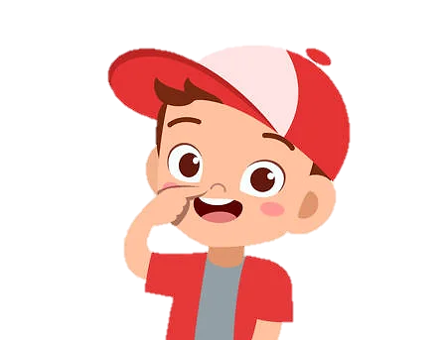
nose
Notes:
Teacher: We use the ... to smell. (Teacher pretends to smell somthing good)
Pupils: nose!

Slide 6
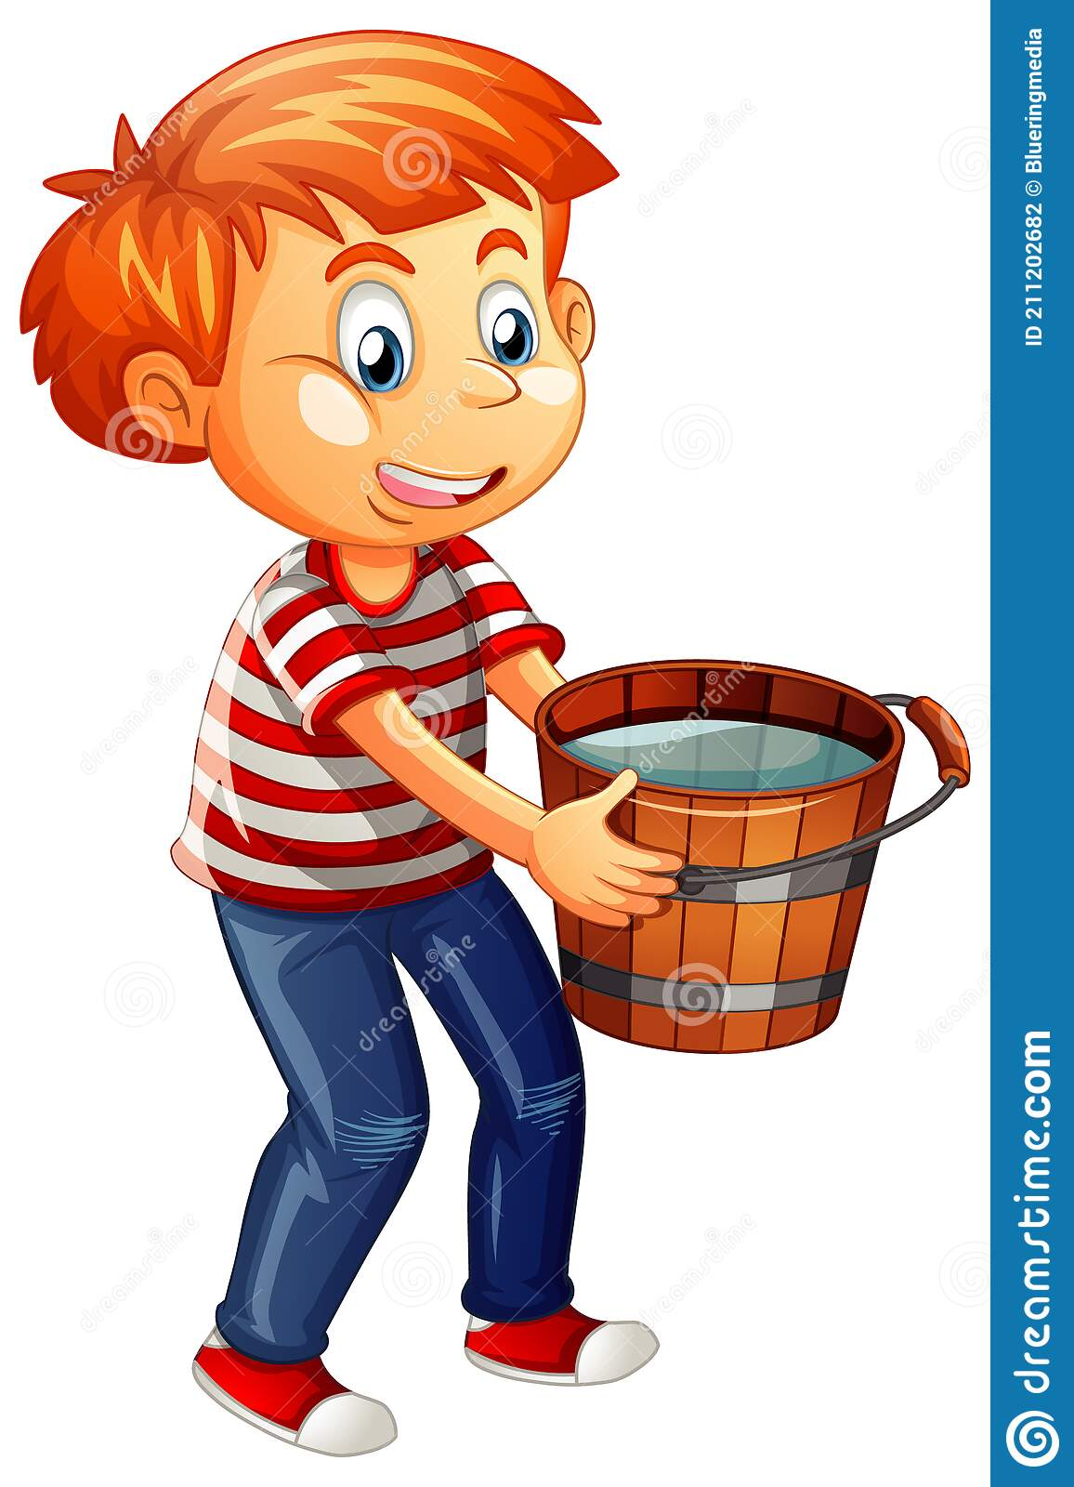
hands
Notes:
Teacher: We hold something with our ... (Teacher pretends to hold heavy thing)
Pupils: hands!

Slide 7
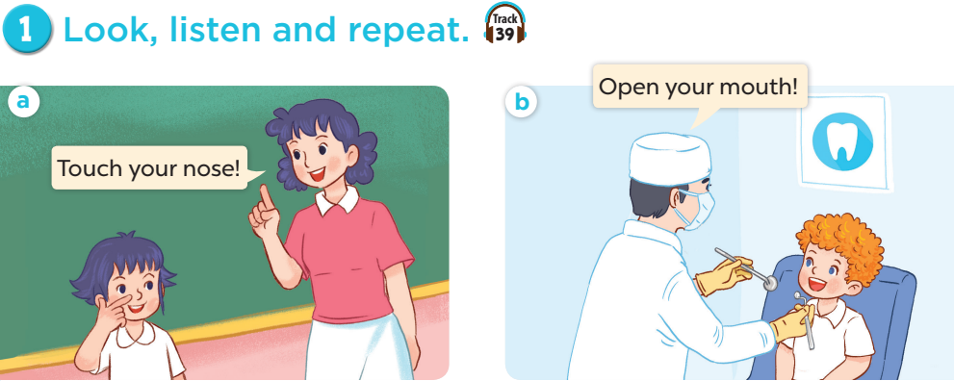

Slide 8
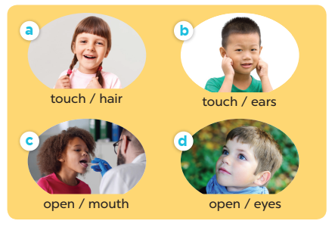



Slide 9
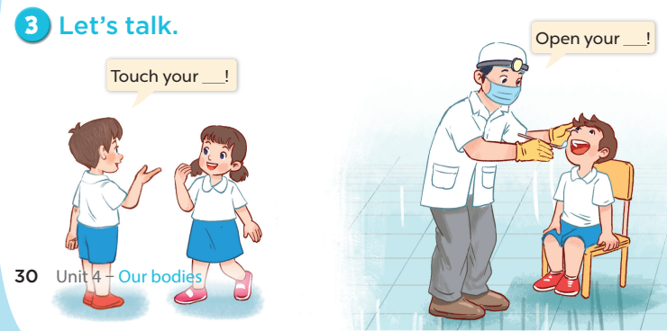

Slide 10
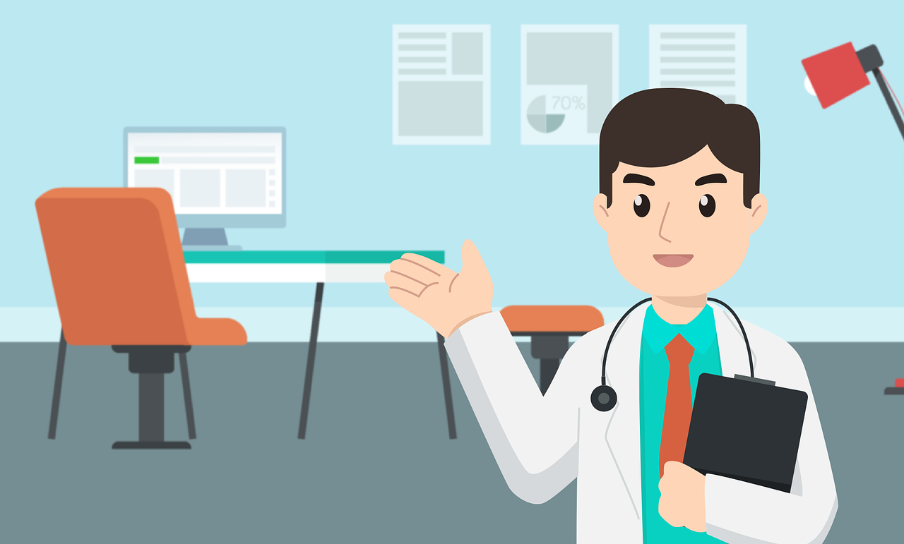
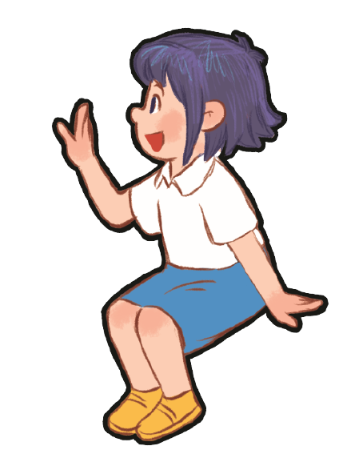
Notes:
Game: At the Doctor's Office
Step 1: Ask some volunteer pairs to role-play in front of class.
Step 2: One pupil is a doctor and the other is a patient, who will describe which body part hurts.
Step 3: When a patient says his/her ..... is hurt. The doctor has to listen carefully and touches that correct body part.

