Slide 1



13
MY house
LESSON 1 - PERIOD 1

Slide 2
1
Warm-up and review

Slide 3

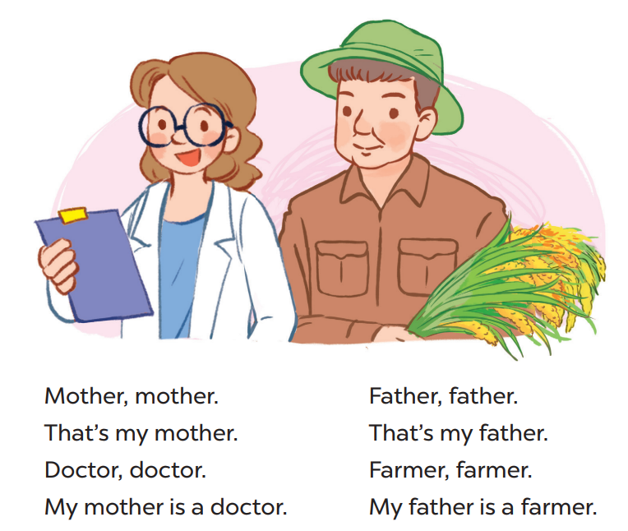
Say the chant

Slide 4
2
Look, listen and repeat. .

Slide 5
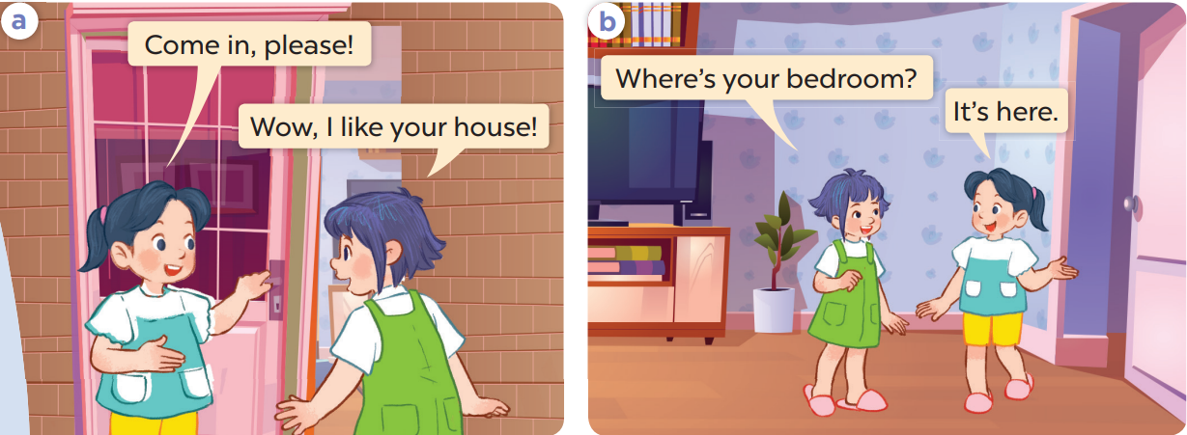
Work in pairs and repeat.

Slide 6
3
Listen, point and say..

Slide 7
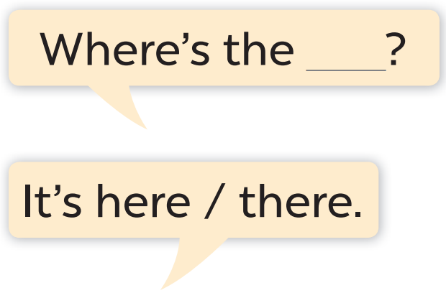
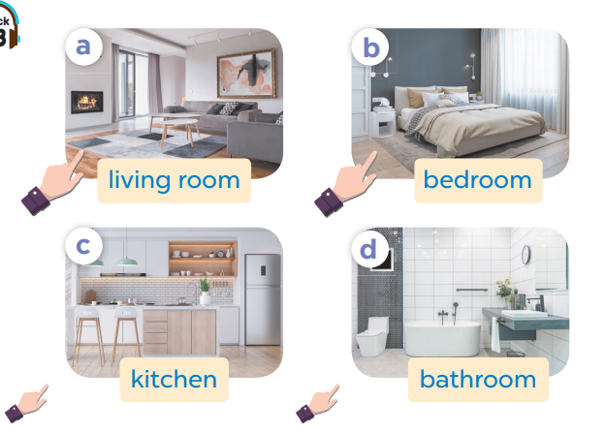

Slide 8
Work in pairs.
Ask and answer.

Slide 9
4
Let’s talk.

Slide 10
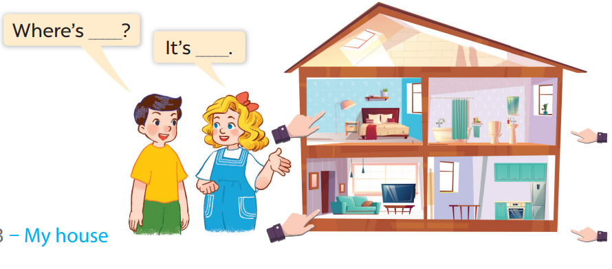
Work in pairs.
Ask and answer.

Slide 11
5
Fun corner and wrap-up

Slide 12



Where is the house?
BACK
It’s there.
It’s here.

