Slide 1







12
LESSON 2 – Period 3

Slide 2
1
Warm-up and review
Game: Simon says
Notes:
Teacher says “Simon says…” for the pupils to do the actions. When the teacher doesn’t start the sentence with “Simon says”, pupils do nothing.
Who can make it until the end is the winner.

Slide 3
2
Look, listen and repeat.

Slide 4
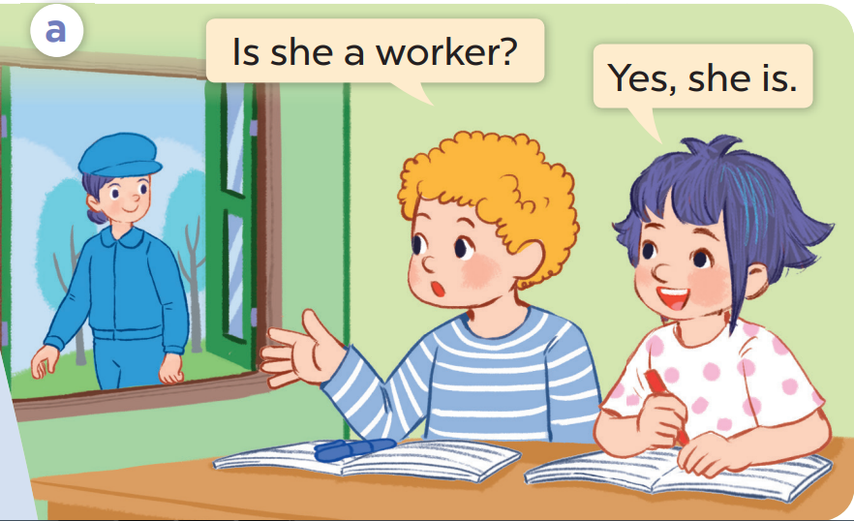
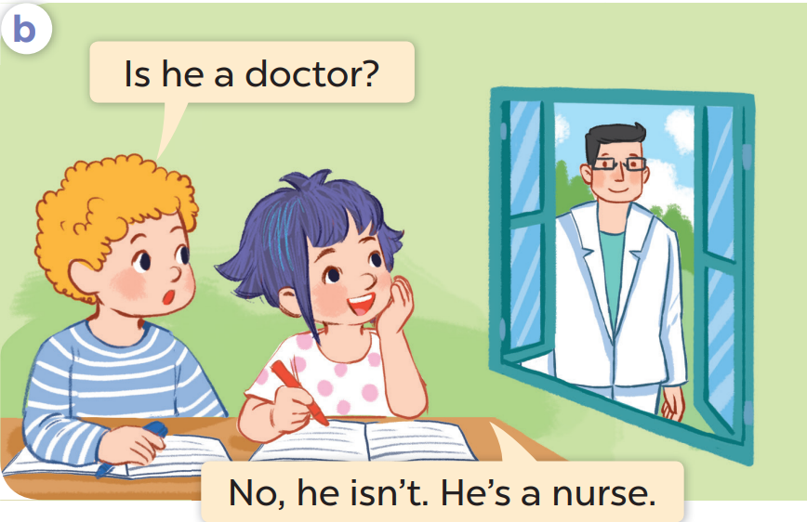

Slide 5


Slide 6
3
Listen, point and say.

Slide 7
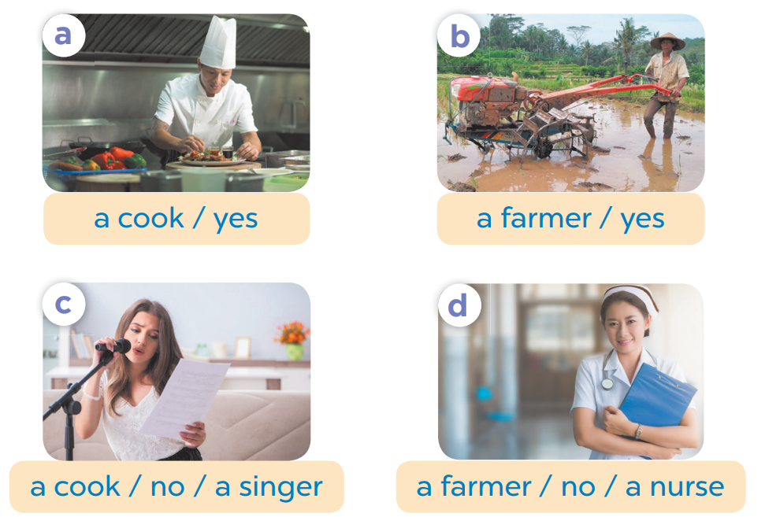
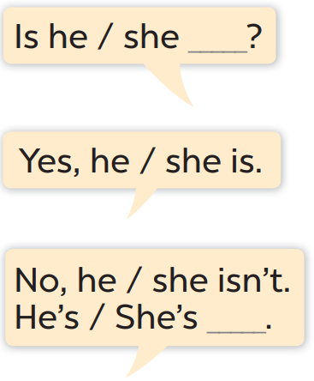

Slide 8
Game: Listen and choose.
Notes:
Pupils listen to the recording, look at the picture, then choose the answer (Yes or No).
This game can be played in groups.
Each group has a board to write the answers.
Groups that have the correct answers will get points.
Encourage pupils to say the sentences aloud after checking the answers.

Slide 9
4
Let’s talk.

Slide 10


Game:
Let’s go fishing!
Notes:
Step 1: Divide the class into 4 teams.
Step 2: Invite 2 pupils from each team to go to the board, choose one question and practice speaking “Is he/ she ________? – Yes, he/she is – No, he/ she isn’t.”.
Step 3: Encourage pupils to practice speaking English.
Step 4: Give points to pupils.

Slide 11
5
Fun corner and wrap-up

Slide 12

Game time!!!

Slide 13
doctor
teacher
driver
farmer
job
worker
singer
cook
nurse

