Slide 1


My pets Lesson 1 - Period 1
16

Slide 2
1
Warm-up and review

Slide 3

Notes:
Sing the song from youtube - https://www.youtube.com/watch?v=pWepfJ-8XU0

Slide 4
2
Look, listen and repeat.

Slide 5

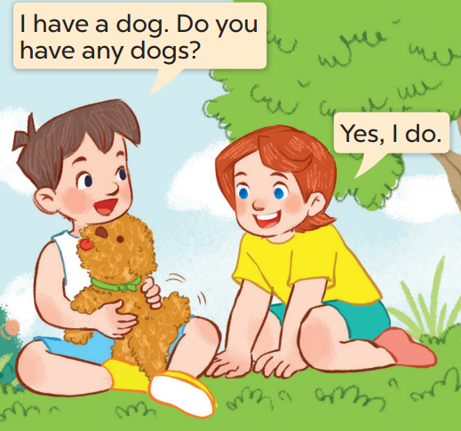
What does Minh have?
Who are they?
Now listen and repeat.
He has a dog.
They’re Minh and Lucy.

Slide 6
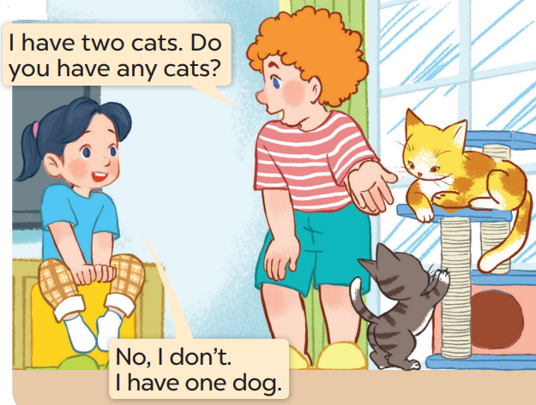
Now listen and repeat.
Whose cats are they?
What pets can you see?
Who are they?
I can see (2) cats.
They’re Mai and Bill.
They are Bill’s

Slide 7
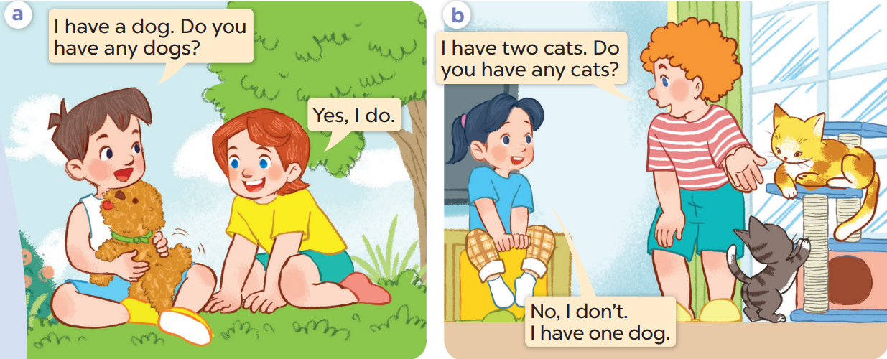
Listen again and repeat.

Slide 8
Work in pairs. Act and say

Slide 9
3
Listen, point and say.

Slide 10
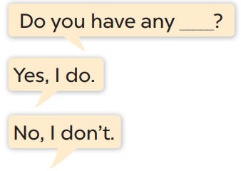
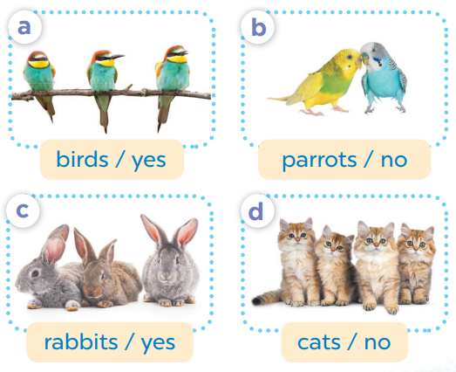

Slide 11
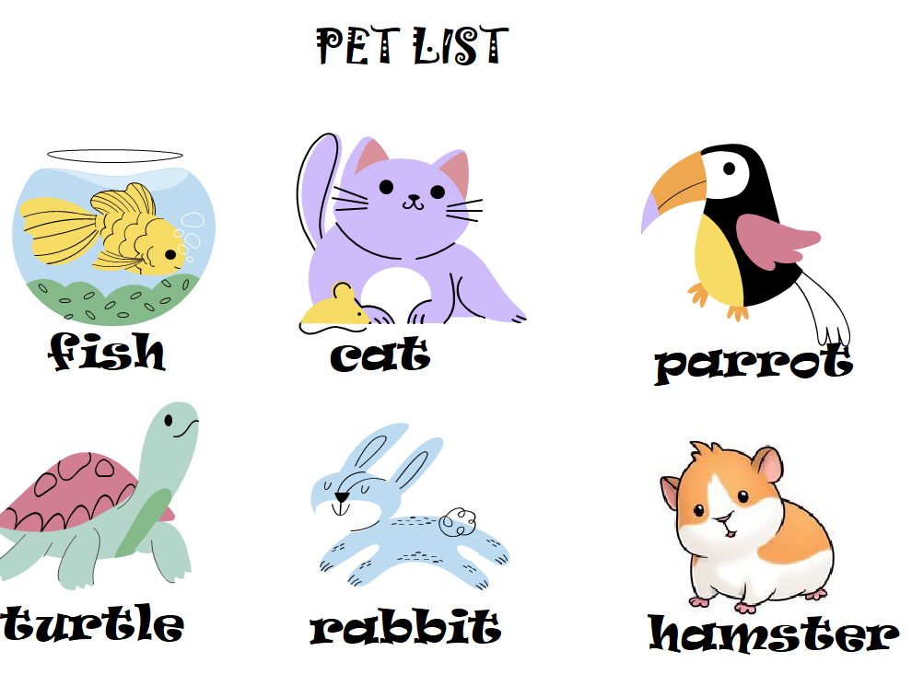


fish
Do you have any………?
No, I don’t..

Slide 12
cats
Do you have any.…….?
Yes, I do.

Slide 13
Yes, I do.
parrots
Do you have any……….?

Slide 14
turtles
Do you have any……….?
No, I don’t.

Slide 15
Pair work
Do you have any……….?
Yes, I do.
No, I don’t.

Slide 16
4
Let’s talk.

Slide 17
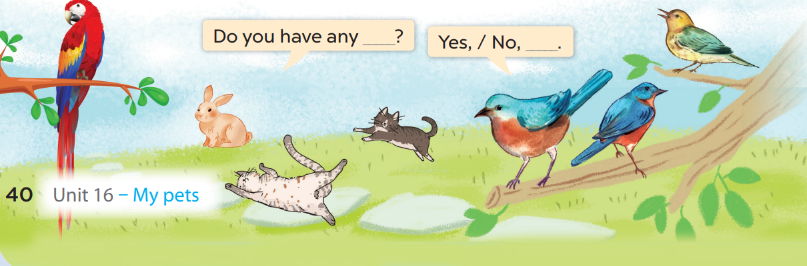

Slide 18
5
Fun corner and wrap-up

