Slide 1



Slide 2


My pets Lesson 2 - Period 4
16

Slide 3
1
Warm-up and review

Slide 4
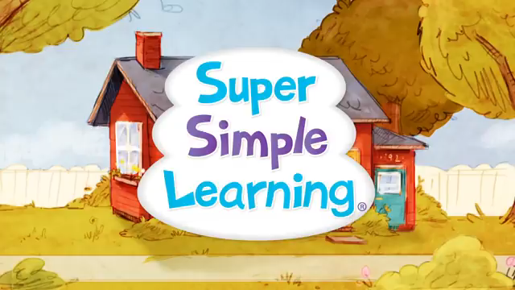
Let’s sing together!
Notes:
https://www.youtube.com/watch?v=pWepfJ-8XU0

Slide 5
2
Listen and number.

Slide 6

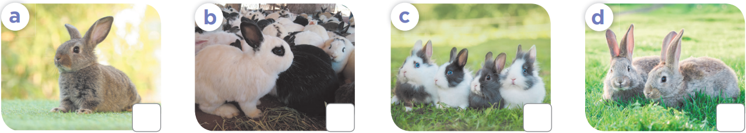
4
1
2
3

Slide 7
3
Look, complete and read.

Slide 8

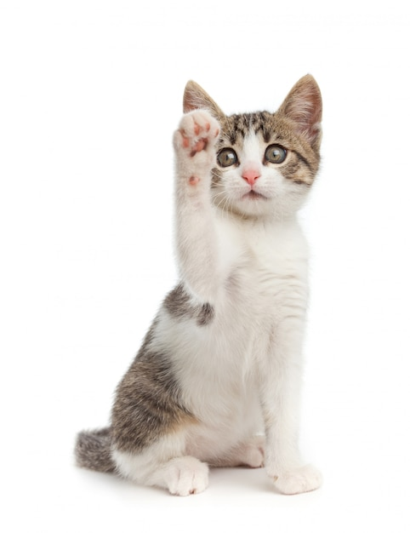






How many ………..do you have?
cat
a cat
cats

Slide 9
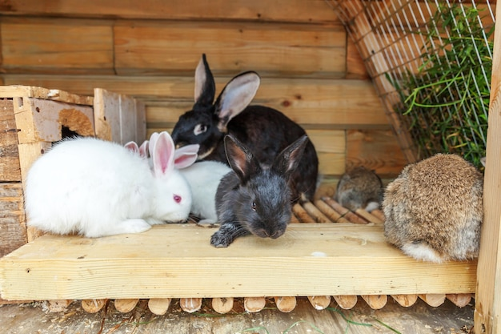
……………… many rabbits do you have?
How
What
Who

Slide 10
How many cats do you have?
I have one cat.
I have some cats.
I have many cats.

Slide 11
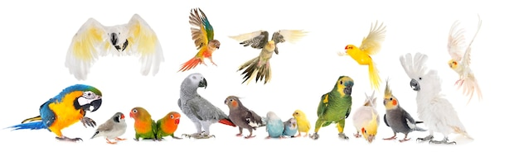
How many parrots do you have?
I have one parrot.
I have some parrots.
I have many parrots.

Slide 12
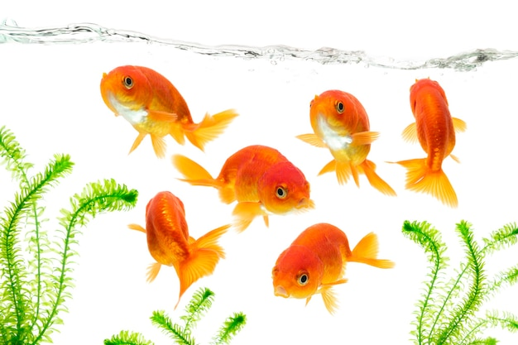
How many fish do you have?
I have one fish.
I have some fish.
I have many fish.

Slide 13
Open your book!

Slide 14
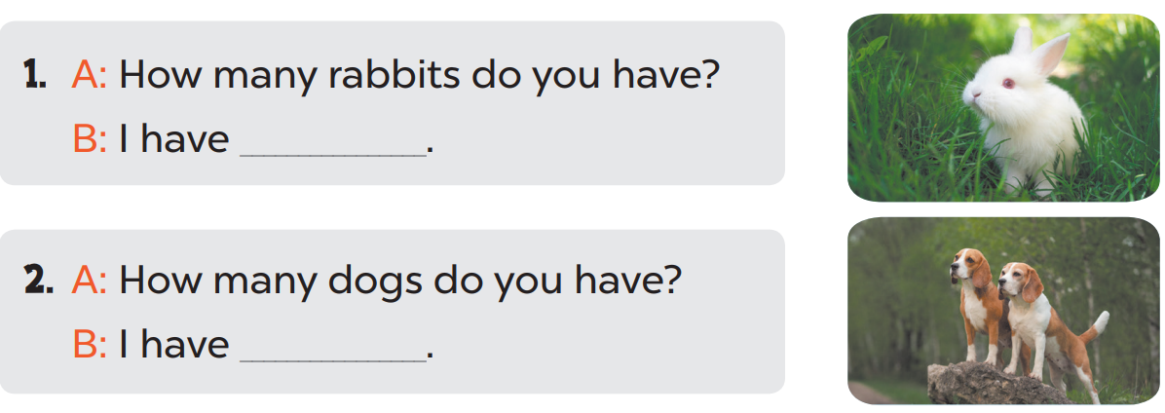
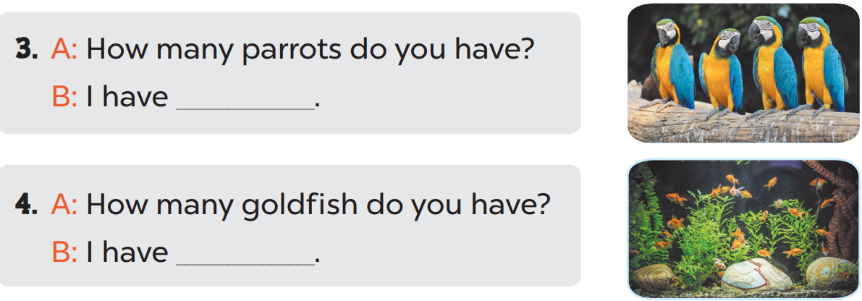
one rabbit.
two dogs.
some parrots.
many goldfish.

Slide 15
4
Let’s play.

Slide 16
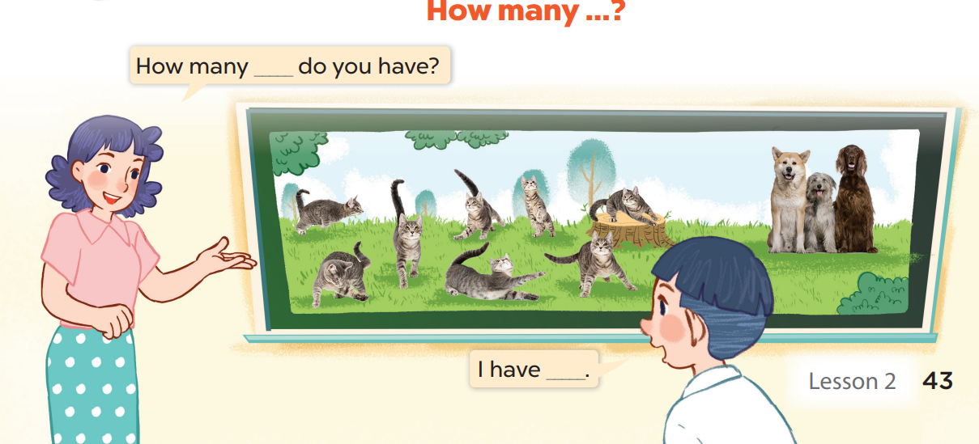

Slide 17
5
Fun corner and wrap-up

