Slide 1




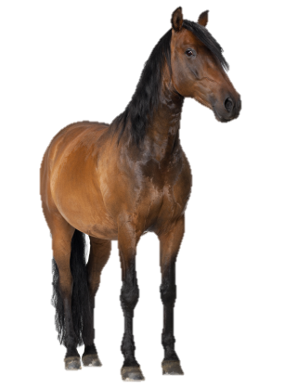
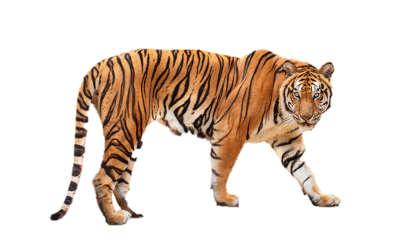


At the zoo
20
LESSON 2
Period 4

Slide 2












01
Warm-up and review

Slide 3

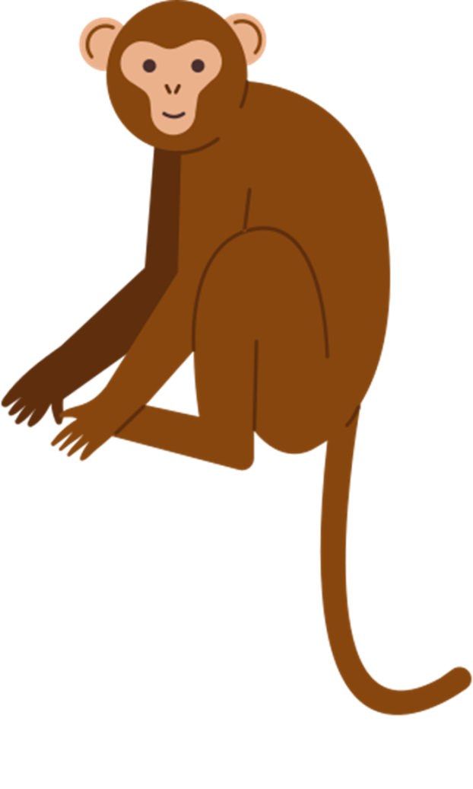
Notes:
Game: Guess me!
- Divide the class into 4 groups.
- Pupils try to identify different body parts of an animal (colour/body/legs,...). Then guess which animal it is.
- Then the teacher shows the last picture, asks the winning group: What is the ... doing?

Slide 4
02
Listen and tick.

Slide 5
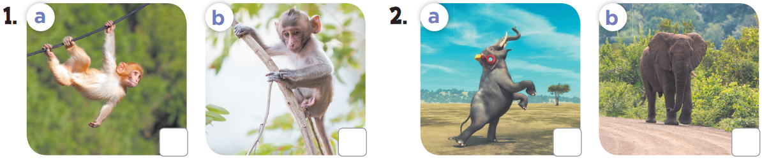


Slide 6
03
Look, complete and read.

