Slide 2







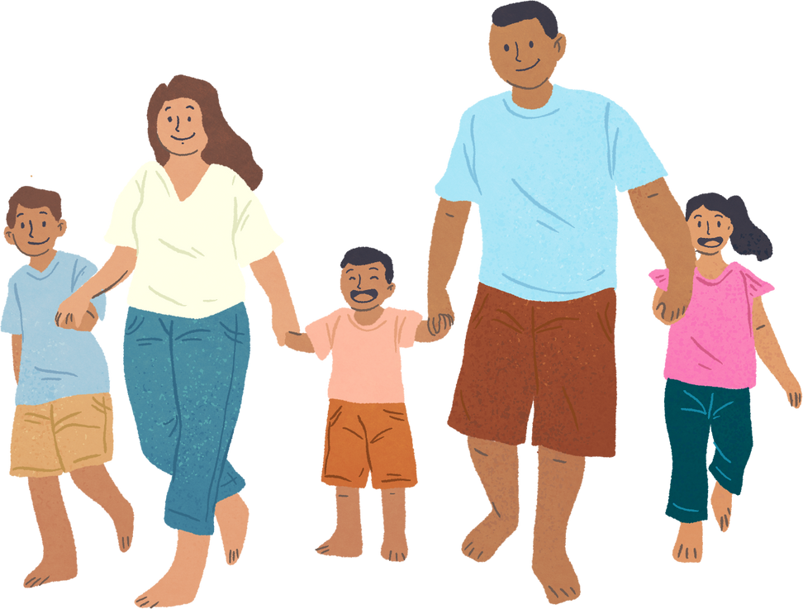


Unit 11: FAMILY TIME
Lesson 3 - Period 5

Slide 3






Table of content
Warm-up and Review.
Activity 1: Listen and repeat.
Activity 2: Listen and underline one more stressed word. Then repeat.
Activity 3: Let’s chant.
Fun corner and Wrap-up.

Slide 4








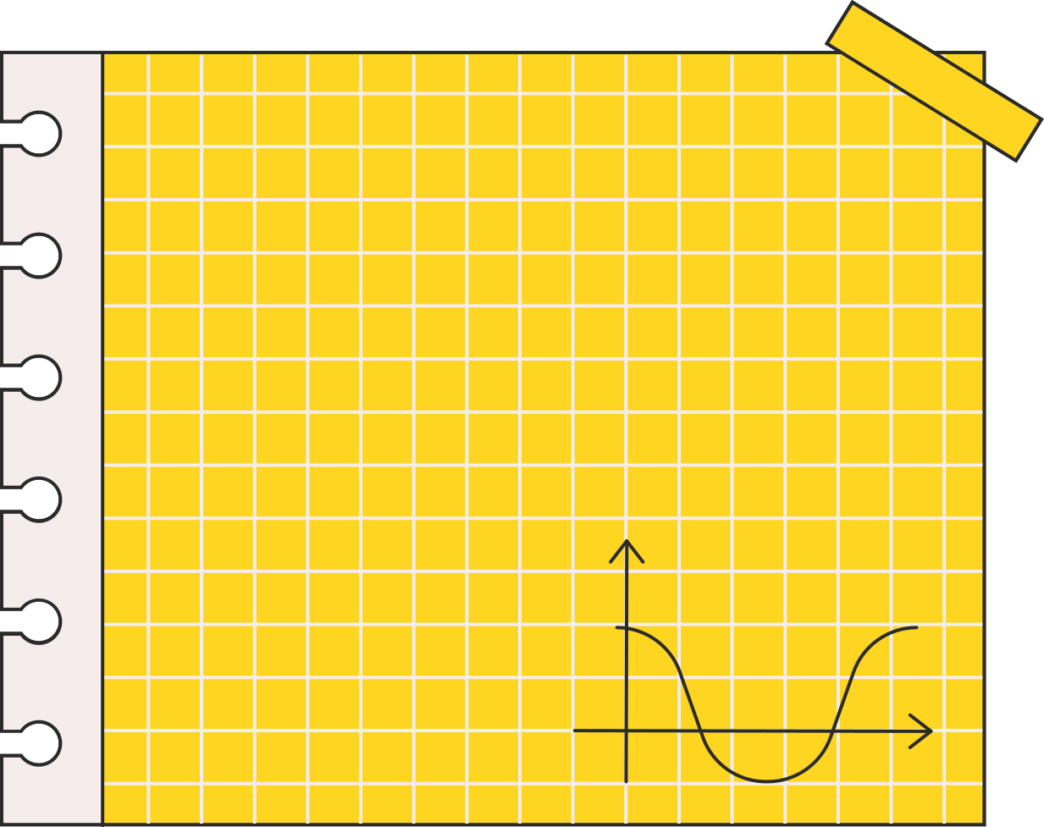



Warm-up and Review.
Let’s sing.

Slide 5







Did you swim last Sunday?
Where were you last Sunday?
I was on the beach.
Did you swim?
Yes, I did. I swam with my mum.
Where were you last weekend?
I was in the park.
Did you walk?
No, I didn't. I took photos there.

Slide 6

01
Activity 1
Listen and repeat.

Slide 7




Listen and repeat.
‘When did you ‘go to ‘London?
Notes:
Step 3: Repeat Steps 1 and 2 for the question ‘What did they ‘do in ‘Finland?

Slide 8
Listen and repeat.
‘What did they ‘do in ‘Finland?
Notes:
Step 1: Draw pupils’ attention to the question ‘When did they ‘go to ‘London?. Play the recording and encourage pupils to point at the words with stressed syllables in 169 the question while listening.
Step 2: Play the recording again and encourage pupils to listen and repeat the question. Do this several times until pupils feel confident. Correct their pronunciation where necessary.

Slide 9

Work in pairs.
‘When did you ‘go to ‘London?
‘What did they ‘do in ‘Finland?
Notes:
Step 4: Let pupils work in pairs or groups, saying the words with stressed syllables and reading the questions until they feel confident.

Slide 10
03
Activity 2
Listen and underline one more stressed word. Then repeat.

Slide 11



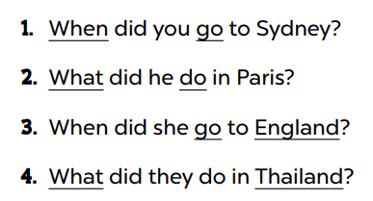


Look and say.
Notes:
Step 1: Tell pupils the goal of the activity. Explain that they have to listen to the recording and underline one more stressed word. Check comprehension.

Slide 12
Listen and underline one more stressed word. Then repeat.
Notes:
Step 2: Play the recording all the way through for pupils to listen to the questions. Play the recording again for pupils to underline one more stressed word of the questions.

Slide 13

Swap your book.
Notes:
Step 3: Tell pupils to swap books with a partner, then check the answers together as a class. Write the correct answers on the board.

Slide 14
Listen and double-check.
Notes:
Step 4: Play the recording again for pupils to double-check their answers. Extension (For consolidation): Invite one or two pupils to stand up and repeat the correct answers.

Slide 15
04
Activity 3
Let’s chant.

Slide 16


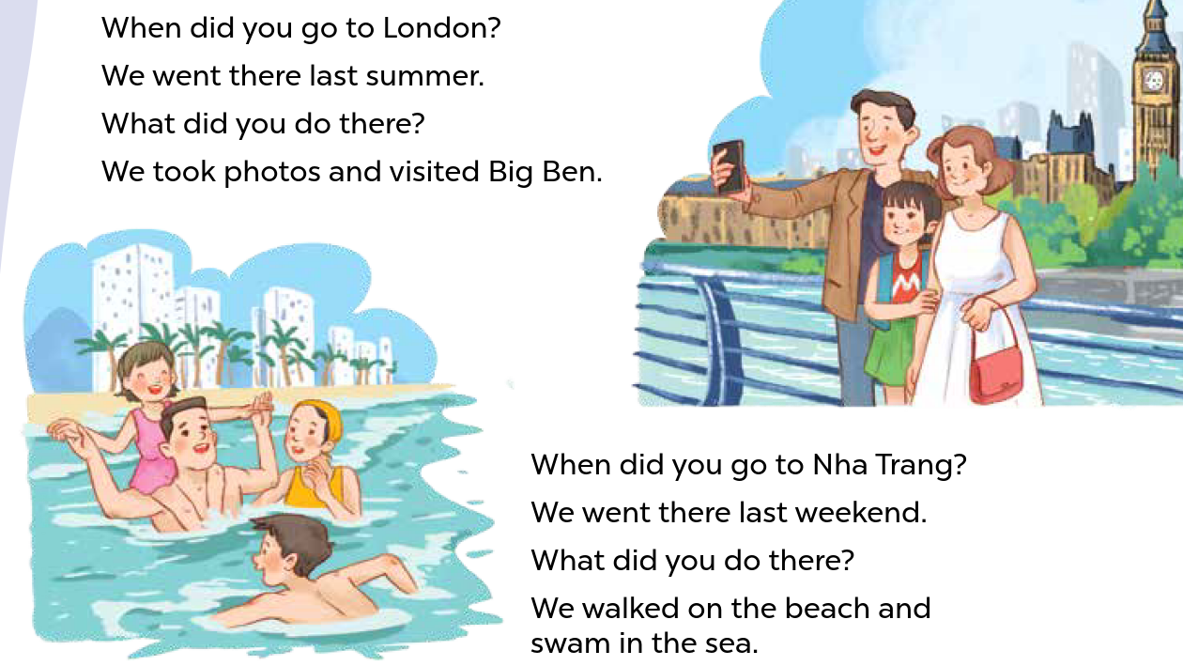



Look and read.
Notes:
Step 1: Draw pupils’ attention to the lyrics of the chant. Check their comprehension.

Slide 17
Listen and chant.
Notes:
Step 2: Play the recording all the way through for pupils to listen to the whole chant. Encourage them to listen carefully to the rhythm and pronunciation. Draw pupils’ attention to the word stress in the questions.
Step 3: Play the recording line by line while pupils listen and repeat. Correct their pronunciation, if necessary.

Slide 18
Chant and clap.
Notes:
Step 4: Play the recording all the way through for pupils to chant. Encourage them to clap along while chanting.

Slide 19
05
Wrap-up
Let’s play a game.

Slide 20




MEMORY CHAIN

Slide 21


Round 1
‘When did you ‘go to ‘Sydney?
‘What did he ‘do in ‘Paris?
‘When did she ‘go to ‘England?
‘What did they ‘do in ‘Thailand?
Notes:
- Divide the class into two groups. Each group has eight students.
- Ask eight students from each group take turn playing the game.
- Have Student A say the first question, then have Student B say the next question and so on.
- If a student forgets a sentence, the group must start from Student A again.

Slide 22


Round 2
‘When did she ‘go to ‘England?
‘What did they ‘do in ‘Thailand?
‘When did you ‘go to ‘Sydney?
‘What did he ‘do in ‘Paris?

Slide 23


Round 3
‘What did he ‘do in ‘Paris?
‘What did they ‘do in ‘Thailand?
‘When did you ‘go to ‘Sydney?
‘When did she ‘go to ‘England?

Slide 24
THANK YOU
FOR PLAYING!

Slide 25
Website: hoclieu.vn
Fanpage: https://www.facebook.com/tienganhglobalsuccess.vn/

