Slide 1


Welcome to our class
Teacher: Phạm Thị Lan Hương
2/26/2025
Võ Thị Thoa

Slide 2
Let’s sing

Slide 3


Slide 4
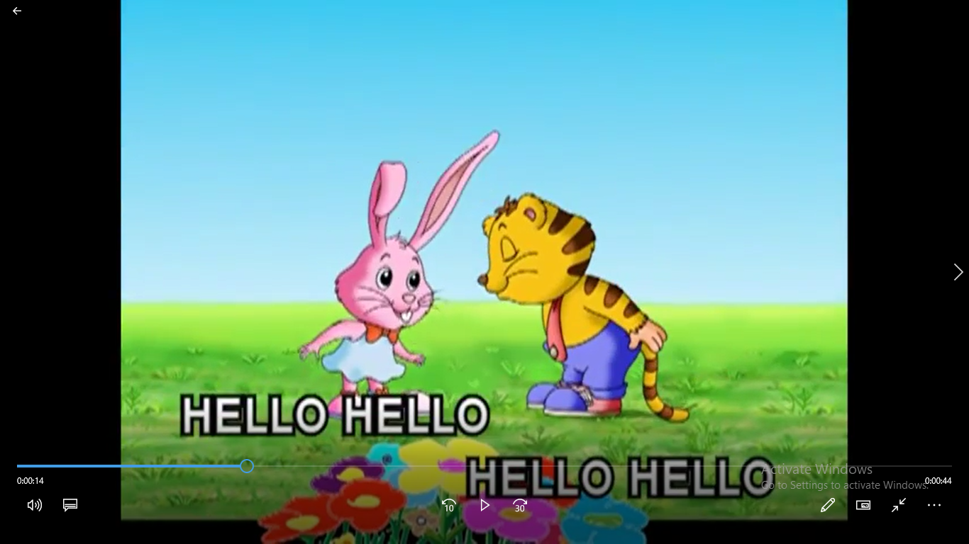

Slide 5


Our special days
13
Lesson 3: Part 4,5,6

Slide 6












Slide 7

When is Mai’s birthday ?
It’s on Sunday

Slide 8
Where will her birthday party be?
It’ll be at 15 Quang Trung Street

Slide 9
What food will they have?
They’ll have pizza, burgers and chips

Slide 10
What drinks will they have?
They’ll have lemonade, apple juice and milk tea.

Slide 11
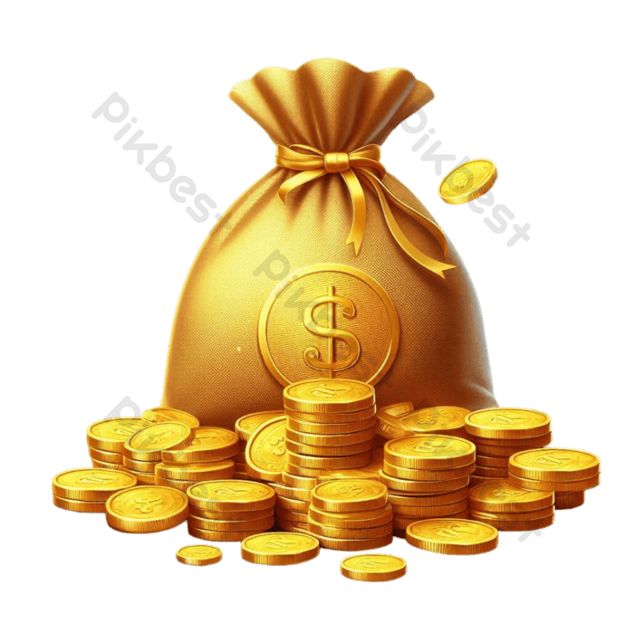

Slide 12


Slide 13
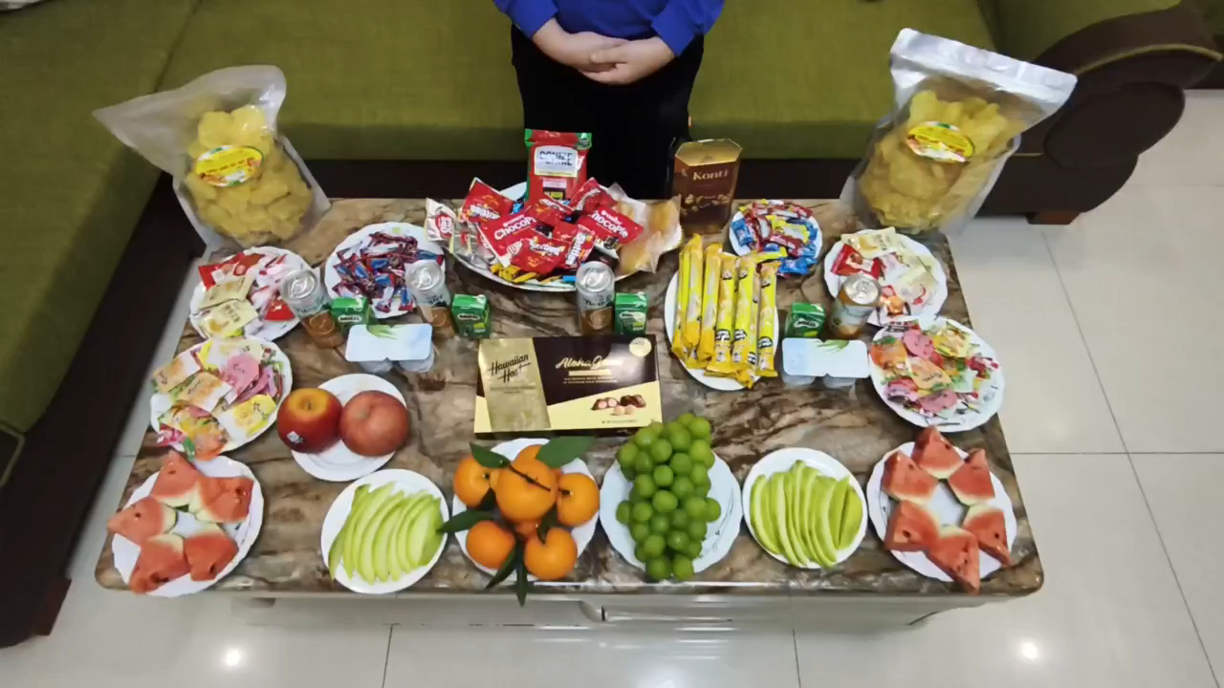

Slide 14


Thank you very much
Good bye! See you again!

