Slide 1












MsPham
0936082789
Unit 17
In the city
Lesson 3 – Period 1

Slide 2

1
Listen and repeat.
'bookshop
How can I get to the 'bookshop?
MsPham
0936082789
'campsite
How can I get to the 'campsite?

Slide 3
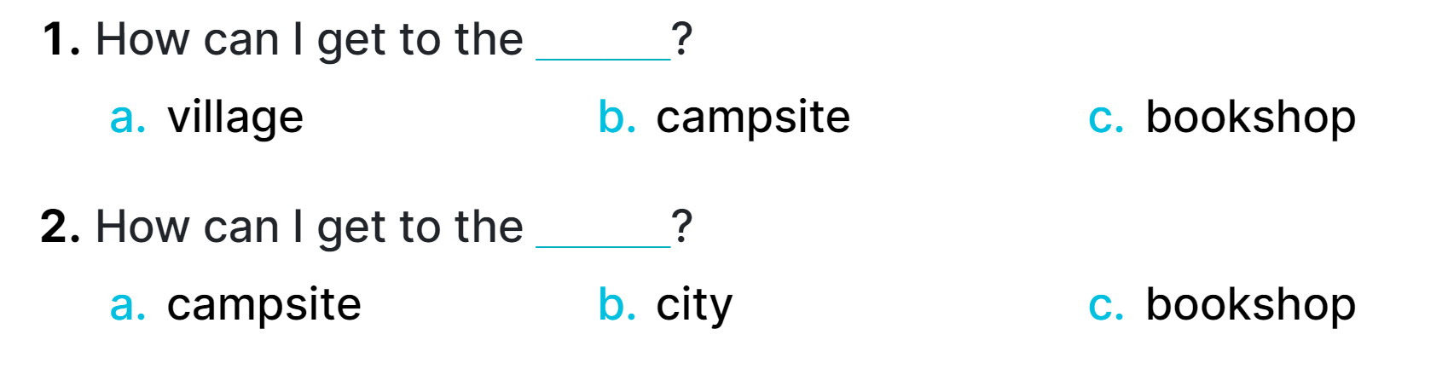
2
Listen and circle.
MsPham
0936082789

Slide 4
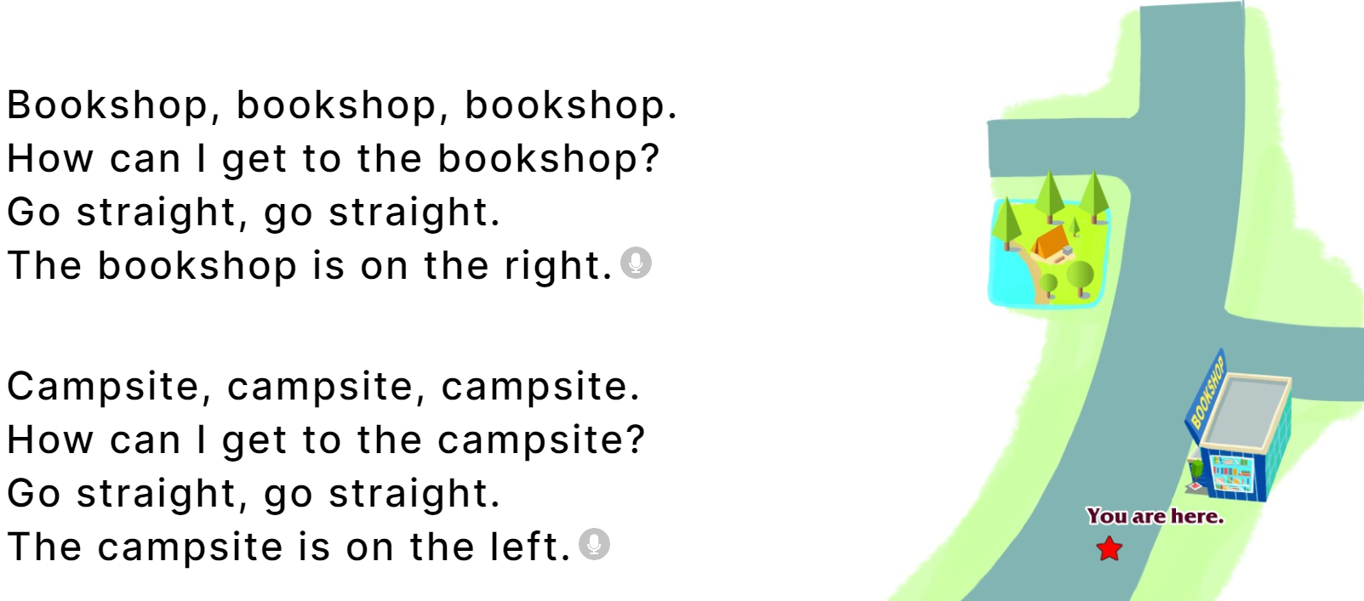
3
Let’s chant.

Slide 5





THANK YOU!
Caring for life, safe travel

