Slide 1




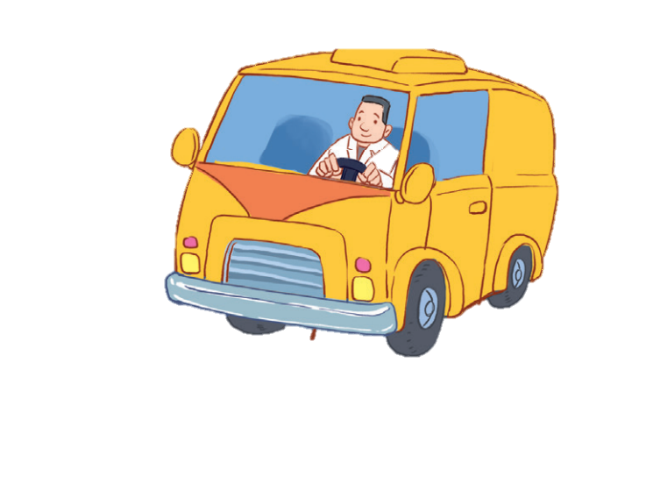

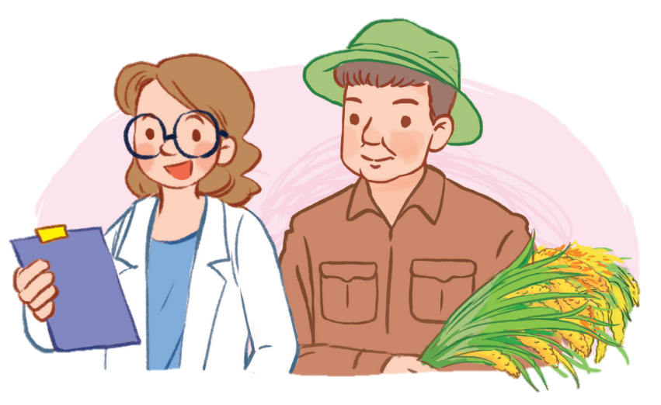
12
LESSON 1 – Period 2

Slide 2











JOBS
JOBS
PLAY
JOBS
JOBS

Slide 3



F
A
E
What's her job?
L
B
D
G
K
C
M
H
J
I
YOU'RE GREAT!
S
N
R
T
O
Q
Z
P
U
Y
D
O
C
T
O
R
V
X
W
CLICK
HERE

Slide 4

F
A
P
What’s his job?
L
B
W
G
A
R
M
H
J
I
YOU'RE GREAT!
S
N
R
K
O
Q
Z
E
U
Y
W
O
R
K
E
R
V
X
G
CLICK
HERE

Slide 5

F
A
E
What's her job?
L
B
D
G
K
C
M
H
J
I
YOU'RE GREAT!
S
N
E
T
O
Q
R
P
U
Y
T
E
A
C
H
E
R
V
X
W
CLICK
HERE

Slide 6

F
I
R
What's his job?
L
B
H
G
K
V
M
E
J
A
YOU'RE GREAT!
S
N
R
D
O
Q
Z
P
U
Y
D
R
I
V
E
R
A
X
W
CLICK
HERE

