Slide 1




14
My bedroom
Lesson 1 – Period 1

Slide 2




①
Warm-up and review
②
Look, listen and repeat.
③
Listen, point and say.
④
Let’s talk.
⑤
Fun corner and wrap-up

Slide 3



Lesson 1
Period 1
①
Warm-up and review

Slide 4
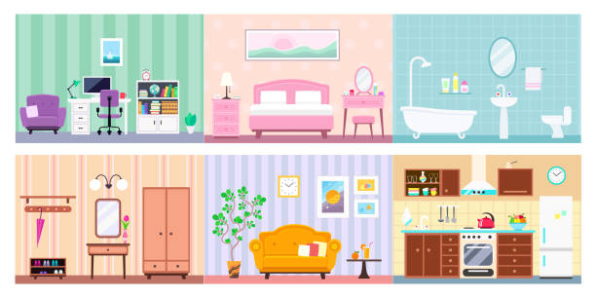
Game: What room is this?
Look and guess
Notes:
Open the coloured squares and guess the room behind.

