Slide 1



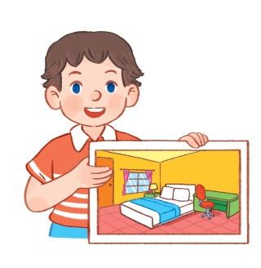

14
My bedroom
LESSON 3 - Period 5

Slide 2








1. Warm-up and review

Slide 3
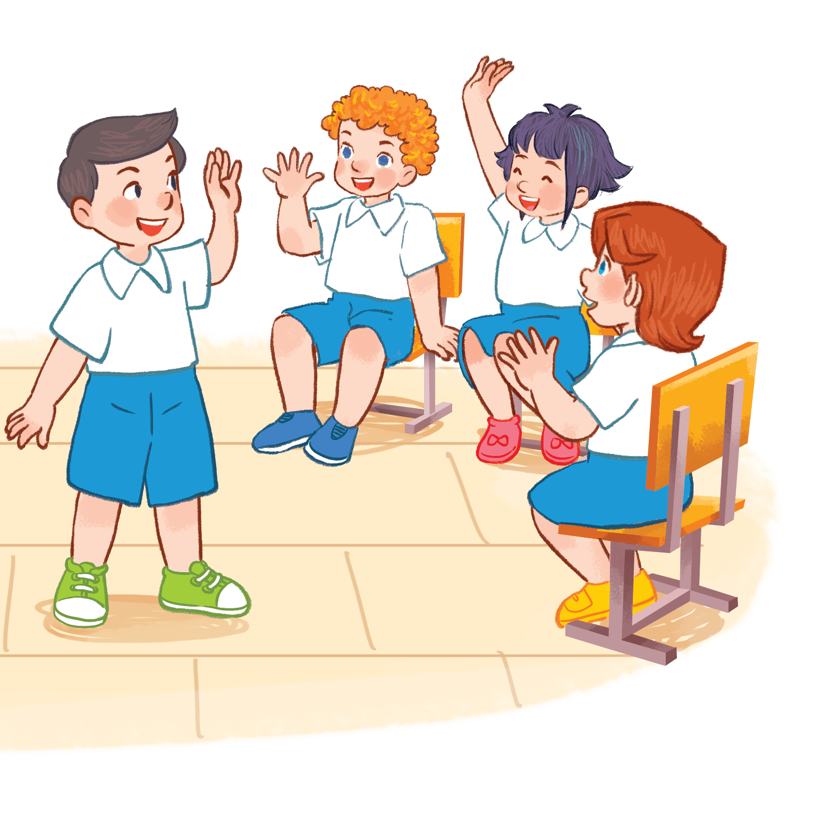
Lucky numbers
Lucky numbers
Notes:
Game: Lucky number.
- Divide the class into 2-4 groups.
Pupils choose numbers from 1 to 6. Look at the pictures then read the sentences to choose the correct answers.
If they answer correctly, their groups will get points.

Slide 4

3
4
2
6
5
1
Next

