Slide 1



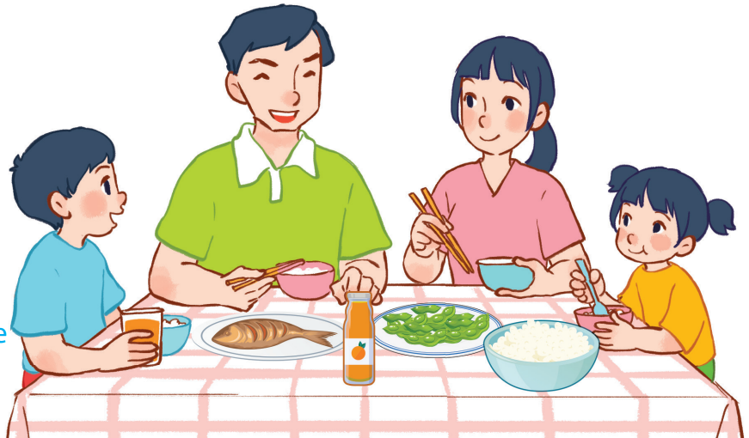
15
At the dining table
LESSON 1 – PERIOD 1

Slide 2
At the dining table
Warm-up
and review
Listen, point
and say.
Fun corner
and wrap-up
Look, listen
and repeat.
Let’s talk.

Slide 3









Team A
Team B
Warm-up
and review
Game: Happy Flowers
30
20
40
30
70
50
80
20
Notes:
Divide the class into 2 teams.
Each team chooses one flower to go to the question.
Have pupils look, read and choose the right option.
Back to the menu for pupils to choose another question.
Pupils continue their turns until there is no flower left.
The team that gets the most points is the winner.

