Slide 1

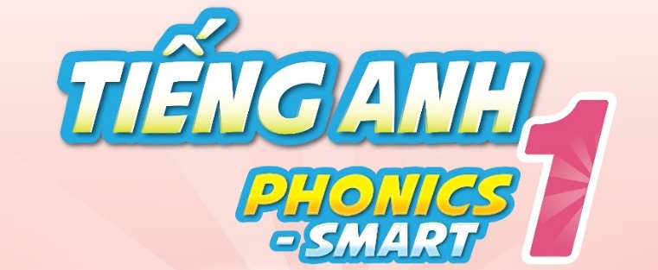

Slide 2
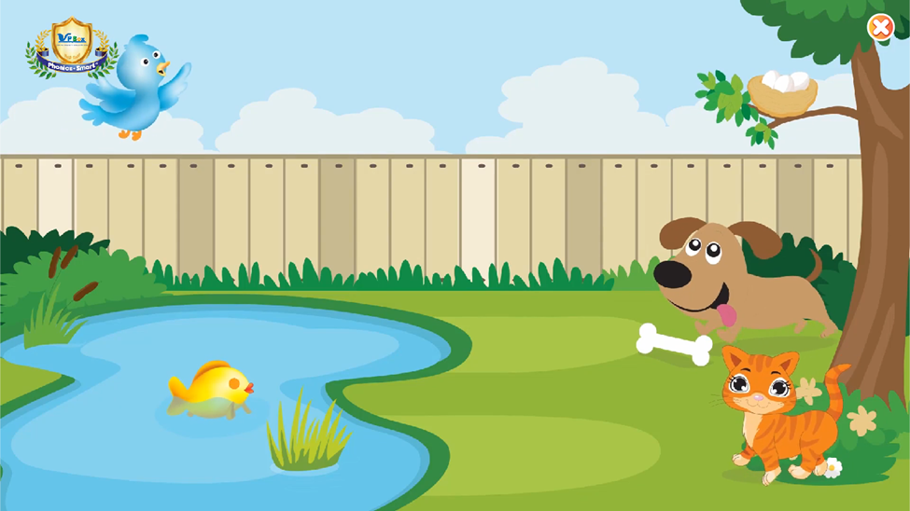
Warm up
Animals song
Notes:
Hello children, How are you doing?
I hope that you are good.
Let’s sing “The animals song”
Today, we will have 2 groups – group 1 and group 2. You are group 1, you are Group 2.

Slide 3
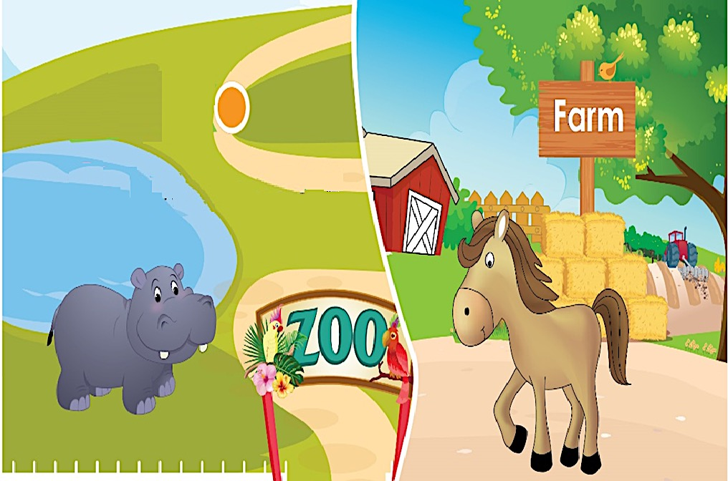
Unit 8
Lesson 2
Notes:
Welcome to Unit 8 – Lesson 2.
Before we continue, Do you remember Lesson 1?
Let’s play a game to review Lesson 1.

Slide 4

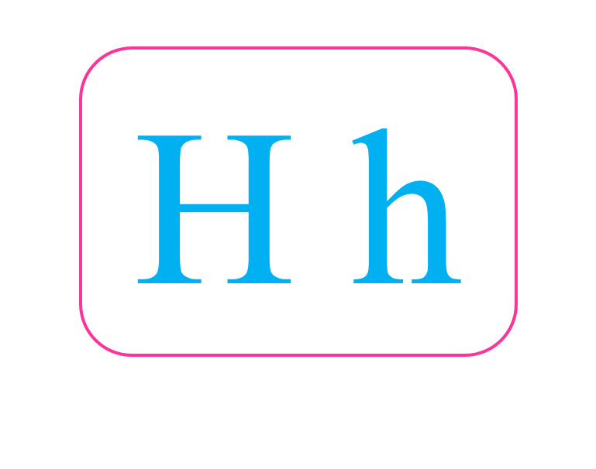
Game: Can you guess?
What is it?
Remove Box
Next Slide
Notes:
This is Guessing game,“I will remove the box one by one, and you guess what it is. OK?”. “Good”
“What is it?- Guess.”
After the picture is shown, ask SS to read again.
Good job. Letter H. 1 point for your group.

Slide 5
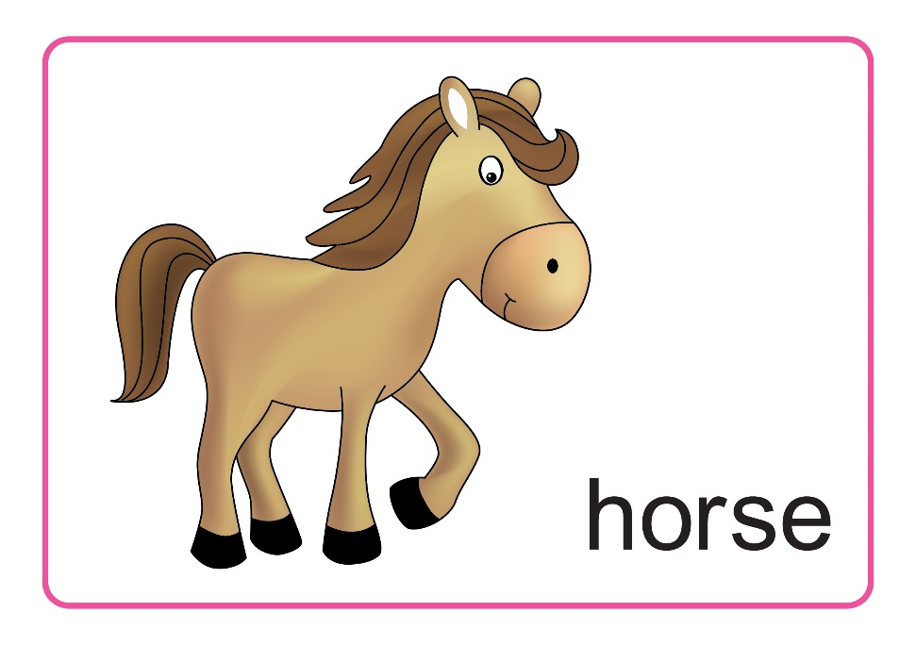
Game: Can you guess?
What is it?
Remove Box
Next Slide
Notes:
Can you guess this one?
Well done. A horse. Your group gets 1 point.

Slide 6
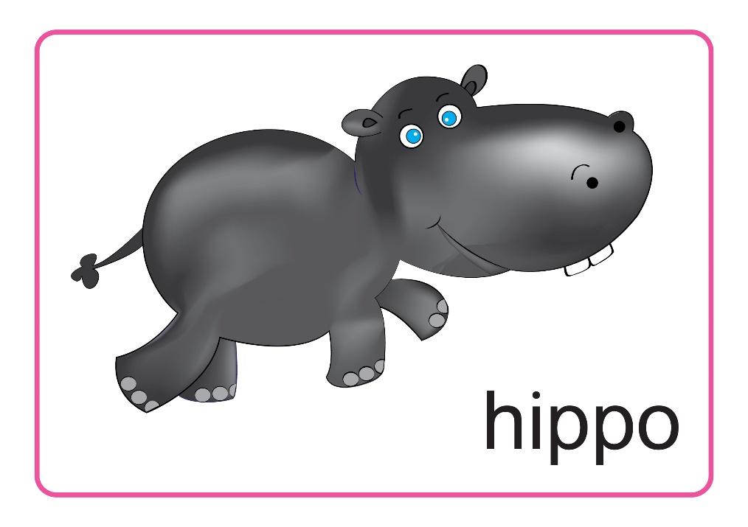
Game: Can you guess?
What is it?
Remove Box
Next Slide
Notes:
How about this one?
What is it?
You’re right.
A hippo. 1 more point.

Slide 7

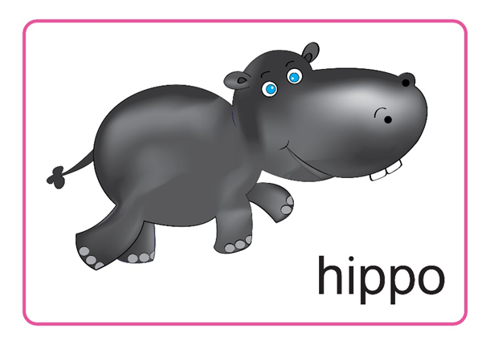
Unit 8 Lesson 2
Review Lesson 1
Notes:
So, these are some cards, we learn in Lesson 1.
Let’s say them again.
Now, we move to Lesson 2.

Slide 8
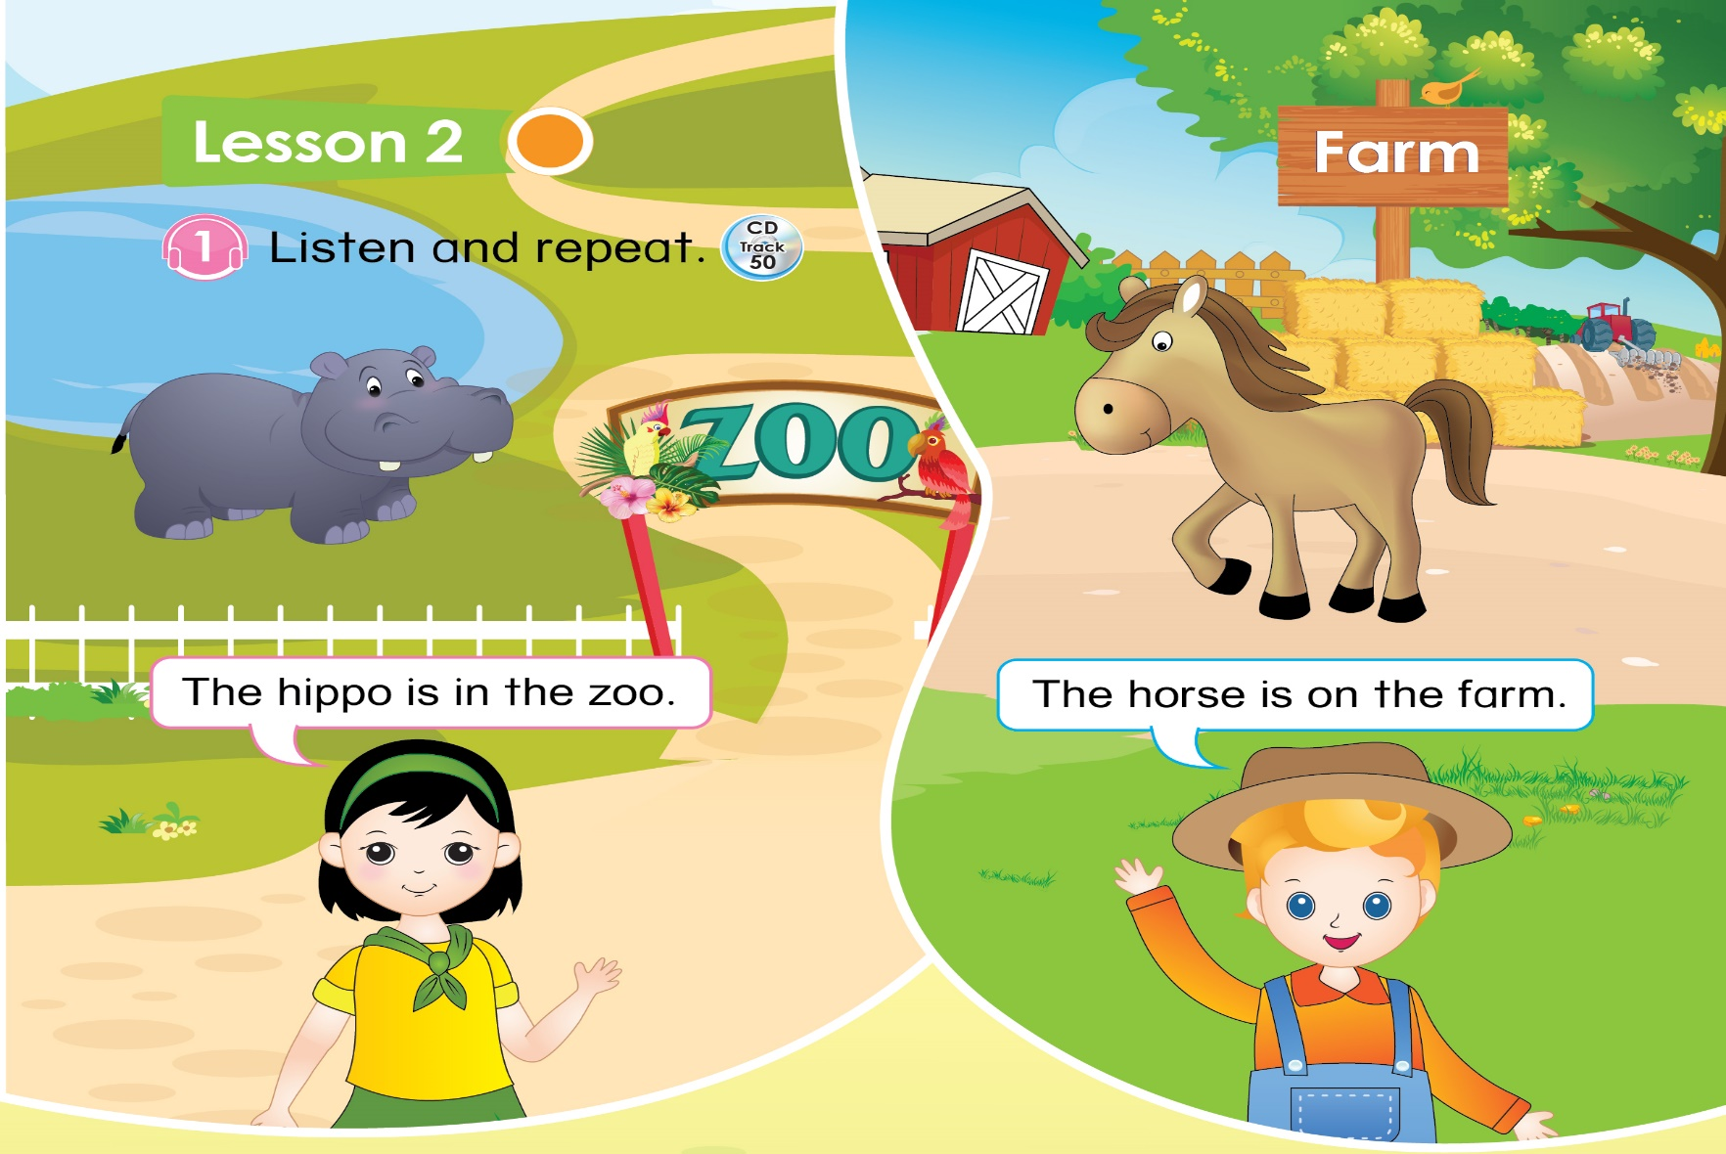

Unit 8 Lesson 2
1. Listen and repeat
1
2
3
The hippo is in the zoo.
The horse is on the farm.
Notes:
-Now, This is Part 1 – Listen and repeat.
You listen 2 times. Click number 1.
“ The hippo is in the zoo”.
“The horse is on the farm”.
-Click number 2 (The second time)
-Click number 3 -Let’s listen and repeat.

Slide 9
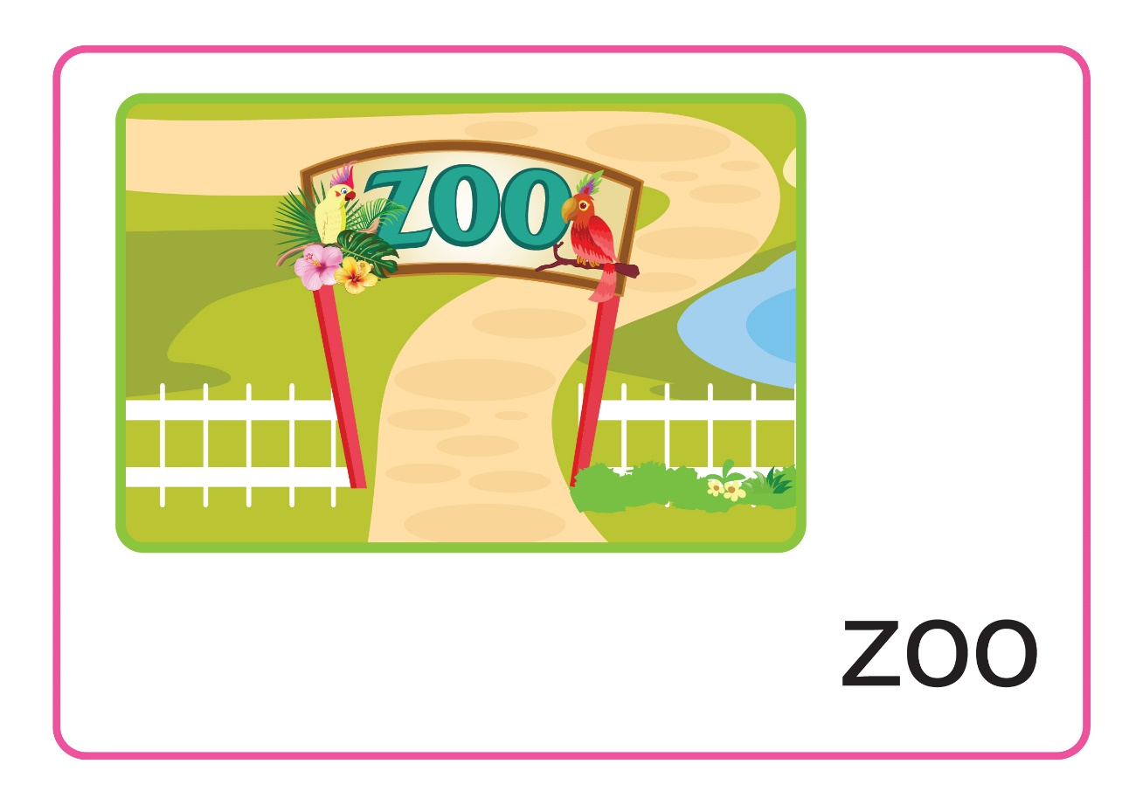
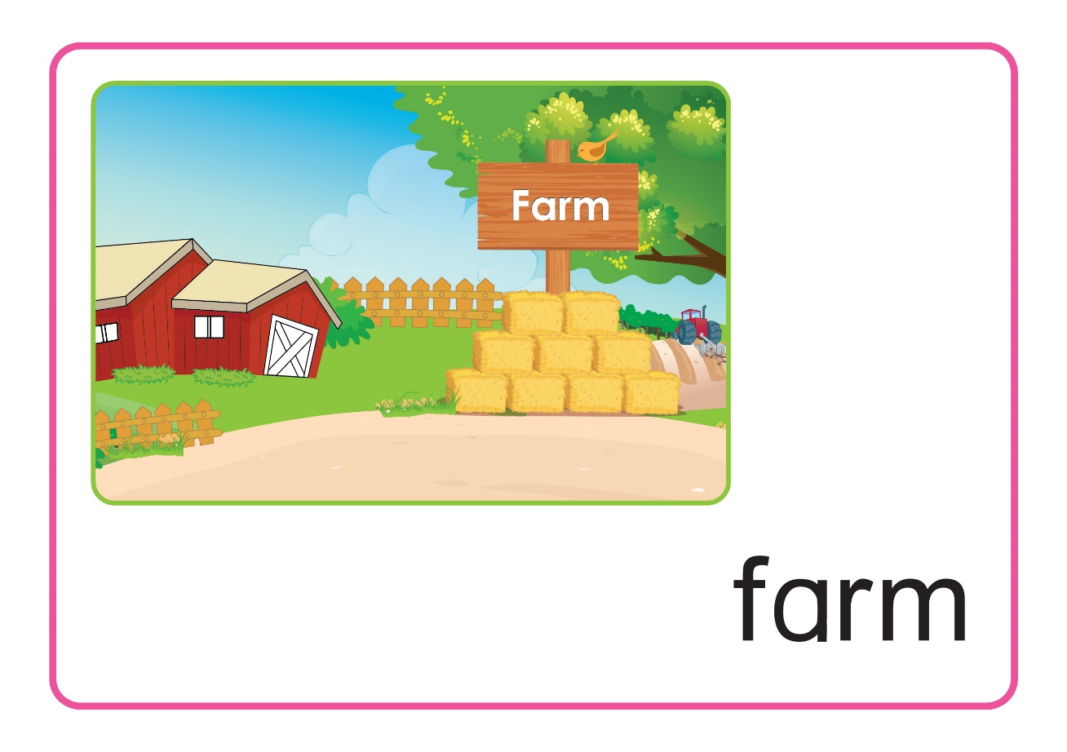
Unit 8 Lesson 2
1. Listen and repeat
Notes:
- Do you know the zoo, and the farm?
We can go to the zoo to look some wild animals like a hippo, a tiger, a lion,…
But on the farm we can see a chicken, a duck, a horse, a sheep, a donkey,…

Slide 10
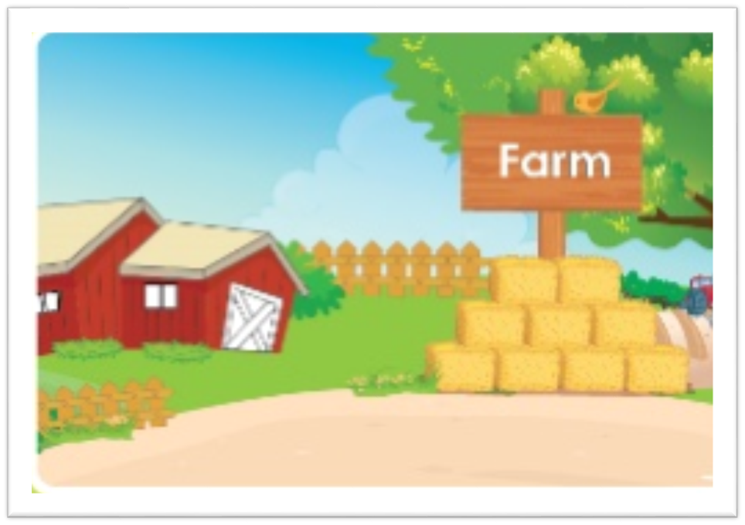
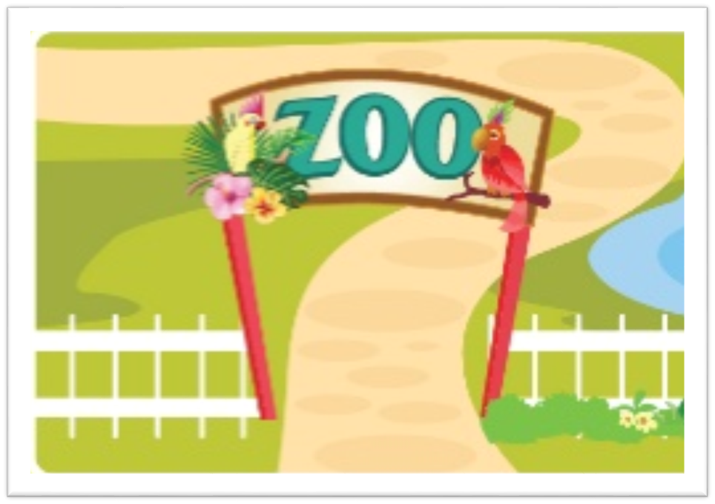
Unit 8 Lesson 2
1. Listen and repeat
The
is on the
1
2
The
is in the
Notes:
- Let’s listen and repeat one more time.
Click 1 “ The horse is on the farm”.
Click 2 “The hippo is in the zoo”.
- Very good!

Slide 11
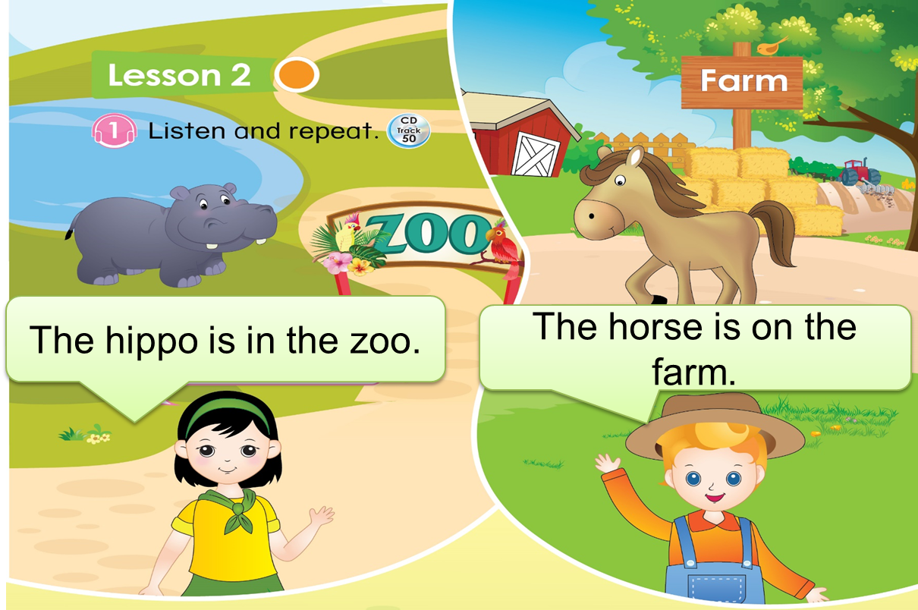
Unit 8 Lesson 2
1. Listen and repeat
Notes:
Now, you look at your book Page 37.
- Can you see the girl? – Yes. Good.
- What does she say? – That’s right!
- The girl says “ The hippo is in the zoo”.
- How about the boy?
- Where is he? Yes. He is on the farm.
- What does he say? – Good job!
“ The horse is on the farm”.

Slide 12

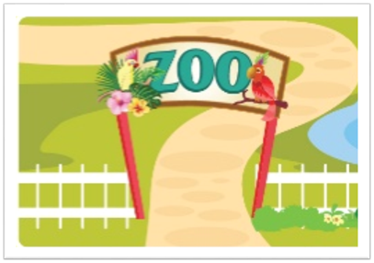

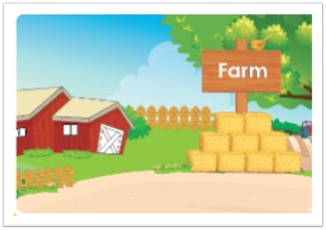
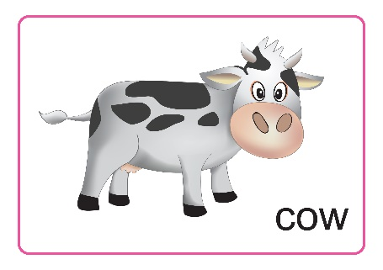
Unit 8 Lesson 2
1. Listen and repeat
2. Listen match and say
Example
horse

hippo

cow
Notes:
Well, we move to Part 2 – Listen, match and say
There is one example. Listen.
Do you hear the horse and the farm? So, we match “horse” and “ farm”.
Now it’s your turn.

Slide 13
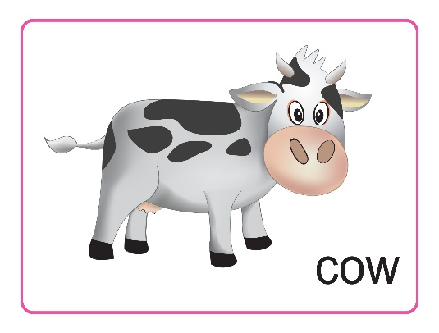
Unit 8 Lesson 2
2. Listen match and say
horse

hippo

cow
Notes:
Now, Look at your book Page 37. Get ready to match and say.
One – Listen. Click. Can you match?
- Click. Do you have the correct answer? “ The hippo is in the zoo”. – Good job.
Listen the last one. Click. Let’s match. We check it. Click.
“The cow is on the farm”.
With the correct answer, your group will have 1 point.
Congratulation.

Slide 14

Unit 8 Lesson 2
Game: Where is it?
on the
The
is
in the
Notes:
- Let’s play the game “Where is it?”
- You will see an animal then you choose where it lives, on the farm or in the zoo.
Look at the example.
The duck – Is it on the farm? Or it is in the zoo.( Pause 3’’ then click to show the answer)
“The duck is on the farm”.
With the correct answer, your group will have 1 point. Good
Next

Slide 15


Unit 8 Lesson 2
Game: Where is it?
is
on the
The
in the
Notes:
The elephant – Is it on the farm? Or it is in the zoo.
Pause 3’’ then click to show the answer
“The elephant is in the zoo”.
With the correct answer, your group will have 1 point. Well done.
Next

Slide 16

Unit 8 Lesson 2
Game: Where is it?
is
on the
The
in the
Notes:
The hippo – Is it on the farm? Or it is in the zoo.
Pause 3’’ then click to show the answer
“The hippo is in the zoo”.
Your group will have 1 point. Great.
Next

Slide 17

Unit 8 Lesson 2
Game: Where is it?
is
on the
The
in the
Notes:
The horse. So, Where is it?
Pause 3’’ then click to show the answer
“The horse is on the farm”.
With the correct answer, your group will have 1 point. Good
- Excellent.

Slide 18
Unit 8 Lesson 2
The
is on the
The
is in the
Notes:
So, can you remember that “ The horse is on the farm”, “The hippo is in the zoo.”
- Let’s say them again.
- Fantastic.1 point.

Slide 19


Unit 8
Sum up
Notes:
Let’s look at your book again to see what we learn today.
Can you say what the girl and the boy are saying? – Very good
Part 2, Look, match and say, can you match? – Well done.
It’s the end of our lesson today.
- Let’s count your points
So the winner is group …. Group …, you also good, too.
Goodbye class

