Slide 1





Slide 2

At the shopping centre
Lesson 1 - Period 1

Slide 3
Table of contents
01
Warm-up and review
02
Look, listen and repeat.
03
04
Listen, point and say.
Let’s talk.
05
Fun corner and wrap-up

Slide 4
01
Warm-up

Slide 5

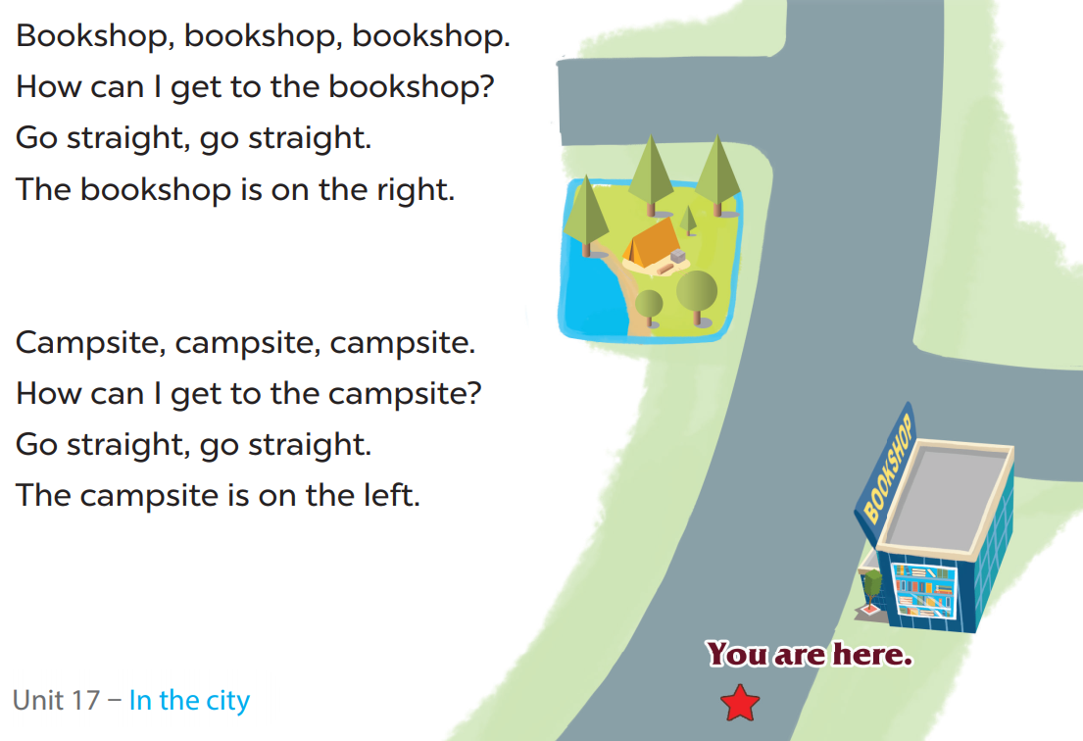
Let’s chant!

Slide 6
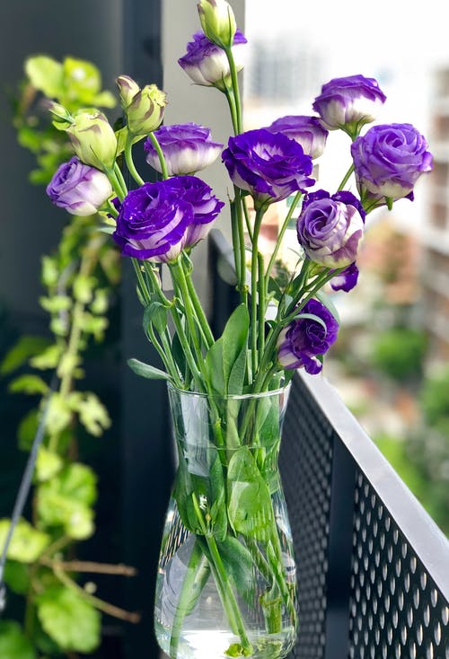

02
Look, listen and repeat.
Pupil’s book page 52

Slide 7
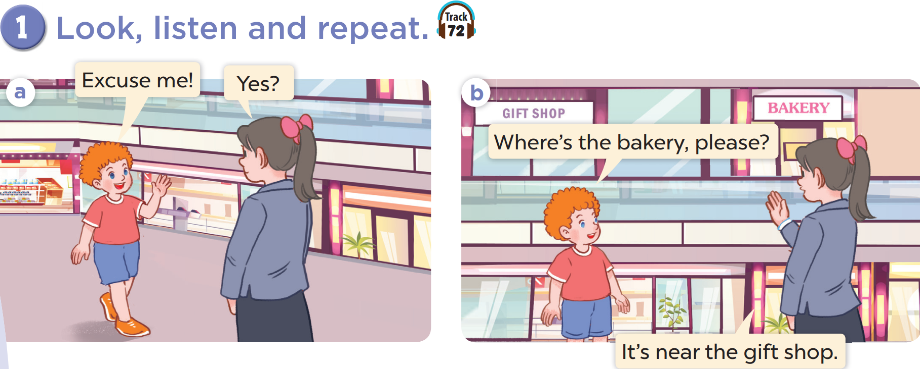






Slide 8
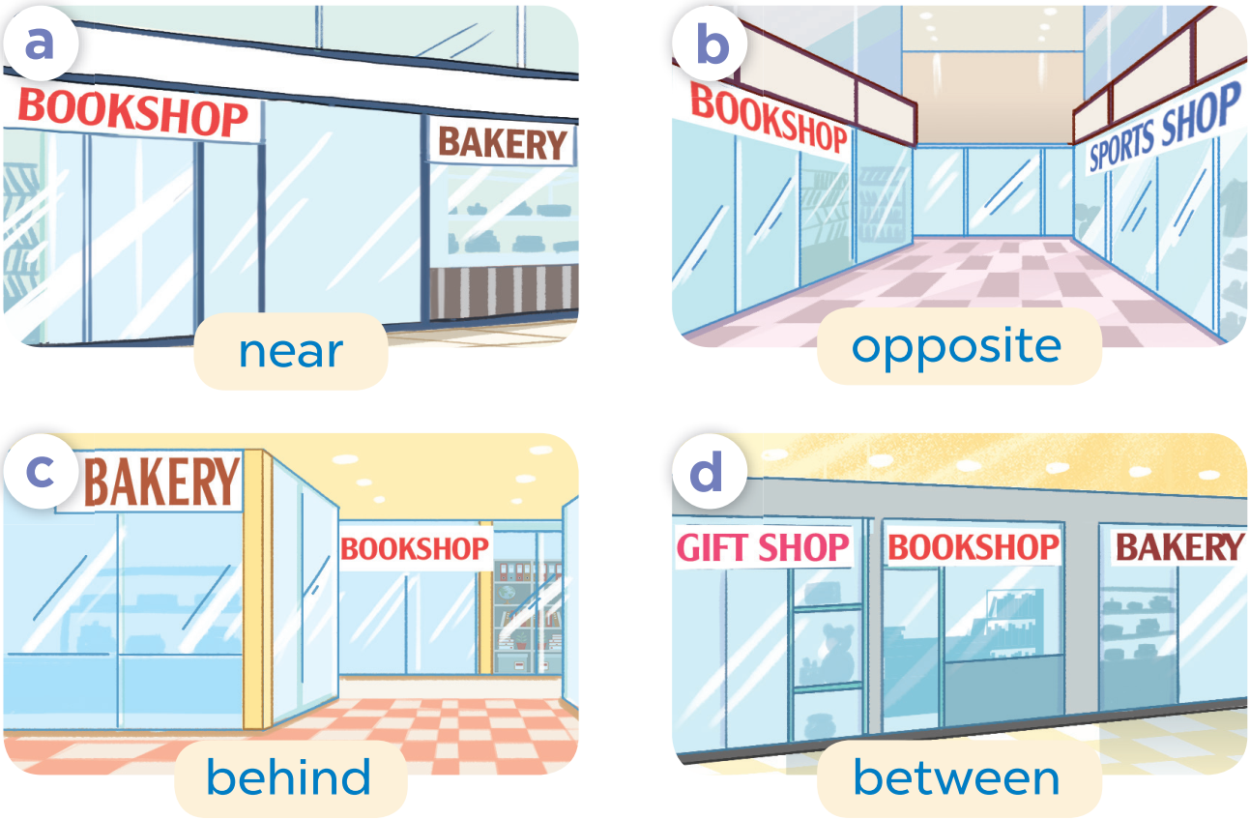
03
Listen, point and say.
Pupil’s book page 52

Slide 9
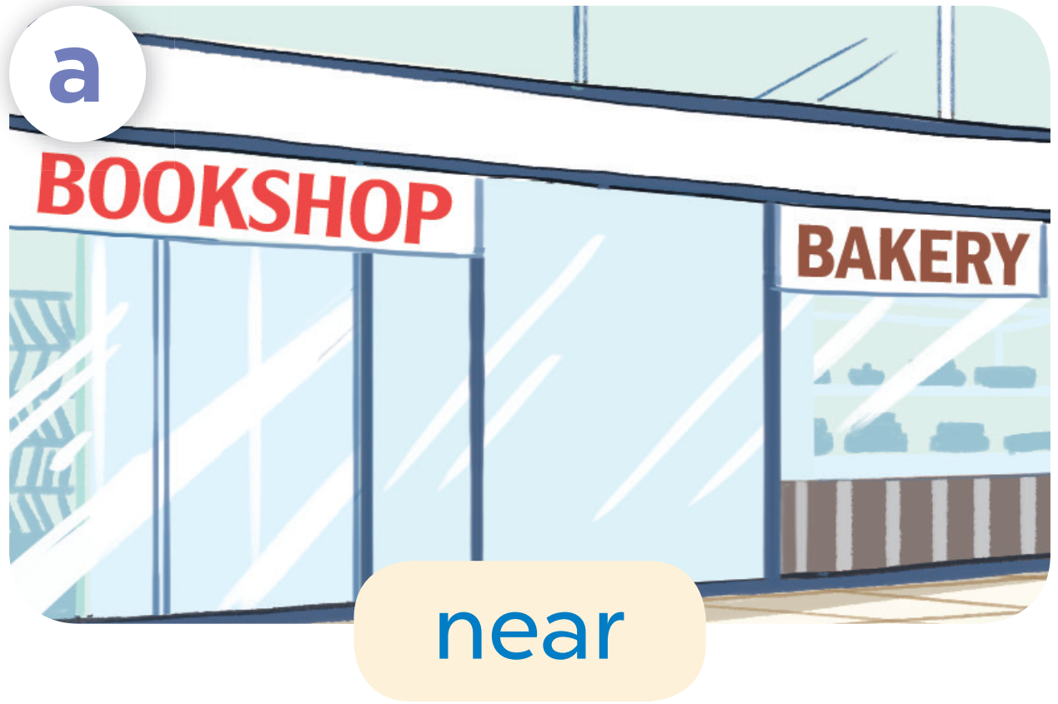
near

Slide 10
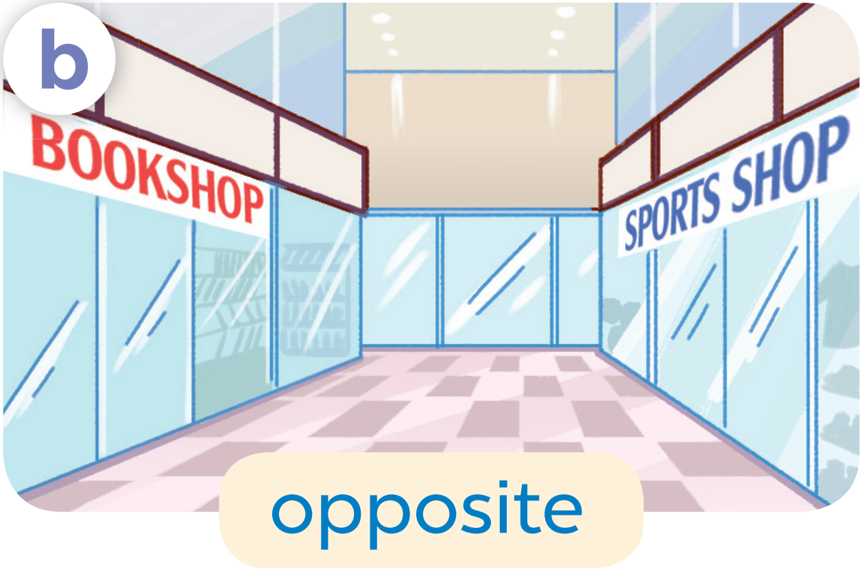
opposite

Slide 11
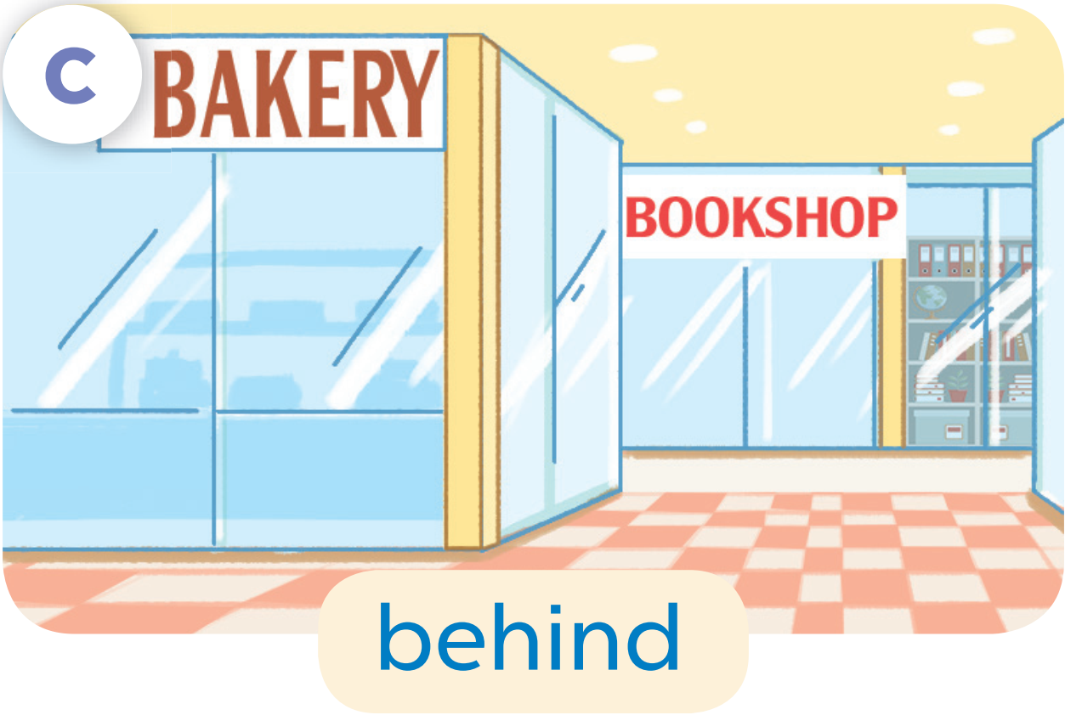
behind

Slide 12
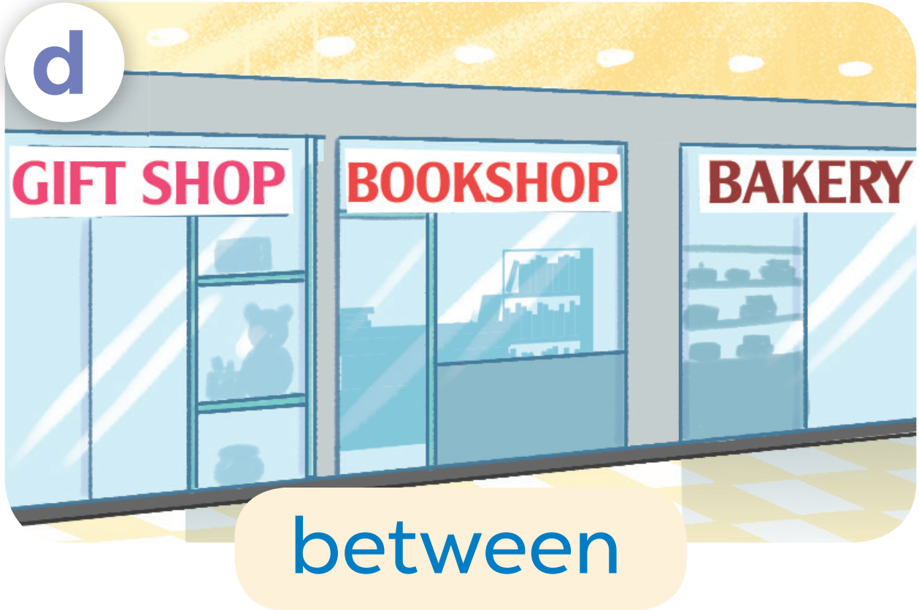
between

Slide 13
Let’s practise!

Slide 14
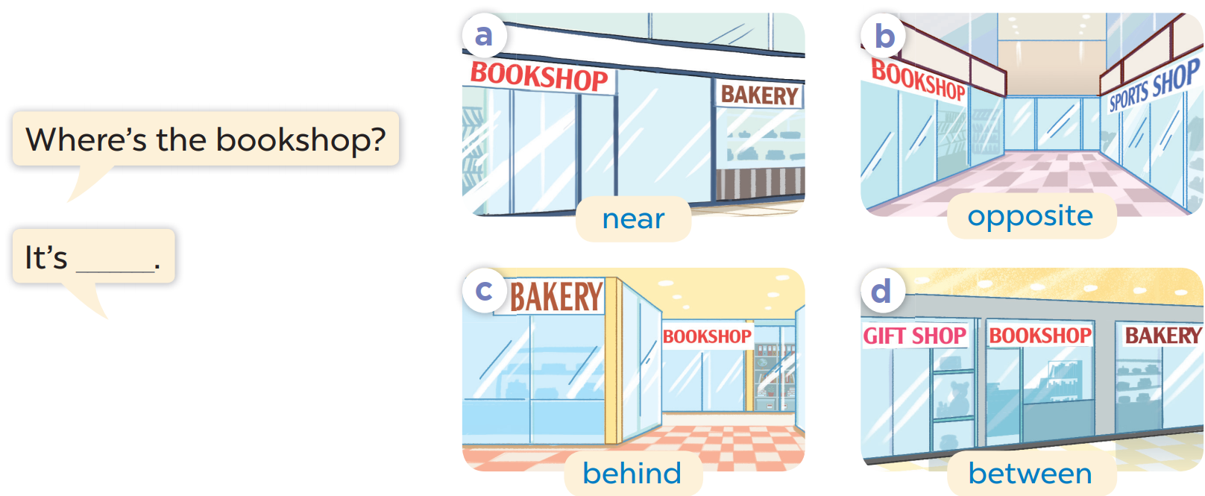


Slide 15
04
Let’s talk.

Slide 16
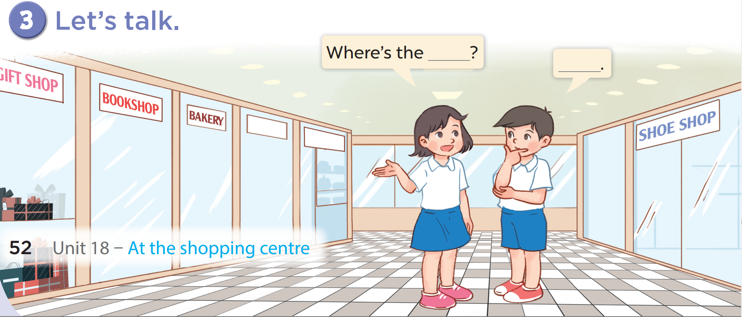

Slide 17
05
Fun corner

Slide 18



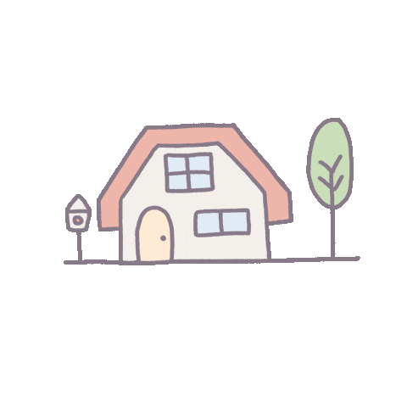
= 10 points
= - 20 points
= 50 points

Slide 19









TEAM 1
TEAM 2
TEAM 3

Slide 20
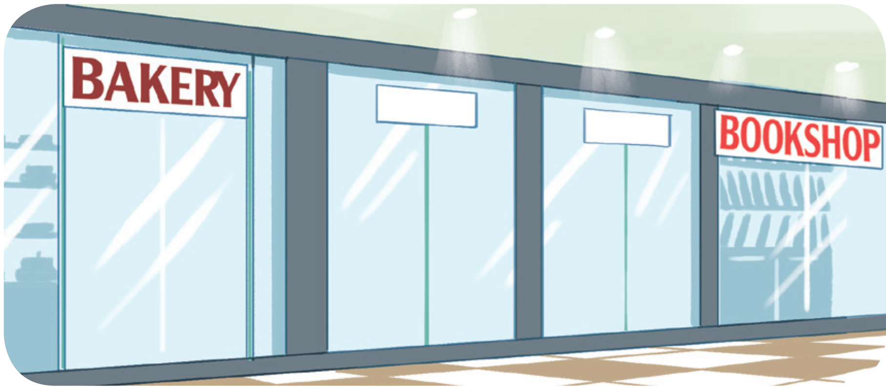
Where’s the bookshop?
It’s near the bakery.

Slide 21
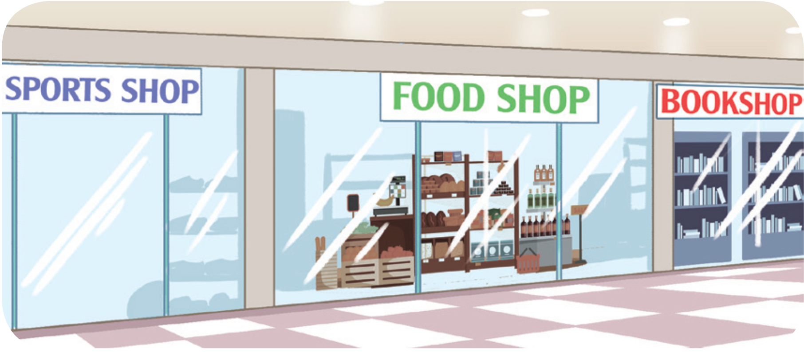
Where’s the food shop?
It’s between the sports shop and the bookshop.

Slide 22
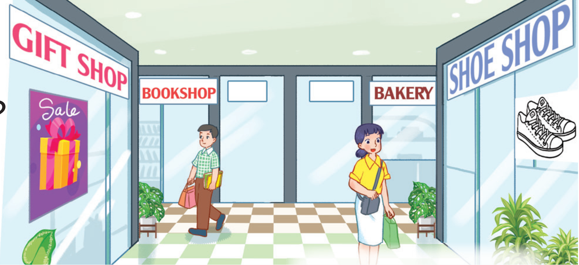
Where’s the shoe shop?
It’s opposite the gift shop.

Slide 23
Where’s the bakery?
It’s near the bookshop.

Slide 24
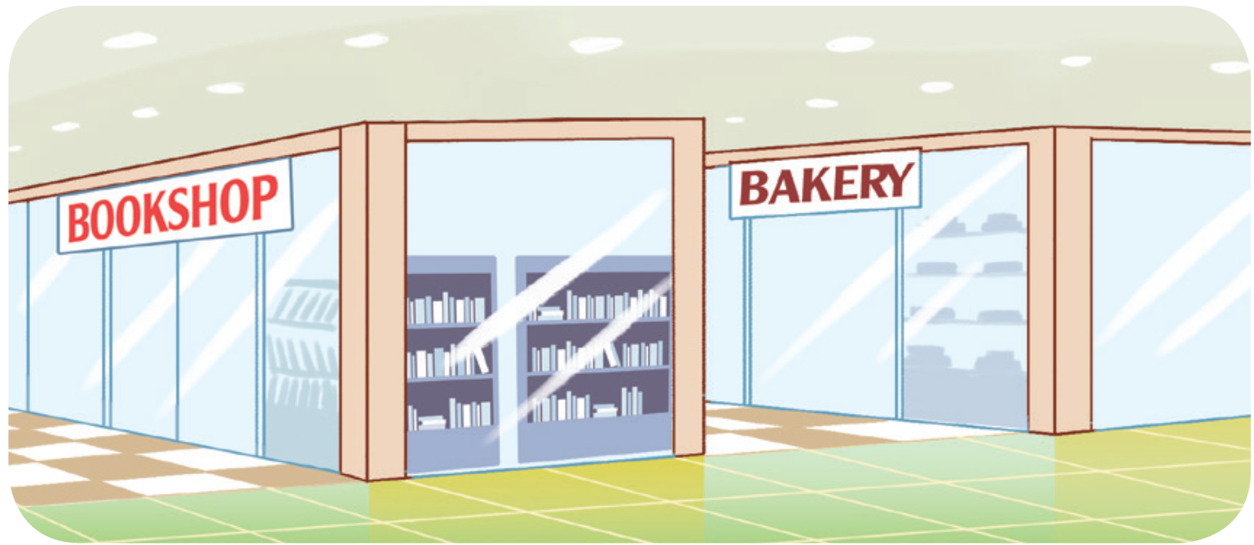
Where’s the bakery?
It’s behind the bookshop.

Slide 25
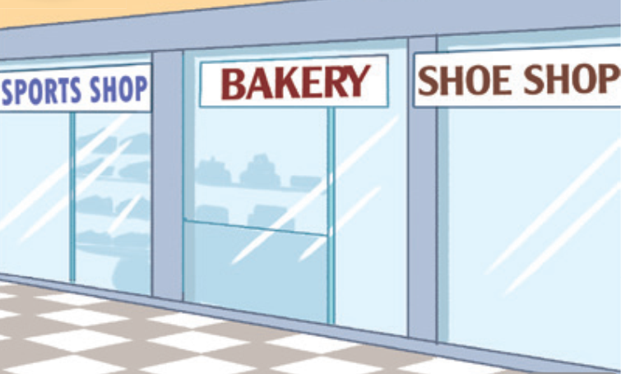
Where’s the bakery?
It’s between the sports shop and the shoe shop.

Slide 26
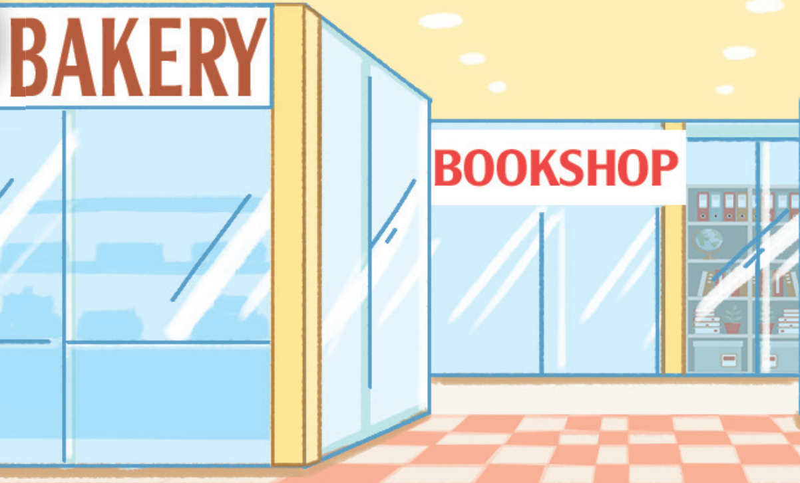
Where’s the bookshop?
It’s behind the bakery.

Slide 27

Where’s the sports shop?
It’s opposite the bookshop.

Slide 28
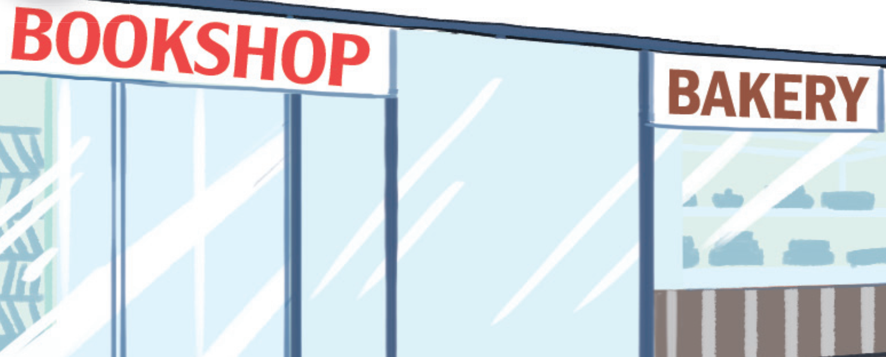
Where’s the bookshop?
It’s near the bakery.

