Slide 1




Slide 2


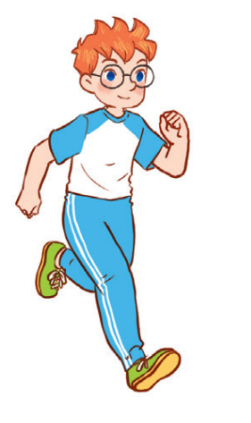
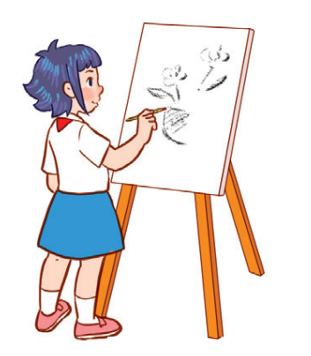

Unit 8
Period 2

Slide 3
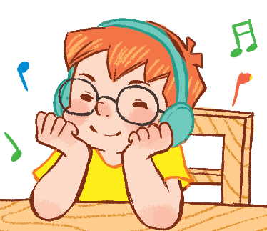
Listen and tick or cross.
2
2

Slide 4
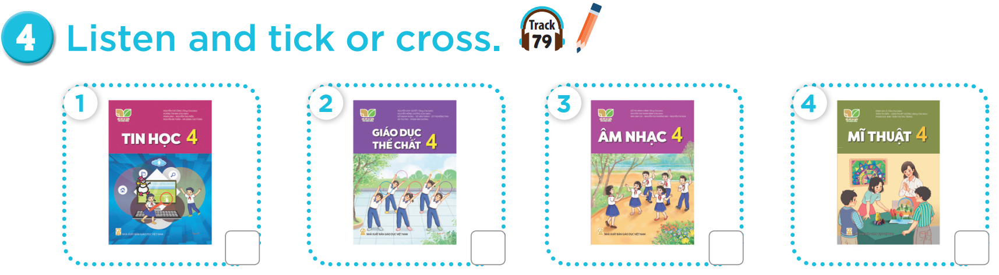


Slide 5
✓
✗
✓
✗

Slide 6
Look, complete and read.
3
3

Slide 7
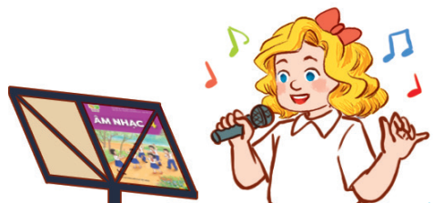
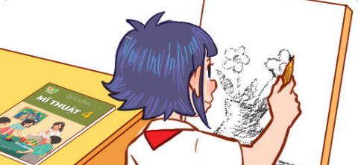

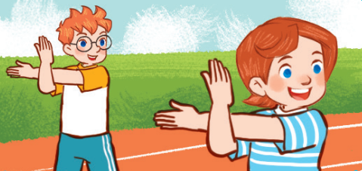

Slide 8
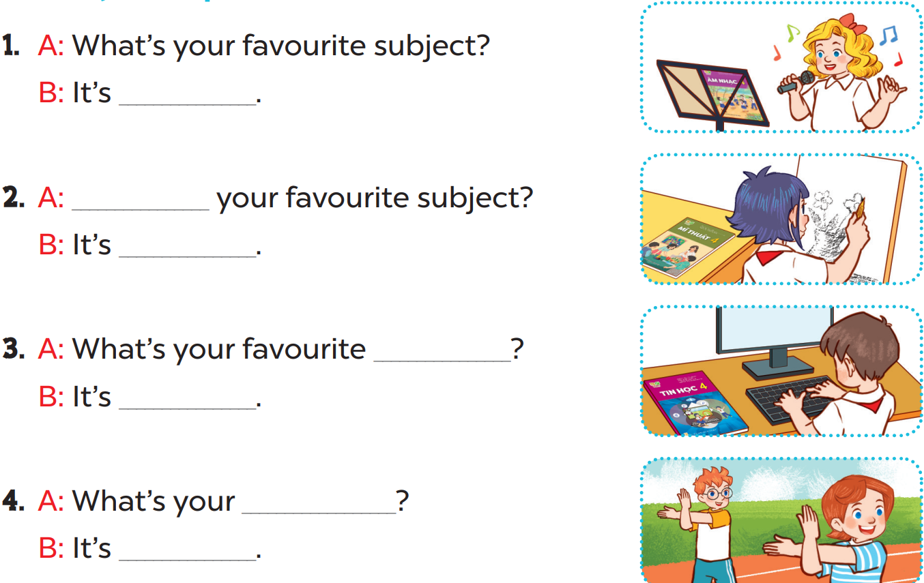

Slide 9
music
What’s
art
subject
IT
favourite subject
PE

Slide 10
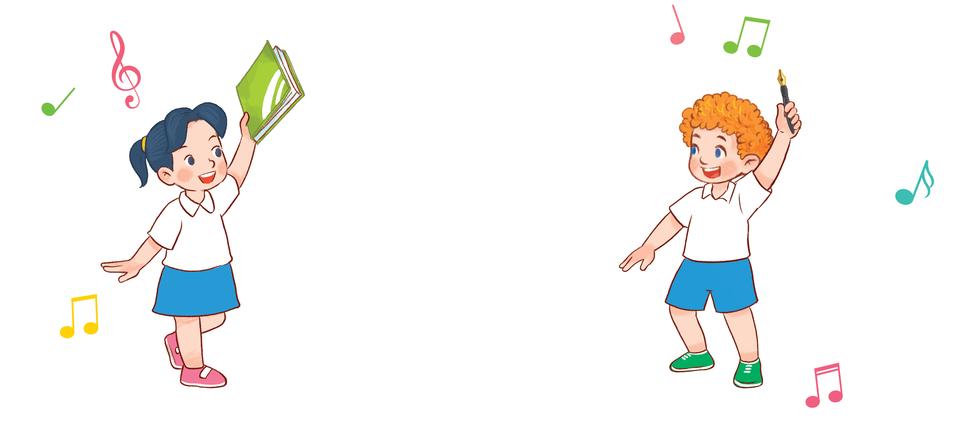
Let’s sing.
4
4

Slide 11
