Slide 2

Unit 10 Our school trip
Lesson 2 - Period 3

Slide 3

Table of content
01
Warm-up and Review
02
Activity 1. Look, listen and repeat
03
Activity 2. Listen, point and say
04
Activity 3. Let’s talk
05
Fun corner and Wrap-up

Slide 4


02
Activity 1.
Look, listen and repeat.

Slide 5

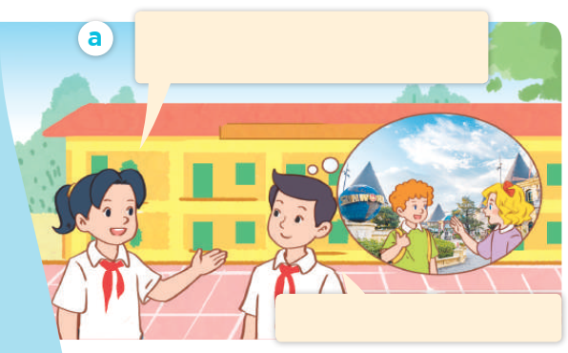
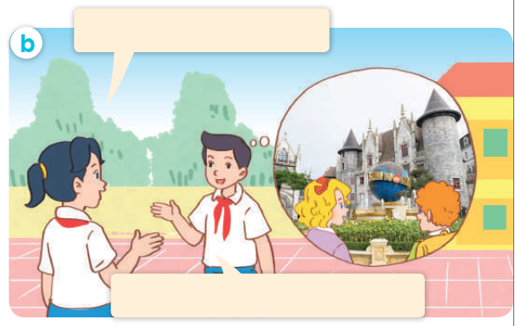
Look, listen and repeat.

Slide 6
Look, listen and repeat.
Where did Mary and Bill go on the school trip last weekend?
They went to Ba Na Hills.

Slide 7
Look, listen and repeat.
What did they do there?
They visited the old buildings.

Slide 8
Look, listen and repeat.
Where did Mary and Bill go on the school trip last weekend?
What did they do there?
They went to Ba Na Hills.
They visited the old buildings.

Slide 9
03
Activity 2.
Listen, point and say.

Slide 10
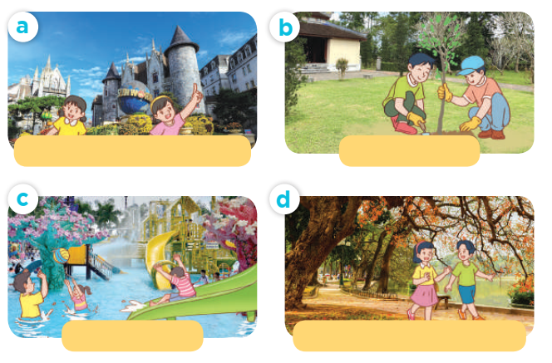
Listen, point and say.

Slide 11
Listen, point and say.
visit the old buildings

Slide 12
Listen, point and say.
plant trees

Slide 13
Listen, point and say.
play games

Slide 14
Listen, point and say.
walk around the lake

Slide 15

What did they do there?
They _______.

Slide 16
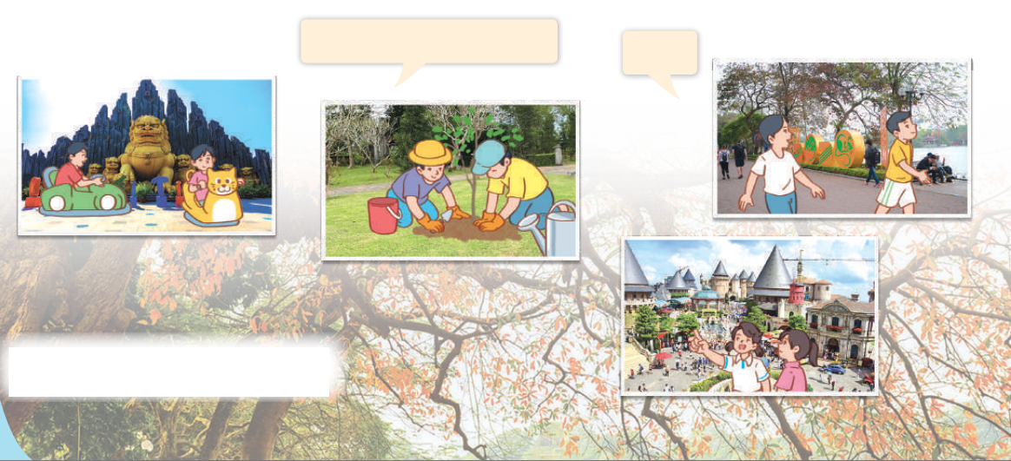
Let’s talk.
What did they do there?
___.

Slide 17



What did they do there?
They ___.

Slide 18
Website: hoclieu.vn
Fanpage: https://www.facebook.com/tienganhglobalsuccess.vn/

