Slide 1


Slide 2









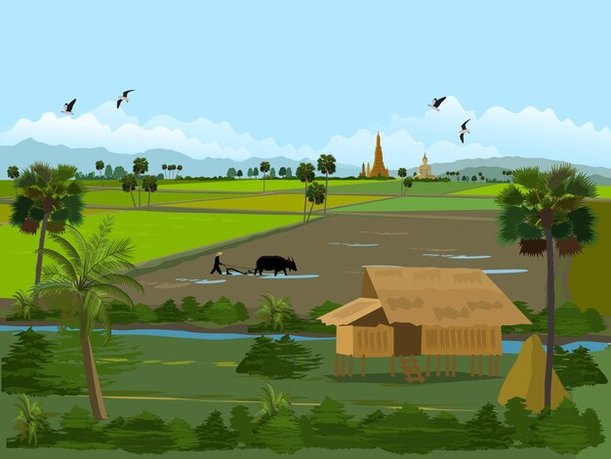
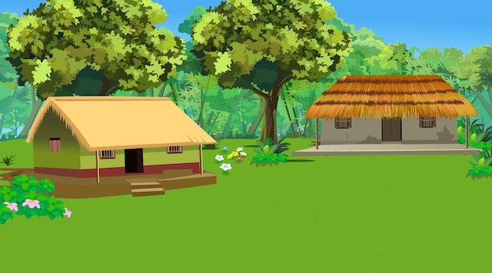

Unit
Lesson 3 - Period 3

Slide 3

02
Activity 6
Listen and repeat.

Slide 4





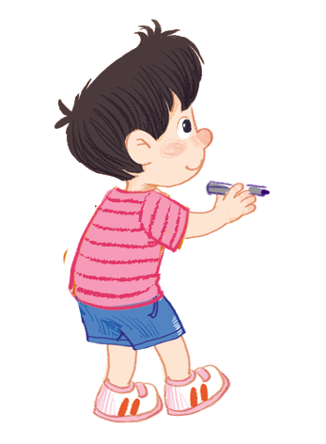

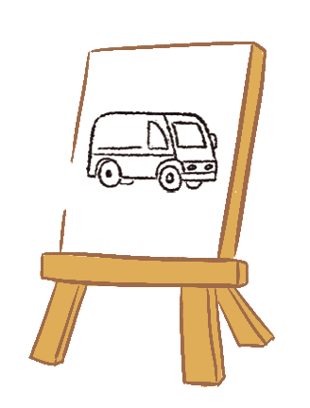



Listen and repeat.
Can you draw a van?
Can you draw a van?
Can you draw a van?
Can you draw a van?
No, I can’t.
No, I can’t.
No, I can’t.
No, I can’t.
Yes, I can.
Yes, I can.
Yes, I can.
Yes, I can.

Slide 5
03
Activity 7
Let’s talk.

Slide 6



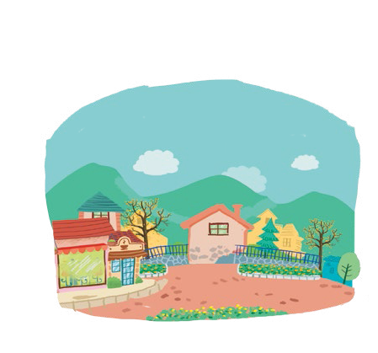
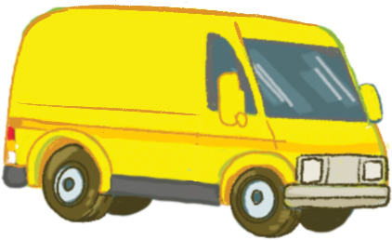


Let’s talk.
Can you draw a _____?
Yes, ______.
No, ______.
a
b
c
d

Slide 7
Can you draw a _____?
Yes, ______.
No, ______.
a

Slide 8

Can you draw a _____?
Yes, ______.
No, ______.
b

Slide 9
Can you draw a _____?
Yes, ______.
No, ______.
c

Slide 10
Can you draw a _____?
Yes, ______.
No, ______.
d

Slide 11
04
Activity 8
Let’s sing!

Slide 12
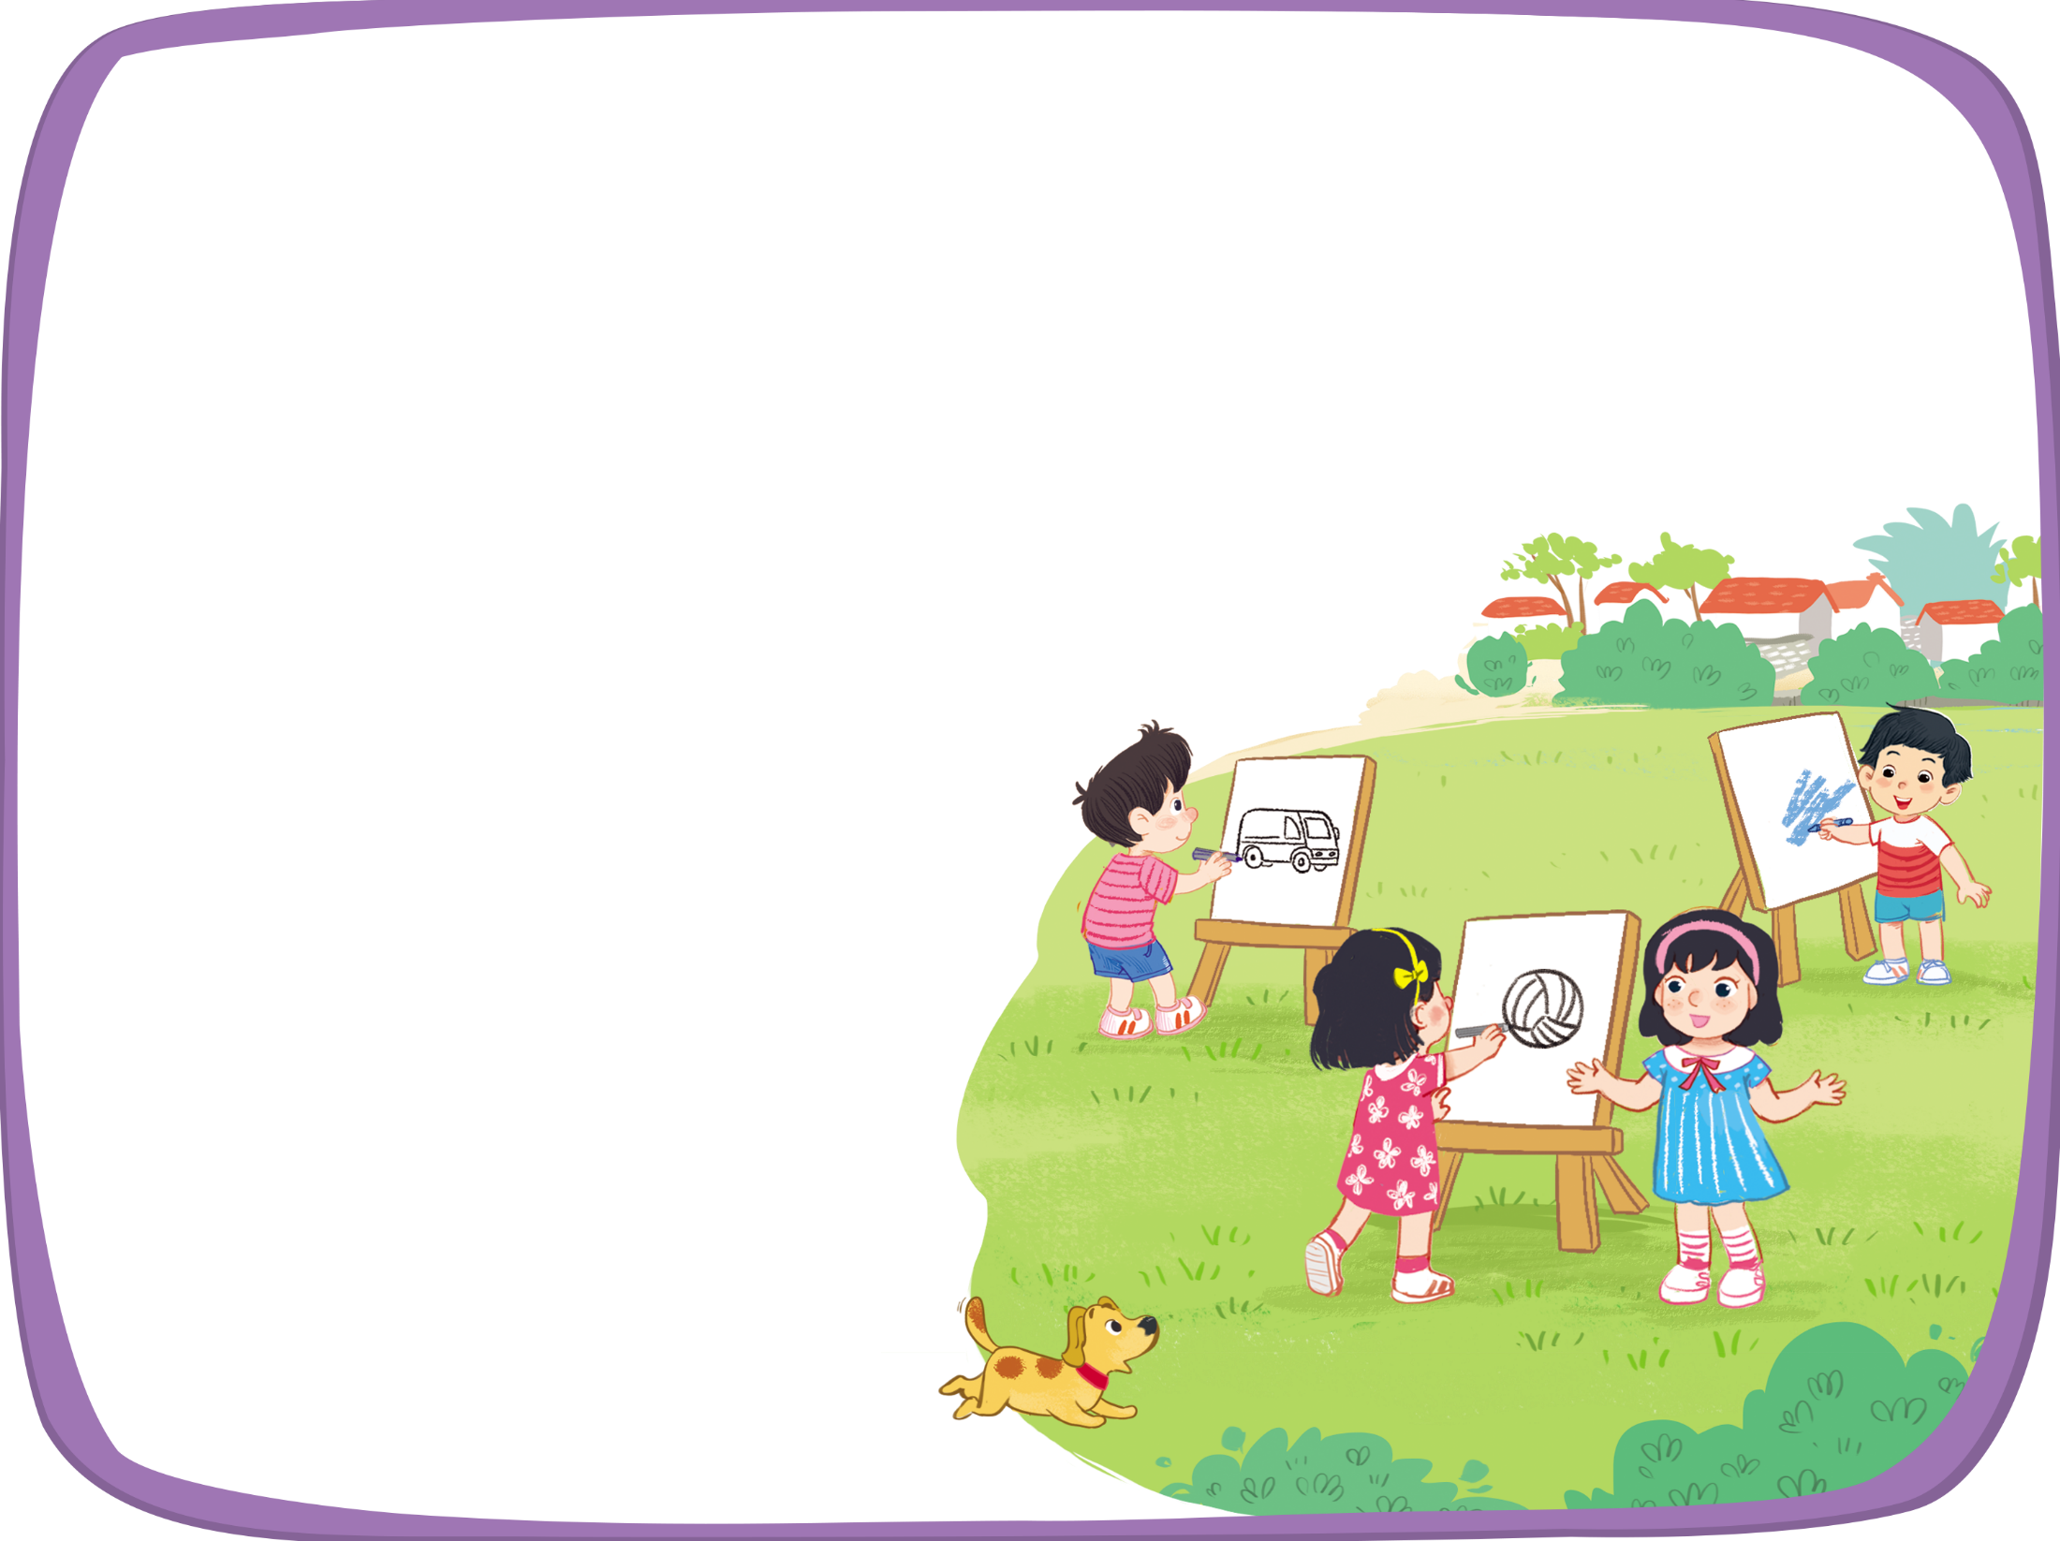


Let’s sing!
Can you draw a van?
Can you draw a van?
Can you draw a van?
Can you draw a van?
Yes, I can.
Yes, I can.
Yes, I can.
Yes, I can.
Can you draw a volleyball?
Can you draw a volleyball?
Can you draw a volleyball?
Can you draw a volleyball?
Yes, I can.
Yes, I can.
Yes, I can.
Yes, I can.
Can you draw a village?
Can you draw a village?
Can you draw a village?
Can you draw a village?
No, I can’t.
No, I can’t.
No, I can’t.
No, I can’t.

Slide 13
05
Fun corner
and
Wrap-up

Slide 14


Option 1
Option 2

Slide 15
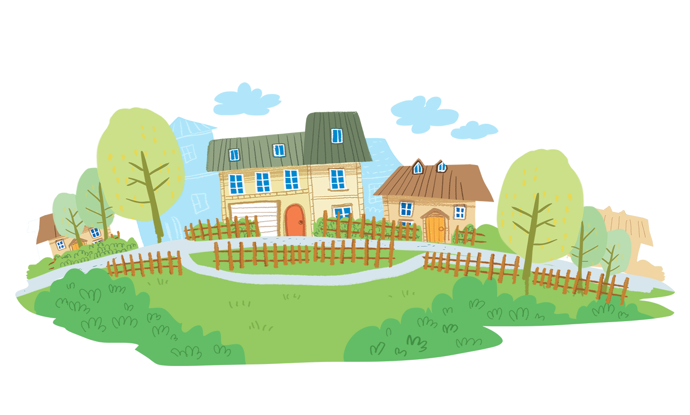
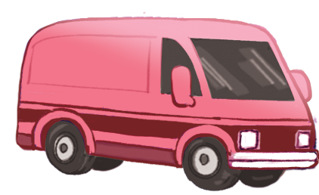
Time to say goodbye!
v

Slide 16
Website: hoclieu.vn
Fanpage: https://www.facebook.com/tienganhglobalsuccess.vn/

